Slide 1
TDCP evaluation results
Ericsson RAN1 #110

Slide 2
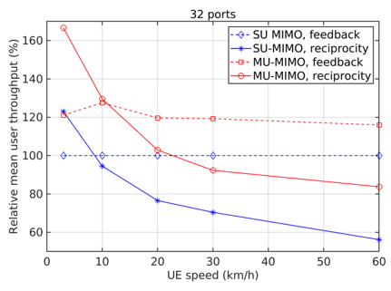
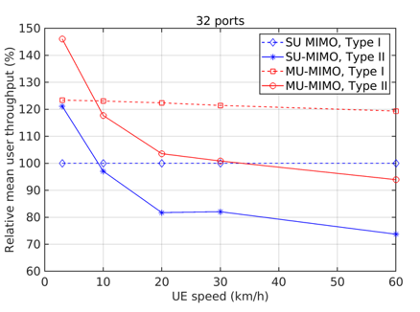
Use case 1 (left figure): Precoding based on reciprocity vs. CSI feedback
Use case 2 (right figure): Precoding based on Type I vs. Type II CSI
Switching point for both use cases are round 10 km/h

Slide 3
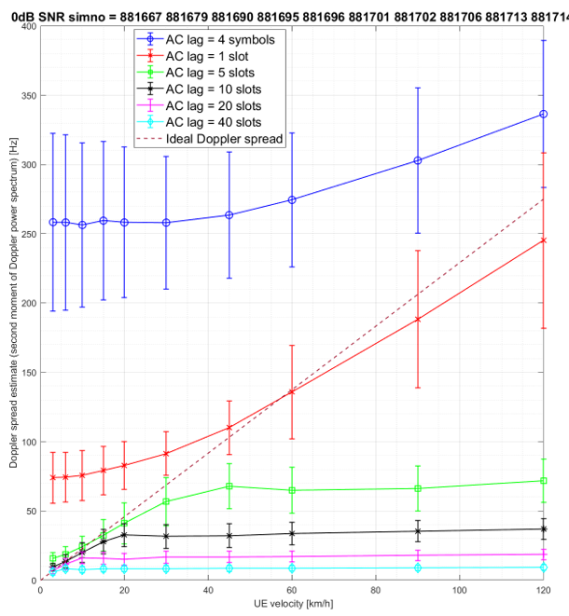
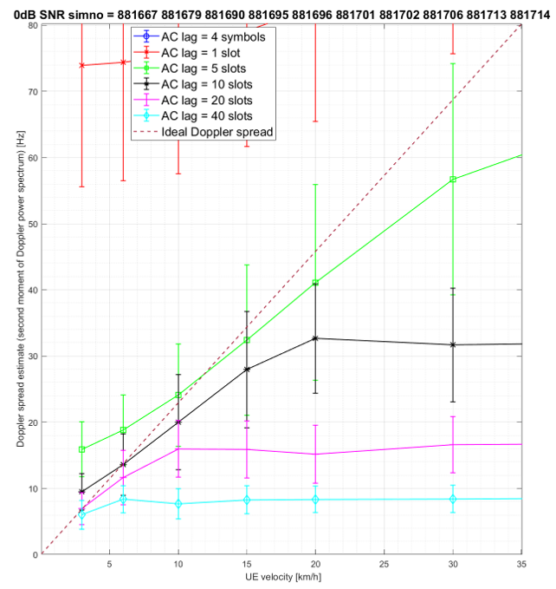

Slide 4
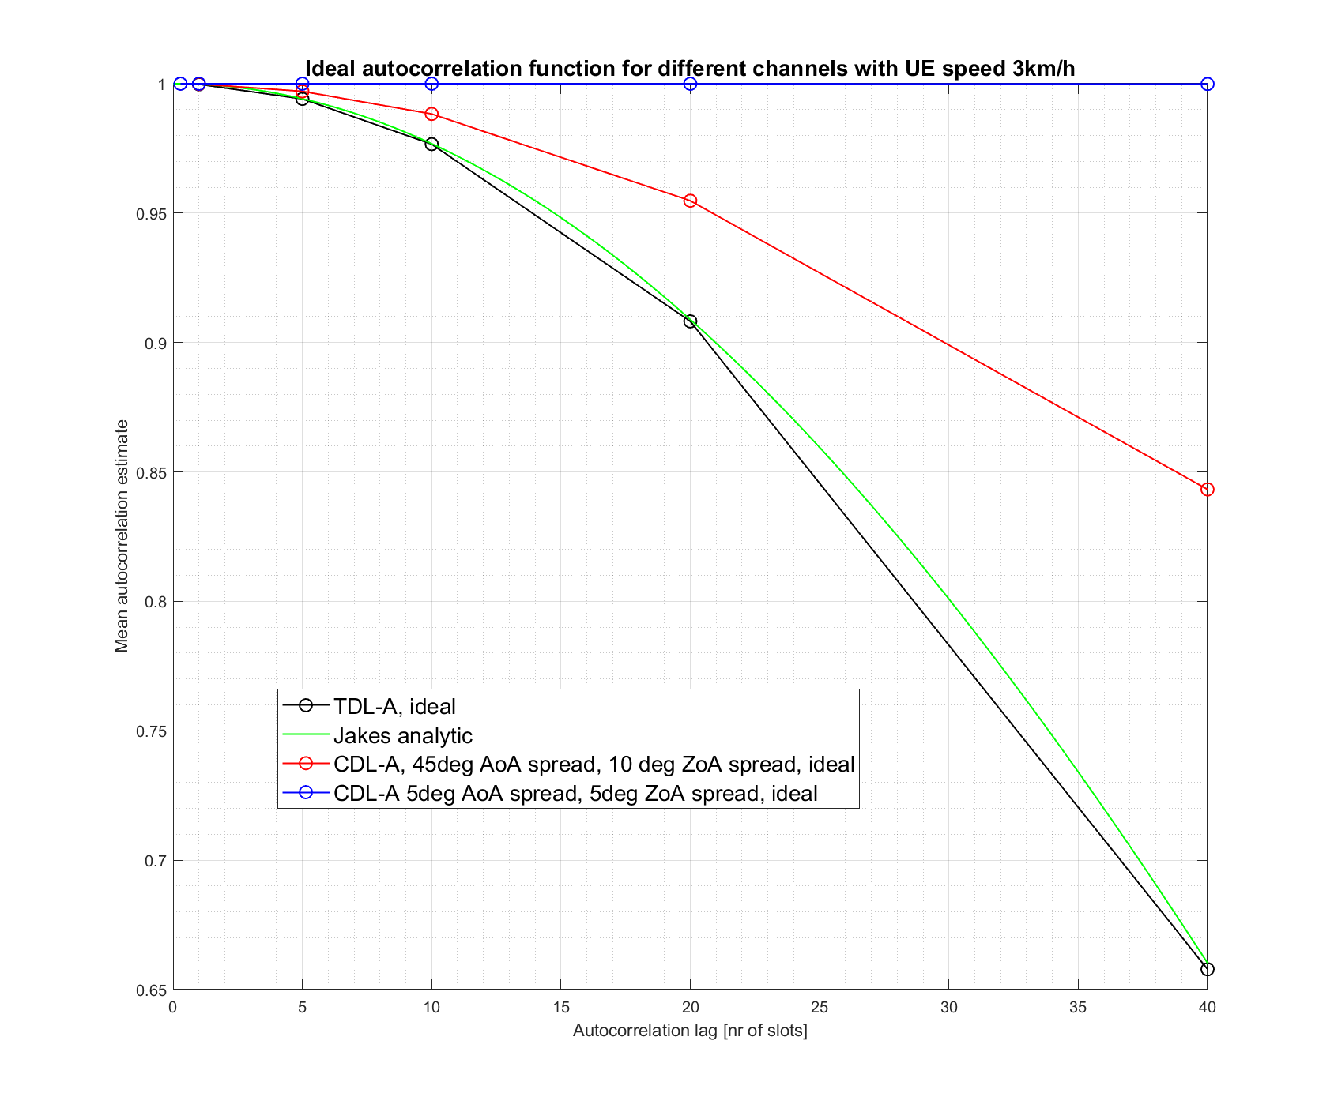
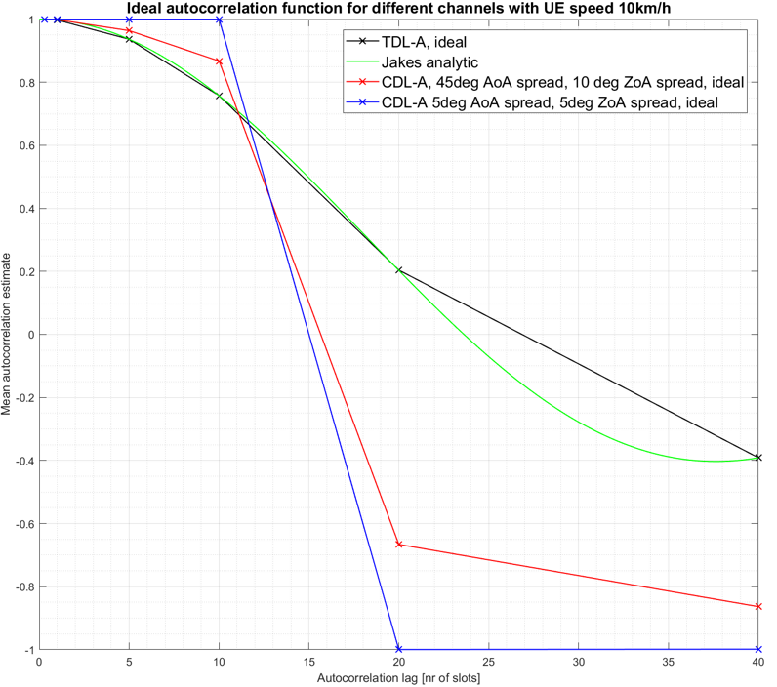
Autocorrelation vs. Doppler shift
Maximum doppler shift would be the same for channels with vastly different channel variabilities, and it does not reflect how fast channel varies with time.

Slide 5
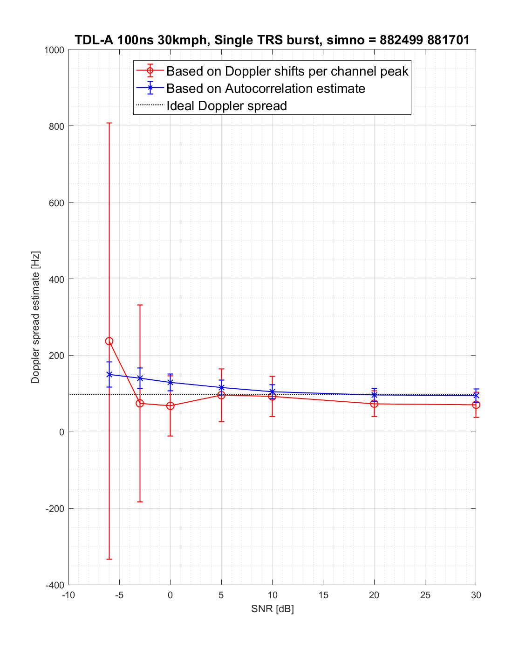
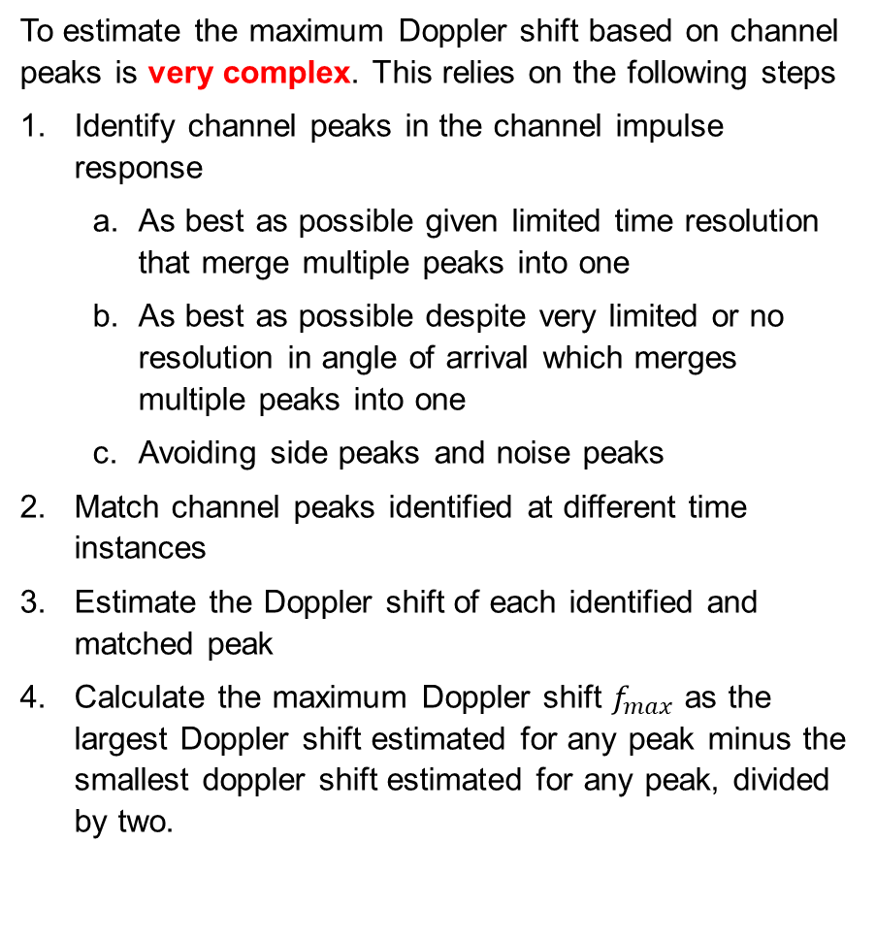
Autocorrelation vs. Doppler spread based on channel peaks
To estimate the maximum Doppler shift based on channel peaks is very complex. This relies on the following steps
Identify channel peaks in the channel impulse response
As best as possible given limited time resolution that merge multiple peaks into one
As best as possible despite very limited or no resolution in angle of arrival which merges multiple peaks into one
Avoiding side peaks and noise peaks
Match channel peaks identified at different time instances
Estimate the Doppler shift of each identified and matched peak
Calculate the maximum Doppler shift $f_{max}$ as the largest Doppler shift estimated for any peak minus the smallest doppler shift estimated for any peak, divided by two.

Slide 6
Proposed description for AltA. and AltB.
AltA. Based on Doppler profile
E.g., Doppler spread derived from the 2nd moment of Doppler power spectrum
AltB. Based on time-domain correlation profile
E.g. correlation within one TRS resource, correlation across multiple TRS resources
note: the correlation over one or more lags of TRS resource may be condiered. The lags may be within one TRS burst or different TRS bursts

