Slide 1
MC services over satellite access
Ericsson

Slide 2
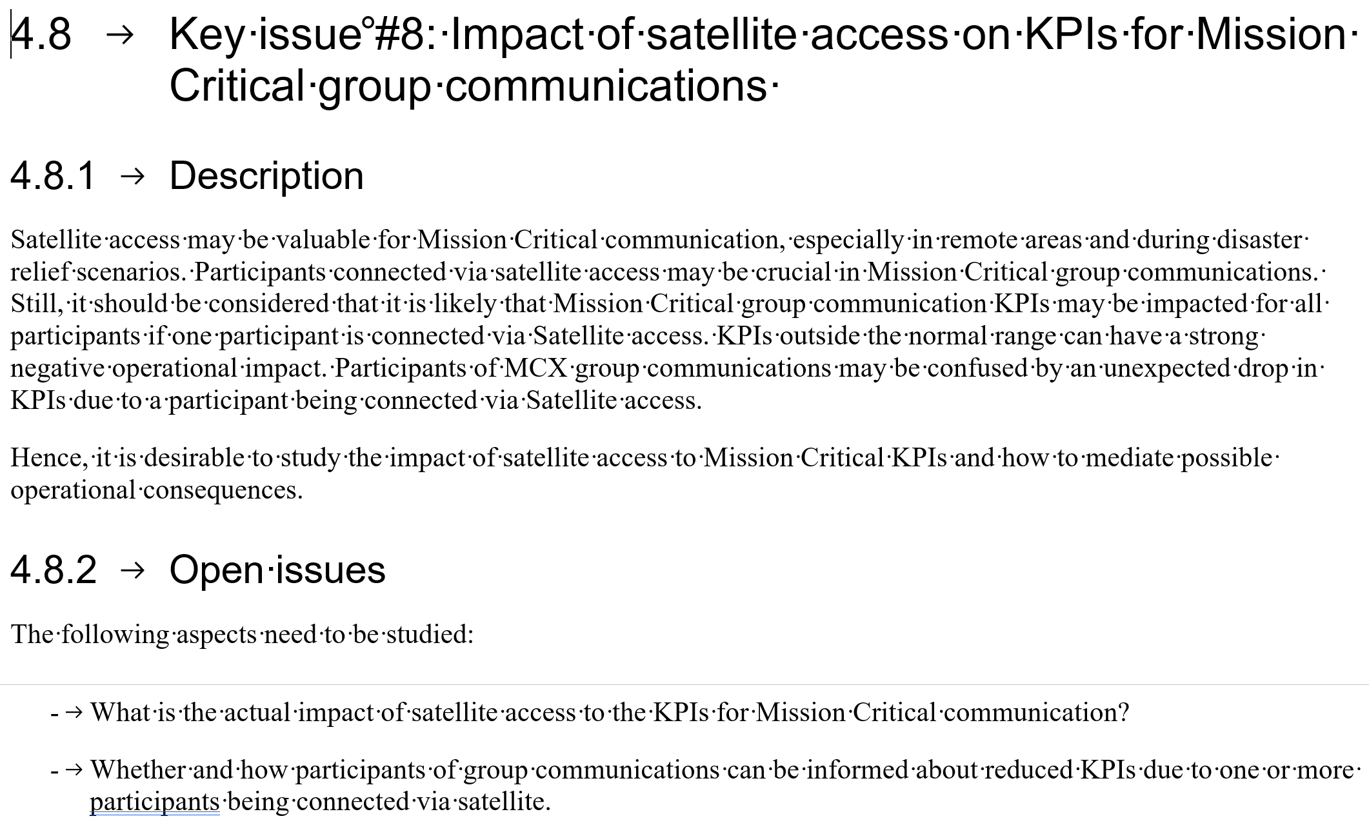

Slide 3
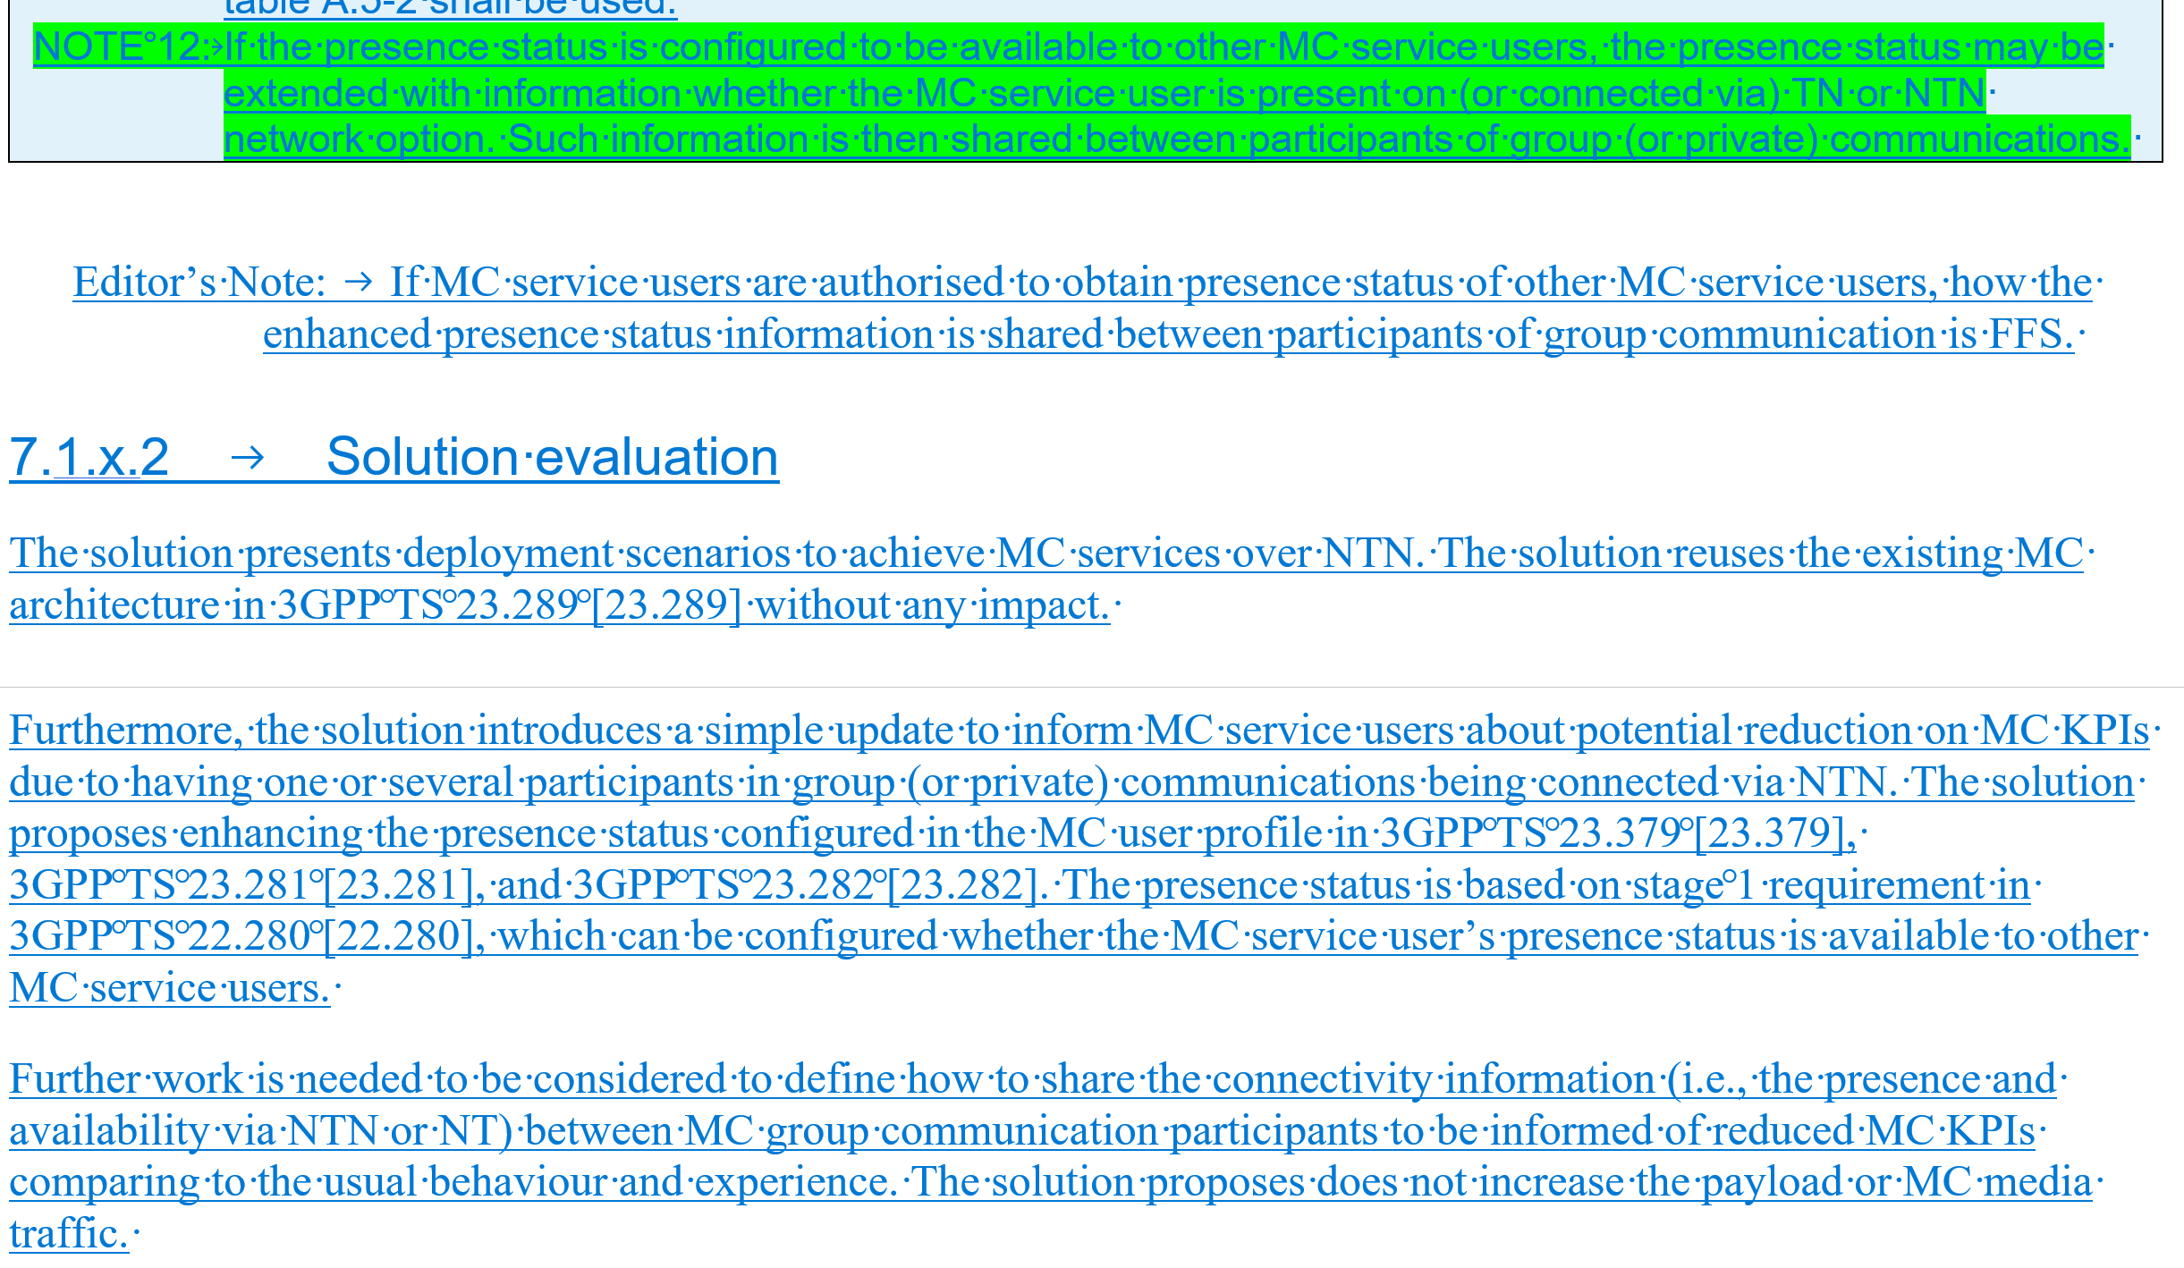

Slide 4
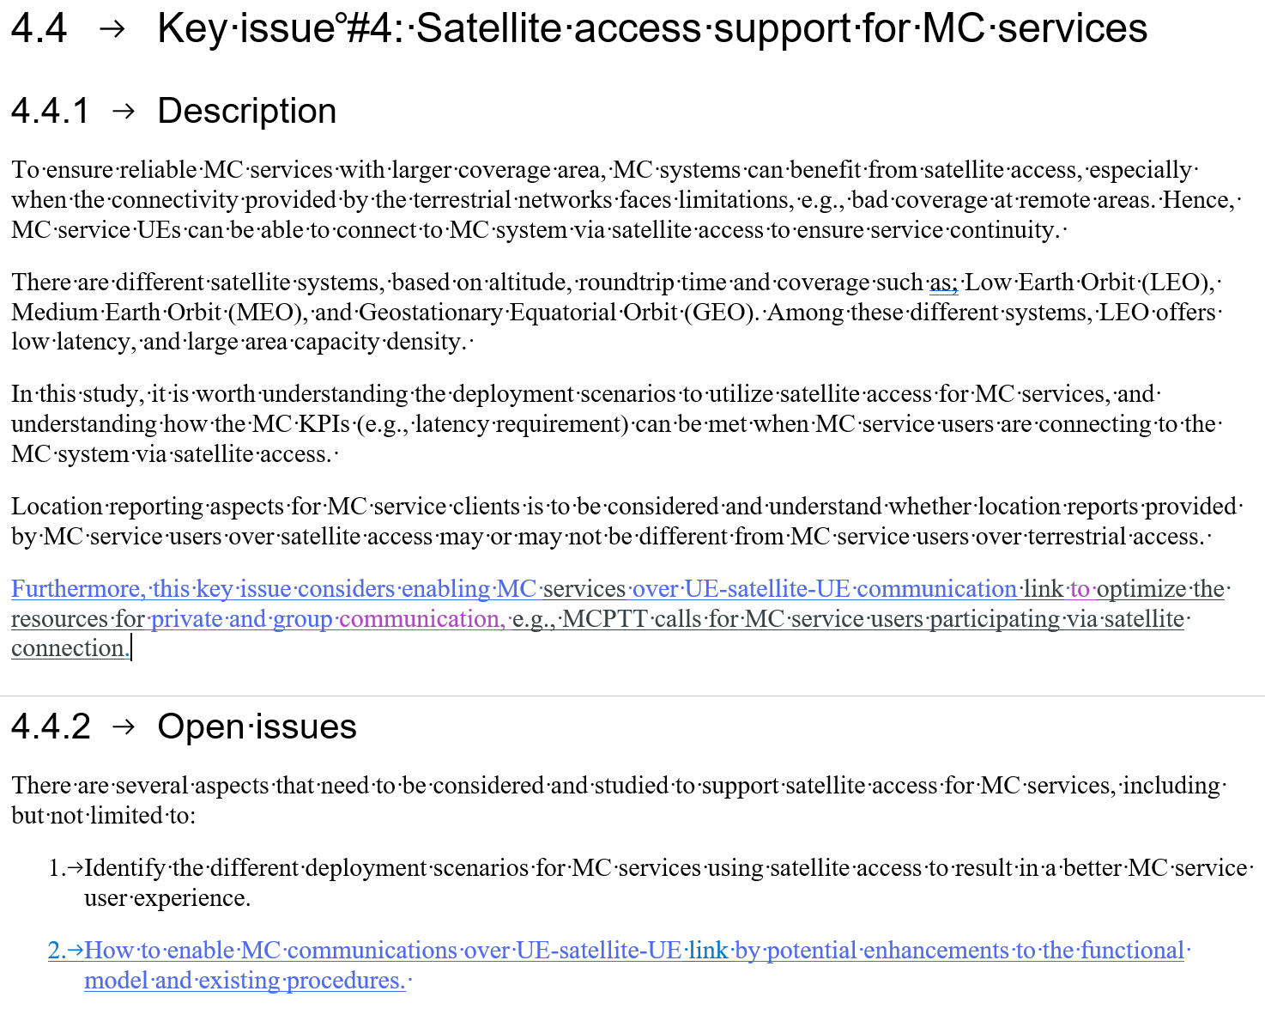

Slide 5
What to do next?
Do we accept the presence status as a possible solution and improve it in the next meeting?
Interesting companies bring other appropriate solution
If no solutions get agreed in the satellite study, the same discussions continue in the IOPS study
Overall evaluation and conclusion

Slide 6
Thank You!

