Slide 1
User Guide - Using Forge in SA5 (updated for SA5 #158 due to Forge/Gitlab upgrade)
Nokia, Nokia Shanghai Bell, Ericsson
(Revision of S5-246381)

Slide 2
Background/Agenda
High level steps for CR Authors
A simple guide of Forge usage with screenshot for newcomers
Basic Forge environment
Forge environment: tools provided
Basic operations
Pinpoint the cause of validation failure
Create branches
Create merge request
Web IDE for editing, reviewing changes, commit change set
Generating word CR (code change part) automatically with a Draft merge request
Advanced user tips
Rebase with command line
Merge with conflictions
Common Q&A

Slide 3
High level steps for CR author
updated for #158
Create the CR branch from release branch or meeting integration branch, whichever includes the latest stage 3 (Refer to: create a branch)
Create draft MR towards integration branch (Refer to: create a Merge Request)
Add stage 3 changes to CR branch, check validation status (Refer to: web IDE Editor)
Resolve the validation issue(s) if there is any (Refer to: Pinpoint the cause of a validation failure)
Download the "Word CR text: artifact" and (Refer to: high level step 5)
Copy MR link and commit code to CR cover page
Copy-paste change-marked stage 3 clause into the Word CR
If stage 3 revisions are needed, repeat steps 3-5
Set MR to final (Mark as Ready) when CR is agreed in SA5 meeting (Refer to: create a Merge Request)
And set MR to “Closed” when CR not agreed.

Slide 4
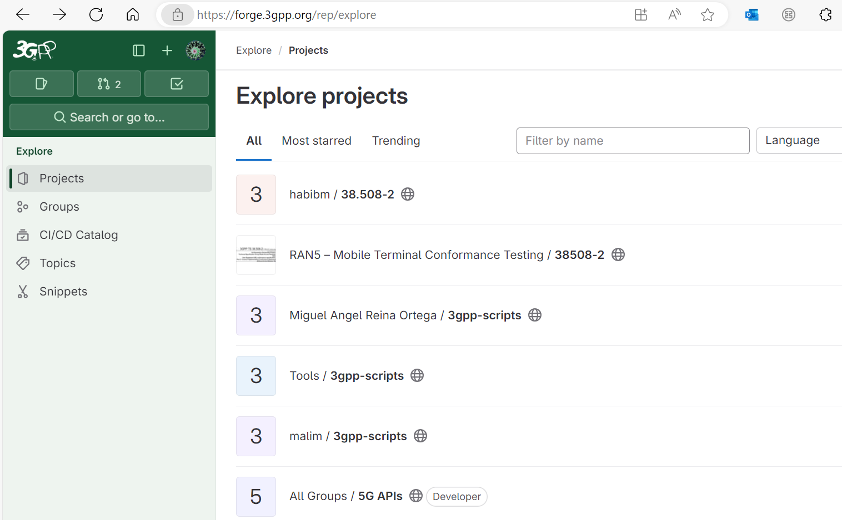
Basic Forge environment: to find SA5 Repo
updated for #158
Forge is built with GitLab Enterprise Edition.
Using Forge requires understanding of basic knowledge of git. More material could be found here:
Git (git-scm.com) or
Index · User · Help · GitLab (3gpp.org)
Common validation scripts used in SA5
CT repository: also including SA5 OpenAPI
SA5 CH Repository
SA5 OAM Repository

Slide 5
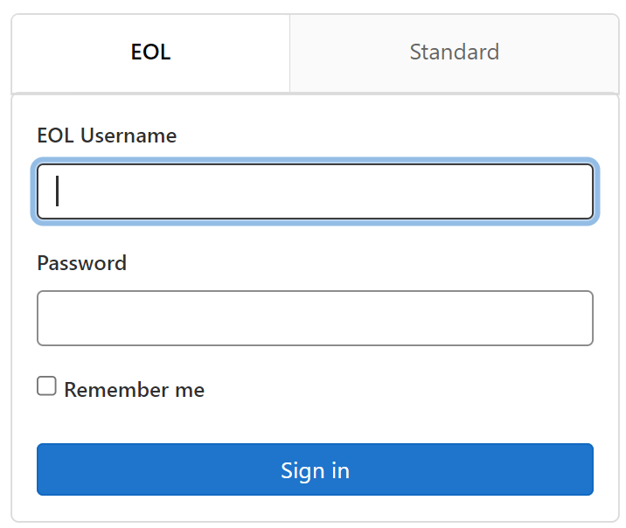
Forge: main entry and login
updated for #158
Direct Link to SA5 repository start page: https://forge.3gpp.org/rep/sa5/MnS
After login, first to select your branch or create a CR branch, then code change can be done by opening the stage 3 file directly with simple IDE or using the Web IDE tool.
Note: if you do not have the write access (e.g., can not see the new branch button), send email to MCC to apply the access. (Credential is the same as that for 3GPP portal.)
Without login, you have read only permission.

Slide 6
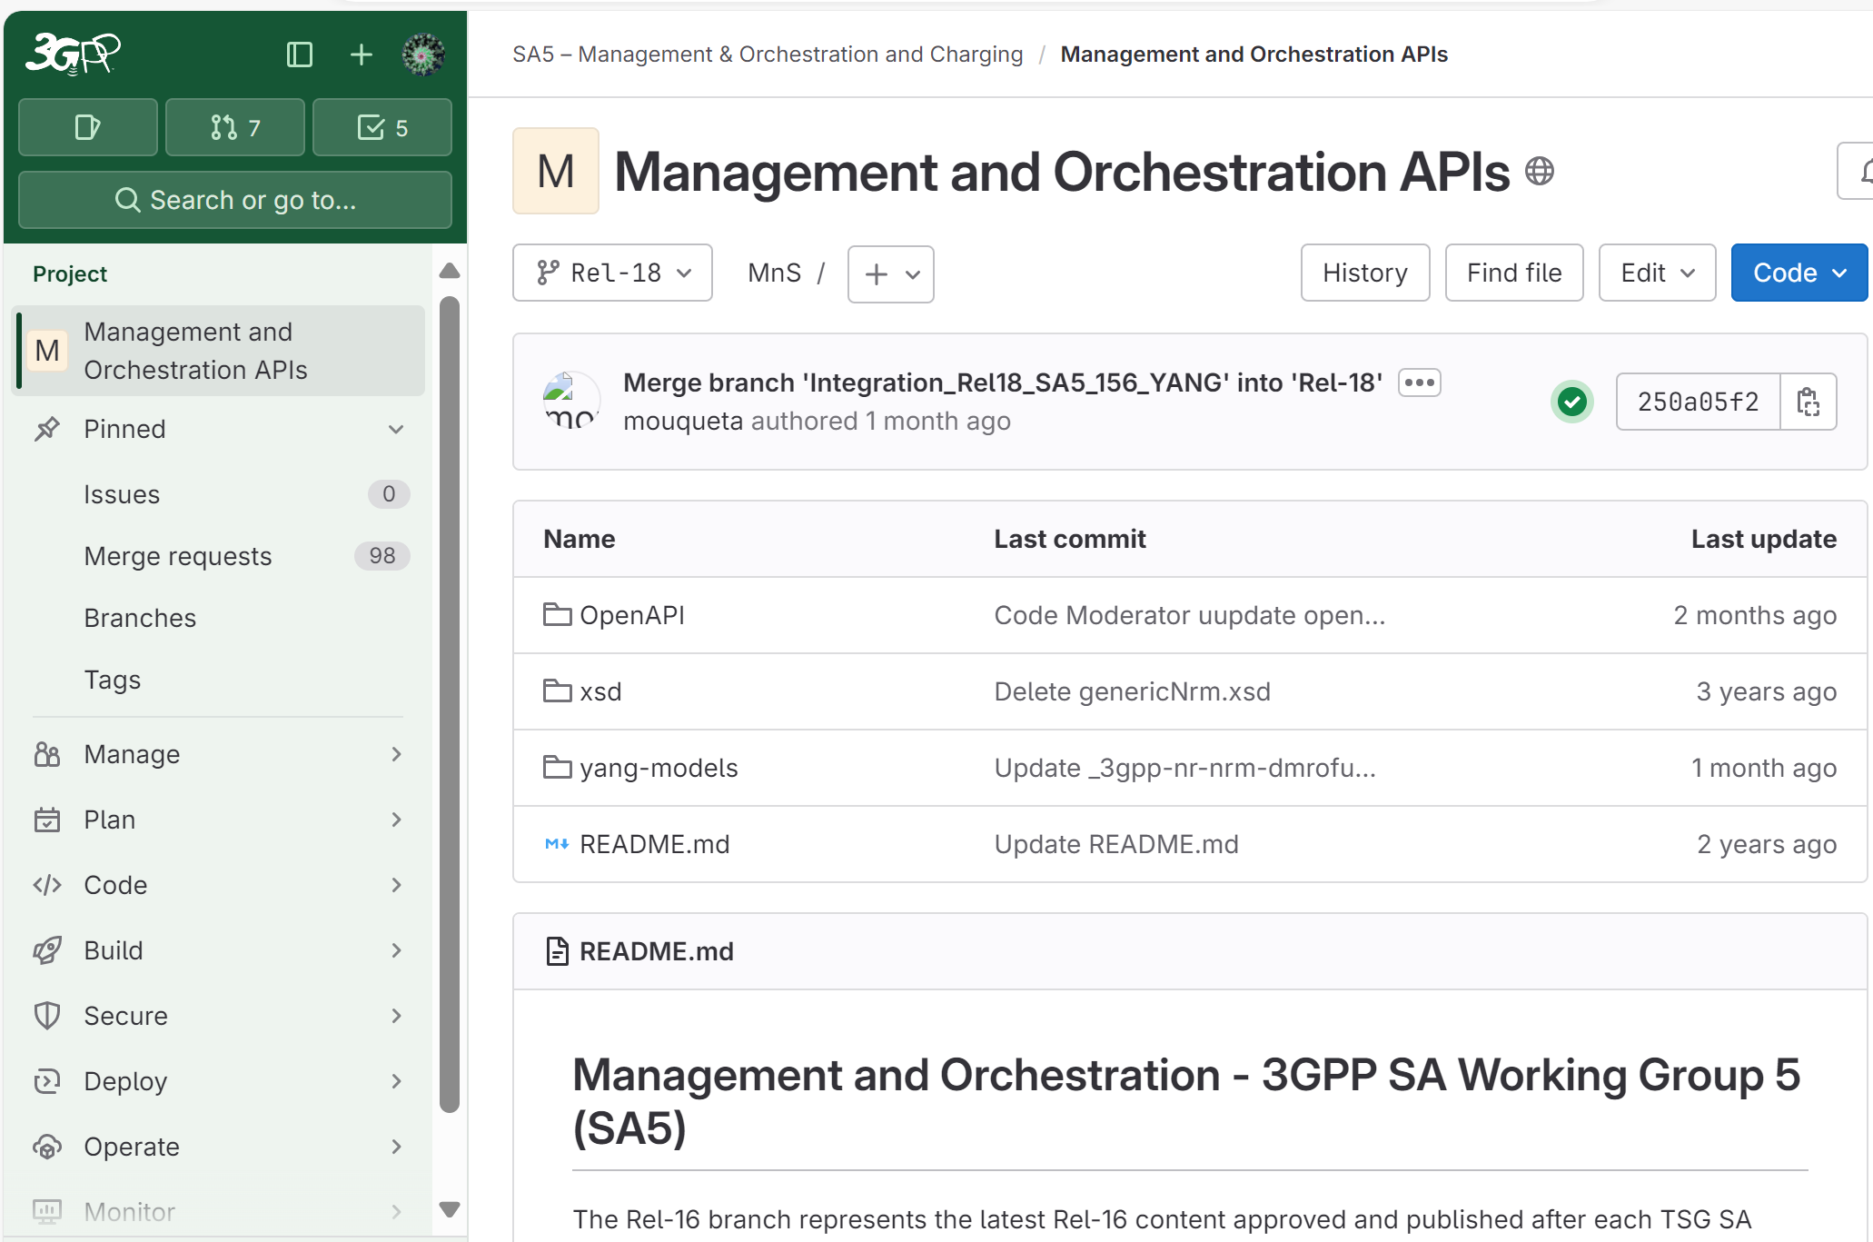
Basic Forge environment for SA5
updated for #158
“History” is to find commit history
“+” is to add new file/create branches
The “Edit” is very powerful tool for code changes/review, commit
Indicates the current branch/tag
Green √ indicating validation is successful.
Under directory Code
“Repository” directory includes branches/ commits.
OpenAPI Solution set
YANG Solution set

Slide 7
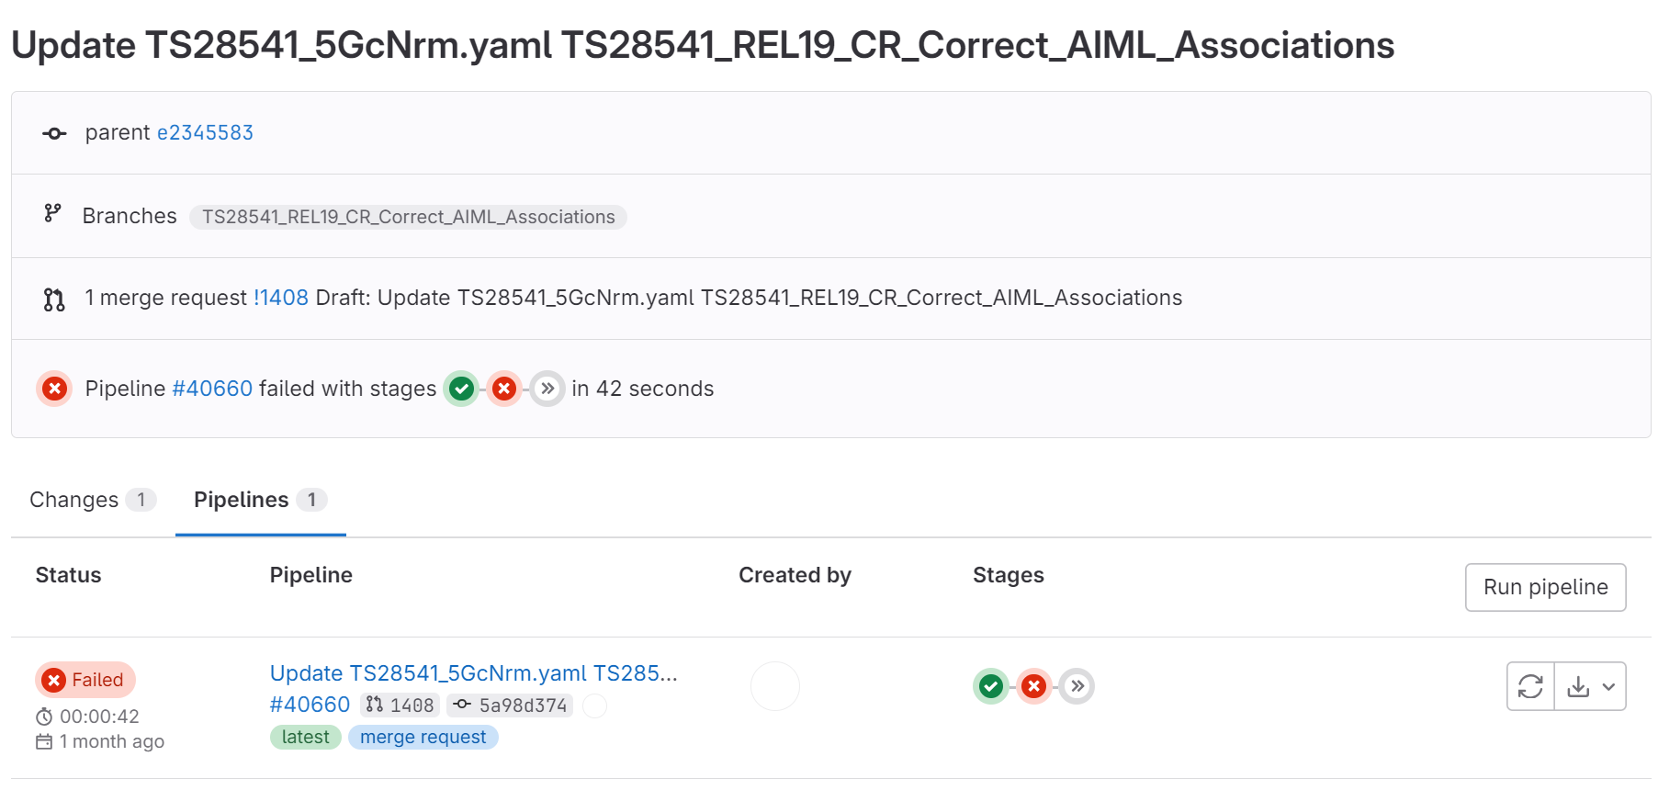
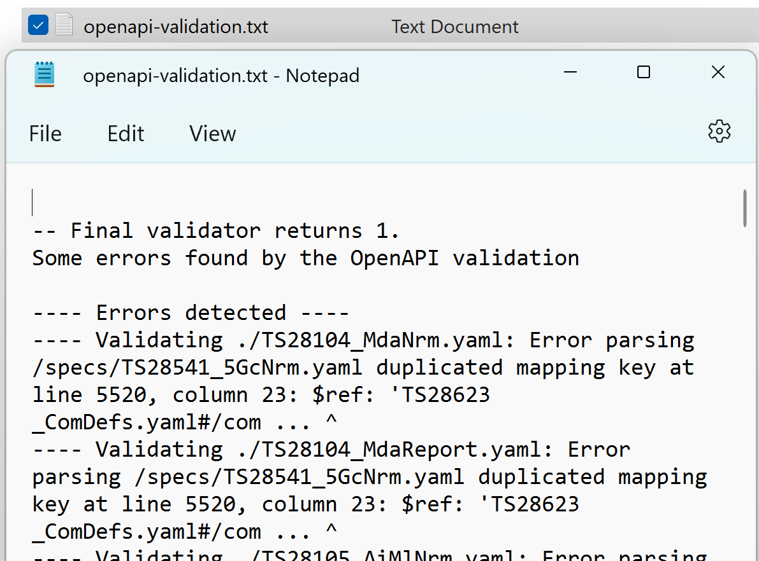
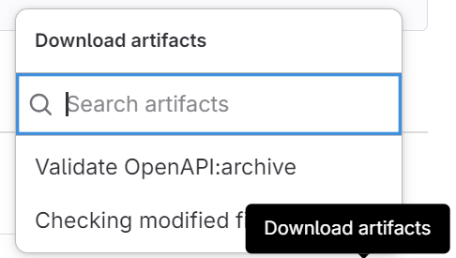
Basic Forge environment for SA5: pinpoint the cause of a validation failure
updated for #158
Step 1: open the failed pipeline
Step 2: locate the validation failure of related solution set
Step 3: download the failure log
Step 4: pinpoint the cause(s) of error(s) and fix it accordingly

Slide 8
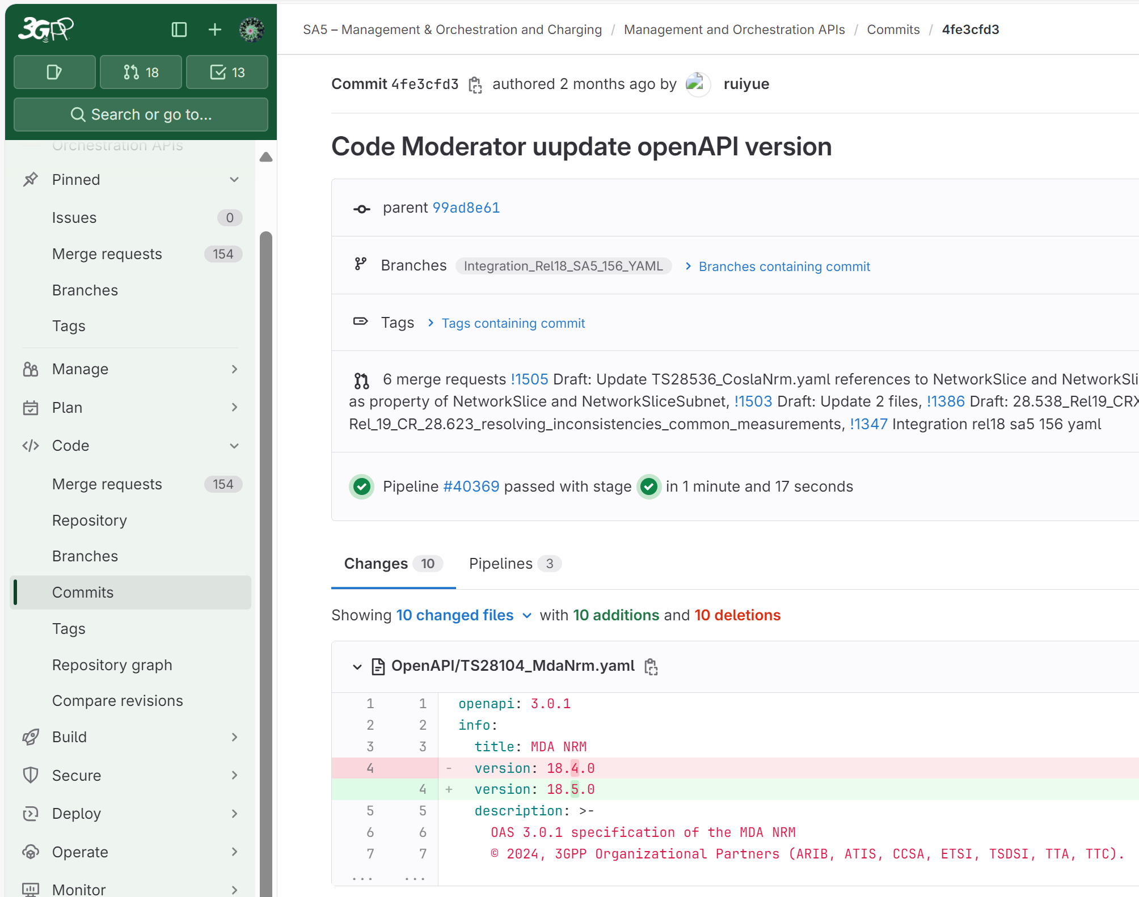
Basic Forge environment for commit
updated for #158
What service provided by Forge: check details of commit
target branch
Summary of changes in this commit
Change details: line by line, character by character

Slide 9
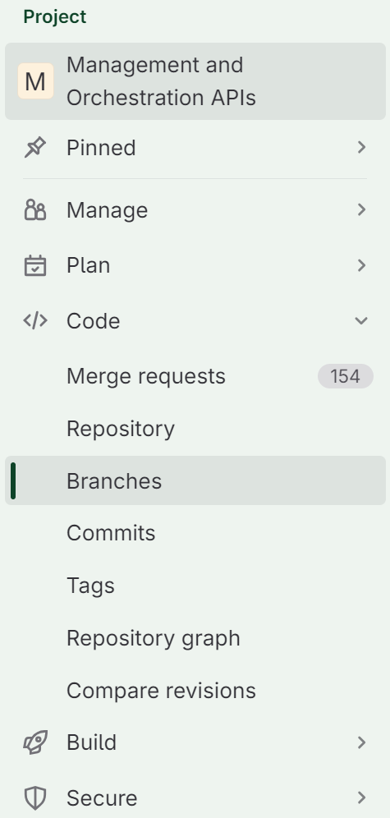
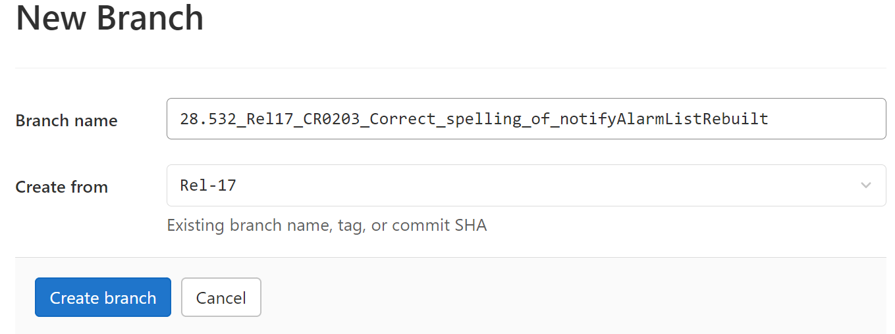
Forge: create a branch
updated for #158
3 click this button
1
4. Follow the branch name rules (in working procedure) for your CR branch name.
naming rule of the branch: TS number_Release number_(CR number/ Other Tag)_tDoc title (Note: CR Number, Other Tag are optional), and the spaces in tDoc title is replaced with “_”
Note: reserved release names (Rel-16/Rel-17/Rel-18/Rel-19) are not allowed in title. To make it simpler, do not use “-” in the title.
2
5. Select the base branch, normally from release branch (e.g., Rel-19)
6
Examples of branch name:
28.541_Rel18_CR1051_Correction_of_NEFFunction_and_Sliceprofile, (with CR number)
28.541_Rel18_meeting151_Correction_of_NEFFunction_and_Sliceprofile, (with Other Tag)
28.541_Rel18_Correction_of_NEFFunction_and_Sliceprofile, (with no optional items),
28.623_28.541_Rel17_YANG_Corrections
(with no CR number or tag, two/or more spec number indicate one branch includes depended/related stage 3 change for multiple specifications)

Slide 10
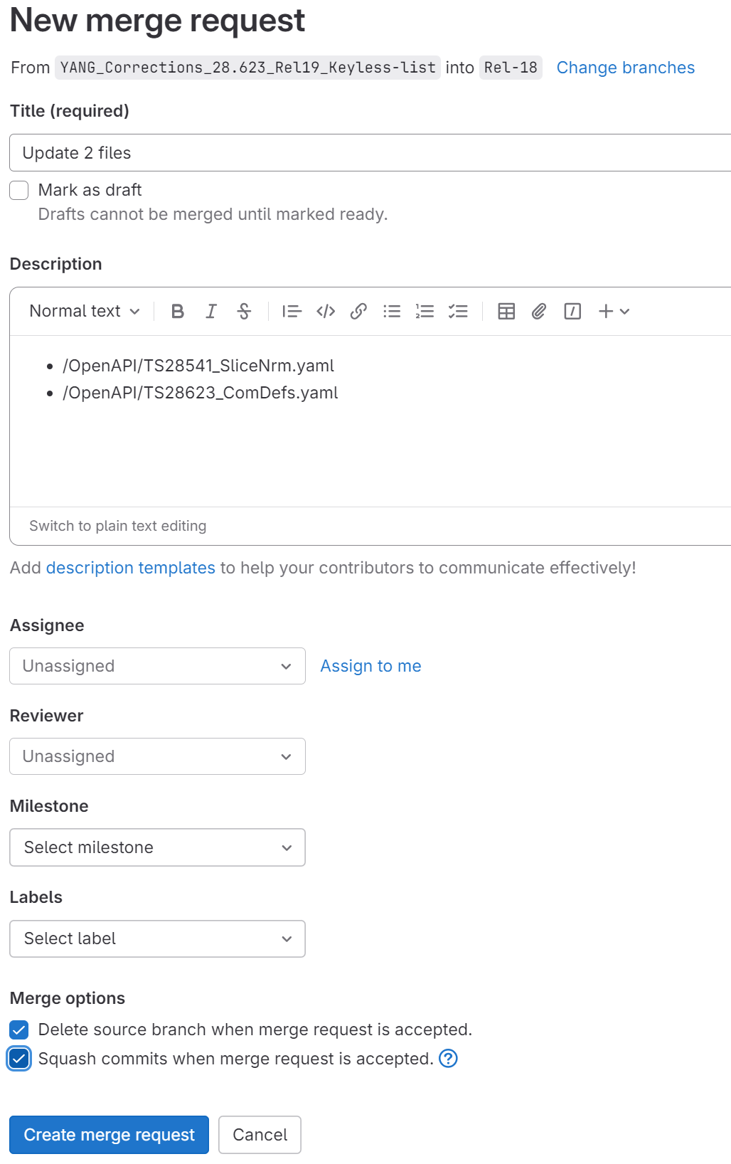
Forge: creating a Merge request
updated for #158
Step 1: Find your Branch and Click Merge Request button
Step 2: Update the target Branch when needed: normally target branch should be an integration branch: e.g. Integration_Rel19_SA5_157_YAML
Step 3: MR title shall include:
TS number,
Release number,
CR number,
CR summary (CR key words, CR title, etc.)
By default, it will use the last commit comments.
(Note: when MR is created before CR reservation, the CR number shall be added to MR title at least before marking it as “Ready”. MR title can be updated anytime (refer to Edit MR).
Step 4: should mark the MR as “Draft”
Step 5: Mark both Merge options.
Step 6: click "create merge request", then you are done

Slide 11
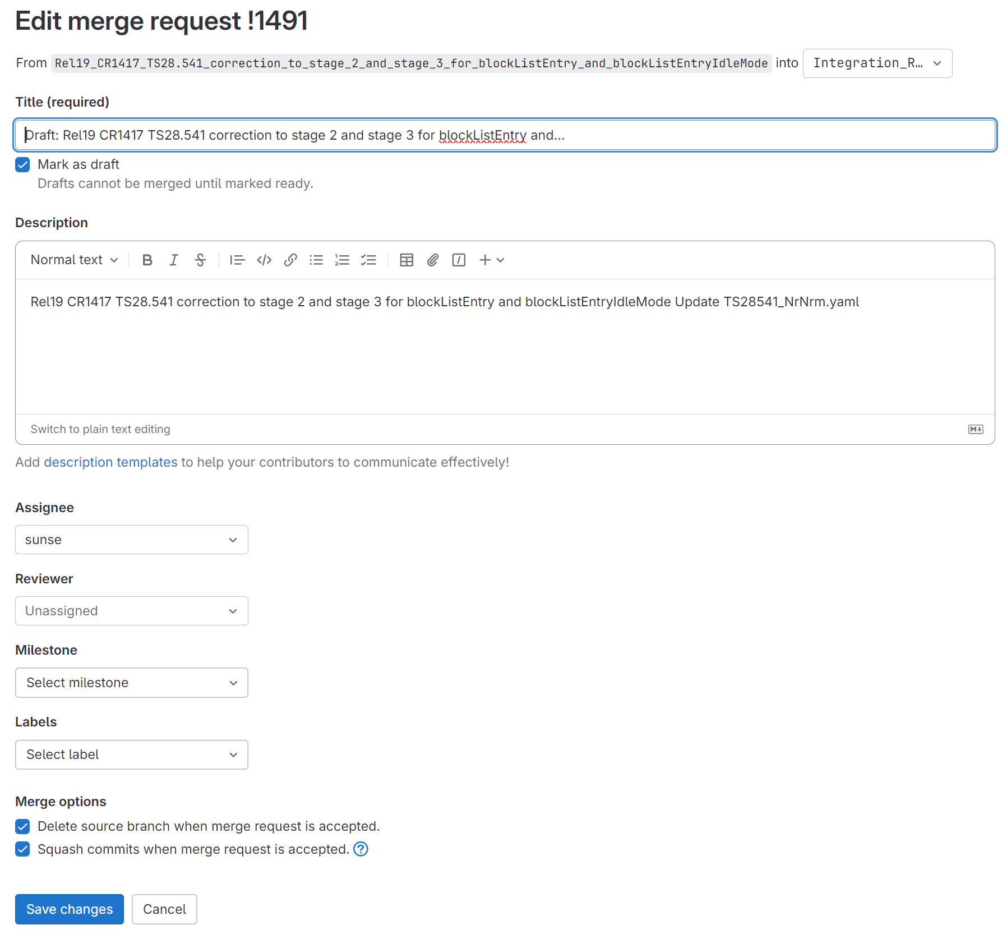
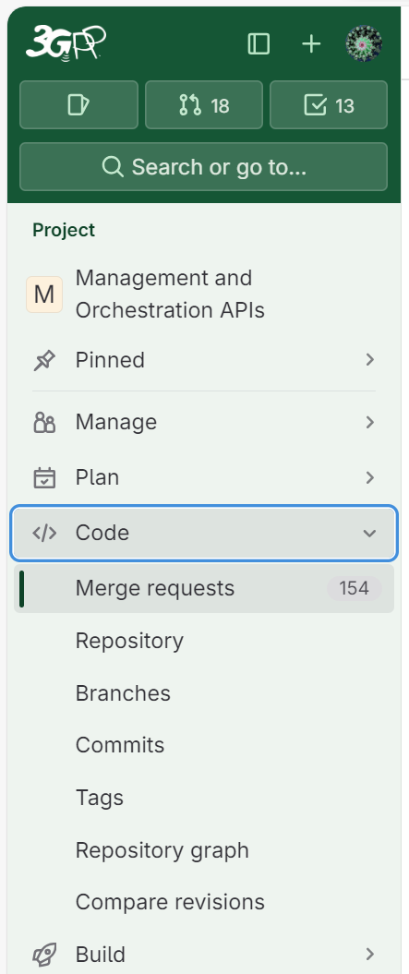
Editing The MR (especially MR Title)
updated for #158
Step 2: Click “Edit” button.
Step 3: Update the MR title if the mandatory information entries are missing. (Note: Spec Number, Release number, CR Number, CR summary are mandatory information entries in the title)
The tDoc may also be helpful to be added to Description Section.
Step 4: (optional) Update other entries when needed.
Step 1: Open Merge request and find your MR (or use the MR Link directly)
Step 5: Click “Save changes", then you are done.

Slide 12
Forge workflow with meeting timeline
Branch handling: what action needed and at when (for details to check working procedure)
Meeting Timeline
SA5 base branch, Normally release branch (i.e., Rel-18)
Base release branch with e.g., SA5#150 meeting approved contents
CR author is recommended to reserve the tDoc before creating MR
CR author to create CR development branch from latest release branch (Or meeting specific Integration branch, preferred) anytime.
150 CR1 branch
150 CR2 branch
150 CRn branch
CR author should create a draft merge request (Note: with CR number in MR title*)
SA5 meeting done
CR author to mark Merge request as ready (from draft): once agreed at SA5 level. (And closed if not agreed)
Code Moderator handle the CR merger request.
150 integration branch
Integration_Rel18_SA5_150_YAML
SA Plenary meeting done
Code moderator to initiate the Merge request (after SA meeting) to release branch
Code Master (MCC) merge the merge request to release branch
Code moderator or Code Master creates tag
SA5 release branch (i.e., Rel-18)
* If the tDoc reservation is done post creating MR, the MR title shall be updated to include the CR number.

Slide 13
Forge: Web IDE editor overview
updated for #158
You can use the Web Editor to make changes to a single file directly from the GitLab UI. To make changes to multiple files, see Web IDE.
In the Web Editor, you can:
Create a file
Edit a file
Upload a file
Create a directory
Create a branch
Create a tag
Switch Branch
Commit changes
Create Merge request
Click “web IDE” button to active Web IDE
And more: Web IDE | GitLab

Slide 14
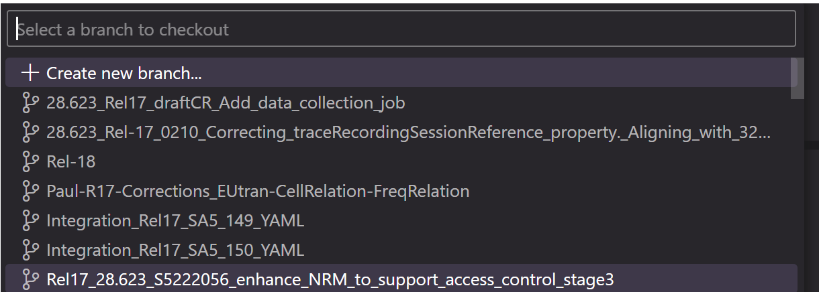
Forge: Web IDE editor: switching branches
switch from current working branch to another branch (existing or a new branch)
There two buttons are used to add new file(s) or folders.
New folder is only for new SS. New file is for new SS file (e.g., a new OpenAPI Yaml file)
Step2: In new pop-up window, to:
> Select “+ Create new branch” to create a new branch, or
> Input the target branch name (part of the name or full branch name) you would like to switch to
Step3: Click “yes” to checkout the target branch (to make it editable). Just to make sure you have saved (committed) the changes in the current branch.
Step1: Click current branch name to switch to another branch or create a new branch

Slide 15
Forge: Web IDE editor: searching and editing
Step1: Input the key words (not case sensitive) you would like to locate in the file.
Step2: You will see the “n of m” summary, m indicates the total number of matched key words, n indicates the n-th match.
This area is so-called miniMap of the Stage 3 file. It’s kind of full screenshot of the whole stage 3 file.
You could use the grey bar to quickly move around your editing area (in case the file is huge). To be noted, the grey bar will be invisible if your mouse leaving the file for some time, it will be visible once mouse moving back.

Slide 16
Forge: Web IDE editor: diff
updated for #158
Step 1: select this button to check the total changes (per file).
Step2: each highlight indicates a change (relative location of a file). You could see the character-by-character difference (against original file, which is in the left part)

Slide 17
Forge: Web IDE editor: commit changes
updated for #158
Step1: Input commit comments (TS number, release number, CR number and change summary/key words are needed)
Note: this comment will be used as MR title by default.
Step2: (optional) switch to a new branch for commit.
Step3: click “Commit to …” button. This is to commit the change to the selected branch (current branch by default) and push to a Forge branch.

Slide 18
Edit one file
There are two methods to edit a stage 3 file.
Open with Web IDE: Refer to Slide Editing with Web IDE
Edit: Edit the current file only, simple to use, good for single file.

Slide 19
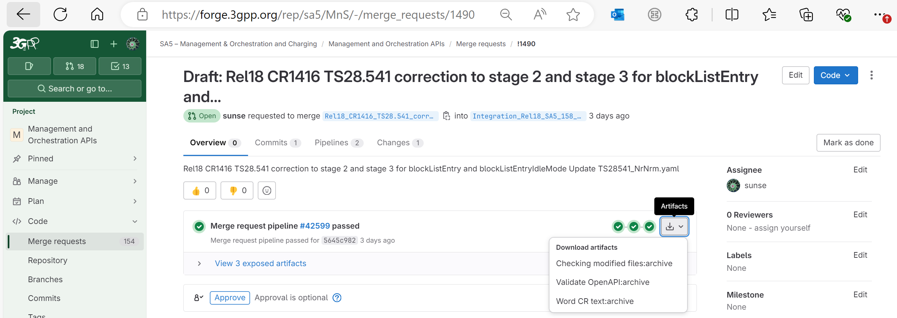
Forge: Generating word CR (code change part) with a Draft merge request
updated for #158
This function was newly introduced function from Forge in late 2022.
Note 1: Contribution author creates a merge request towards the Integration branch before meeting start. At this stage the MR shall be marked as a draft MR. If a CR includes both YANG and YAML changes, two separate MRs are needed. The MR Forge link(s) shall be added to the MS Word CR's cover page 'Other Comments' section."
Step1: open the merge request
Step 2: Click first option (Download “Word CR text:archive” artifact) when available (when the YANG basic and the YAML checks passed).
Note 2: before CR is agreed in SA5 closing plenary meeting, the merge request shall be in status “Draft”. When in draft status, the title of merge request starts with “Draft:”, see example below.
Note 4:
The automatically generated word artifact is a Word file with line-by-line stage 3 change track per Yaml file (for YANG, it’s a YANG file).
At the top of the word artifact, you could find the MR link and commit code. They can be copied directly to Word CR cover page.
The stage 3 content should be used directly in Word CR
Select “Mark as ready” or Click “Mark as ready” button to make it ready for merge (e.g., when CR is agreed in SA5 closing plenary meeting).
Note 3: MR in Draft status cannot be merged.

Slide 20
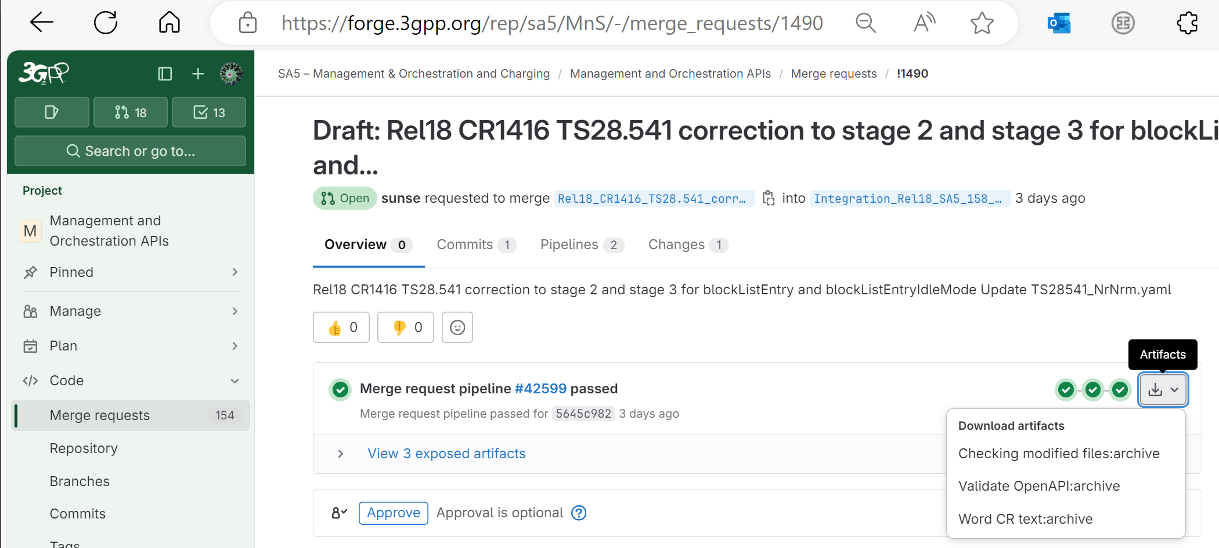
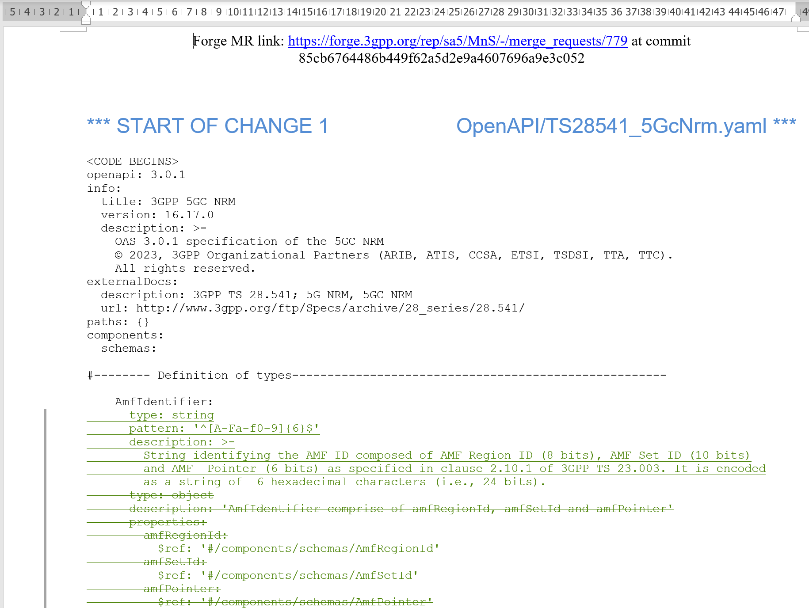
High level step: Step 5 (Forge Link)
updated for #158
Step1: open the merge request
Step 2: Download artifacts: “Word CR text:archive”
Step 0: (optional) Find the merge request page from here
Step 3: At the top of the word artifact, you could find the MR link and commit code. They can be copied directly to Word CR cover page (to “Other comments”).
Step 4: The 2nd part of word artifact is the stage 3 with change track per stage 3 file.
This stage 3 content should be used directly in Word CR.
(No more manual editing to stage 3 code in word! You may add the clause number before stage 3 code for Rel16/17, no clause number for Rel18 onwards)

Slide 21
Forge: advanced tips
Rebase and command line rebase
Merge confliction handling
Generate list of stage 3 code
Note:
> Only for advanced user or code moderators.
> Assumed the user has good experience with git and has a local git environment as well as some common tools for code editing, comparison, etc.

Slide 22
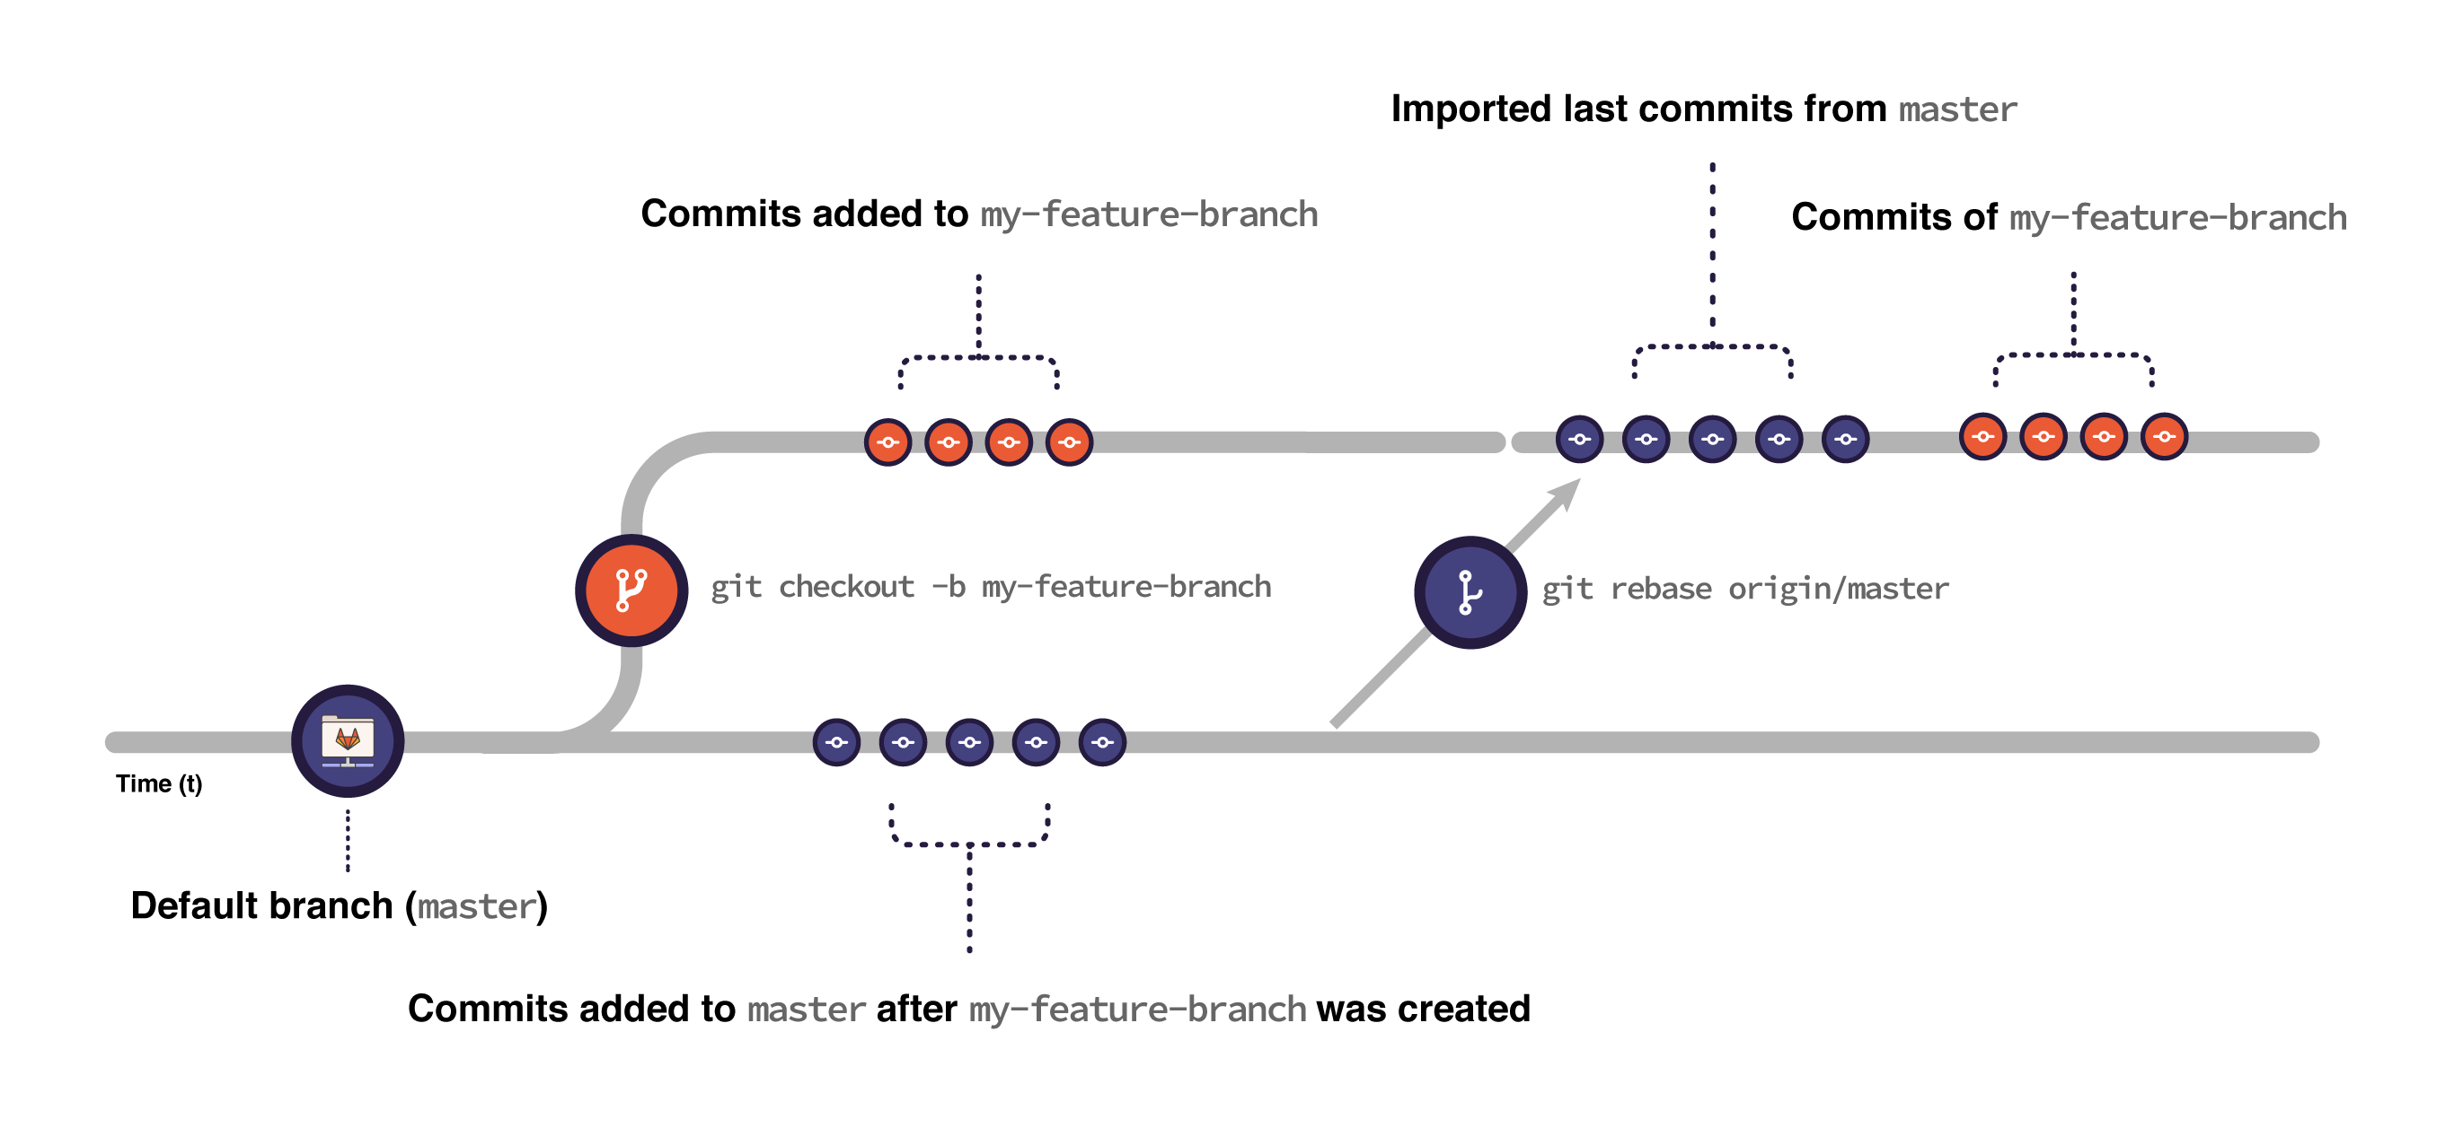
Git: Rebase
When you rebase:
Git imports all the commits submitted to main after the moment you created your feature branch until the present moment.
Git puts the commits you have in your feature branch on top of all the commits imported from main:
Figure is from: Introduction to Git rebase and force-push | GitLab
Command line example for rebased
git fetch origin
git fetch origin Rel17-draft
git checkout "Integration_Rel17_SA5_140_YAML"
git pull
## --- backup 140_yaml branch & switch back --
>> git checkout -b "Integration_Rel17_SA5_140_YAML_rebaseBK26Jan2022"
>> git checkout "Integration_Rel17_SA5_140_YAML"
git rebase "origin/Rel17-draft"
git pull
git push origin "Integration_Rel17_SA5_140_YAML"
Command to create a backup branch, which has all contents before rebase, could be used for recovery anytime
This command is to push commit (rebase) in local branch to remote repo
Notes:
It’s safer to back up your branch before rebasing to make sure you don’t lose any changes. For example, consider a feature branch called my-feature-branch:
Open your feature branch in the terminal:
>> git checkout my-feature-branch
Checkout a new branch from it:
>> git checkout -b my-feature-branch-backup
Go back to your original branch:
>> git checkout my-feature-branch
Now you can safely rebase it. If anything goes wrong, you can recover your changes by resetting my-feature-branch against my-feature-branch-backup:
Make sure you’re in the correct branch (my-feature-branch):
>> git checkout my-feature-branch
Reset it against my-feature-branch-backup:
>> git reset --hard my-feature-branch-backup
Note that if you added changes to my-feature-branch after creating the backup branch, you lose them when resetting.

Slide 23
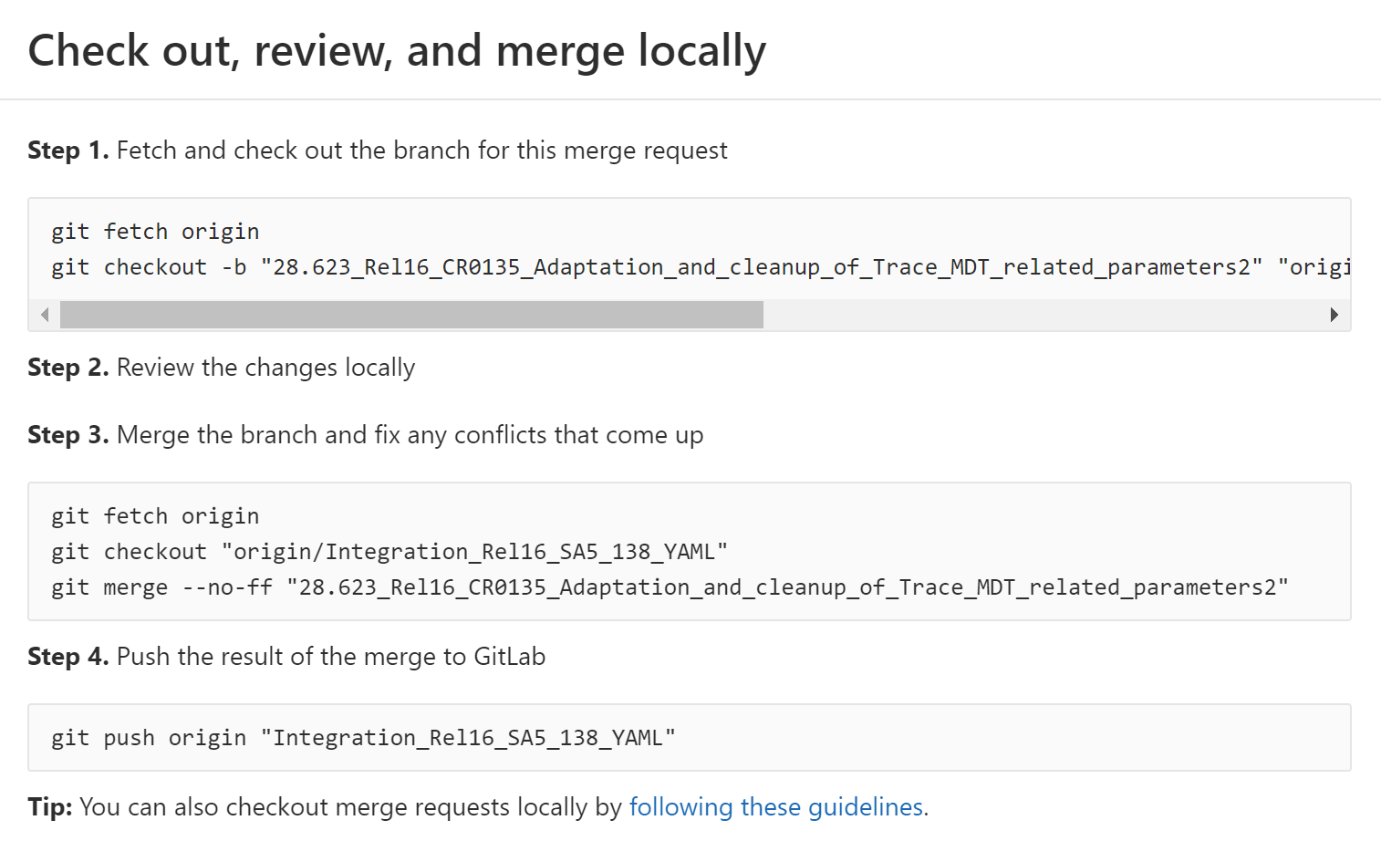
Fetch origin copies all branches from remote refs/heads name space and store them to local refs/remotes/origin name space
Git: Merge Request handling
Create a local branch from remote branch and switch to local branch 28.623_xx
(Note: Same branch name is used)
Alternatively, 2nd command can be:
git checkout -b "Integration_Rel16_SA5_138_YAML" "origin/Integration_Rel16_SA5_138_YAML“
Use some tools (e.g., vim, VSC, WinMerge, etc.) to resolve confliction, then “git add x, git commit x” (x stands for the file updated.
## ---- Example for CR0584
git fetch origin
git checkout -b "TS28.541_CR0584_Enhance_NRM_to_support_local_NEF_selection" "origin/TS28.541_CR0584_Enhance_NRM_to_support_local_NEF_selection"
git checkout "Integration_Rel17_SA5_139_YAML"
git merge --no-ff "TS28.541_CR0584_Enhance_NRM_to_support_local_NEF_selection"
git push origin "Integration_Rel17_SA5_139_YAML"
Notes:
git fetch origin
git checkout -b "28.541_Rel17_CR0630_Stage3_update_for_UPF_and_PCF" "origin/28.541_Rel17_CR0630_Stage3_update_for_UPF_and_PCF"
git fetch origin
git checkout -b “Integration_Rel16_SA5_138_YAML” “origin/Integration_Rel16_SA5_138_YAML“ or integration已经有了
git checkout "Integration_Rel17_SA5_140_YAML"
git merge --no-ff "28.541_Rel17_CR0630_Stage3_update_for_UPF_and_PCF“
git push origin "Integration_Rel17_SA5_140_YAML"
## ---- Example for CR0584
git fetch origin
git checkout -b "TS28.541_CR0584_Enhance_NRM_to_support_local_NEF_selection" "origin/TS28.541_CR0584_Enhance_NRM_to_support_local_NEF_selection"
git checkout "Integration_Rel17_SA5_139_YAML"
git merge --no-ff "TS28.541_CR0584_Enhance_NRM_to_support_local_NEF_selection"
git push origin "Integration_Rel17_SA5_139_YAML"

Slide 24
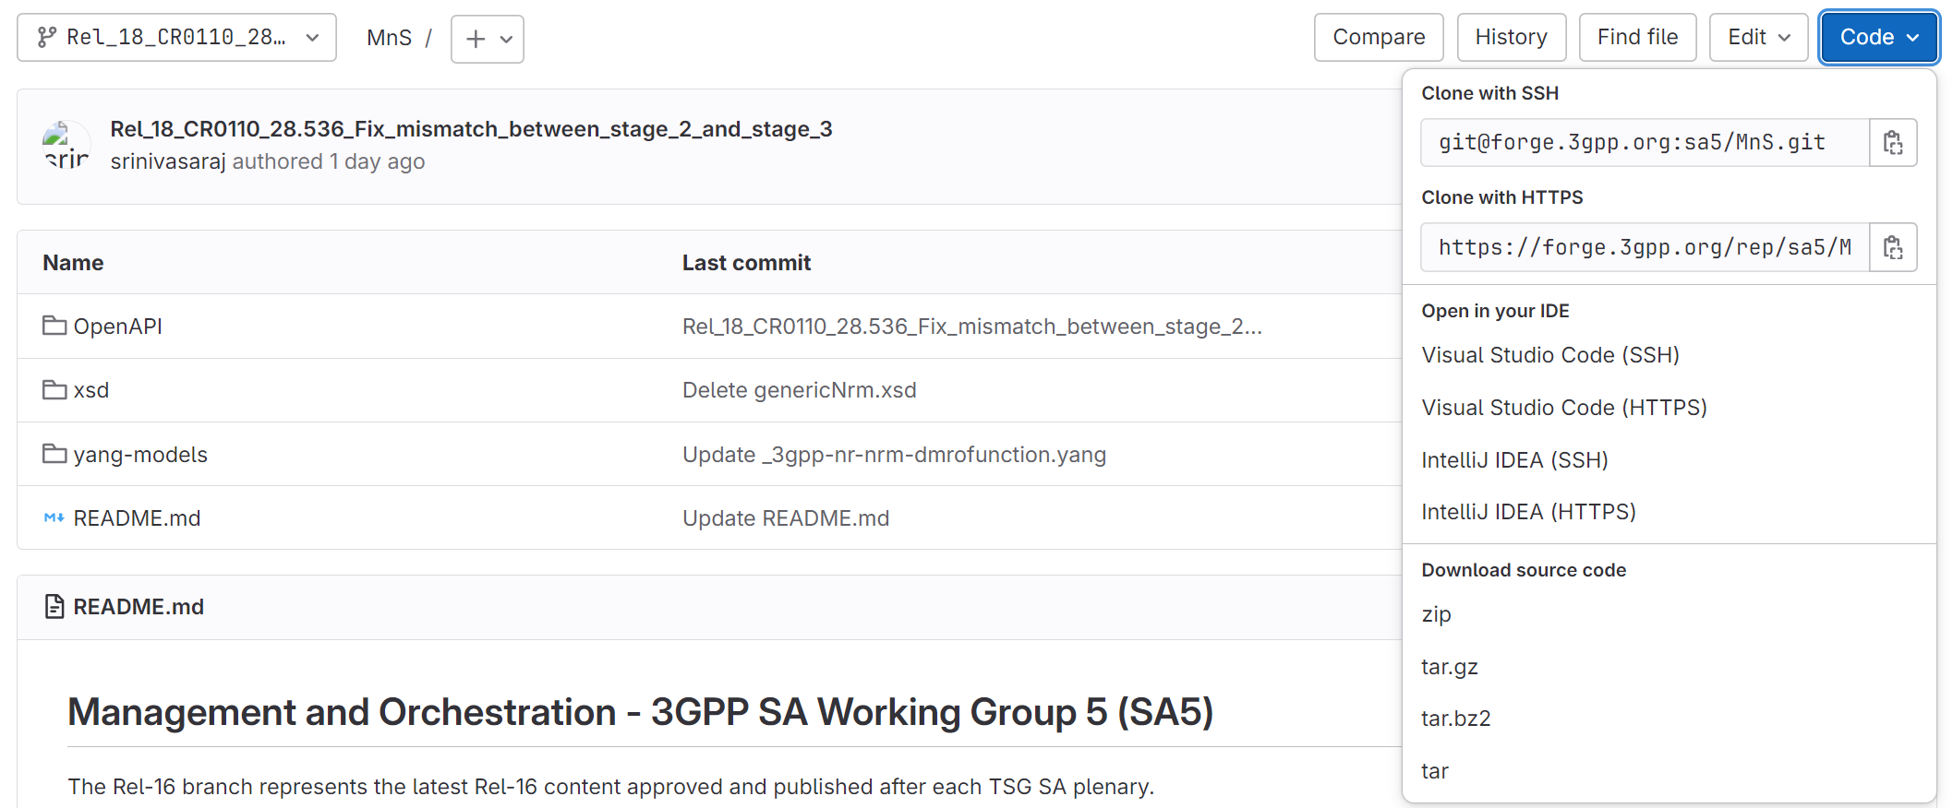
Generate a list of stage3 code for a release
Updated for #158
Step1: Select the Release
Step 2: Click Code button
Step 3: Select one of the compression type
The downloaded file (e.g., MnS-Rel-18.zip) includes the latest snapshot of stage 3 code for the select release.
Note: you could also use a Tag in step1 to generate a list of stage 3 code for specific version (e.g., for specific meeting)

Slide 25
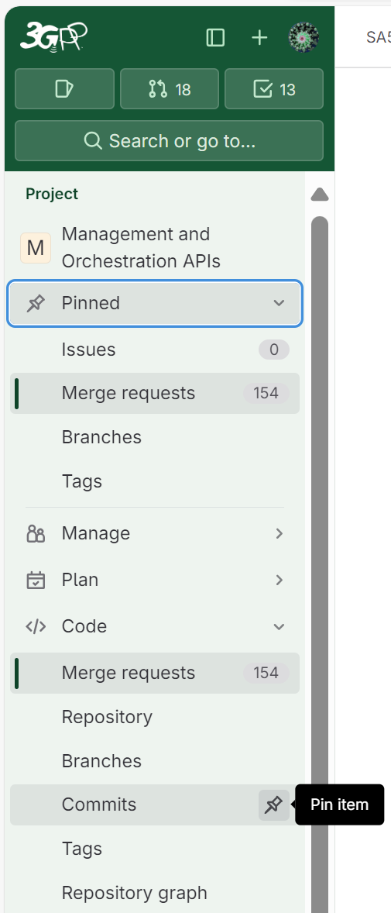
Newly created for #158
Tips to use Forge effectively: use Pinned item
This was newly introduced function in late 2024.
Collect all your frequently used items here to use Forge more effectively.
Click the icon to Pin the item, so you will be able to find all pinned items in Pinned directory.

Slide 26
Q&A
Common Q&A
Q1. I can not create branch, (or I do not see the New branch/Merge Request button)?
A1: You are not logged in to Forge, refer to login to Forge. Or you do not have the edit permission, send request to MCC for the same.
Q2. After creating the MR and commits, if there further revision of stage 3, anything to do with MR?
A2: MR link remains the same, but there will be new commit code. Each commit has one commit code and there will be new validation record. You only need to update the final commit code to CR cover page (no change to MR link). You can also get the update word artifact with the same MR link and update commit code.
Q3. I can create CR branch from a release/integration branch or a tag, what’s the difference?
A3: A branch is an active line of development whereas a tag is an immutable reference to a specific commit on a branch. Tag is a fixed version number, point to a specific version of code e.g., code approved in SA#100 meeting. A branch of Rel-18 is changing from time to time when never there is a new batch of contents approved for Rel-18. Hence, creating a CR branch from a Rel-18 branch, the CR branch created at different meeting will have different contents (i.e., the latest Rel-18 contents of the recent SA meeting). Creating a CR branch from a Rel-18 tag, the CR branch will always have the same contents as that in the Tag. By default, use the latest integration branch for your CR branch
Q4. What’s the relationship of SA5 repository and 5G_APIs repository
A4: As per request, after each SA plenary meeting. OAM OpenAPI files will be copied to 5G_APIs repository for all releases by code moderators. At the end of SA plenary meeting, 5G_APIs will create tags for each release and so does SA5 repository. For the same release, the tags from 5G_APIs and SA5 repository point to the same version of OAM OpenAPI contents. SA5 OAM CR author may use the OpenAPI files/tags in 5G_APIs but not recommended.

Slide 27
Reference
Reference
Wiki for CI/CD pipeline, validation and Word CR text: https://forge.3gpp.org/rep/sa5/MnS/-/wikis/home
Git resource: Git (git-scm.com) or Index · User · Help · GitLab (3gpp.org)
Forge Repository list: https://forge.3gpp.org/rep/explore
Direct Link to SA5 repository start page: https://forge.3gpp.org/rep/sa5/MnS
Direct Link to 5G_APIs repository: https://forge.3gpp.org/rep/all/5G_APIs (store a copy of SA5 OpenAPI solution set for Rel16/17/18, including both CH and OAM)

Slide 28
Change History
Change History
Since SA5#152
SA5#152: high level workflow, WebIDE updated.
SA5#154: wording update, outdated information updated, Reference, Editing one file.
SA5#157: adding the “Forge: create a branch”, “Editing the MR” and “Generate a list of stage3 code for a release” charts.
SA5#158: update the GUI due to Forge (GitLab version) upgrade.

Slide 29
Thanks

