Slide 1
SoH on the correction of deferred location procedure
SA WG2 Meeting #165 S2-240xxxx
14 - 18 October, 2024, Hyderabad, India
CATT

Slide 2
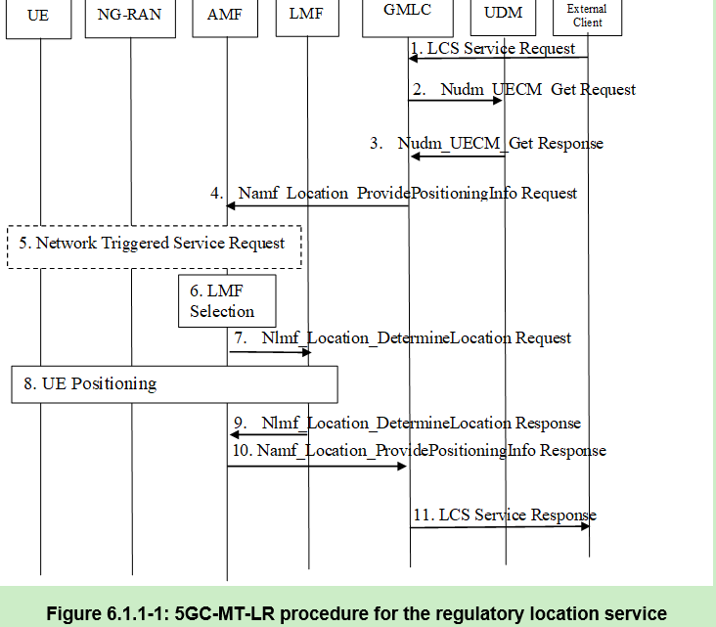
Background
LCS Correlation identifier (LCS CID) is used in 5GC-MT-LR, 5GC-MO-LR and deferred 5GC-MT-LR Procedures to correlate UE positioning session in AMF.
In most cases, CID is allocated by AMF. And AMF Knows UE ID, thus it can correlates this CID with UE ID.
Take 5GC-MT-LR for example:
At step 7, AMF allocates the CID and sends the location request (which included the CID) to LMF.
At step 8, LMF uses the received CID as session ID to trigger the UE Positioning procedure, the LMF send this CID to AMF. The AMF use the CID to correlate this positioning request with the UE.

Slide 3
Problem
However, there‘s a case that LMC allocates the CID in deferred location procedure.
The flow in the picture shows how an error would happen in such case:
Step 14 of clause 6.3.1 of TS 23.273, AMF allocates the CID and includes this CID-AMF in the Location Request message sent to LMF.
Step 15, LMF starts UE Positioning by sending Namf_Communication_N1N2MessageTransfer, where Session ID = CID-AMF. By using this CID-AMF, AMF CAN correlate the request with UE context, and proceeds the DL NAS TRANSPORT as in the steps in clause 6.11.1 (for UE assisted and UE based positioning procedure).
Step 27, after the delivery of event report, LMF determines to trigger UE Positioning procedure. The LMF allocates the CID and sends N1N2 message to AMF where Session ID = CID-LMF. However, the AMF has no knowledge of this CID and CANNOT correlate this request message with UE context.
Note:
x: the steps in 6.3.1
(x): the steps in 6.11.1
In step 27, AMF could not correlate CID-LMF, thus the UE positioning procedure fails.

Slide 4
SoH
Solutions proposed
UE ID based solution: S2-2410905 (S2-2410906, S2-2410907, S2-2410908), CATT, Qualcomm Incorporated
Step 25: AMF provides UE ID to LMF
Steps 26 – 27: LMF provides Event Report ACK/LPP message and UE ID to AMF. Based on UE ID, the AMF knows which UE the Event Report ACK/LPP message belongs to.
SoH
Agree the UE ID based solution as documented in: S2-2410905 (S2-2410906, S2-2410907, S2-2410908)
Yes:
No:

