Slide 1
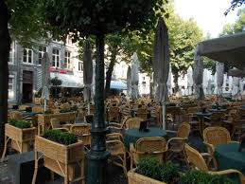
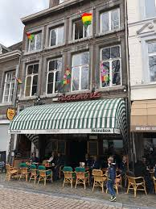
MMS Session – Tuesday 19:00 ~
We have reserved a private room upstairs (called ‘Gallery’) at Café Charlemagne - https://english.cafecharlemagne.nl/
Onze Lieve Vrouwenplein, Centre of Maastricht, approximately 30 mins walking or by public transport from MECC
We can’t bring our own wine or drinks, but we have our own bar. You can pay for your own drinks.
Max 40 people, but the café is at a square with terraces and several other restaurants
Café serves food in bar and at terrace. Kitchen open until 22:00.

