Slide 1
Years of developing ICT Standards
Welcome to 3GPP SA WGs
@ Hyderabad!
14th – 18th October 2024

Slide 2
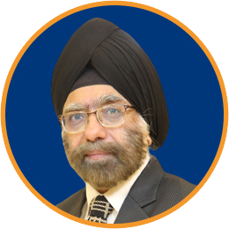
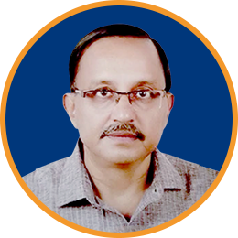
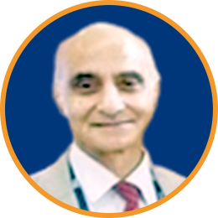
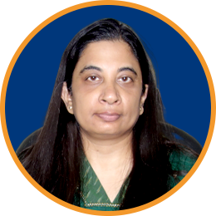
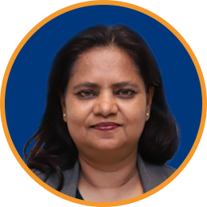
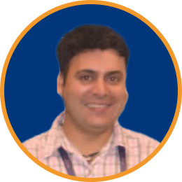
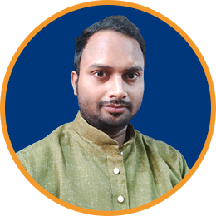
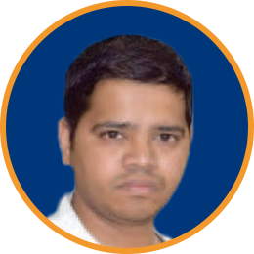
Government of India – DoT, MEA & MHA
TSDSI Secretariat
Sponsors
Kuljit Singh
AK Mittal
PK Jaswal
Silver Sponsors
Bronze Sponsor
Shefali Sinha
Anupam Sinha
Harsh Arora
Logistics Partner
Design Partner
Asif Iqbal
Rajesh Vasudev

Slide 3
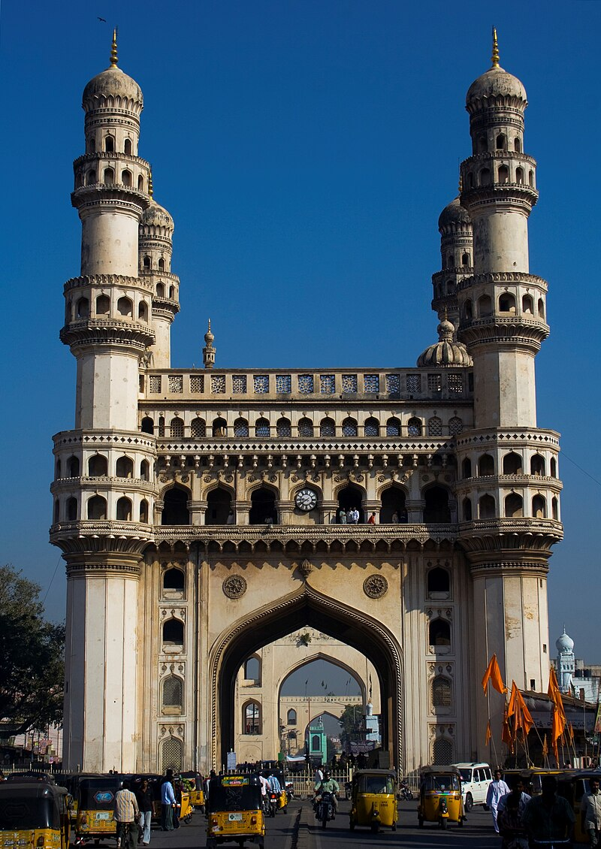
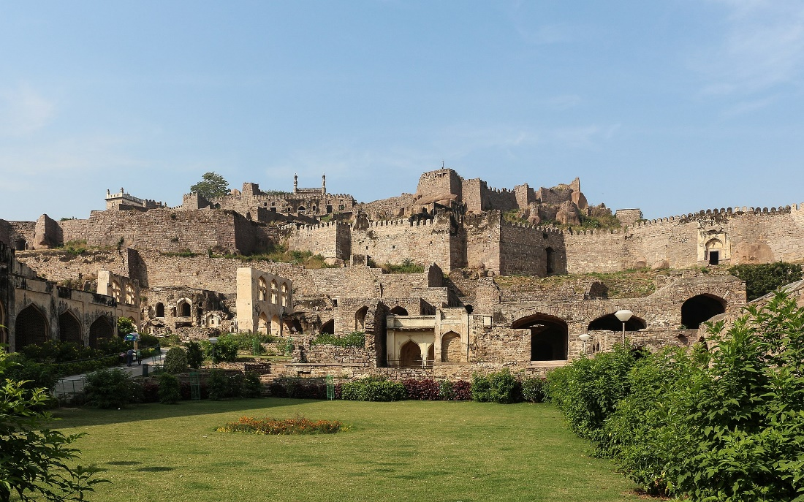
Hyderabad’s History
Hyderabad is the capital city of the southern Indian state of Telangana. It has a population of more than 11 million, making it India's sixth most populous metropolitan area.
Ancient history of the region:
Around 3rd century BC, the region around Hyderabad was part of the Mauryan empire.
Since the fall of the Mauryan empire, the region has seen the rise and fall of many empires such as the Satvahanas, Chalukyas and the Kakatiyas.
Medieval Hyderabad:
Sultan Quli Qut-ul-Mulk gained control of the region in 1518, and built the fortress of Golconda, which till date is a popular tourist destination.
In 1591, the fifth Qutb Shahi sultan, Muhammad Quli Qutb Shah, established Hyderabad, to extend beyond fortified Golconda, and construction of Charminar.
By the mid 18th century Asaf Jah I, the Mughal viceroy, declared his sovereignty and founded the Asaf Jahi dynasty, also known as the Nizams. The descendants of Asaf Jah ruled Hyderabad as Nizams until India’s independence.
During the Nizam rule, Hyderabad was the largest princely state in India, and the king was considered to be the richest in the world!
Hyderabad is also known as the “City of Pearls” due to its role in pearl trade.
Charminar
Golconda Fort

Slide 4
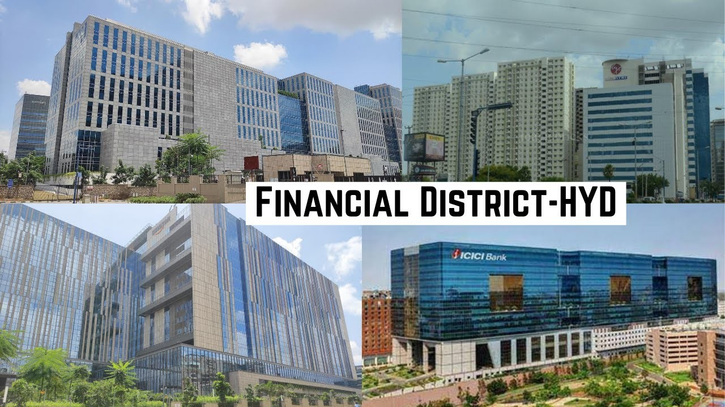
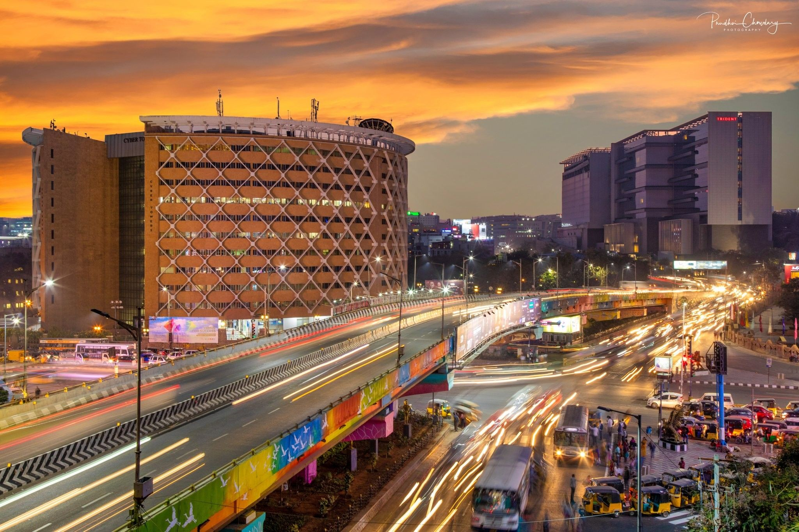
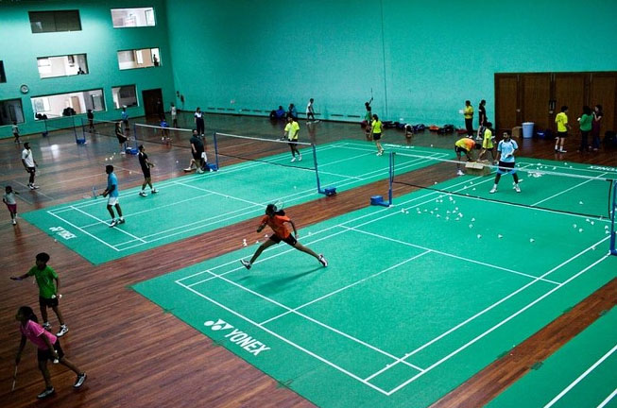
Today’s Hyderabad!
Hyderabad is referred to as the Pharma City of India as it is the hub of pharmaceuticals and biotechnology research in India.
It is currently an emerging information and technology hub of India, with some of the biggest multinational companies having their campuses in the city. Amazon, Microsoft and Meta have one of their largest campuses in Hyderabad, outside USA.
Hyderabad is also the hub for badminton in India, and is known to have created some of the most prominent players such as P.V Sindhu (world ranking 2 in 2017), Kidambi Srikanth and Saina Nehwal (world ranking 1 in 2015).
The Pullela Gopichand Badminton Academy (PGBA) in Hyderabad is known to train and create some of the top ranked badminton players for India.

Slide 5
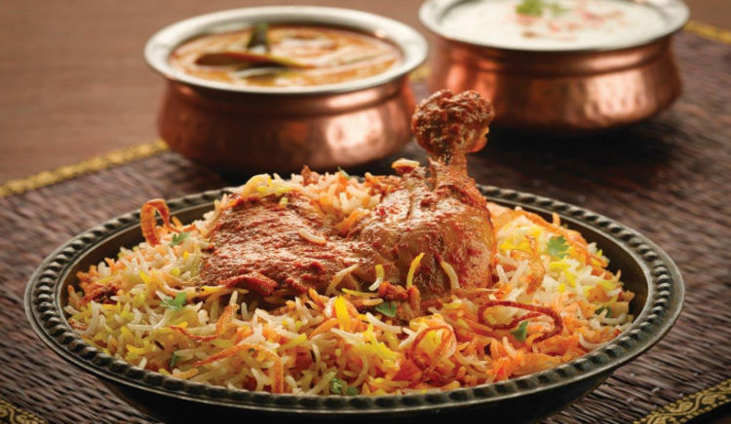
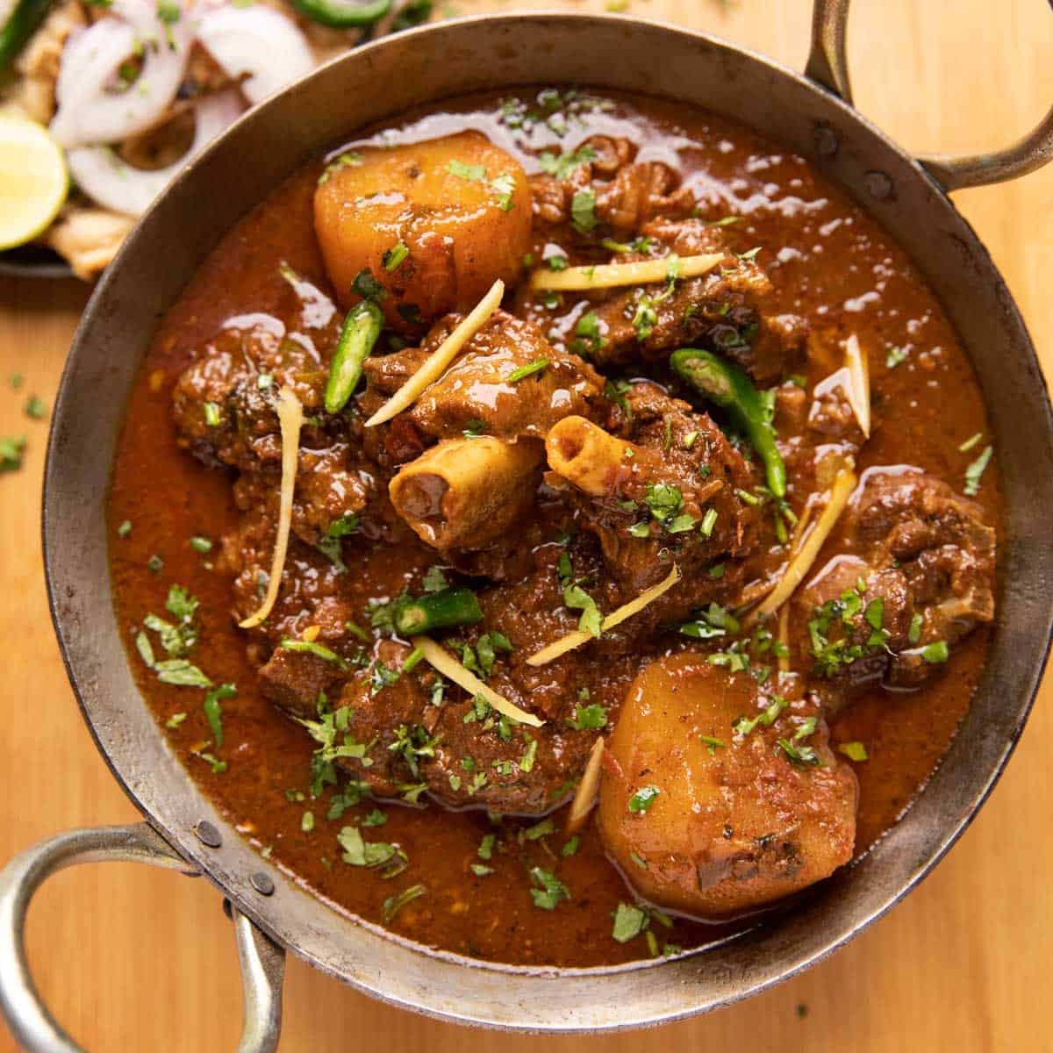
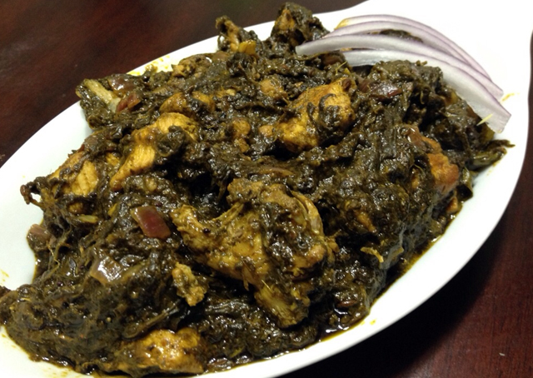
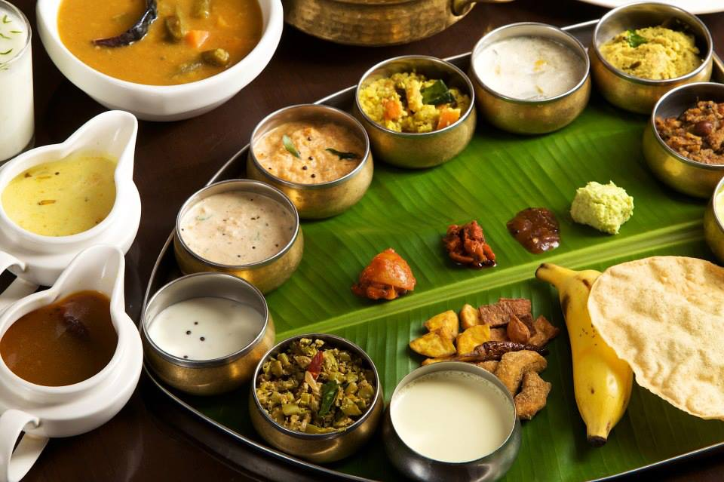
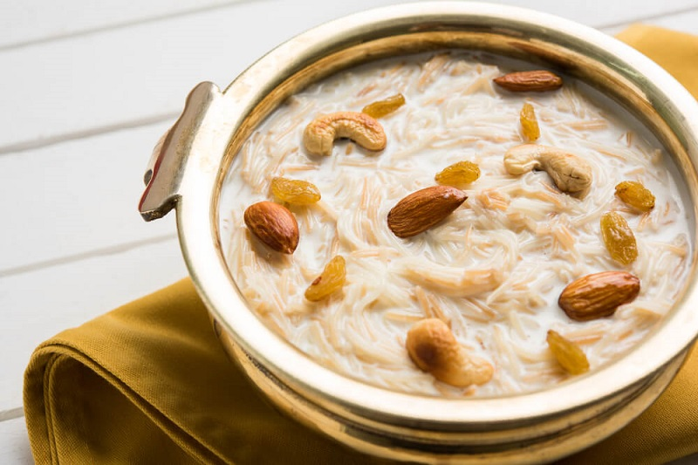
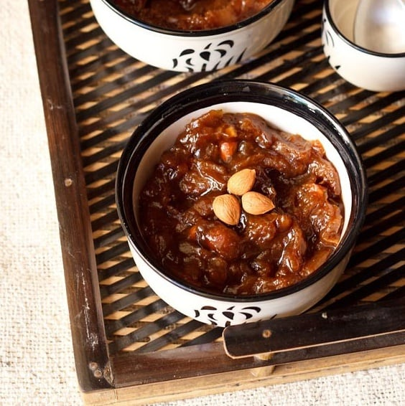
Hyderabad – Food
Hyderabadi Dum Biryani
Telangana Mutton Curry
Gongura Chicken Curry
Traditional Andhra Meal
Semiya Payasam/Keer
Qubani ka Meetha

Slide 6
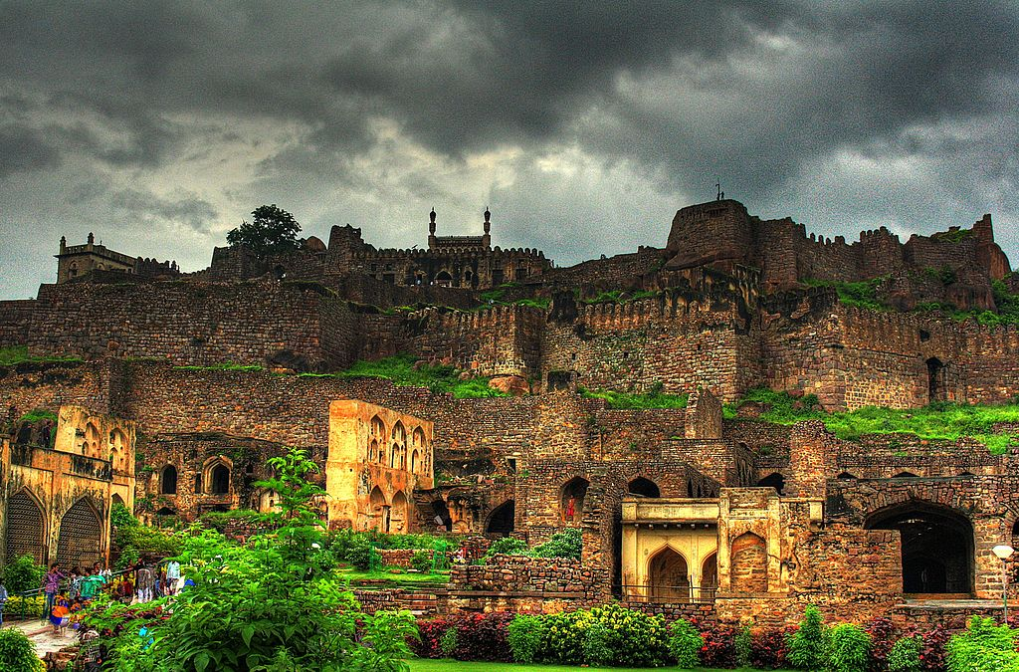
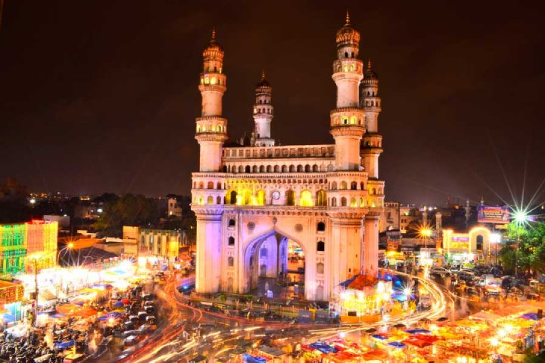
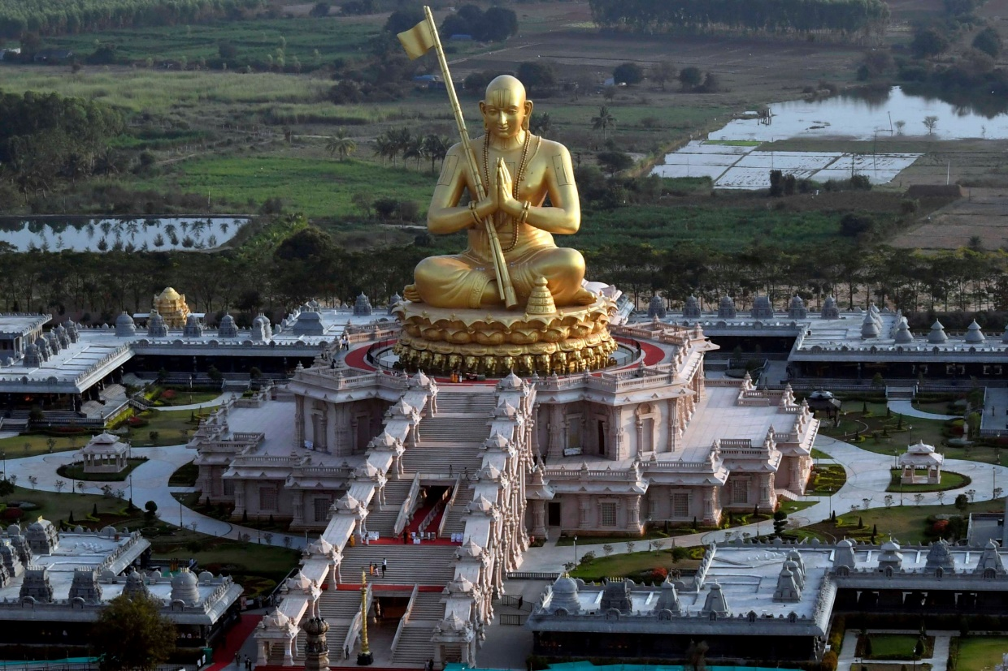
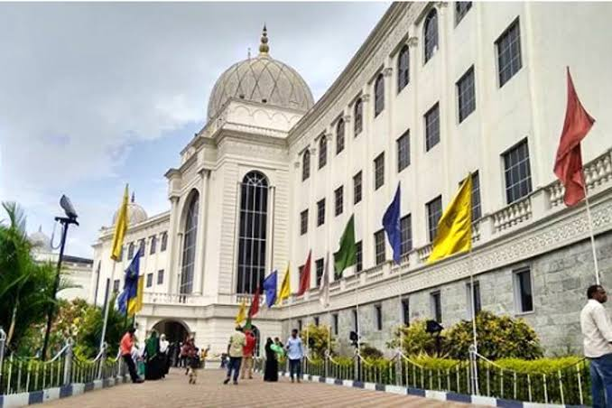
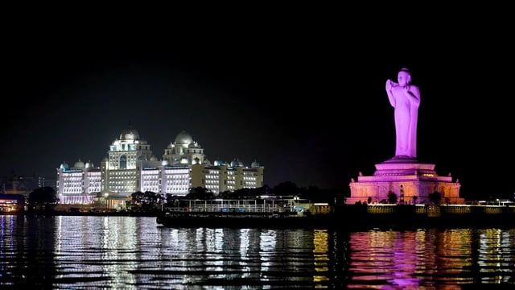
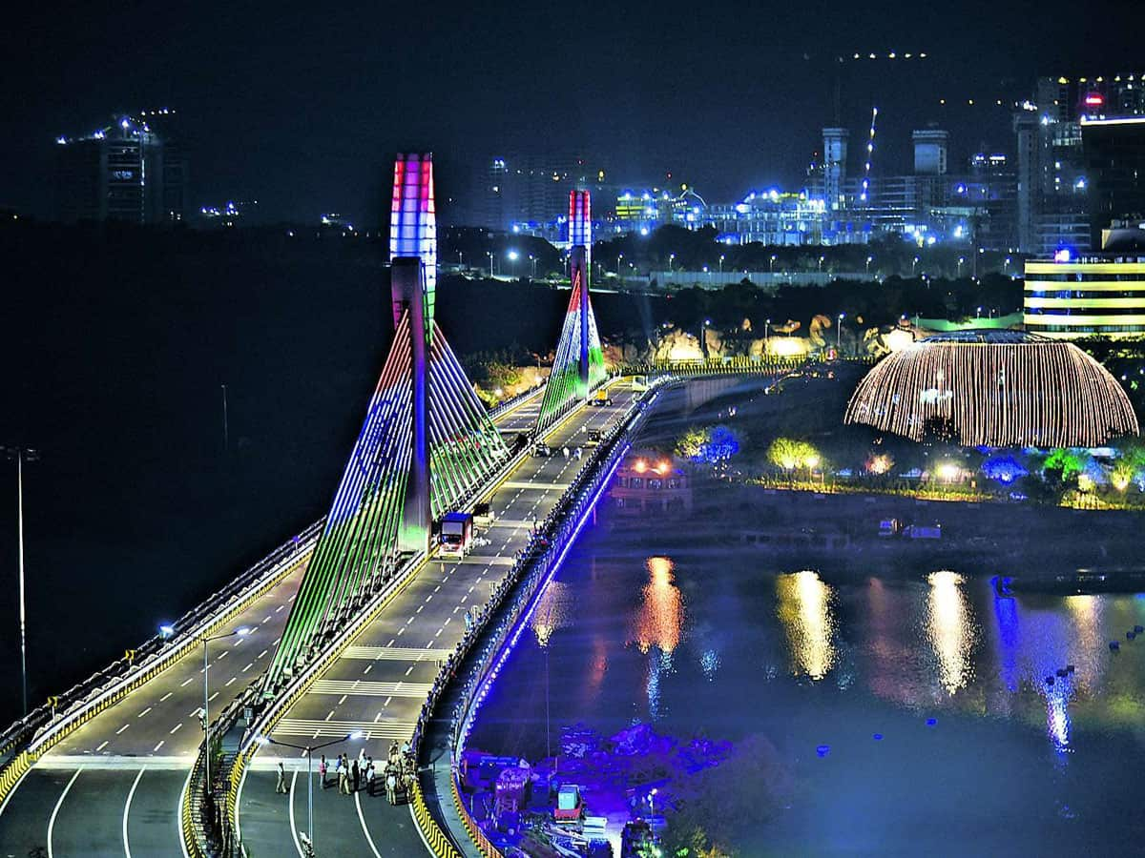
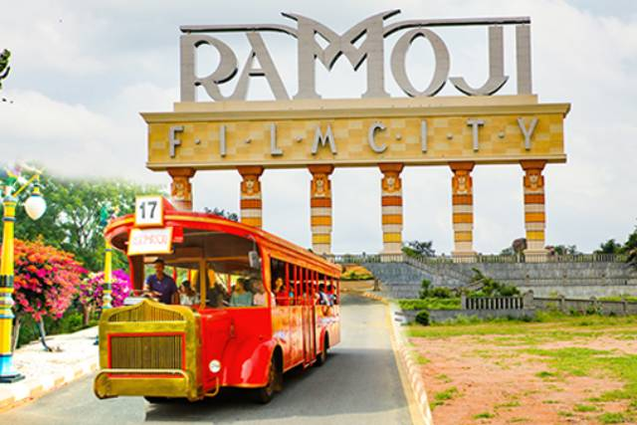
Hyderabad – Places to see
Golconda Fort
Charminar (Old City)
Statue of Equality
Salarjang Musuem
Tank Bund (Buddha Statue)
Bridge at Durgamma Cheruvu
Film City/Tollywood

Slide 7
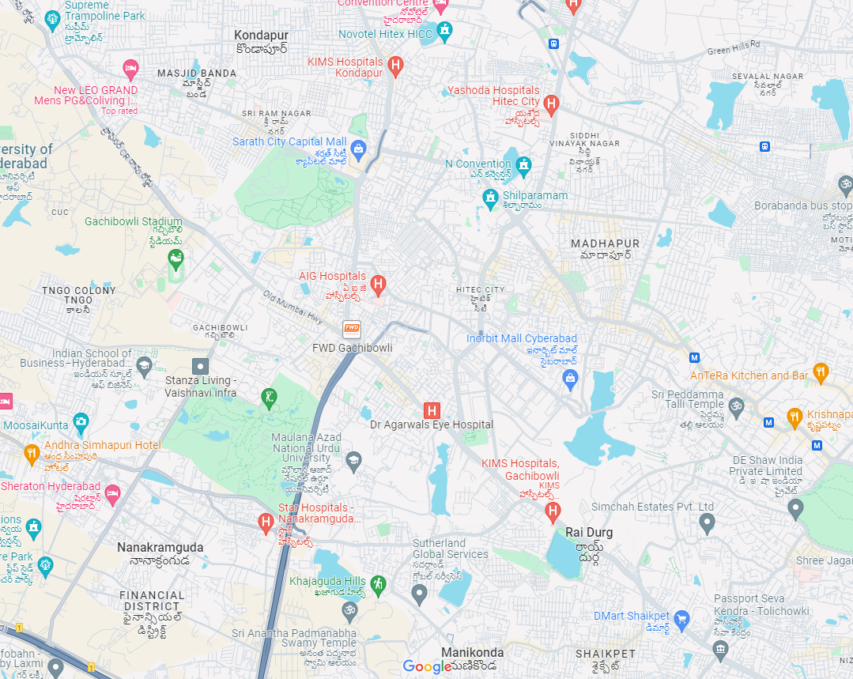
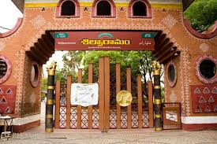
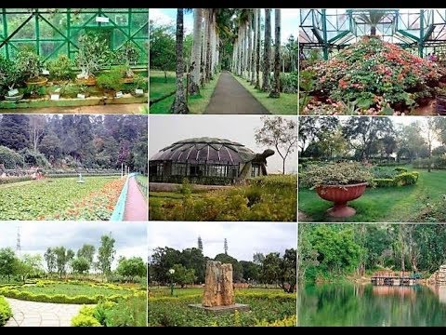
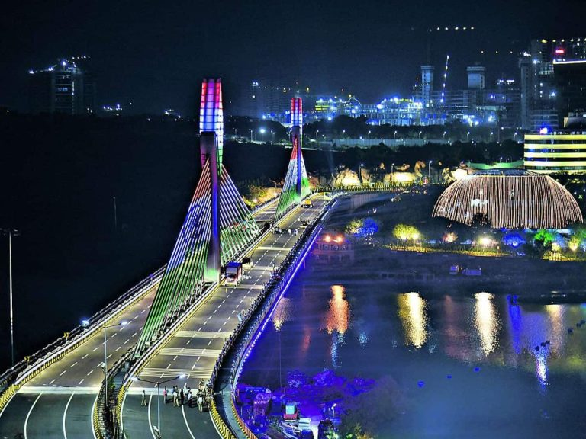
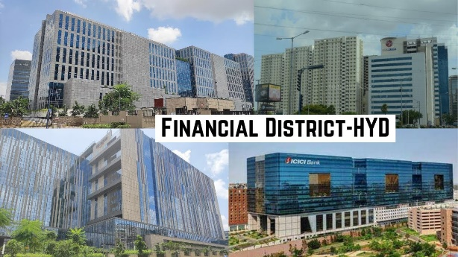
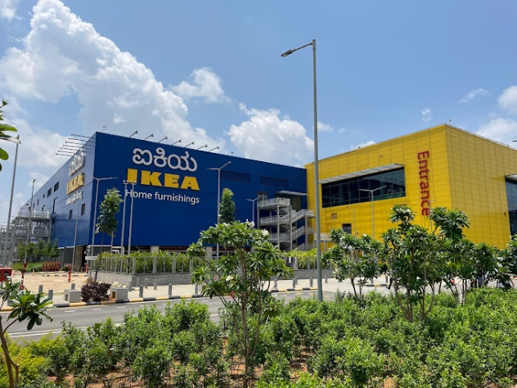
Nearby attractions
Gachibowli: (~5KM) KVR Botanical garden and enroute for shopping and eateries.
Novotel HICC – We are here
Shilparamam: (~4KM) Art and crafts village
Avasa Hotel
Durgam Cheruvu Lake: (~10KM) Hanging bridge, enroute IKEA, Inorbit Mall
Financial District: (~12KM) Offices and IT Hub

Slide 8
Meeting Logistics
Coffee Breaks (morning and afternoon) – Lobby (Ground Floor & First Floor & Second Floor)
10:30 to 11:00 am
3:30 to 4:00 pm
Lunch (12:30 to 2:00pm) – Lobby (Ground Floor & First Floor) – ONLY with coupons!
Meeting Room Allocation:
1) SA2 Plenary/Main – HICC Ground Floor (Hall 1 & 2)
- SA2 Breakout 1 – HICC Annex Ground Floor (G.01 & G.02)
- SA2 Breakout 2 – HICC Annex Ground Floor (G.03 & G.04)
2) SA3 Plenary/Main – HICC First Floor (MR1.01 & MR1.02 & MR1.03)
- SA3 Breakout – HICC First Floor (MR 1.03)
3) SA5 Plenary/Main – HICC Ground Floor (G.05 & GR.06)
- SA5 Breakout 1 (OAM) – HICC Second Floor (MR2.01)
- SA5 Breakout 2 (Charging) – HICC Second Floor (MR2.02)
4) SA6 Plenary/Main – HICC First Floor (MR1.05 & MR1.06)
- SA6 Breakout – HICC First Floor (MR1.04)

Slide 9
Shuttle Service & Private Taxis
Shuttle Service (Avasa <--> Novotel)
Avasa to Novotel HICC (Morning)
7:30 am, 8:00 am, & 8:15 am
Novotel HICC to Avasa (Afternoon)
12:30pm, 1:00pm
Avasa to Novotel HICC (Afternoon)
1.00 pm, 1:30pm
Novotel HICC to Avasa (Evening)
6:00pm, 7.00 pm & 7.30 pm
Private Taxis (4 hours/40km)
Sedans – 2000 INR (~25 USD) – 3-4 passengers
SUV/MPV – 3000 INR (~40 UD) – 6 passengers
Tempo Traveller – 7500 INR (~90 USD) - 12 passengers
Ride hailing taxis (Uber, Ola) are very popular in India

Slide 10
Post-meeting networking event
Friday - 4pm onwards!

Slide 11
Thank You For further help, please visit the Registration Desk! Feedback Survey Link (5 Mins) Feedback SA WG Meetings Oct 24
PLEASE RETURN YOUR LANYARDS TO THE ORGANIZERS AT THE END OF THE MEETING

