Slide 1
Discussion on improvements of creating class diagram
Nokia, Nokia Shanghai Bell
Revision of S5-245236

Slide 2
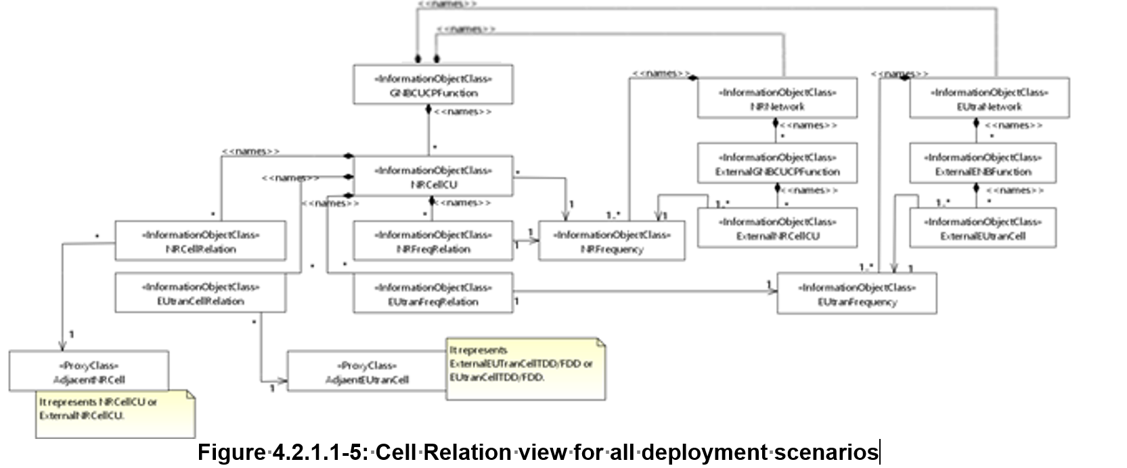
Background / Observations
In several specifications with Stage 2 definitions, such as TS 28.622 and TS 28.541, there are several class diagrams, some of which are quite complex. A few issues have been observed:
Lack of Editable Source Code: Not all diagrams have editable source code, hindering maintenance and updates.
Low Figure Quality: Some diagrams, like Figure 4.2.1.1-5 in TS 28.541, exhibit poor quality, compromising clarity and readability.

Slide 3
Proposal for improvement recommendations
CR author should add the editable source file or source code for the diagram to specification Annex
Recommend to use PlantUML for diagram generation
For example, when the PlantUML is used to create the diagram and CR author should add related source code as Annex.
Diagram Quality improvements:
Low quality diagram should not be allowed, e.g., the group or specification rapporteur to decide the acceptable quality level.
The CR author is recommended to use high quality image format, such as Scalable Vector Graphics (SVG) format, to store the diagram file.
The SVG format enable sharp figure with smaller file (figure) size, and
SVG files can be scaled up or down without losing quality

Slide 4
Proposal for Endorsement
Endorse the “Proposal for improvement recommendations” as way forward for creating class diagrams

Slide 5
Thank you!

Slide 6
Backup: Links
PlantUML (Link for software and user guide): https://plantuml.com/download
Online tool to generate PlantUML diagram: https://www.plantuml.com/plantuml/uml/SyfFKj2rKt3CoKnELR1Io4ZDoSa70000
PlantUML word plugin: https://github.com/plantuml/word-template
For Advanced User, plugin (extensions) for VS Code could be used: PlantUML

Slide 7
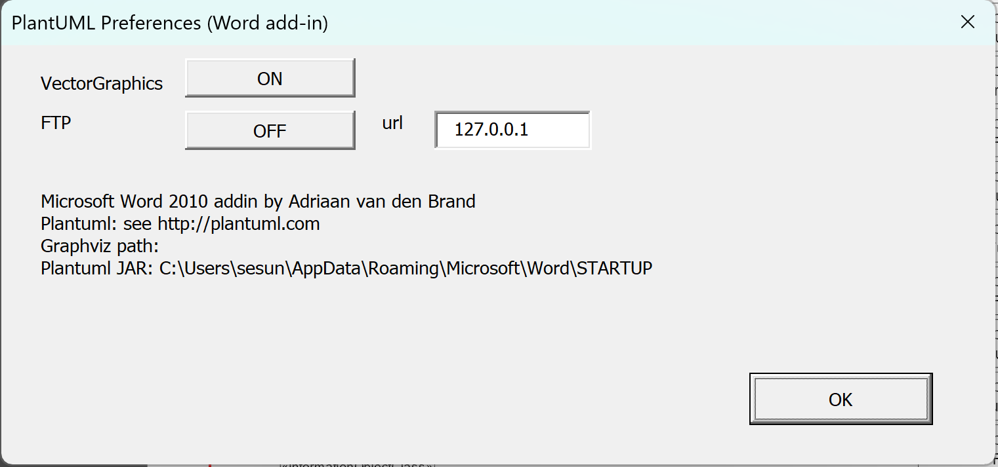
Backup: Enable SVG in Word
Enable SVG in PlantUML within word plugin.
Step 1: From Word menu, locate the “PlantUML”
Step 2: Choose “Preferences”
Step 3: Mark the VectorGraphics button as “ON”

Slide 8
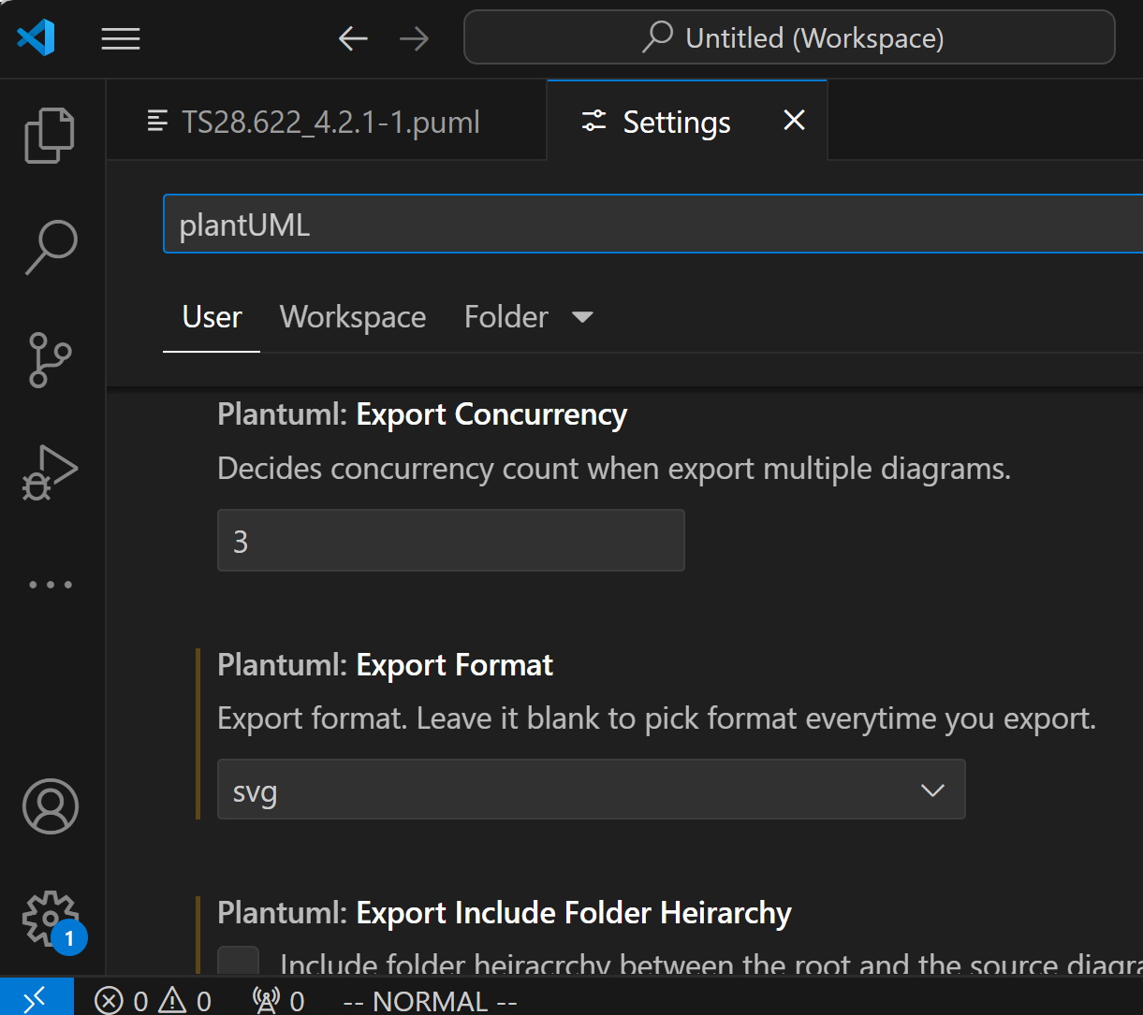
Backup: Enable SVG in VSC extension
Step 2: Input “PlantUML” to locate the settings related to PlantUML
Step 3: Choose “svg” as export Format
Step 1: Click this ICON and selecting “Settings”

