Slide 1
Way forward for ZTS

Slide 2
Way Forward Options
(normative/informative) ZTS captured in TS 33.501
(normative/informative) Separate TS for ZTS TS 33.XXX
(Hybrid - normative/informative) Proposes KI 1 requirements in TS 33.501 and additional informative guidance in a 900 series TR
(Hybrid - normative/informative) Proposes KI 1 requirements in a new TS and additional informative guidance in a 900 series TR
(informative) 900 series TR only

Slide 3
Normative requirements Options (if needed)
Option 1: Minimal set of Requirements for normative work
The NF supports the generation of security event logs.
Security event logs at-rest prior to being collected are confidentiality and integrity protected.
Security event logs in-transit are confidentiality and integrity protected.
The NF supports a set of data (e.g., information elements as applicable) for the security event logs.
NOTE: see TR/TS 33.XXX for additional details on data collection for security event logs
Option 2: Agreed set of Requirements for KI 1 for normative work
All requirements in TR 33.794 KI 1 conclusions are used as normative security requirements. E.g., see S3-245080

Slide 4
Background

Slide 5
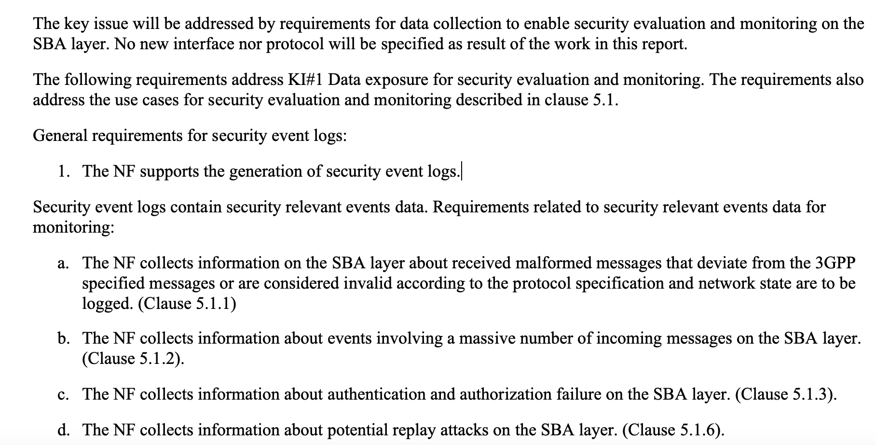
Concluded Requirements Addressing KI 1

Slide 6
Additional requirements agreed in SA3#119
Security event logs at-rest prior to being collected are confidentiality and integrity protected.
Security event logs in-transit are confidentiality and integrity protected.
The NF supports a set of data (e.g., information elements as applicable) for the security event logs.

