Slide 1
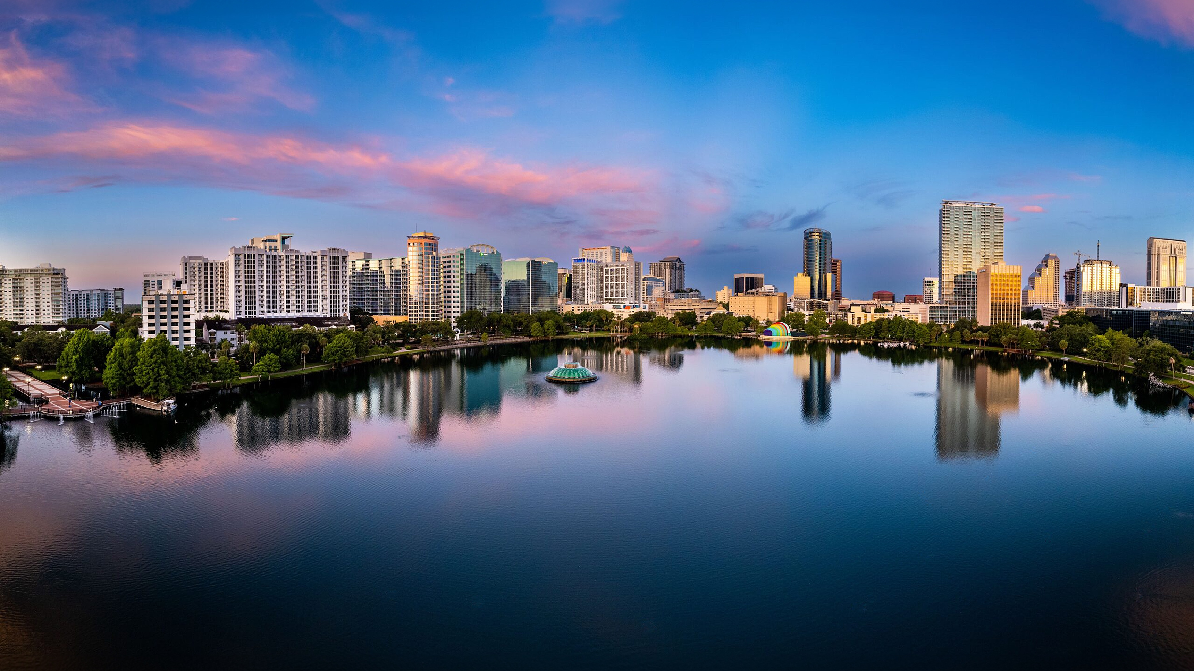

Working Group Meetings Orlando
November 18-22, 2024 | Orlando, FL

Slide 2

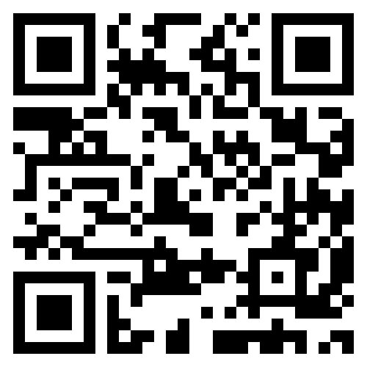
Visit the 3GPP Orlando website for updated meeting information including room assignments/maps:
https://3gppmeetings.atis.org/orlando2024/
For inquiries during the meeting contact:
orlando2024@atis.org

Slide 3
Security/Registration
Delegates are responsible for printing their own identity badges using the link provided in their registration acknowledgment email.
There is no QR code or scanning at the meeting rooms.
For security, only delegates wearing meeting lanyards with pre-printed badges will be permitted to enter the meeting rooms and coffee breaks.
Security is not provided in the meeting rooms; you are responsible for your own equipment.
Delegates who need visa letters for the 3GPP 2025 Dallas/Baltimore Meetings may submit online requests for printed copies for pickup next week at the Hilton Orlando Lake Buena Vista.

Slide 4

WiFi Info
Wireless LAN :
SSID: 3GPPWIFI
Password: 3GPP3GPPM (CAPITAL LETTERS!)
Server IP Address: 10.10.10.10
--> USUAL SETTING
Notes:
Same for both hotels

Slide 5
RAN/CT Meeting Hours (Lake Buena Vista)
There are limits on meeting times:
Monday: 9:00 AM – 7:30 PM
Tuesday/Wednesday/Thursday: 8:30 AM – 7:30 PM
Friday: 8:00 AM – 4:00 PM
*Please note, meeting times will be strictly observed to avoid incurring union overtime. Outside of the stipulated meeting hours, the venues’ AV, screens, projectors or microphones may not be used. Personal projectors may not be used at any time.
Please consult agenda documents for individual working groups for specific meeting times for each working group.

Slide 6
SA Meeting Hours (Buena Vista Palace)
There are limits on meeting times:
Monday: 9:00 AM – 7:00 PM
Tuesday/Wednesday/Thursday: 8:00 AM – 7:00 PM
Friday: 8:00 AM – 4:00 PM
*Please note, meeting times will be strictly observed to avoid incurring union overtime. Outside of the stipulated meeting hours, the venues’ AV, screens, projectors or microphones may not be used. Personal projectors may not be used at any time.
Please consult agenda documents for individual working groups for specific meeting times for each working group.

Slide 7
Coffee Breaks
Monday – Thursday
  Morning Coffee Break: 10:30 AM – 11:00 AM
  SA Afternoon Coffee Break: 3:30 PM – 4:00 PM
  CT Afternoon Coffee Break: 3:30 PM – 4:00 PM
  RAN Afternoon Coffee Break: 4:30 PM – 5:00 PM
Friday
Morning Coffee Break (only): 10:30 AM – 11:00 AM

Slide 8
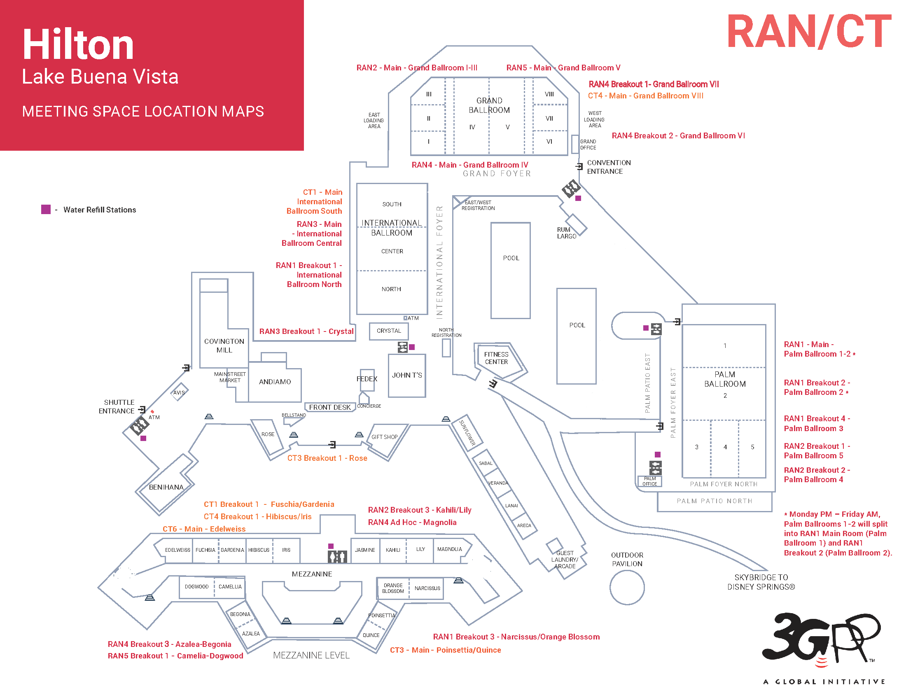
Notes:
Same for both hotels

Slide 9
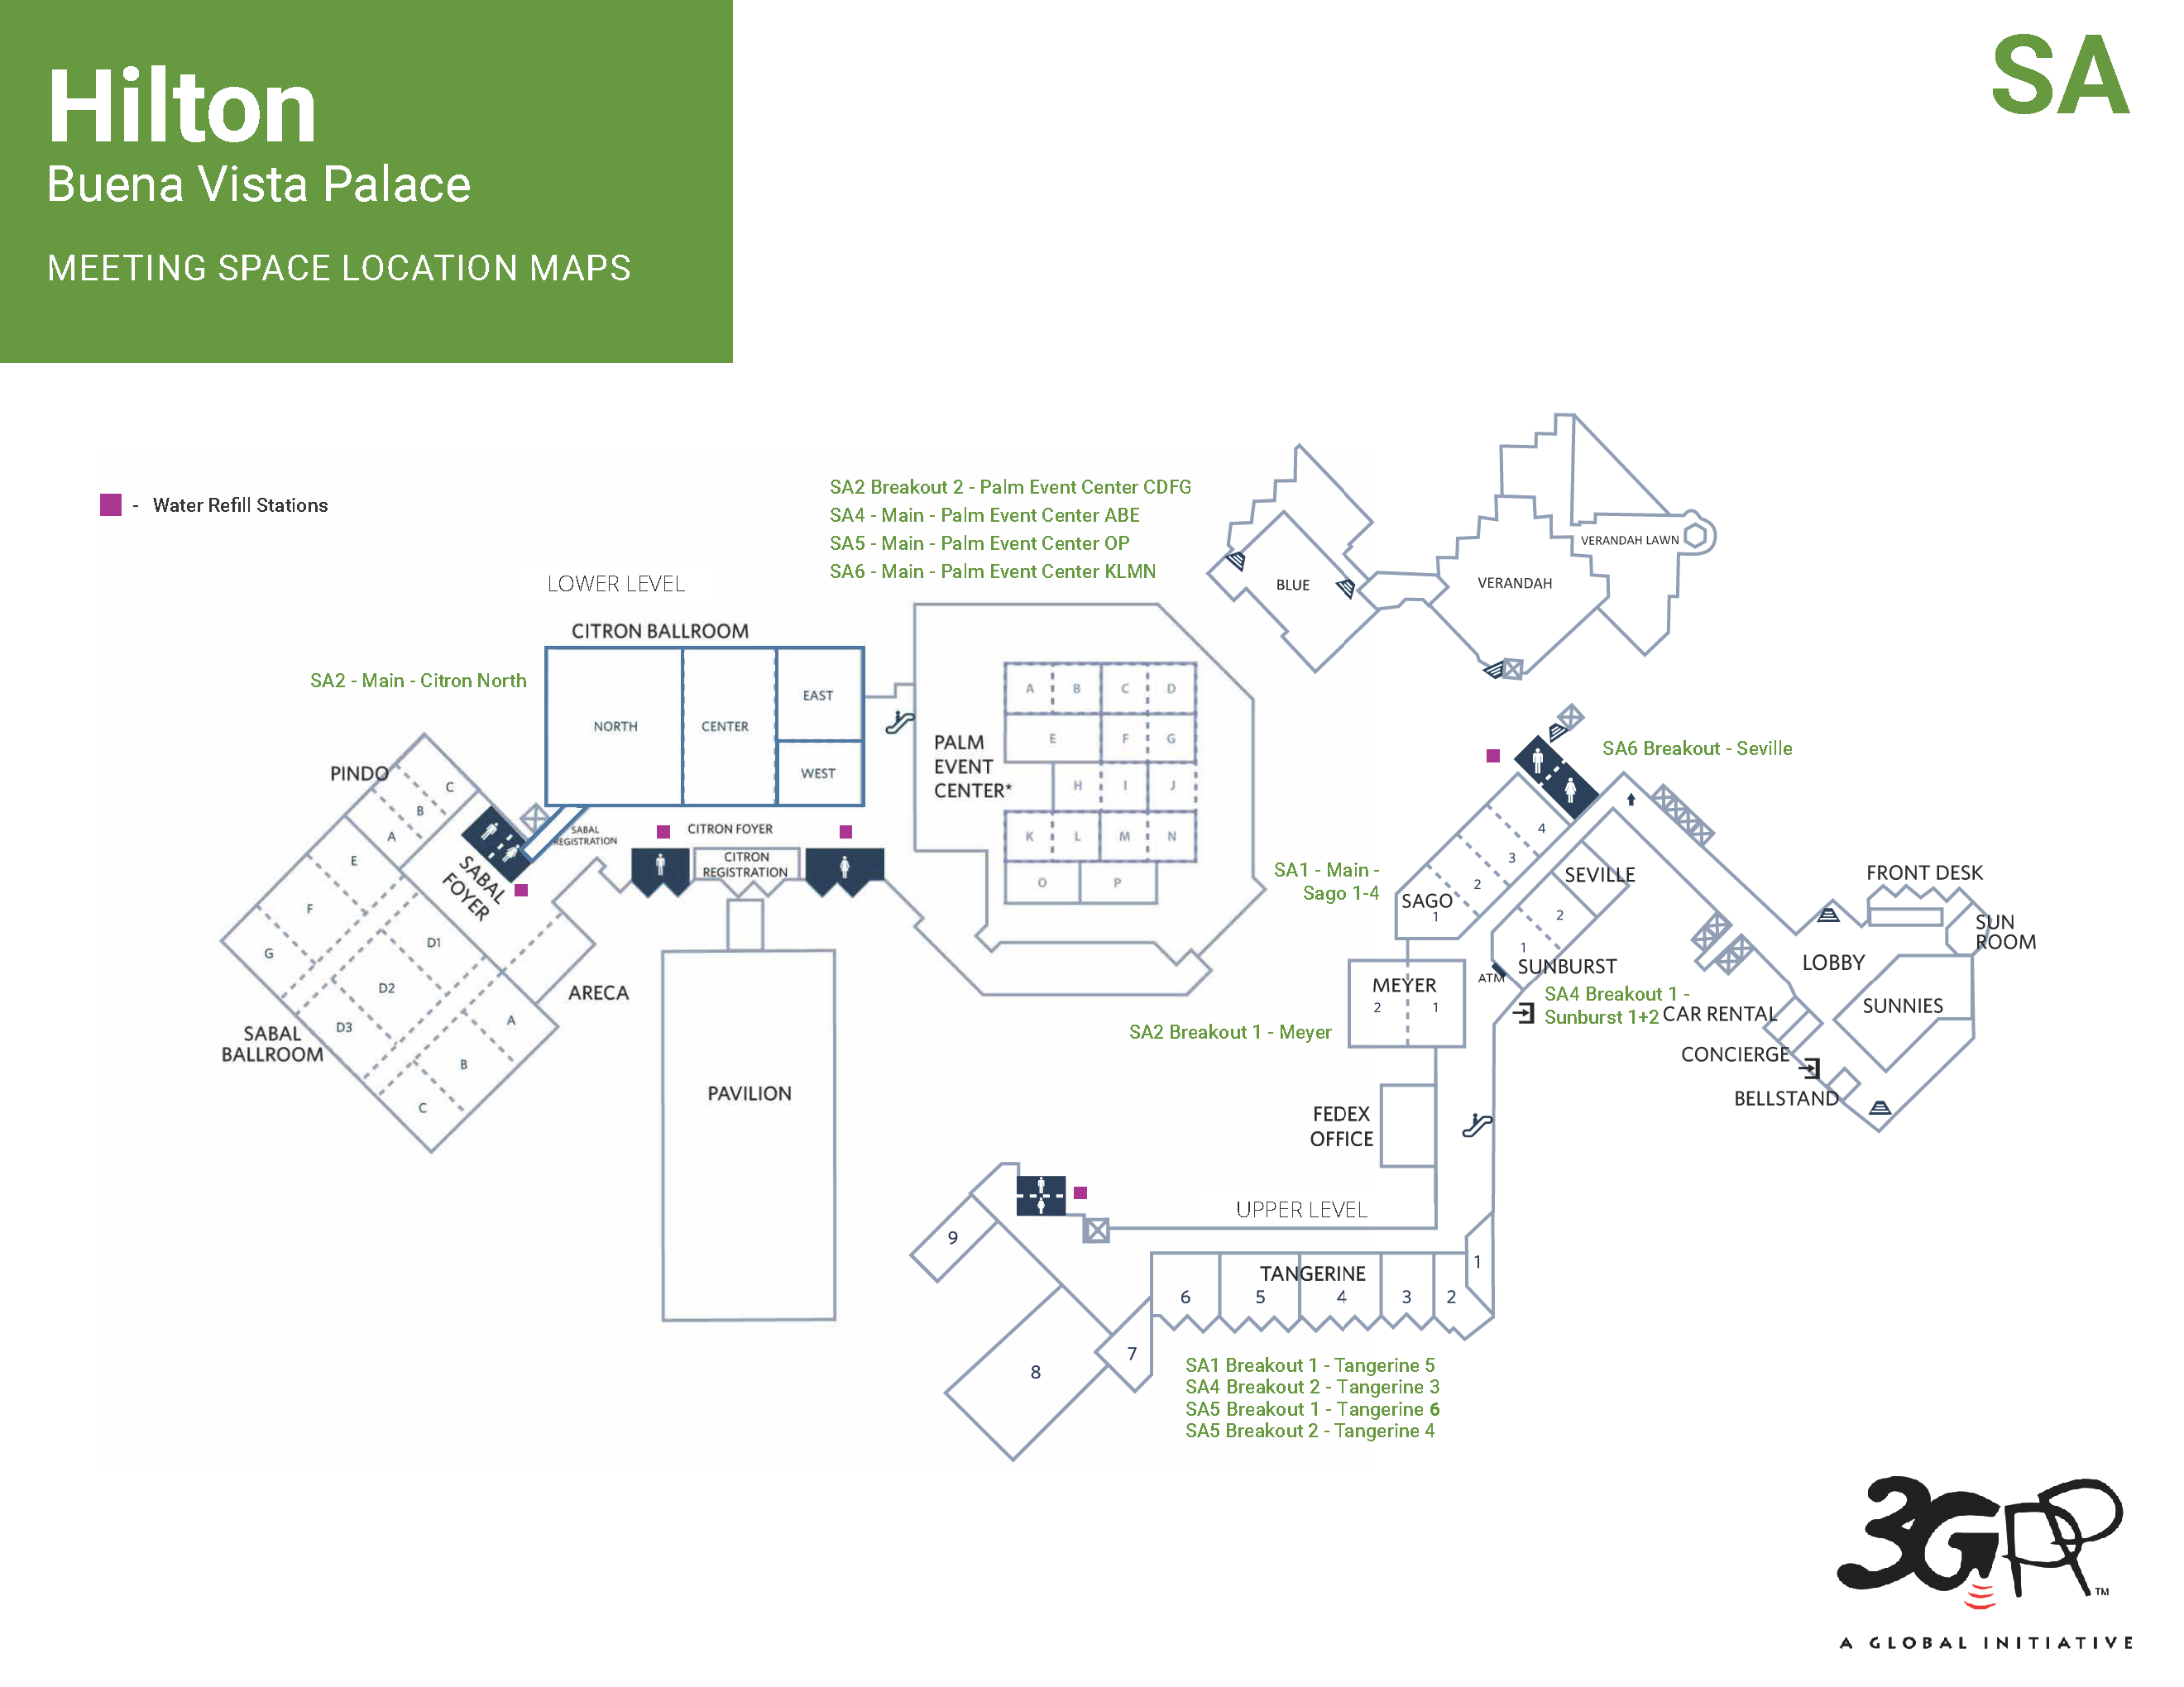
Notes:
Same for both hotels

Slide 10
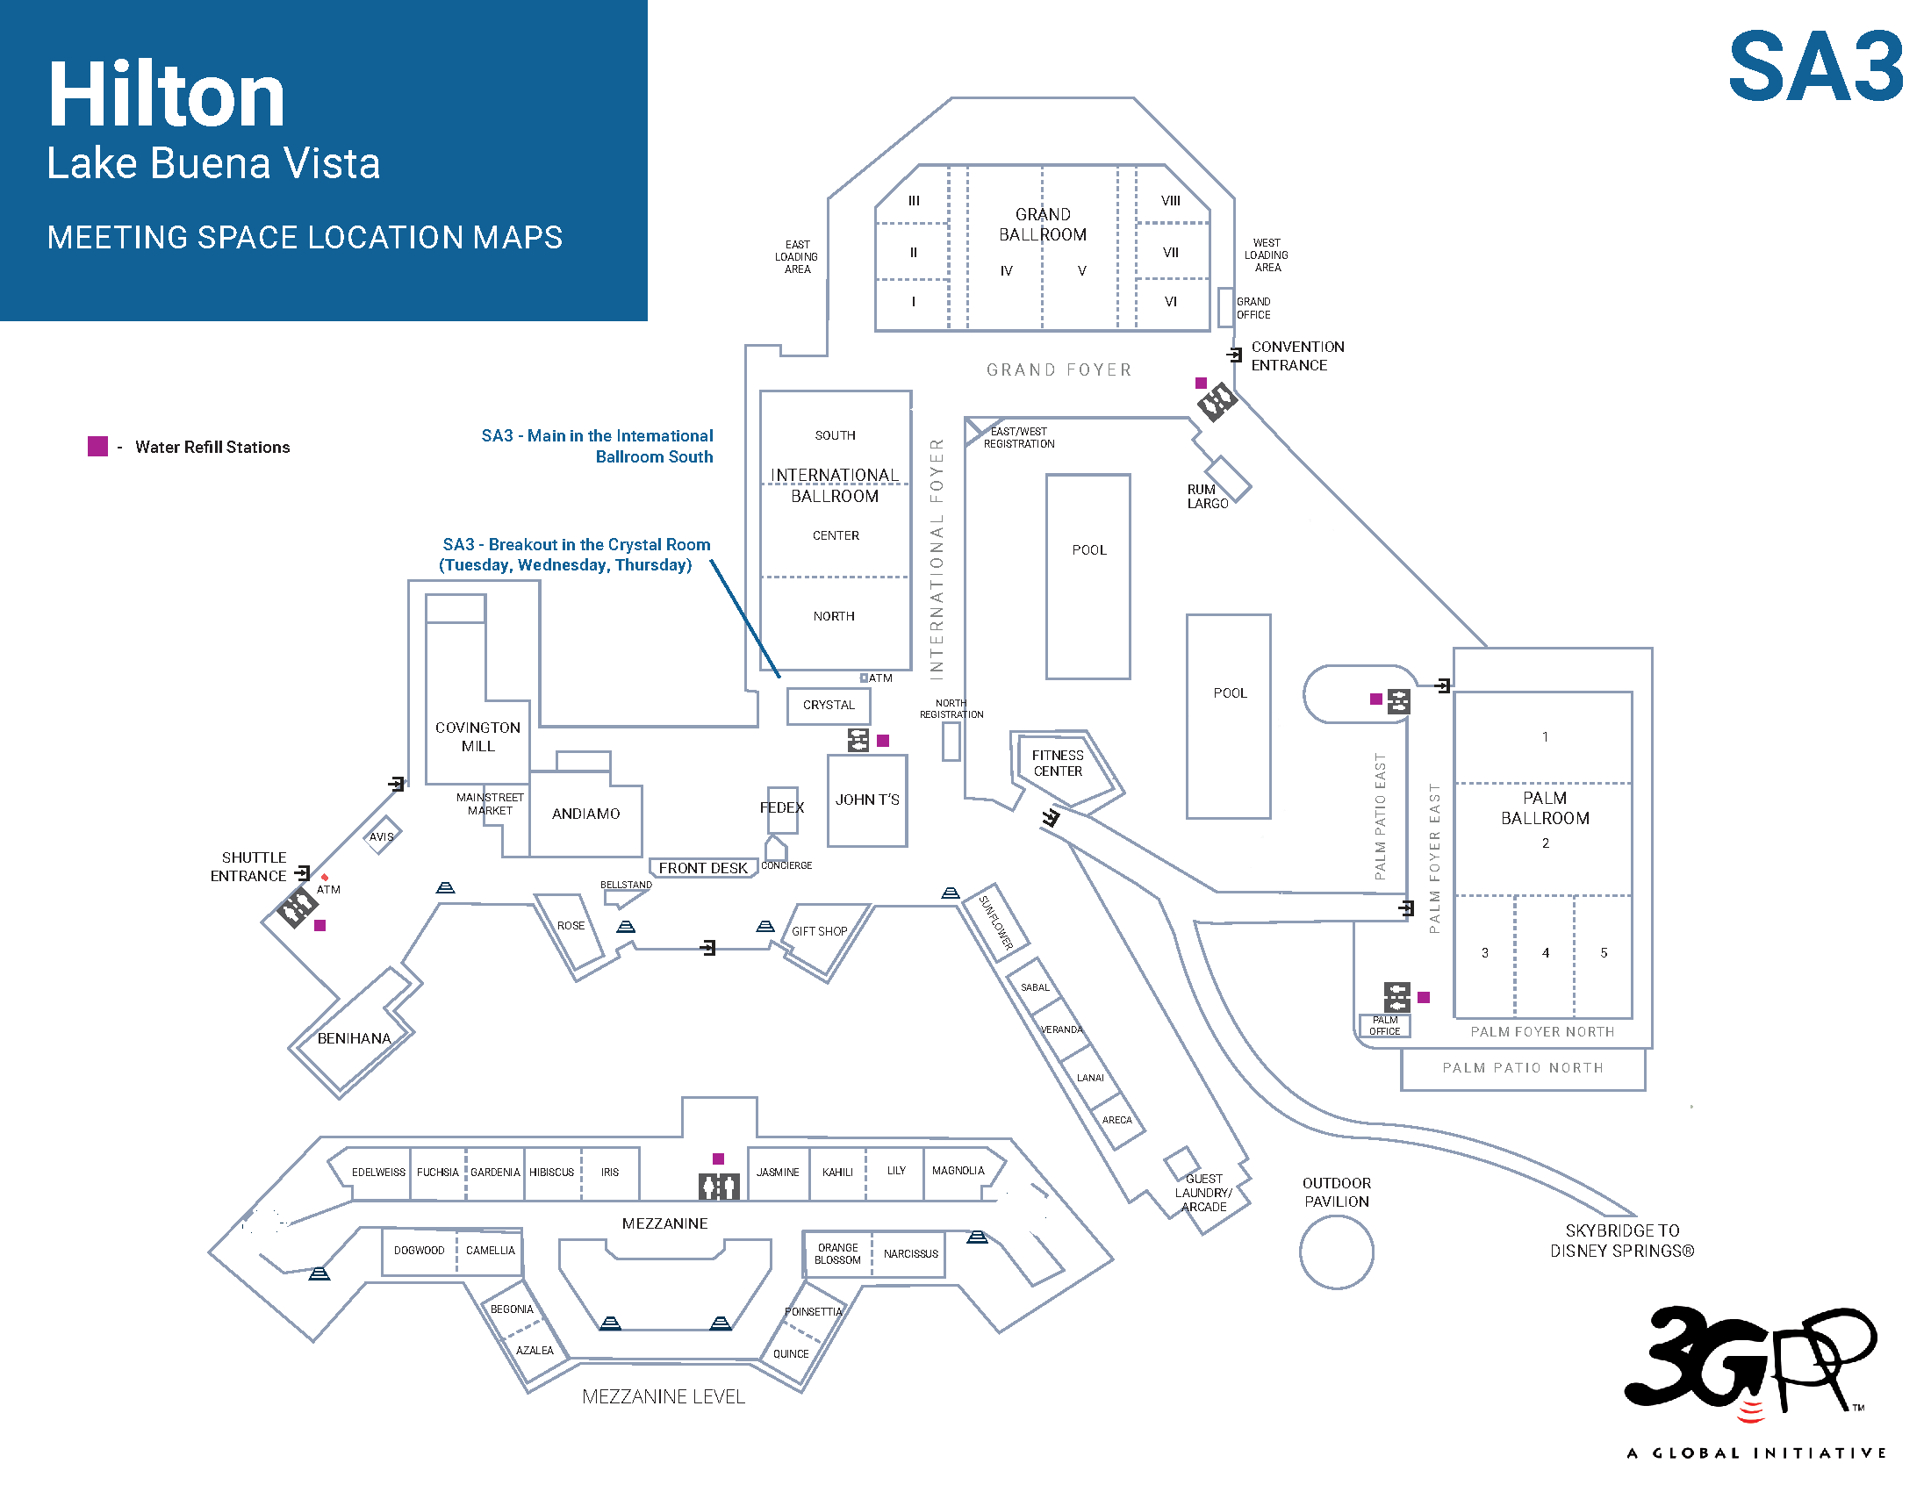
November 11-15, 2024
Notes:
Same for both hotels

Slide 11
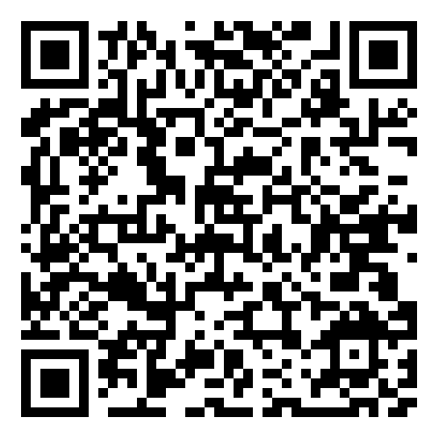
For more dining options visit Hilton’s guide:
Lunch Options
Hilton Lake Buena Vista
Covington Mill Open daily for lunch 11:30 am–2 pm
Mainstreet Market (Grab & Go) Open daily from 6 am–1 am
Rum Largo Poolside Bar & Café Open daily from 11 am – 6 pm, Weather permitting
Hilton Buena Vista Palace
Letterpress Open daily for brunch, 7 am – 2 pm
Blue Open Seasonally: 9 pm – 1 am
Citrus 28 (Grab & Go) Open daily, 6 am – 1 am
Shades Open Sunday – Thursday, 11 am – 8 pm, Friday & Saturday, 11 am – 9 pm,
Weather permitting
Disney Springs (9 min walk from Lake Buena Vista, 13 min walk from Buena Vista Palace)
Earl of Sandwich Open 9 am-11 pm
eet by Maneet Chauhan Open 11 am-11 pm
Rainforest Café Open 11 am – 11 pm
B.B. Wolf's Sausage Co. Open 12 pm – 11 pm
The Daily Poutine Open 11 am – 11 pm
The Polite Pig Open 11 am – 1 pm

Slide 12
Welcome to Orlando!
Explore Orlando by visiting these top attractions
Walt Disney World Resort: Just a stone’s throw away, immerse yourself in the magic of Disney with its four theme parks and countless entertainment options.
Universal Orlando Resort: Experience thrilling rides, shows, and attractions, including The Wizarding World of Harry Potter.
ICON Park: Enjoy the iconic Wheel for panoramic views, alongside various dining and entertainment venues.
Orlando Science Center: Engage with interactive exhibits and live science demonstrations suitable for all ages.
Lake Eola Park: Take a serene walk or swan boat ride in this picturesque downtown park, surrounded by the city skyline.
Orlando Museum of Art: Discover contemporary and ancient works in this cultural hub of creativity and history.
Kennedy Space Center: Take a day trip to explore NASA’s primary launch center, just a short drive from Orlando

Slide 13
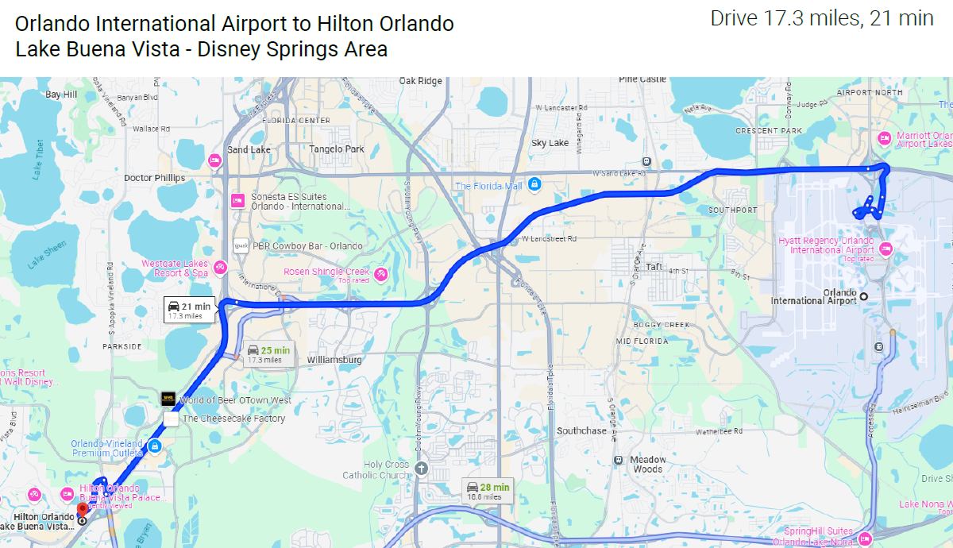
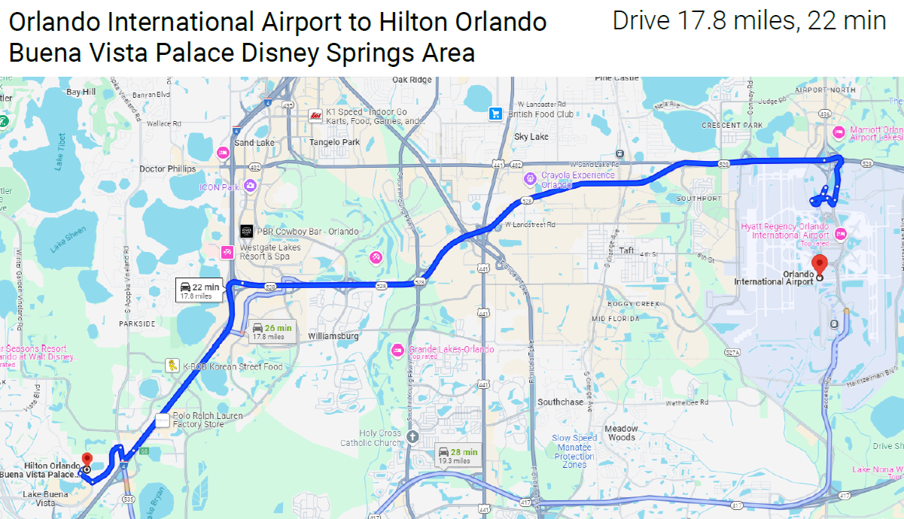
Orlando Airport to Hotels
Hilton Orlando
Lake Buena Vista:
1751 Hotel Plaza Blvd
Lake Buena Vista, FL 32830
+1(407) 827-0000
Hilton Orlando
Buena Vista Palace:
1900 E Buena Vista Dr
Lake Buena Vista, FL 32830
+1(407) 827-2727
Notes:
Supplementary slide info

Slide 14
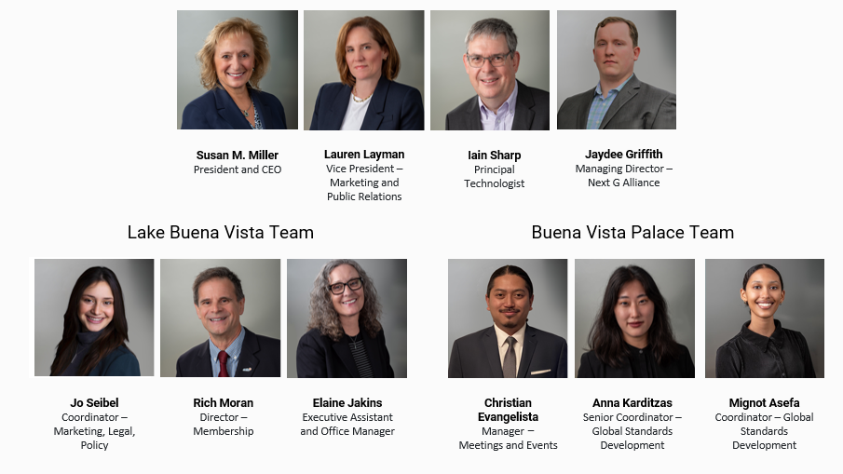
ATIS On-Site Team

Slide 15

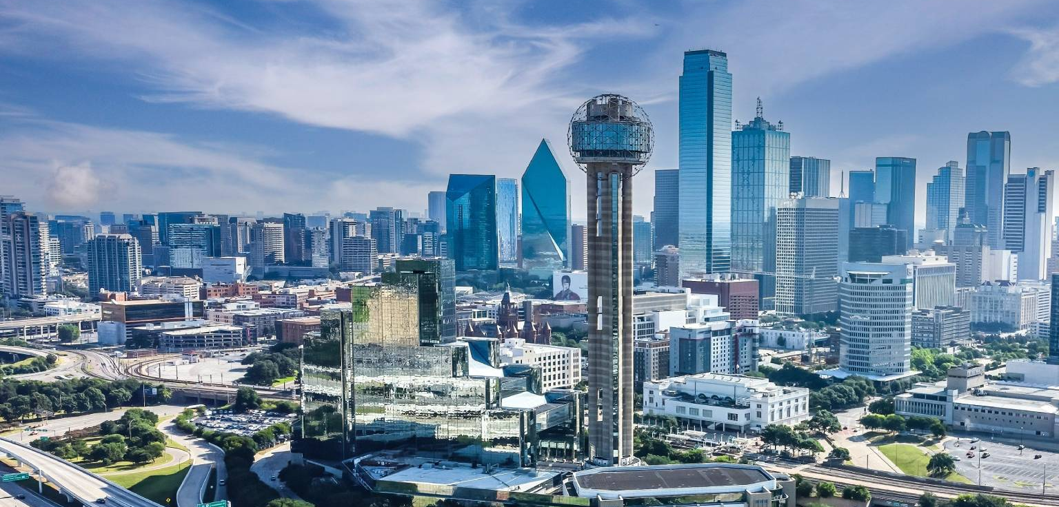
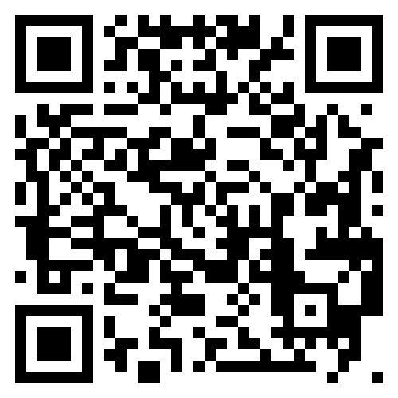
3GPP Working Group Meetings Dallas | November 17-21, 2025
Meeting Venues:
Sheraton Dallas (RAN/CT/SA Working Groups)
Visa Invitation Letter Request:
Delegates requiring visas are encouraged to apply as soon as possible. Printed copies of Dallas visas will be available on-site at ATIS Registration Desk, Lake Buena Vista.
Visit ATIS' 3GPP Dallas website: https://3gppmeetings.atis.org/dallas2025
Notes:
“if you need a visa apply now” delegates are encouraged to apply as soon as possible

Slide 16
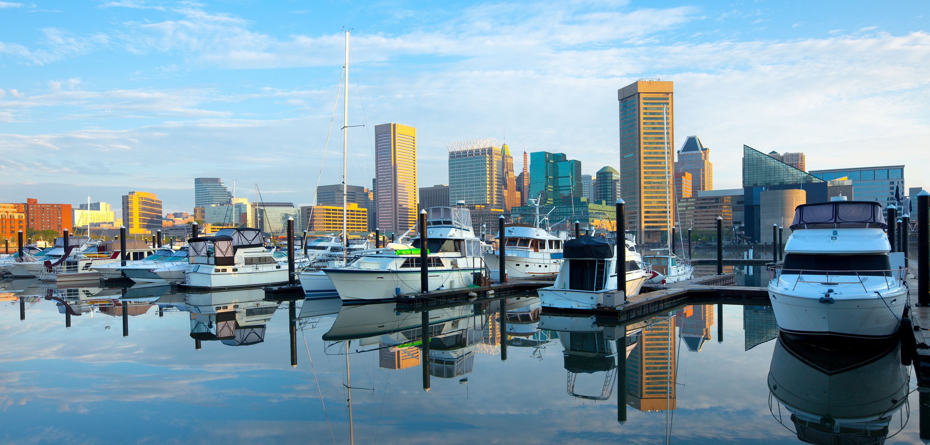
3GPP TSG Meetings Baltimore | December 8-12, 2025
Meeting Venues:
Baltimore Marriott
Visa Invitation Letter Request:
Delegates requiring visas are encouraged to apply as soon as possible. Printed copies of Baltimore visas will be available on site at ATIS registration desk, Lake Buena Vista.
Visit ATIS' 3GPP Baltimore website: https://3gppmeetings.atis.org/baltimore2025
Notes:
“if you need a visa apply now” delegates are encouraged to apply as soon as possible

Slide 17
ATIS Wishes
3GPP Delegates
A Successful Meeting
Notes:
Same for both hotels

