Slide 1
Summary of [111]

Slide 2
Scope
[AT128][111][NES] (OPPO)
Scope: Discuss and suggest max number of N and Ns values, which is configurable by NW. Also discuss if there is problem with the current PEI.
Intended outcome: Discussion summary in R2-2410930. F2F offline discussion schedule will be announced by offline discussion rapporteur.
Deadline: Comeback in Thursday CB session.

Slide 3
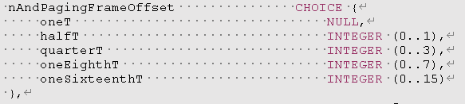
Issue-1: Discuss and suggest max number of N and Ns values, which is configurable by NW
Ns: 8? 16?
N: T/32? T/64? T/128? T/256?

Slide 4
MoM
[OPPO] can we allow value(s) for Ns=8,16 And N=T/32, T/64, T/128, T/256?
[vivo, ZTE, Xiaomi] Ns=8,16 [LG] Ns=8 [E///] slot level indication would be necessary for Ns>8 at least.
[vivo] N=at least T/32. [ZTE] N= T/32, T/64. [Xiaomi] N= T/32, T/64, T/128, T/256 [E///] even T/32 is infeasible considering legacy UE. [SS] not sure it is the only scenario.
[ZTE] and we need to introduce PMO configuration. [Xiaomi, LG] tend to not introduce new PMO configuration.
Proposal-1: Introduce value(s) for Ns=8. FFS on 16.
Proposal-2: Introduce value(s) for N= T/32. FFS on T/64, T/128, T/256

Slide 5
Issue-2: Also discuss if there is problem with the current PEI.
Issue-2A: PEI covering both legacy PO and R19-only PO @ 0433 (Huawei)
“Larger value of POnumPerPEI can reduce the average PEI overhead per PO, but there can also cause potentially larger paging latency and larger UE power consumption due to longer UE wake-up time before PO monitoring,”
P3: RAN2 to discuss whether R19 NES UEs monitor the same PEI with legacy Ues.
P4: If the same PEI is monitored by R19 NES UEs and legacy UEs, RAN2 to discuss PEI association when Ns is extended to 8:
  Option 1: One PEI monitoring occasion is associated to one PF when Ns is 8;
  Option 2: One PEI monitoring occasion is associated to at most 16 POs.

Slide 6
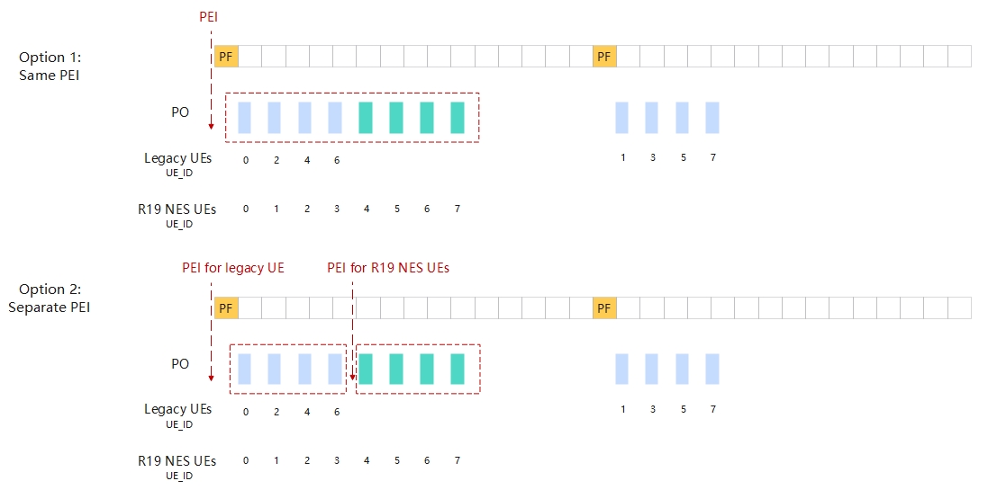
Issue-2: Also discuss if there is problem with the current PEI.

Slide 7
MoM
[OPPO] Seems the key issue is whether to allow or disallow configuration of po-numberPerPEI so that a same PEI associates with the two types of PO:s, i.e., 1) PO:s monitored by legacy UE (may or may not shared with R19 UE, up to network configuration), and 2) PO:s monitored only by R19 UE
[HW] yes that is the key point. And the Q is whether we allow separate PEI-O configuration for legacy and R19 Ues. [Apple] can be left to network configuration to solve this issue by setting po-numberPerPEI properly, no strong view. [Xiaomi] up to network configuration [LG] sympathy with HW proposal, and separate PEI is better. [HW] separate PEI = separate PEI-O configuration.

Slide 8
MoM
Proposal-3: R2 further discuss whether 1) A single PEI-O configuration, and relying on NW implementation to have to separate PEI for the two types of Pos, and 2) separate PEI-O configuration, and thus automatically separate PEIs for the two types of POs. where the two types of Pos are 1) PO:s monitored by legacy UE (may or may not shared with R19 UE, up to network configuration), and 2) PO:s monitored only by R19 UE

Slide 9
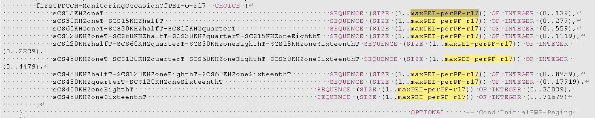
Issue-2: Also discuss if there is problem with the current PEI.
Issue-2B: PEI-O location configuration @ 9942 (Apple)
O9: The legacy PEI framework can’t work when Ns is in increased to 8 or 16. For example, when po-NumPerPEI = 1 and Ns=8, only the first 4 POs (i.e. i_s =0/1/2/3) can be associated with PEI and the last 4 POs (i.e. i_s =4/5/6/7) can’t be associated with any PEI.
P8: RAN2 study how to support PEI when Ns value is increased to 8 and 16.
 | po-NumPerPEI=1 | po-NumPerPEI=2 | po-NumPerPEI=4
maxPEI-perPF=1 | Ns=1 | Ns=2 | Ns=4
maxPEI-perPF=2 | Ns=2 | Ns=4 | Ns=8
maxPEI-perPF=4 | Ns=4 | Ns=8 | Ns=16

Slide 10
MoM
[OPPO] seems the key issue is whether we
1) Simply leave it to network implementation to set po-NumPerPEI and maxPEI-perPF properly, in order to be compatible with Ns=8/16 w/o further spec effort, OR
2) RAN2 further look into the issue when the setting of po-NumPerPEI and maxPEI-perPF are incompatible with Ns=8/16.
Proposal-4: leave it to network implementation to set po-NumPerPEI and maxPEI-perPF properly, in order to be compatible with Ns=8 w/o further spec effort

Slide 11
WF
Proposal-1: Introduce value(s) for Ns=8. FFS on 16.
Proposal-2: Introduce value(s) for N= T/32. FFS on T/64, T/128, T/256
Proposal-3: R2 further discuss to whether 1) based on a single PEI-O configuration, and rely on network implementation to have separate PEI:s for the two types of PO:s, or 2) based on separate PEI-O configurations, and thus automatically separate PEIs for the two types of PO:s. Where the two types of Pos are 1) PO:s monitored by legacy UE (may or may not shared with R19 UE, up to network configuration), and 2) PO:s monitored only by R19 UE
Proposal-4: R2 assume to leave it to network implementation to set po-NumPerPEI and maxPEI-perPF properly, in order to be compatible with Ns=8 w/o further spec effort

