Slide 1
Summary of [111]

Slide 2
Scope
[AT128][111][NES] (OPPO)
Scope: Discuss and suggest max number of N and Ns values, which is configurable by NW. Also discuss if there is problem with the current PEI.
Intended outcome: Discussion summary in R2-2410930. F2F offline discussion schedule will be announced by offline discussion rapporteur.
Deadline: Comeback in Thursday CB session.

Slide 3
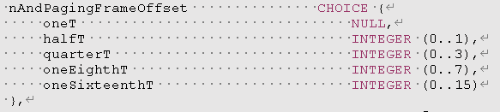
Issue-1: Discuss and suggest max number of N and Ns values, which is configurable by NW
Ns: 8? 16?
N: T/32? T/64? T/128? T/256?

Slide 4
MoM
[OPPO] can we allow value(s) for Ns=8,16 And N= T/32, T/64, T/128, T/256?

Slide 5
Issue-2: Also discuss if there is problem with the current PEI.
Issue-2A: PEI covering both legacy PO and R19-only PO @ 0433 (Huawei)
“Larger value of POnumPerPEI can reduce the average PEI overhead per PO, but there can also cause potentially larger paging latency and larger UE power consumption due to longer UE wake-up time before PO monitoring,”
P3: RAN2 to discuss whether R19 NES UEs monitor the same PEI with legacy Ues.
P4: If the same PEI is monitored by R19 NES UEs and legacy UEs, RAN2 to discuss PEI association when Ns is extended to 8:
  Option 1: One PEI monitoring occasion is associated to one PF when Ns is 8;
  Option 2: One PEI monitoring occasion is associated to at most 16 POs.

Slide 6
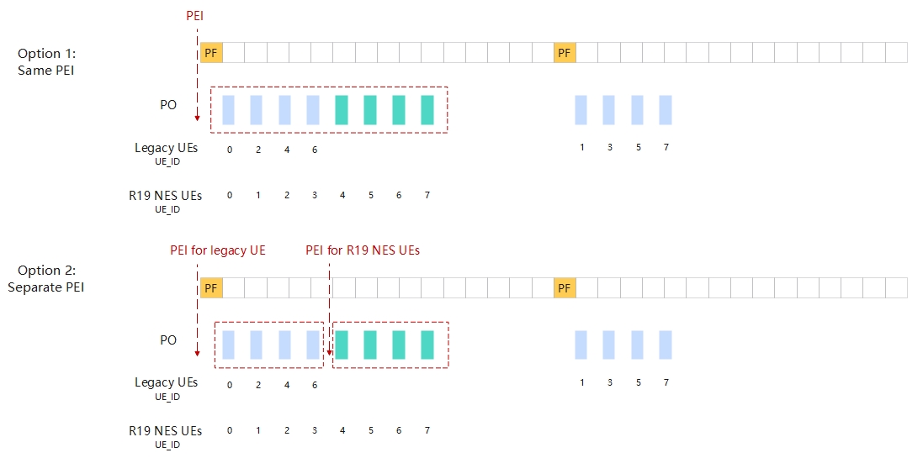
Issue-2: Also discuss if there is problem with the current PEI.

Slide 7
MoM
[OPPO] Seems the key issue is whether to allow or disallow configuration of po-numberPerPEI so that a same PEI associates with the two types of PO:s, i.e., 1) PO:s monitored by legacy UE (may or may not shared with R19 UE, up to network configuration), and 2) PO:s monitored only by R19 UE

Slide 8
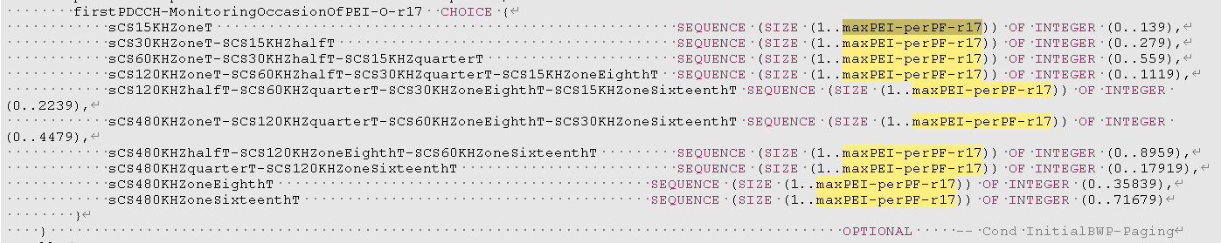
Issue-2: Also discuss if there is problem with the current PEI.
Issue-2B: PEI-O location configuration @ 9942 (Apple)
O9: The legacy PEI framework can’t work when Ns is in increased to 8 or 16. For example, when po-NumPerPEI = 1 and Ns=8, only the first 4 POs (i.e. i_s =0/1/2/3) can be associated with PEI and the last 4 POs (i.e. i_s =4/5/6/7) can’t be associated with any PEI.
P8: RAN2 study how to support PEI when Ns value is increased to 8 and 16.
 | po-NumPerPEI=1 | po-NumPerPEI=2 | po-NumPerPEI=4
maxPEI-perPF=1 | Ns=1 | Ns=2 | Ns=4
maxPEI-perPF=2 | Ns=2 | Ns=4 | Ns=8
maxPEI-perPF=4 | Ns=4 | Ns=8 | Ns=16

Slide 9
MoM
[OPPO] seems the key issue is whether we
1) Simply leave it to network configuration to set po-NumPerPEI and maxPEI-perPF properly, in order to be compatible with Ns=8/16 w/o further spec effort, OR
2) RAN2 further look into the issue when the setting of po-NumPerPEI and maxPEI-perPF are incompatible with Ns=8/16.

