Slide 1
NF Profile
Huawei

Slide 2
Considerations on NF selection
Responsibilities in selection process
  OAM responsible for NF switch-on/switch-off
  CN responsible for NF selection (only amongst NFs that are switched-on and registered in NRF)
  CN responsible for usage of optional features of NF (e.g. UPF information exposure for analytics)
Essential new parameters for NF selection
  Scheduled switch-off time/always on indication: under control of OAM and mandatory (to ensure that SSC mode 1 PDU Session can be served)
  Current optional feature support level (i.e. all optional features, some optional features, no optional features): could be under OAM or CN control, optional
Optimization related information for NF selection
  Energy efficiency: in general an NF with higher energy efficiency is preferred
  Renewable energy: an NF using renewable energy could however be better
  Costs of energy (not part of Rel19): the price of the renewable energy/energy mix could matter too
  Energy consumption: in the end, the NF with higher energy consumption may be selected
  There are quite many dependencies and criteria possible (which may also vary over time and will often depend on the local deployment)
  Consequently, optimization related parameters should be avoided/minimized due to the introduced complexity

Slide 3
Considerations on NF selection
OAM
EIF
Scheduled switch-off
time
Optional feature support level
Energ efficiency
Renew-able energy
Energy
consum-ption
Carbon emission
Costs of energy
...
Mandatory for the selection
Additional and optional for the selection
NF selection logic

Slide 4
New parameters: Energy Priority
Background
  The definition of several parameters requires a lot of discussion (e.g. how are they provisioned, how are they possibly used, how do they relate to each other etc.)
  Question: How to avoid adding several parameters related to energy (while still supporting dynamic changes) in NF profile?
Resolution
  Define of a new single parameter Energy Priority Information for the NF Profile;
  Energy Priority Information is set according to operator policy about which energy criteria to consider for NF discovery/(re-)selection and how to combine them;
  Avoids any complicated logic at NF consumer;
Usage:
  If more than one NF matches the criteria, the NF consumer can select the NF whose Energy Priority Information has a higher priority;
  The definition of the priority is left to operator policy, e.g. :
    Example #1: The NFs with renewable power supply have higher Energy Priority, or the NF with higher renewable ratio can be assigned higher priority
    Example #2: The NFs (UPF) with higher Energy Efficiency have higher Energy Priority;
    Example #3: any combination of above and other existing parameters.
Renewable power supply of the NF
Renewable energy ratio
Energy Efficiency of the slice
OAM(NF)/EIF
Configure
Energy Priority Information
NF Profile
NRF

Slide 5
On the Energy Efficiency
Background
  Energy Efficiency is the candidate parameters that to be checked.
Our views
  Energy efficiency is not a single values, but it changes depending by the load;
  Due to the possible Static power consumption for the different NF nodes, at different load the NF may appear “different energy efficiency” Therefore, the selection seems to be done at same “load conditions”
    i.e., less efficiency NF in the long run can seems more efficient,
  Therefore, there is no obvious benefits to consider energy efficiency in this release.
    Details please see the Annex.

Slide 6
Annex

Slide 7

Energy Efficiency considerations (I)
Name
  Energy Efficiency
  Definition
There is no SA5 related definition of per-NF level Energy Efficiency (see TS 28.310, only slice/RAN-level EE)
Indicating ratio of NF service KPI (e.g. forwarded data volume of UPF, etc.) over Energy consumption by the NF over time window.
The indication refers to a relative value, e.g., three levels of Low, Medium, High to avoid frequent update of this information element. The granularity of such indication and how to calculate is to be defined by SA WG5.
Considerations
The energy efficiency is not a single values, but it changes depending by the load
Consideration #1.7:In case of linear increases of EC vs load with a minimum EC at load zero (EC=a*Load+k), the Energy Efficency defined as ratio between a performance parameter directly proportional of load (P=c*Load) and the EC change with the load , i.e. it is not a constant value with the Load.
$$EE=\frac{Performance}{EC}=\frac{c∗Load}{a∗Load+k}$$
EnC vs Load
EE vs Load
Since EE is defined as the ratio between Performance and Energy consumption, and the Energy consumption is function of the performance, the two parameters are the 2 faces of the same coin.

Slide 8
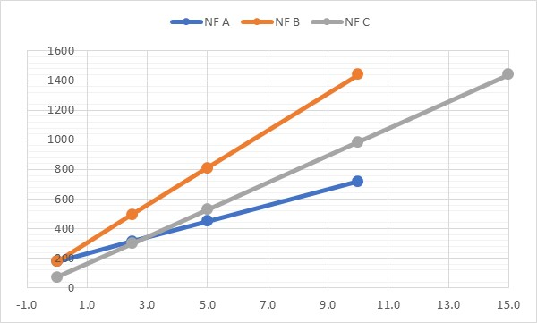
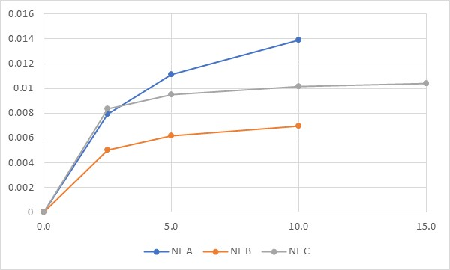
Energy Efficiency considerations (II)
NF A:
  EnC static: 50 Wh = 180 kJ
  EnC Max= 200 Wh = 720 kj
  KPI → Data Volume → Max DV = 10 Gb
NF B:
  EnC static: 50 Wh = 180 kJ
  EnC Max= 400 Wh = 1440 kj
  KPI → Data Volume → Max DV = 10 Gb
NF C
  EnC static: 20 Wh = 72 kJ
  EnC Max= 400 Wh = 1440 kj
  KPI → Data Volume → Max DV = 15 Gb
NF C is
preferable
NF A is
preferable
Due to the possible Static EnC for different node, at different load the less efficiency NF can seems more efficient, The selection needs to be done at same “load conditions”

Slide 9
Energy Efficiency considerations (III)
Case A at T0 which is the best NF assuming different load condition
Current status for NF A, B & C based on different load
A) Which is the most efficient to be selected? NF C
B) But if the NF A would have been selected considering an extra load of 5 GB due to the selection ? NF A would be preferable

Slide 10
Energy Efficiency considerations (IV)
Due to the possible Static EnC for different node, at different load the less efficiency NF can seems more efficient, The selection needs to be done at same “load conditions”

Slide 11
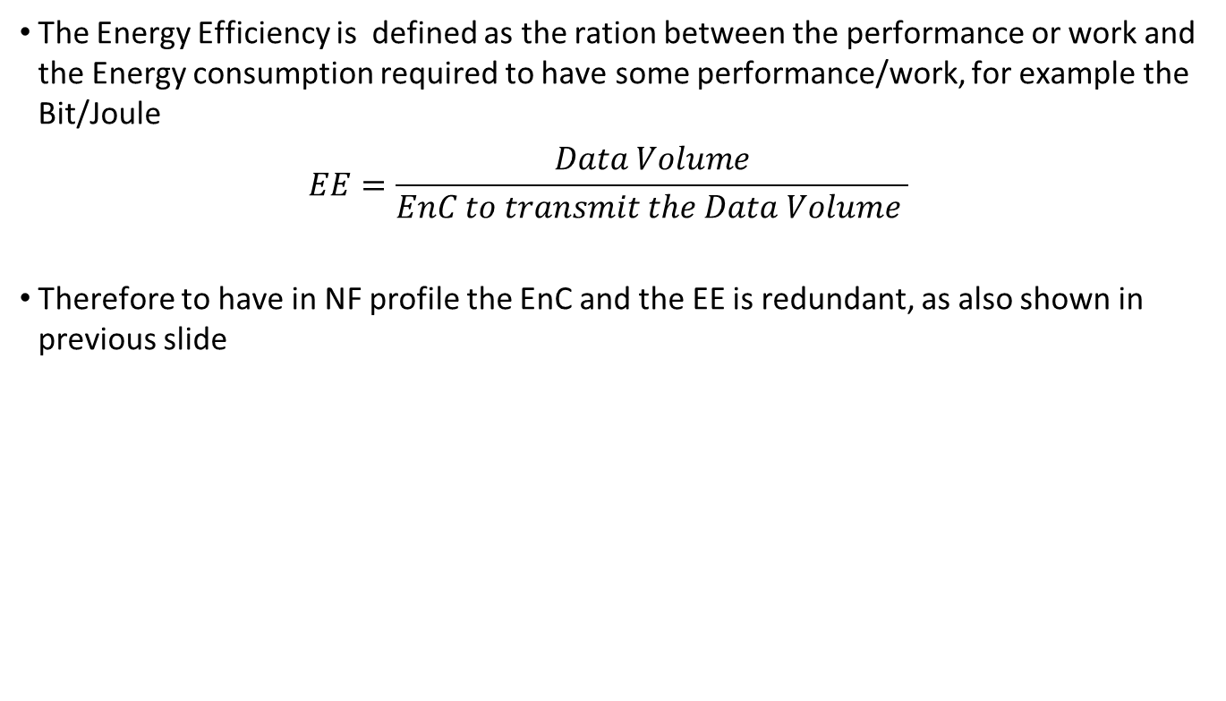
Energy Efficiency & Energy consumption
The Energy Efficiency is defined as the ration between the performance or work and the Energy consumption required to have some performance/work, for example the Bit/Joule
$$EE=\frac{Data Volume}{EnC to transmit the Data Volume }$$
Therefore to have in NF profile the EnC and the EE is redundant, as also shown in previous slide

