Slide 1
Huawei view on SA5 Rel-20 5G-Advanced Priorities
Source: Huawei

Slide 2
General consideration for 5GA standardization in SA5
SA5 shall clearly differentiate the time plan for SA5 management prime features and SA5 support to network features.
SA5 management prime features should start as early as possible to best utilize the early time in Rel-20.
SA5 support to network features should wait for the readiness of corresponding network features, and most likely taking more later time in Rel-20.
SA5 shall provide corresponding Management, Orchestration and Charging solutions to support 5GA new network features in the same release, a checkpoint analysis should be done in Rel-20 to identify what to be managed in September 2025.
In addition to SA1 requirements, SA5 should also take into account of operators’ requirements in other related working groups (e.g. NGMN, GSMA and TM Forum etc.) as inputs for SA5 prime features which potentially to be done in the time frame of Rel-20.
Like to get more views from SA5 operators on which groups should provide inputs to SA5, and how to capture such requirements in SA5.
SA5 should influence the industry to reuse 3GPP Management services in the end to end process and avoid standard fragmentation in the context of 3GPP network and service management.

Slide 3
Huawei opinion on TU allocation portion of 5GA part/6G part in Rel-20
Support to use TU to control/monitor the meeting time in Rel-20
TU allocation portion of 5GA part/6G part in Rel-20
Huawei prefers top down approach (i.e. decide budget allocation first, then plan the Rel-20 feature list accordingly).
Huawei opinion on TU allocation:
2/3 of total TU for 5GA SA5 management features, and 1/3 of total TU for 6G SA5 management features.
For 5GA SA5 management features
SA5 support of network features shall provide complete Management, Orchestration and Charging solution to enable multiple vendors interoperability in the same release
5GA Management and orchestration features shall not dramatically change the existing SBMA architecture

Slide 4
Candidate Management Support to R20 RAN/CN Network Features
RAN Rel-20 5G-A candidate topics(RP-243292)
SA2 Rel-20 5G-A candidate topics (SP-241989)
R20 RAN features | OAM support | CH support
AI/ML Air Inteface | Yes, CM/PM | NA
MIMO Evolution | TBD | NA
Ambient IoT | Yes, CM/PM | NA
AI/ML mobility | Yes, CM/PM | NA
IoT NTN | Yes, CM/PM | NA
AI/ML for NG-RAN | Yes, CM/PM | NA
Coverage enh.(incl.FR2) | TBD | NA
NES | TBD | NA
Mobility Enh | TBD | NA
XR | Yes, CM/PM | NA
UAV/UAM Enh. | TBD | NA
NR NTN | Yes, CM/PM | NA
Sensing/ISAC | Yes, CM/PM | NA
SON/MDT | Yes, CM/PM | NA
R20 5GC features | OAM support | CH support
Integration of satellite components in the 5G architecture Phase 4 | Yes, CM/PM | Yes
AI/ML Enhancements | Yes, CM/PM | TBD
Ambient IoT | Yes, CM/PM | Yes
Integrated Sensing and Communication | Yes, CM/PM | Yes
Energy Efficiency Enhancement | Yes, CM/PM | Yes
XR and Media Service | Yes, CM/PM | Yes
Indirect Network Sharing Phase 2 | Yes, CM/PM | Yes
User Identities and Authentication Architecture –Phase2 | TBD | Yes
Enhancement for ePDG based access to 5GC | TBD | Yes
Mission Critical Service, Multimedia Priority Service | TBD | TBD
Industrial network enhancement | TBD | TBD
SMS to emergency center | TBD | TBD
NG_RTC continuation | TBD | Yes
Note:
“Yes” means orchestration, management and charging standardization support is needed

Slide 5
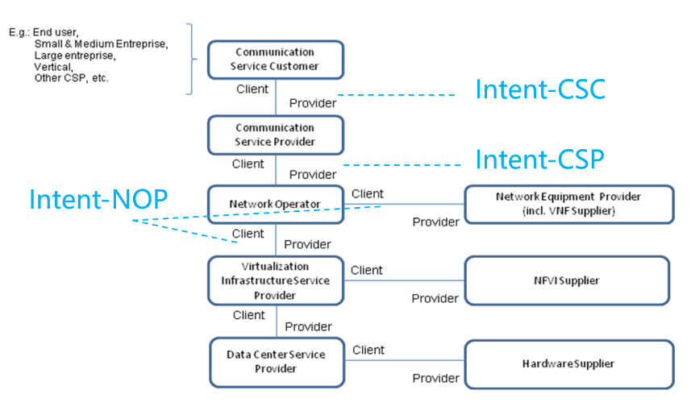
Intent driven management for 5G Advanced Networks (OAM prime feature)
Potential scope for Rel-20 work
Scenario specific intent to support several scenarios
Intent from Communication Service Customer (Intent-CSC) scenarios.
Radio network performance assurance scenarios enhancement (e.g., assurance for specific UE types (e.g., Redcap UE), mobility and packet delay related performance assurance).
Radio service pre-evaluation and assurance scenarios enhancement (periodically exploring maximum values for UENumberTarget different areas, radio service assurance for different service characteristics.)
Intent driven management capabilities
Intent handling capability registration and discovery to support multiple intent handling functions deployment scenarios.
Enhancement of intent negotiation capabilities (Rel-19 continuous).
Potential impacts to support natural language intents translation(Rel-19 continuous).
Enablers for intent fulfilment.

Slide 6
Trouble shooting for 5G Advanced Networks (OAM prime feature)
Potential scope for Rel-20 work
Motivation: the process of issue identification and process of issue diagnostic analysis and recovery can be performed by different MnFs, the standardized interactions between MnFs performing these processes need to be introduced to support automation for issue handling.
Trouble shooting scenarios:
- Network performance issues diagnostic analysis and recovery
- Alarm/Fault diagnostic analysis and recovery
Potential MnS capabilities for trouble shooting:
- Issue diagnostic analysis and recovery capability discovery (e.g., the issue types are supported to be analyzed or recovered)
- Issue diagnostic analysis and recovery request
- Progress or status monitor for the Issue diagnostic analysis and recovery
- Issue diagnostic analysis and recovery result report
Cross Domain MnFs
Issue identification (e.g. MDAF, Manual)
Issue diagnostic analysis and recovery capability discovery
Issue diagnostic analysis and recovery request
Issue diagnostic analysis and recovery result report
Issue diagnostic analysis
Issue recovery
Domain MnFs
Note: relevant to MDA, CCL

Slide 7
NDT for 5G Advanced Networks (OAM prime feature)
Potential scope for Rel-20 work
NDT supporting new scenarios:
SA1 R19 TR 22.840 introduced plenty of use cases on Ambient IoT. To support AIOT services (e.g., inventory, command, etc.) which rely on the capability of readers, NDT can simulate the radio network performance with AIOT serivce features and BS reader capability.
SA1 R19 TS 22.125 introduced UAV usages on flight path management and UTM assistance to support UAV pre-flight preparation. The requirements are shown as follows:
NDT can simulate the network performance with UAV service features on grid granularity to support the flight path optimization.
MnS capability enhancement
Network capacity/performance simulation on grid granularity to support specific network services (e.g., AIOT service, UAV flight)
Planned flight path
Optimizing..
Optimized flight path
Network optimization iteration
Grid map supporting UAV flight path optimization

Slide 8
SBMA enhancement for 5G Advanced Networks (OAM prime feature)
Potential scope for Rel-20 work
Management model for Management Function, including decouple of management model and network resource model.
Enhancement of guidelines for model driven approach for SBMA
Streaming of management data based on message bus
Software management capability, including automated software management and non-automated software management
Inventory Management, specially for inventory network resource model
Enhancement of alarm/fault management, including retrieving historical alarms (i.e. stored inactive alarms)

Slide 9
Ambient IOT management for 5G Advanced Networks (network support feature)
Potential scope for Rel-19 work
Background: R19 progress in other working groups
To support AIOT feature in R19:
RAN approved R19 AIOT WID (RP-243326)
SA2 endorsed R19 AIOT WID (SP-241979)
Configuration management for AIOT RAN
Configuration management for AIOTF
Configuration management for interfaces between AIOT RAN and AIOTF, AIOTF and other related core network NFs (e.g., AMF, NEF)
Potential scope for Rel-20 work
Background: AIOT is in high priority among both RAN and SA2 R20 5GA topics
To support AIOT feature in R20:
Configuration management enhancement to support AIOT feature
Performance management for AIOT services, including new measurement and KPIs for AIOTF and AIOT RAN
AIOT device fault management
Trace enhancement to support AIoT service
RAN endorsed AIOT as one of the 5GA topics in R20 (RP-243292)
SA2 endorsed AIOT as one of the core 5GA topics in R20 (SP-241989)

Slide 10
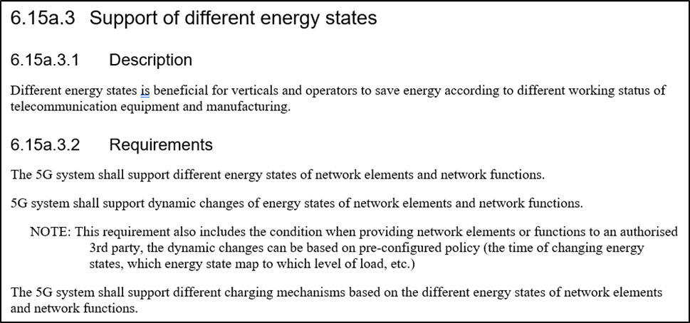
Energy Efficiency for 5G Advanced Networks
Energy states
(OAM support to network features)
AI/ML management enriched by ES
(OAM prime feature)
Study potential solution(s) to support SA1 requirement wrt. ‘Energy states’, in conjunction with SA2.
Study whether and how AI/ML management can be enriched during the different phases of AI life cycle (training, inference, etc.) with:
Energy related information such as Carbon Emission, Carbon Emission Efficiency, Renewable Energy Factor, etc.
EnergySavingState
From 3GPP TR 22.883 (Study on Energy Efficiency as service criteria Phase 2 (Rel-20))

Slide 11
AI/ML management for 5G Advanced Networks
Potential scope for Rel-20 work
(OAM prime feature)
(OAM support network feature)
Enhancement of AI/ML management capability for the relevant AI/ML lifecycle operational steps, including
AI/ML training/inference management policies for different scenarios (e.g. NG-RAN intelligent scenarios)
Enhance the AI/ML performance monitoring includes observing the performance of the ML model during the ML model application for different scenarios (e.g. AI specific performance evaluation for NG-RAN intelligent scenarios) .
AI/ML for Rel-20 MDA scenarios.
Enhancement of management scenarios to support AI/ML based NG-RAN and 5GC including:
NG-RAN AIML-based function defined by RAN3 (e.g. R19 leftover AI/ML based network slice optimization use case)
AI/ML on Air interface of OAM related defined by RAN1/2 (e.g. UE side training data collection for one-side model, or dataset transfer for two-side model)
AI/ML enhancement defined by SA2

Slide 12
Huawei opinion on potential SA5 Rel-20 5G-Advanced Network
NO. | Title | OAM Prime or Network support | 5GC dependencies | RAN dependencies | Other SDO dependencies
1. | Intent driven management for 5G Advanced Networks | OAM Prime feature | No | No | TM Forum, ETSI ZSM, GSMA OPG
2. | Trouble shooting for 5G Advanced Networks | OAM Prime feature | No | No | No
3. | NDT for 5G Advanced Networks | OAM Prime feature | No | No | ETSI ZSM
4. | SBMA enhancement for 5G Advanced Networks | OAM Prime feature | No | No | No
5. | Ambient IOT management for 5G Advanced Networks | network support feature | Yes | Yes | No
6. | Energy Efficiency for 5G Advanced Networks | OAM Prime feature and network support feature | Yes | No | ETSI EE，ITU-T SG5
7. | AI/ML management for 5G Advanced Networks | OAM Prime feature and network support feature | Yes | Yes | No

Slide 13
Thank You !

