Slide 1
China Unicom view on SA5 Rel-20
5G-Advanced Priorities
Source: China Unicom

Slide 2

TU allocation portion
Since 6G requirements have not been clearly defined, China Unicom’s opinion on TU allocation portion of 5GA part/6G part in Rel-20:
  2/3 TU for 5GA
  1/3 TU for 6G

Slide 3
Overall View on Rel-20 Topics
No. | Use cases | Brief Descriptions | Related Specs /WIs
1 | Management of AIoT | New management architecture and functions of A-loT Enhancements on management aspects of A-loT Business level requirements for OAM&P of A-loT | TS 28.541/TS 28.552 /TS28.554/New TS
2 | Management of Network Sharing Phase 4 | Enhance IOCs to support plmn-granularity measurements Potential enhancements to support management of shared satellite NG-RAN Potential enhancements to support management of INS utilizing in disaster scenarios | TS 22.261/TS 23.501
3 | Management of ISAC | Enhancements to support management of Sensing function Enhancements to support management of Sensing data Enhancing management mechanism with Sensing | TS 22.261/TS 23.501
4 | Knowledge-assisted management | 1. Knowledge representation 2. Knowledge-assisted closed loop & intent management 3. Explainable AI/ML
5 | Trace-based User-level measurement | Investigation on trace as new data source in NG RAN Introduction on trace-based UE level measurements Enhancements on existing UE-level measurements | TS 28.558/TS 28.550
6 | NTN managements | Further enhancement on existing UCs Management support for service continuity and different services with multi-orbit satellites Management support for Broadcast services with satellite access

Slide 4
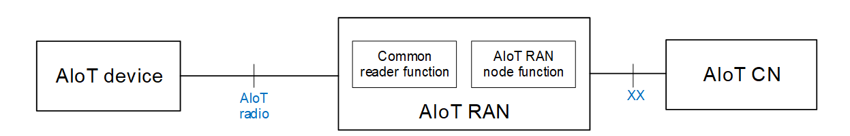
Use Case 1: Management of Ambient IoT
Background：
Ambient IoT (A-IoT) aims to provide complexity and power consumption significantly lower than the existing 3GPP IoT technologies (e.g. NB-IoT and eMTC) for supporting higher local device density in the order of magnitude.
RAN WGs has investigated RAN level solutions for Ambient loT in TR 38.769 and new WID on Rel-19 Ambient loT was approved in RP- 243326.
SA1 has finished some standardization of Ambient IoT in TR 22.840 and TS 22.369.
SA2 has studied to investigate solutions for architectures to support Ambient IoT in TR 23.700-13.
Potential Objectives:
New management architecture and functions for A-IoT
  AloT RAN：Network element management functions of common reader function and AIoT RAN node function for topology 1.
  AloT CN：Network element management function of AIoTF.
Business level requirements for OAM&P of A-IoT
  Management support for A-IoT consumers, including interface configuration, relevant data collection.
  Management capabilities exposure to A-IoT consumers: upper Layer functions (e.g. Inventory, Command).
  Management of Topology and Workflows for Common Reader Function and A-IoT RAN Node Function.
New management architecture and functions for A-IoT
  Influences on associated existing information entities.
  Potential enhancements on the management of AMF and UDM.
  Measurement or KPI requirements related to A-IoT.

Slide 5
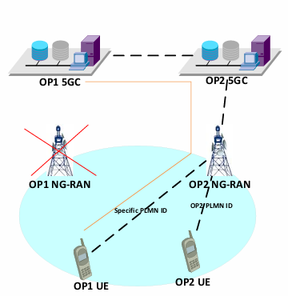
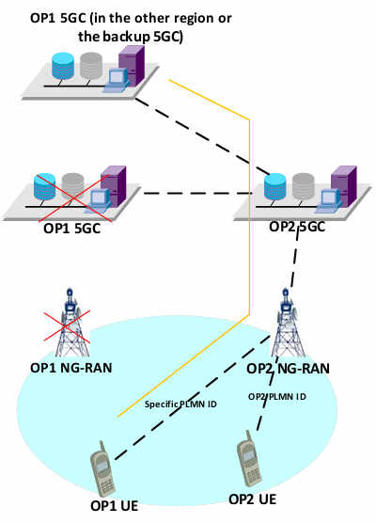
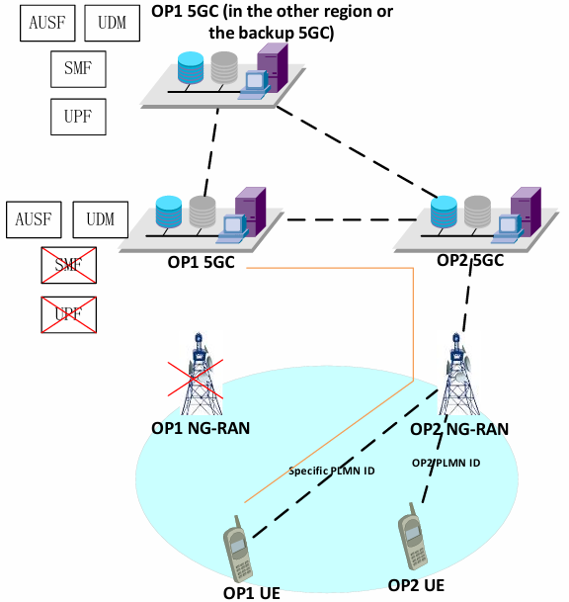
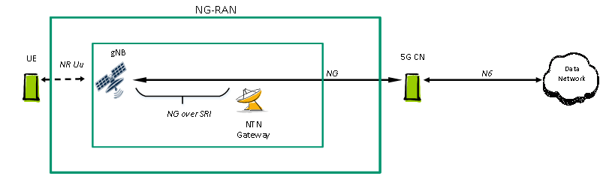
Use Case 2: Management of Network Sharing Ph4
Potential enhancements to support management of identifying INS case
Investigate potential management enhancements to configure AMF/UDM/SMF/PCF to identify whether it is the Indirect Network Sharing case or other home routing cases.
Potential enhancements to support management of INS utilizing in disaster scenarios
Management architecture enhancements to support sending disaster notice to POP by OAM.
Potential configuration enhancements in the scenarios NG-RAN , NFs of 5GC or the whole 5GC with the disaster condition. Possible disaster scenarios are depicted as follows:
Only NG-RAN is broken
NG-RAN and part of NFs are broken
NG-RAN and 5GC are broken
Potential enhancements to support management of shared satellite NG-RAN
Investigate potential network sharing management architecture enhancements
Investigate potential management enhancements to enable plmn-granularity configurations for different deployment scenarios of satellites
Investigate potential CN configuration enhancements to support using INS to share NG-RAN
3GPP Management System

Slide 6
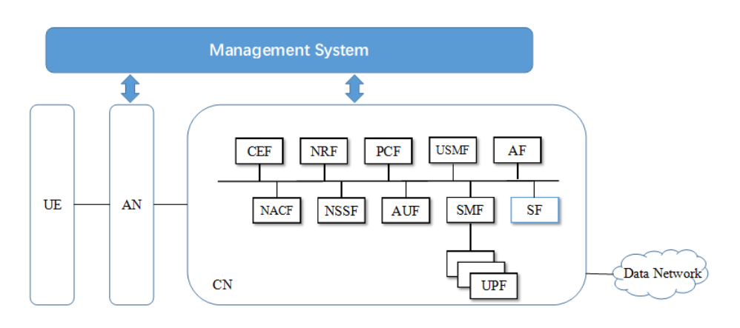
Use Case 3: Management of ISAC
Enhancements to support management of Integrated Sensing and Communication
Investigate potential management architecture
Investigate potential IOCs、measurements、KPIs related to ISAC
Investigate potential configurations and policy mangement for ISAC
Categories | KPI | Descriptions
Estimation | Accuracy of Positioning Estimate | Describes the closeness of the measured sensing result (i.e., position) of the target object to its true position value.
 | Accuracy of Velocity Estimate | Describes the closeness of the measured sensing result (i.e., velocity) of the target object to its true velocity.
Sensing | Confidence Level | Describes the percentage of all possible measured sensing results that can be expected to include the true sensing result considering the accuracy
 | Sensing Resolution | Describes the minimum difference in the measured magnitude of target objects (e.g., range, velocity) that allows detecting objects of different magnitudes.
Detection | Missed Detection Probability | Describes the conditional probability of not detecting the presence of a target object/environment when the target object/environment is present.
 | False Alarm Probability | Describes the conditional probability of falsely detecting the presence of a target object/environment when the target object/environment is not present.
Common | Max Sensing Service Latency | Time elapsed between the event triggering the determination of the sensing result and the availability of the sensing result at the sensing system interface.
 | Refreshing Rate | Rate at which the sensing result is generated by the sensing system. It is the inverse of the time elapsed between two successive sensing results

Slide 7

Use Case 4: Knowledge-assisted Management
Existing automated optimization(human involved any time especially in decision)
Enhanced automated optimization(Knowledge management function involved instead of human)
MNO experts
undefined
Analytics
Extract (Explicit knowledge)
Reason
Input expertise as knowledge
Query&reuse knowledge
Analytics
Decision
evolve
OA&M knowledge management function
Data
Data
Knowledge(Tacit knowledge
Query interfaces
Knowledge extraction
Knowledge storage
MNO experts
Observation
Execution
Observation
Execution
Decision
Knowledge representation
Knowledge reason
    Knowledge representation: Knowledge management function provides a unified representation and query approach to make optimization expertise characterized as highly-fragmentation and hardly-reused flexible to access.
    Knowledge-assisted closed loop: Knowledge management function gets involved instead of experts to increase the automation efficiency.
    Explainable AI/ML: Knowledge management function provides experts with explainable human-friendly intelligence.
    Potential Capabilities:
      OA&M knowledge management function
      Unified knowledge representation
      Knowledge collection, storage and query interfaces
      Knowledge services for automated reason and decision
    Reference
      [1]TMF IG1130F “SDN/NFV impacts on TAM Knowledge Management”
      [2]TMF IG1190E “AIOps Knowledge Management ”
      [3]ETSI GR ENI 031 “Construction and application of fault maintenance network knowledge graphs.”
      [4]ITU-T SG2/Q6 M.fkmtom“Framework of knowledge management for telecom operation and management”

Slide 8
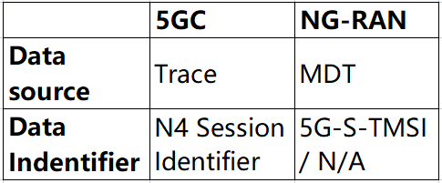
Use Case 5: Trace-based UE-level measurements for NG-RAN
Background
RAN- support AI/ML enabled NG-RAN: AI/ML function can analyze metrics related to UE level performance related to perform optimal resource management and mobility decisions for network slicing.(TR 38.743、TR 38.744)
SA2- support analytics conducted by NWDAF: Packet delay between PSA UPF and UE, and packet delay in NG-RAN for a specific UE.（S5-233839）
Research status
SA5: TS 28.558 specifies the UE-level measurements for 5G system, and the corresponding collection and reporting mechanisms.
Potential objectives
Investigate the feasibility of introducing Trace mechanism on data collection and reporting for NG-RAN UE-level measurements
Investigate new Trace-based UE-level measurements for NG-RAN
Potential enhancements on existing UE-level measurements in the aspets of measurement object and UE identifier
MDT triggered by event is supported by measurement of M1-M9.
Trace has the capability to log data on any interface at call level for a specific user or mobile type
Existing UE-level measurements for NG-RAN is limited. Some analysis requirements such as mobility cannot be satisfied in NG-RAN.
Measurement object and UE identifier need to be clear.

Slide 9
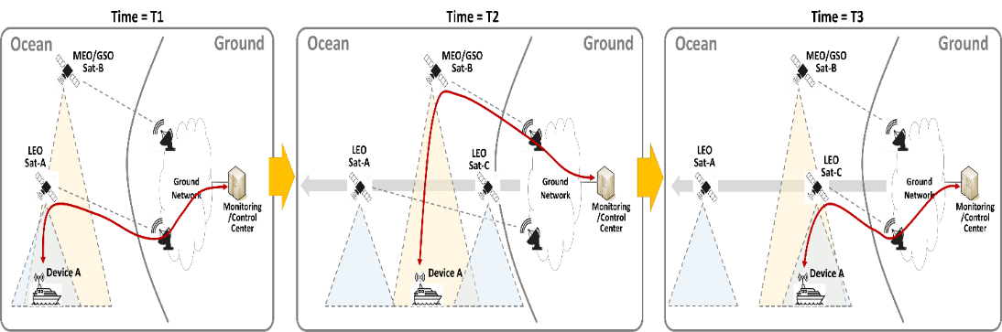
Use Case 6: NTN Management (OAM_NTN_Ph3)
NTN management enhancements on transparent mode and regenerative mode with gNB/eNB &5GS functions on-board the NTN
  Further enhancement on existing UCs
    Management of connections and associations between satellite and ground systems
    NTN mobility management enhancement
    Management support of Store and Forward Satellite operation
    UE-Satellite-UE communication
    Energy efficiency on satellite access system
  Management support for service continuity and different services with multi-orbit satellites
  Management support for Broadcast services with satellite access
Maybe other management requirements will be added depending on RAN and SA2 groups.
Example of service continuity through multi-orbit satellite access

Slide 10
Thank You !

Slide 11
RAN Rel-19 Project Update: Ambient-IoT
SI Study on solutions for Ambient IoT (Internet of Things) in NR was successfully completed
  TR 38.769 v2.0.1 on Study on solutions for Ambient IoT (Internet of Things) in NR was approved in RP‑243319
Way forward for Ambient IoT for REL-19 and REL-20 was endorsed in RP‑243280
New WID on Rel-19 Ambient IoT was approved in RP‑243326
TSG RAN to approve a Rel-19 work item for Ambient IoT, with the following scope based on the Rel-19 study:
  Indoor inventory & command, deployment scenario 1 with topology 1 (in D1T1-B)
  Backscattering device with RF-ED receiver: Device 1
  CW node outside topology (D1T1-B case 1-4), single-tone unmodulated waveform without hopping
    FDD spectrum: CW in UL, D2R in UL, R2D in DL
  Device unavailability: direction 1 from TR
  Proximity determination: solution 1 from TR
Workplan for Rel-19:
  No impact to Rel-19 ASN.1 freeze, no impact to the timeline of Rel-20. Rel-20 Ambient IoT starts after the completion of the Rel-19 Ambient IoT WI.
  Completion of the Rel-19 work (Core Part) is targeted at the stage-3 functional freeze for Rel-19 in Sept. 2025, with 3 quarters for RAN2/3/4 and 2 quarters for RAN1.
Workplan for Rel-20:
  Includes D2T2
  Includes Device 2
  A limited number of additional use cases, deployments, connectivity topologies, devices, traffic types in TR38.848 as a starting point
  Note: work on D2T2, device 2 shall follow the Rel-19 study conclusions, and further down-selection of architecture options for topology 2 may be needed. For indoor use cases, deviations from Rel-19 study conclusion shall be well justified and agreed.
  Details to be discussed at a later RAN plenary meeting, including the need for study phase.
For both Rel-19 and Rel-20, co-ordination with SA2/3 is expected

Slide 12
R19 Ambient IoT scope and workplan
R19 work scope aligns with RAN approved Rel-19 work item(RP-243326)
Stick to Rel-19 Stage 3 and ASN.1/OpenAPI freeze time, no impact to the timeline of Rel-20.
Endorse SA2 Rel-19 work item (SP-241979) – SA2 is expected to bring a WID with necessary updates to the objectives for approval in TSG#107
SA3 study shall focus to specify appropriate security features for device 1 and D1T1 with direct and indirect interface options.
Check point in TSG#107 on SA3 study conclusions and further SA2 progress
SA5 is expected to bring the related work item (including charging) for approval in TSG#107
SA ask SA3 and SA2 to finalize, in Q1 2025, the conclusions for the Ambient IoT work with the focus on device 1 and D1T1, in particular:
  Appropriate security requirements and features (SA3).
  Whether and how to support enabling temporarily disabled AIoT devices (SA2)
  Temporary ID or not (SA3)
  The entity to store the static and dynamic information, and usage for the stored information (SA2)
SA ask to SA2 stabilize the overall architecture for AIoT device 1 and D1T1, and if TUs allow, to proceed in 2025 Q1 with PCRs for a new TS and draft CRs on the already concluded aspects.

