Slide 1
CATT view on SA5 Rel-20
5G-Advanced

Slide 2

Overall View on SA5 Rel-20 5G-A
CATT overall view on SA5 Rel-20 5G-A content
  Potential 5GA management and orchestration topics
    NTN_OAM_Ph3
    AIML enhancement & Automation
    SON/MDT/Trace/QoE enhancement
    Other candidate features to address operators’ immediate needs
  Potential 5GA charging topics
    Charging aspects of integrating satellite component into 5GS in Rel-20

Slide 3
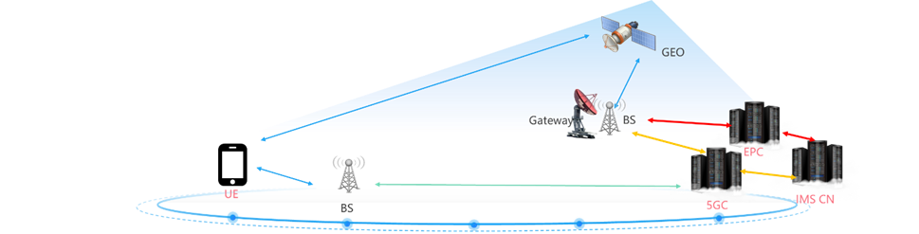
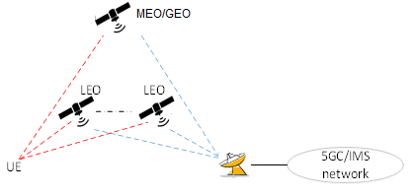
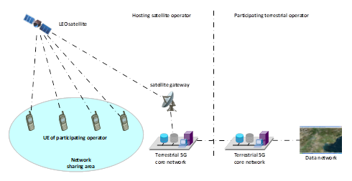

NTN Related Topics
1. NTN_OAM_Ph3 (SI & WI) – 4 TUs
  IMS voice call via GEO satellite access
  Co-ordination among multi-types of satellite access
  Cooperation between satellites connected via ISL
  Support of indirect sharing of satellite access network
  Further enhancement of TN/NTN convergence to better support some TN fundamental services
From Rel-20 SA1 5GSAT_Ph4
From Rel-20 SA1 5GSAT_Ph4, 18 use cases on multi-orbit satellite access were identified
Rel-20 SA1 INS_SAT introduces more business models based on satellite network sharing. INS is the basic mechanism.

Slide 4
Intelligence and Automation
1. AIML enhancement
  UE data collection for RAN AI/ML
  Further enhancement MDA (Management Data Analytics)
  AI/ML Model Evaluation
  Generative AI
2. Other Intelligence & Automation related topics
  Digital Twins
  intent driven management
  Closed Control loop management
Notes:
AI/ML Model Evaluation :Study the model evaluation mechanism for guaranteeing model performance and efficiency before and after the AI/ML model provisioning.

Slide 5
MDT/Trace/QoE/SON and other topics
1. MDT/Trace/QoE/SON
  Enhancement for new scenarios such as NTN, XRM etc.
  Potential enhancement for MDT/QoE/Trace mechanism for AI/ML data collection
2. Potential new features in Rel-20
  XRM
  Integrated Sensing & Communications
  Vehicle Mounted Relays
Notes:
Summary : CATT are open to discuss other Rel-20 5G-A topics

Slide 6
Potential 5GA charging topics
1. SAT_CH_Ph4 (SI & WI) – 4 TUs
  UE-satellite-UE communication enhancements for non-IMS services and Mission critical services
  Charging for Resilient Notification service
  Charging for Multi-orbits satellite accesses
  Charging for 5GC supporting IoT NTN
  Charging for Broadcast services via satellite to unregistered UE
  Charging for the S&F feature in 5GS with NR NTN
Leftovers from Rel-19 SA2 5GSAT_Ph3
From Rel-20 SA1 5GSAT_Ph4,
support of Satellite Communication with Resilient Operation Mode for Public Safety

Slide 7
Thank You !

