Slide 1
Welcome to Fukuoka
3GPP RAN-RAN1#81, RAN2#90, RAN3#88, RAN4#75, RAN5#67, SA2#109 and SA6#4
The Japanese Friends of 3GPP
Ericsson Japan, Fujitsu, Hitachi, Huawei Technologies Japan,
KDDI, KYOCERA, MITSUBISHI ELECTRIC, NEC, Nokia Networks Japan,
NTC, NTT DOCOMO, OKI, Panasonic, Qualcomm Japan, SHARP,
SoftBank Mobile, Sony Mobile Communications Japan

Slide 2
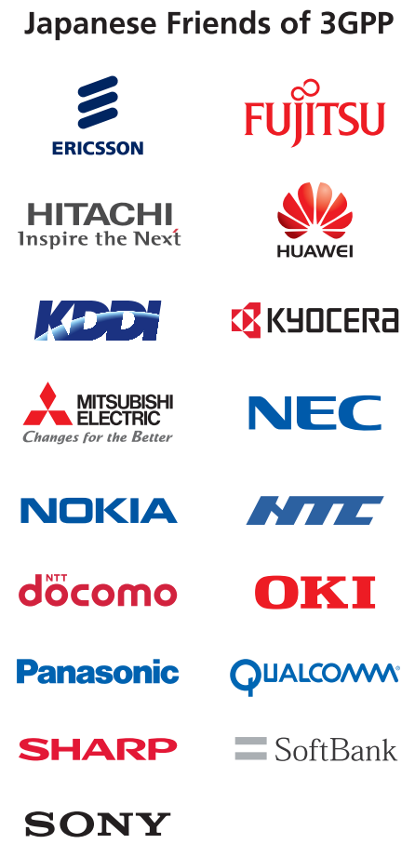
Welcome to Fukuoka
The Japanese Friends of 3GPP warmly welcomes all of you to Fukuoka, Japan where one of the main cities in western part of Japan and could provide you Japanese traditions , exquisite arts or heritages from ancient eras as well as leading trends in the areas as the capital of Kyusyu Region. You can also expect fresh and delicious food in the area.
Enjoy your stay in Fukuoka and have a successful meeting!

Slide 3
About the area
Fukuoka is one of the major cities in western part of Japan, is located at the center of Fukuoka plain and faces to Hakata bay. You will see the latest trends in the area and can visit picturesque beaches or islands near by.
As the city has been one of the main gateways to/from Korean peninsula or China continent since the predawn of Japanese history, you will also see plenty of exquisite art or heritage from its ancient eras together with Japanese traditions.
See also:
http://www.welcome-fukuoka.or.jp/english/396.html
http://kyushu.com/fukuoka/info/history_of_fukuoka/

Slide 4
Some tips on the local area 1
(Transportation)
Fukuoka Yahoo Dome (How to reach the dome next to the meeting venue):
http://www.softbankhawks.co.jp/global/english/index.php#access
Busses Connection Search (Nishitetsu bus)
http://jik.nishitetsu.jp/?lang=en
*The nearest bus stop of the venue is “Hilton Fukuoka Sea Hawk Hotel-mae ” or “Kokuritsu Iryo Center” depending on the buses you get on.
* The bus stops to the venue are "Tenjin Bus Terminal-mae", " Tenjin Shinten-cho Iriguchi ", "Hakata-ekimae A" or "Hakata Bus Terminal 1F“, Fukuoka Airport Terminal 1,2(Domestic Terminal)
Trains Connection Search:
http://www.jorudan.co.jp/english/
http://www.hyperdia.com/en/
*The nearest station of the airport is “Fukuoka-Airport”. The nearest station of venue is “Tojinmachi” or “Nishijin”, and it is 15 minutes’ walk to the venue. The transfer station to JR line is “Hakata”
Fukuoka City Subway:
http://subway.city.fukuoka.lg.jp/eng/index.html
JR Kyushu trains:
http://www.jrkyushu.co.jp/english/index.html

Slide 5
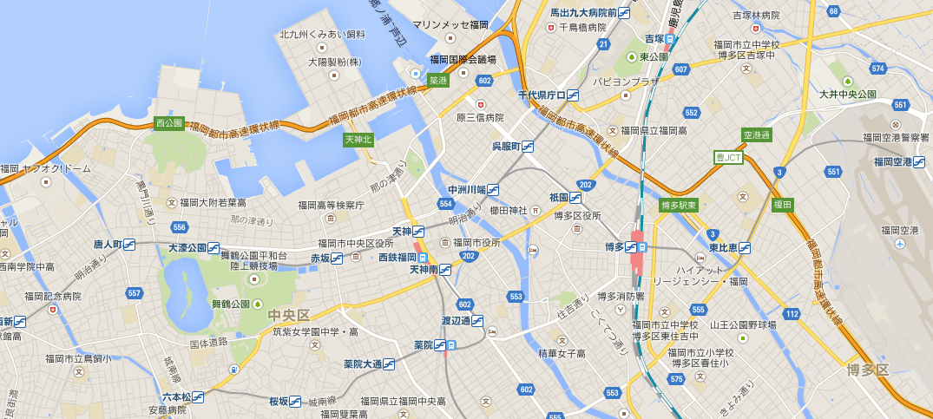
Some tips on the local area 2
(Transportation2)
Hilton Fukuoka
Sea Hawk Hotel
(The venue)
The bus stop for the venue
*The bus Connection Search (slide4) is available by these names below.
Fukuoka-Airport
The nearest subway Station of the airport
Tenjin
One of the major transfer station to the bus for the venue
Hakata-ekimae A
Hilton Fukuoka Sea Hawk Hotel-mae
Hakata Bus Terminal 1F
Kokuritsu Iryo Center
Fukuoka Airport Terminal 1,2(Domestic Terminal)
Tenjin Shinten-cho Iriguchi
Fukuoka
Airport
Nisijin
One of the near subway station of the venue
*Several Complimentary buses (at night) goes to the station from the venue
Tojinmachi
The nearest subway station of the venue
*15min’s walk to the venue
Tenjin Bus Terminal-mae
Hakata
The Transfer station between JR and the subway

Slide 6
Some tips for lunch 1
(Restaurant in the hotel for lunch)
[The restaurant in the hotel]
There are 5 restaurants open around noon in the venue as you see in the web page below.
http://www3.hilton.com/en/hotels/japan/hilton-fukuoka-sea-hawk-FUKHIHI/dining/index.html
The following is the detail information of the 5 restaurants:
-Seala Brasserie and Lounge @4th floor *all-you-can-eat buffet (from 2376yen incl. Tax and Service charge)
Open noon-2:30PM for lunch
http://www.hiltonfukuokaseahawk.jp/restaurant/seala *Japanese web page
-Boukairou @5th floor *Chinese dishes & noodles (from 1544yen incl. Tax and Service charge)
Open noon-2:30PM for lunch *Originally it’s closed on Monday and Tuesday, but it will be open from May.25 (Mon) toMay.29(Fri).
http://www.hiltonfukuokaseahawk.jp/restaurant/boukairou *Japanese web page
-Kinyohtei @35th floor *Teppan-Yaki (from 3801yen incl. Tax and Service charge)
Open noon-2:30PM for lunch
http://www.hiltonfukuokaseahawk.jp/restaurant/kinyoutei *Japanese web page
-Tomozuna @35th floor *Sushi (from 2970yen incl. Tax and Service charge)
Open noon-2:30PM for lunch
http://www.hiltonfukuokaseahawk.jp/restaurant/tomozuna *Japanese web page
-Clouds @35th floor *Western dishes (from 2376yen incl. Tax and Service charge)
Open noon-6:00PM for lunch
http://www.hiltonfukuokaseahawk.jp/restaurant/clouds *Japanese web page

Slide 7
Some tips for lunch 2
(Restaurant around the hotel)
[The restaurant around the Hilton]
There are more than 10 restaurant in the Hawks Town Mall (just 4min from the venue)
as show in the Japanese page below.
http://www.hawkstown.com/mall/kaibou/eat.html
*The restaurants’ name were shown in the next side (translated by Google translation).
You can find the location of the Hawks Town Mall in the silde9.
Besides Hawks Town Mall ,there are also 6 restaurants including fast food restaurants within 10 minutes from the venue as shown in the page below.
http://r.gnavi.co.jp/lang/en/aream5092/
*The 6 restaurants are numbered by 1 to 6 in the slide9.
  Note; Most of the restaurants in the shopping mall do not accept credit cards.

Slide 8
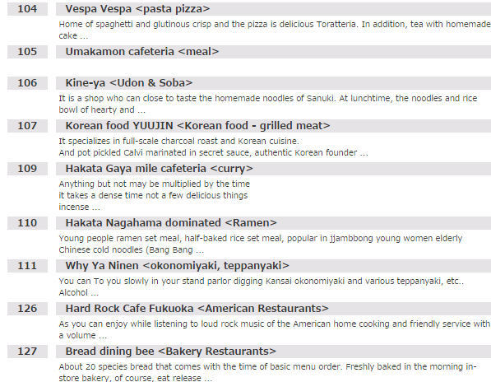
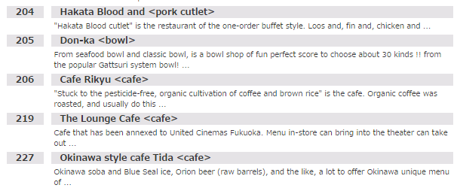
Some tips for lunch 3
(Restaurant in the Hawks Town Mall )
[Mall1 1st floor]
[Mall2 1st floor]
Shokudou
[Mall1 2nd floor]
Gochikatsu <Pork Cutlet >
Shokudou
Don-Ya
Fubi
Nanndeyanen
Hachi
< Bakery Restaurants>

Slide 9
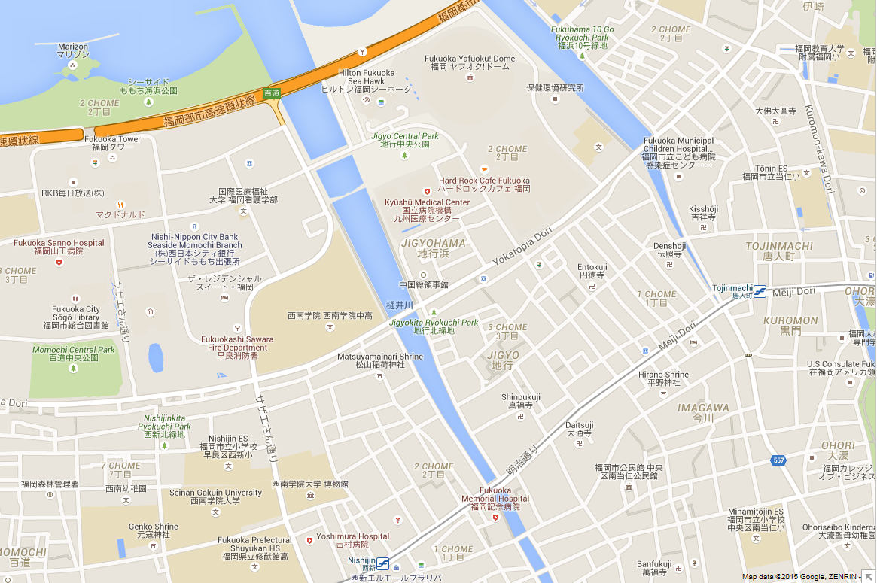
Some tips for lunch 4
(Maps for the restaurant around the hotel)
Hilton Fukuoka
Sea Hawk Hotel
(The venue)
mall1
mall2
2
3
4
5
Hawks Town Mall
6
1
1 UMENOHANA MOMOCHITEN
*Traditional Japanese called "Kaiseki"
2 RAMANIHNA MOMOCHITEN
*Italian Cuisine
3 SUBWAY
4 TOMETEBA MOMOCHIHAMATEN
*Regional Chicken Cuisine
5 McDonald's
6 Tonkatsu HAMAKATSU
*Pork Cutlets
(Note) MOMOCHI or MOMOCHIHAMA is the area's name.

Slide 10
Meeting rooms arrangement
Coffee breaks: 10:30 to 11:00 & 16:00 to 16:30 at Grand Foyer of 1st floor.
Wifi access is available in each meeting room and the Coffee break place.
In case you have made your room reservation via JTB, your room rate includes breakfast, (consumption tax).

Slide 11
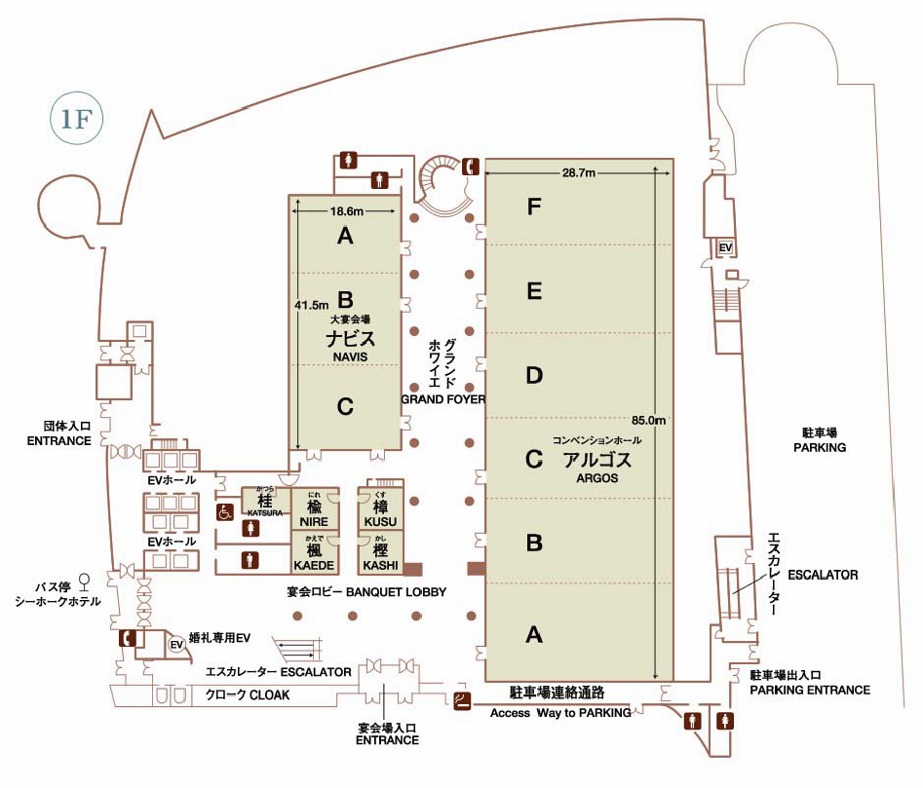
Meeting rooms (RAN1-4, secretariat)
1st
Floor
NAVIS
ARGOS
RAN 4
(Main)
RAN 4
(Breakout)
RAN 2
(Breakout(UTRA))
RAN 3
RAN 1
(Main/Breakout1)
RAN 1
(Breakout2)
X
RAN 1
(Main)
Complimentary
bus stop
(for Nishijin station)
*8PM, 8:30PM, 9:00PM
Secretariat
RAN 2
(Main)
Reception
RAN 2
(Breakout(LTE))
Cloak
Coffee Break (at Grand Foyer)

Slide 12
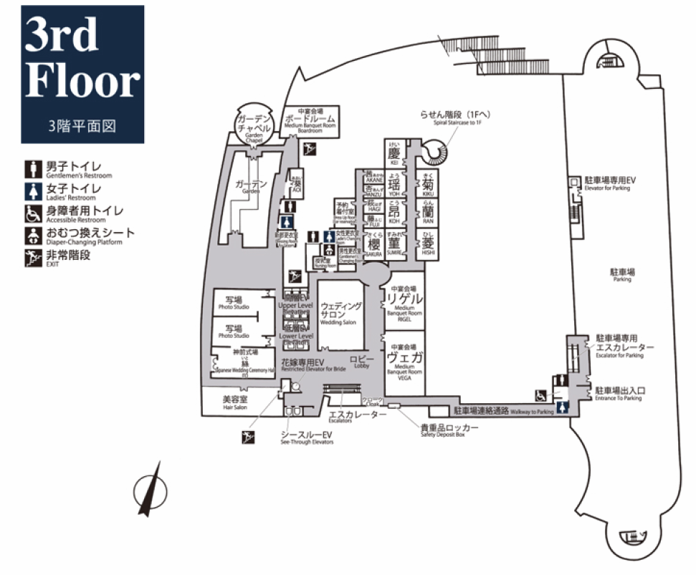
Meeting rooms (SA2, 6)
Boardroom
SA 6
SA 2
(Breakout)
SA 2
(Main)
Vega, Rigel

Slide 13
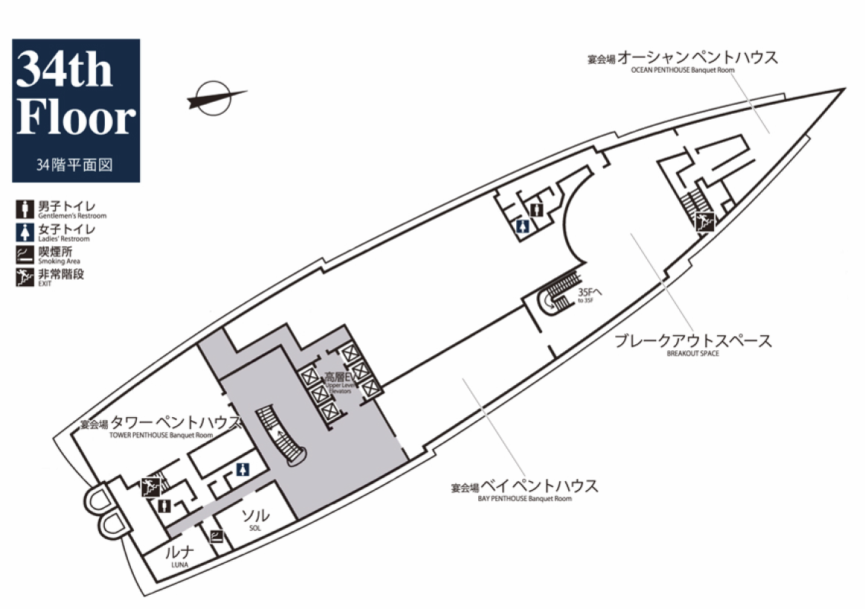
Meeting rooms (RAN5)
RAN 5
(Breakout)
RAN 5
(Main)
Bay Pent House
Tower Pent
House

Slide 14
Attention, please!
Meeting rooms will be opened at 7:30 am and locked after 9 pm.
The meeting rooms will not be locked in the daytime. Please do not leave your personal belongings or PCs unattended when you leave your meeting room.
Please do NOT eat or drink at public areas in the hotel other than in your meeting rooms or at Grand foyer on 1F.
Cloak is available on 1F during the week of the meetings.
Japanese popular pop-star concert and baseball game will be held in Fukuoka Yahoo dome (closed to the venue) from Wednesday to Friday (May.27- 29) and roads will be crowded around the venue on those days.
Please contact meeting coordinators if you have any question :
Ms. Sudo, Ms. Shioya, Mr. Imai, Ms. Inoue or Ms. Taguchi of ILCC Co., Ltd. at the reception desk (1F) in the slide11

Slide 15
Some tips for dinner
Please refer to the restaurant information in Fukuoka ->
You can also find the restaurant information as well as tourist information
in the web page below
http://www.yokanavi.com/eg/gourmet/index
http://fukuoka-now.com/
*Most of the local restaurants nearby may be closed at around 10 pm or earlier. Many restaurants in the down town Fukuoka (Tenjin area or Hakata station area) are opened until midnight.
Complimentary buses leave the venue for Nisijin (Subway station) at 8PM, 8:30PM, 9PM from May.25 to May.29 (Monday to Friday).
Please refer to the bus stop of complimentary buses in the slide11.
Please refer to the train connection search in the slide 4 when you use the subway.

Slide 16
Please don’t miss to check
Welcome to Fukuoka (Fukuoka Convention & Visitors Bureau)
http://www.welcome-fukuoka.or.jp/english/
  FUKUOKA CITY VISITOR’S GUDE（Digital Book）
  http://welcome-fukuoka.or.jp/digiBook-e/index.html
CROSSROAD FUKUOKA:
http://www.crossroadfukuoka.jp/en/event/?mode=top
  Visitor’s Guide:
  http://www.crossroadfukuoka.jp/en/book/pdf/en/2010_04_28_12_36_54.pdf
  Industrial Tourism in Fukuoka:
  http://www.crossroadfukuoka.jp/en/book/view.php?dir=2010_04_28_14_12_03&lang=en

Slide 17
If you have a plan to visit neighboring areas over the week-end,
Saga prefecture: http://www.asobo-saga.jp/lang/english/
Nagasaki prefecture: http://www.nagasaki-tabinet.com/mlang/english/
Oita prefecture: http://www.visit-oita.jp/index.e.html
Kumamoto prefecture: http://kumanago.jp/en/
Kagoshima Prefecture: http://www.kagoshima-kankou.com/for/
Miyazaki prefecture: http://www.kanko-miyazaki.jp/english/index.html
Yamaguchi prefecture: http://www.visit-jy.com/english/
Please consult with your hotel concierge or travel agents in advance since some of the above mentioned areas would be not convenient or far from your hotel.
Information written in Korean and Chinese are also available in most of the sites above.

Slide 18


Acknowledgement
Special Thanks to FCVB (Fukuoka Convention & Visitors Bureau)
and Fukuoka-City

Slide 19
Enjoy your stay
and
have a successful meeting!

