Slide 1
Update of the architecture of considered devices
Yue Liu, China Mobile

Slide 2
Divide the current architecture into two parts
basic architecture
Client-Server model

Slide 3
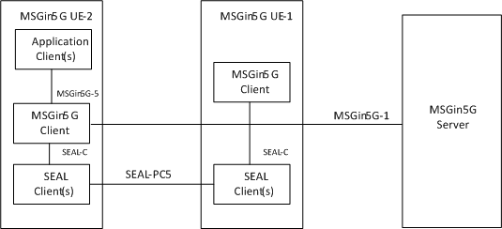
architecture of constrained device-server communication (1)
Constrained device uses MSGin5G UE-1 as UE-to-Network Relay

Slide 4
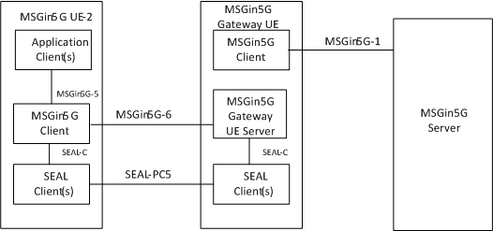
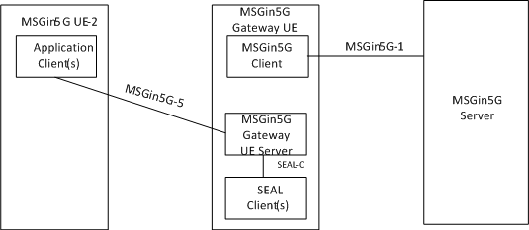
architecture of constrained device-server communication (2)
Constrained device uses MSGin5G UE-1 as MSGin5G Gateway UE
MSGin5G Gateway UE serves the UE without MSGin5G Client
MSGin5G Gateway UE serves the UE with MSGin5G Client in:
Bulk configuration
Bulk registration

Slide 5
Conclusion of UE in the middle
Only one definition of UE in the middle is needed: MSGin5G Gateway UE
  When Constrained device uses MSGin5G UE-1 as UE-to-Network Relay, ProSe UE-to-Network Relay can be used directly and it is out of scope of 5GMARCH
The MSGin5G Gateway UE has two roles:
  Help the UE without MSGin5G Client use the MSGin5G communication
  Handle the specific features, e.g. bulk configuration and bulk registration for the UE with MSGin5G Client

Slide 6
Introduce MSGin5G Gateway UE Server functionality in Gateway UE
MSGin5G Gateway UE Server functionality resides in MSGin5G Gateway UE to serve the constrained device when UE-to-Network Relay is not enough (similar as the MC Gateway UE):
The constrained device is an UE without MSGin5G Client
  Construct the MSGin5G Service ID and mapping the Application ID with the MSGin5G Service ID
The constrained device is an UE with MSGin5G Client but some specific features needed
  Bulk configuration
  Bulk registration

Slide 7
backward compatibility
the MSGin5G Gateway UE interacts with the UE without MSGin5G Client via MSGin5G-5 and interacts with UE with MSGin5G Client via MSGin5G-6, the procedure of UE without MSGin5G Client and the procedures of bulk configuration/registration are not needed to be updated.
The only change needed is change the reference point between the UE with MSGin5G Client and MSGin5G Server when UE-to-Network Relay is used from MSGin5G-6 to MSGin5G-1

