Slide 1
SA6 – past, present and future
From LTE-Advanced to 5G and from MCPTT to Edge enablement
Atle Monrad
(InterDigital Communications)
Chair 3GPP TSG SA WG6 - Application Enablement and Critical Communication Applications

Slide 2

Outline
History and Evolution
Critical Communication Applications
Service Frameworks
Enablers for Vertical Applications
Way Forward

Slide 3
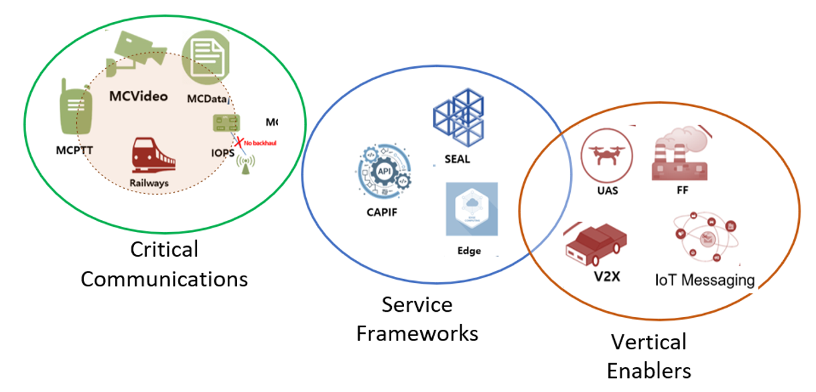

History and Evolution
2014 – 3GPP established a Working Group (WG) dedicated to stage 2 requirements for Mission Critical (MC) Applications - WG SA6 is the home for global Mission Critical Services Standards
  Over 600 user requirements with inputs from TETRA, P25 and mobile broadband industry
First global MCPTT standard published in 2016 (Rel-13)
WG SA6 Terms of Reference expanded beyond Mission Critical in 2017
Current Terms of Reference:
  Critical communication applications (Mission Critical services for public safety, railways)
  Service frameworks (Common API Framework, Service Enabler Architecture Layer, Edge Application enablement, Application Data Analytics Enablement, etc.)
  Enablers for vertical applications (automotive, drones, etc.)

Slide 4
































































3GPP SA6 - Industry Involvement
Below list is not exhaustive
Agencies
Operators
Vendors
Researchers
CATT

Slide 5



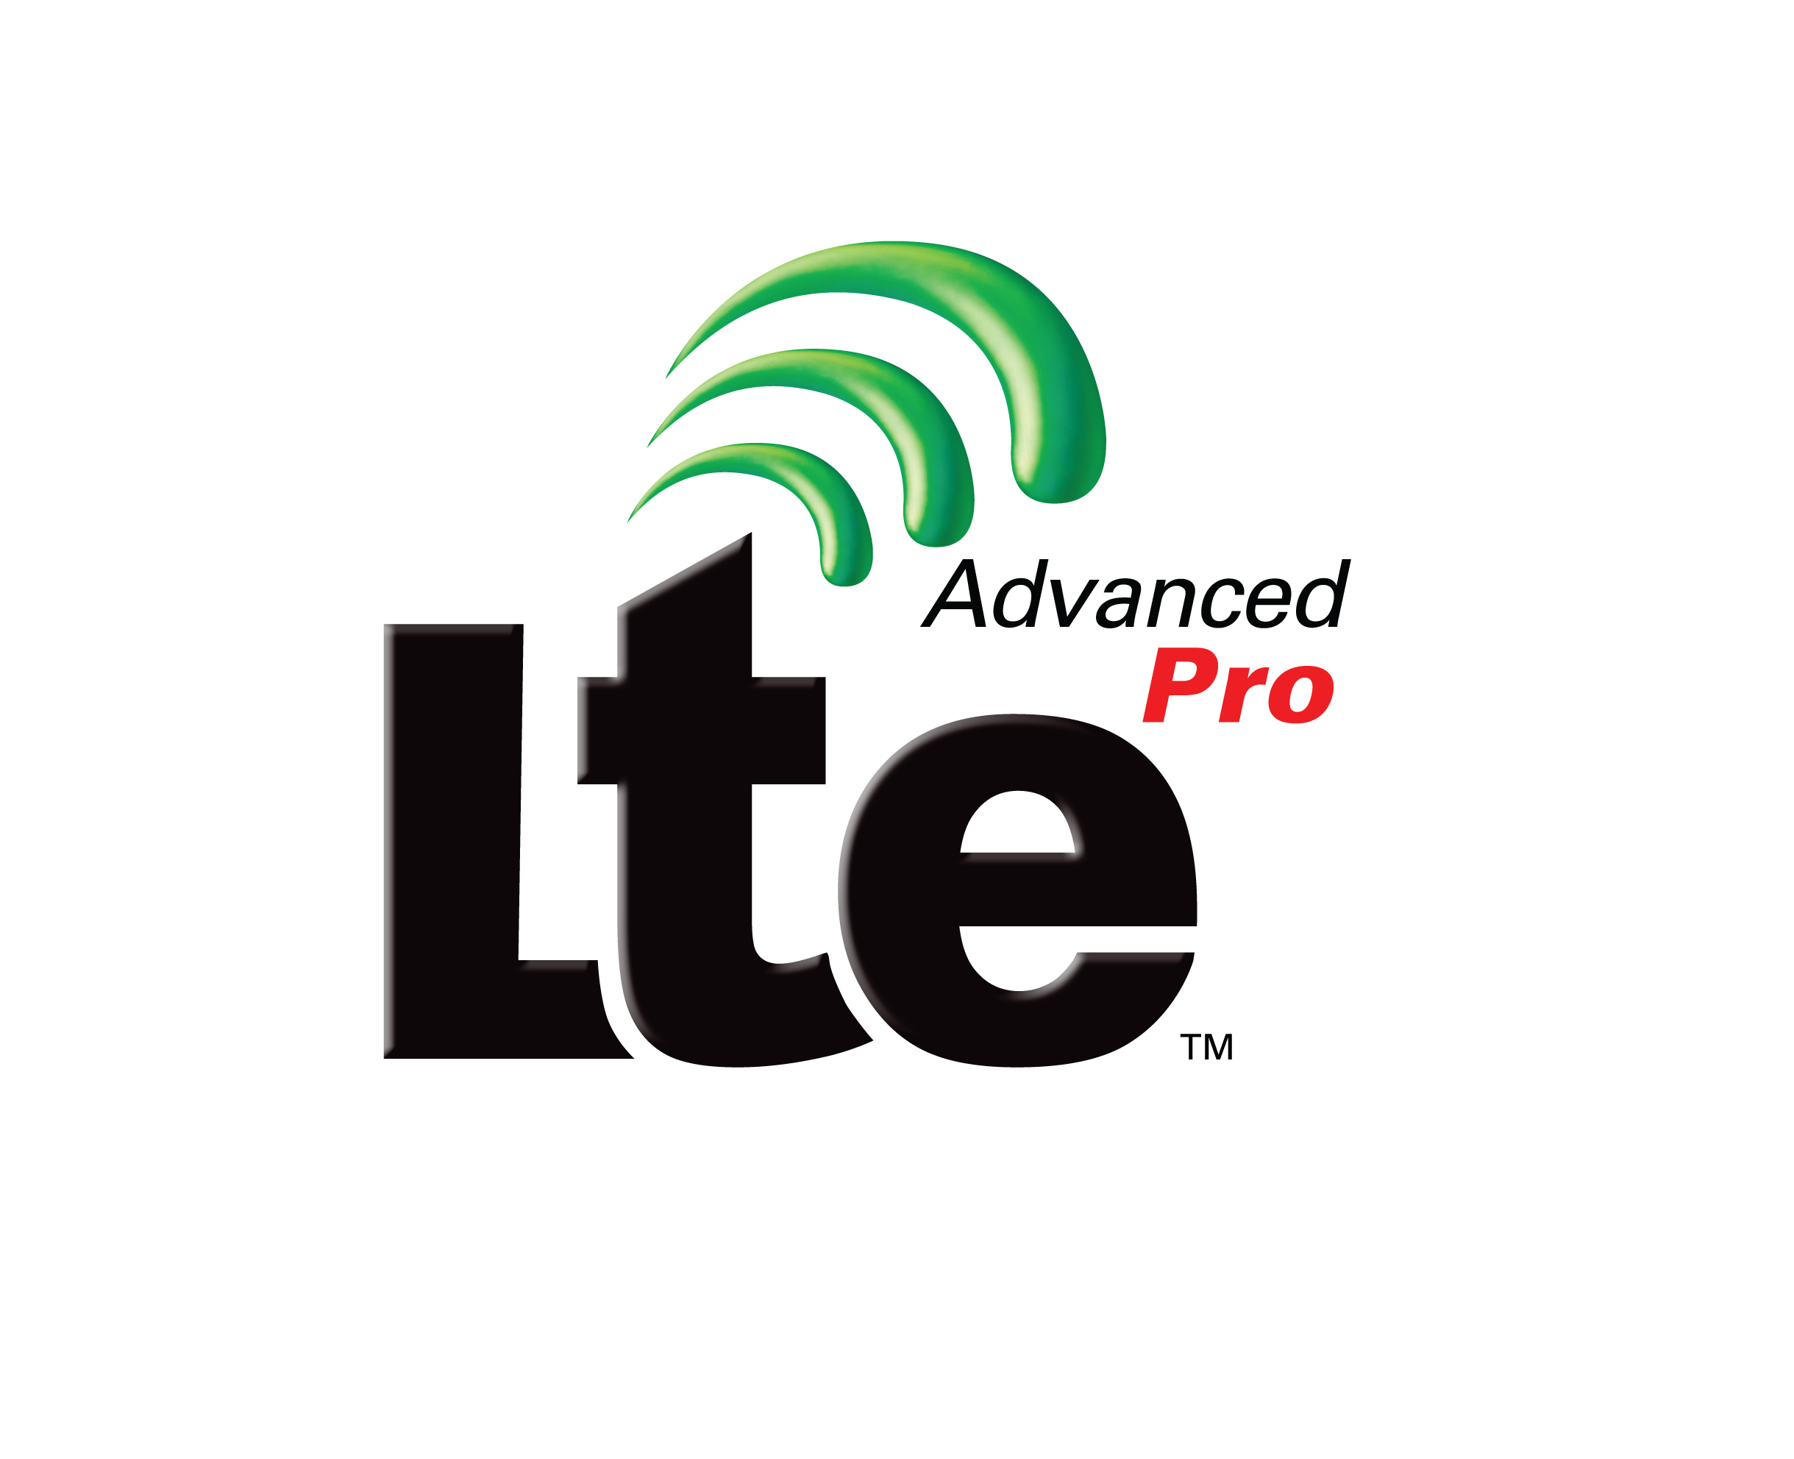
Evolution of Mission Critical & Application Enablement
Rel-18
Rel-19 *
Rel-17
MCX 6.0
MGWUE
Railways 4.0
MCOver5MBS
MCOver5GProSe
MCAHGC
MCShAC (study)
EDGEAPP 2.0
SEAL 3.0
SEALDD
ADAES
NSCALE
5GFLS
SNAAPP
PINAPP
V2XAPP 3.0
UASAPP 2.0
5GMARCH 2.0
MCX 7.0
Railways 5.0
MCShAC
EDGEAPP 3.0
SEALDD 2.0
CAPIF 3.0
CAPIF_EXT
AIMLAPP
eLSApp
Metaverse_App
XRM_Ph2_App
5GMARCH 3.0 UASAPP 3.0
MMTel_App
5GSAT_Ph3_APP
MCPTT 5.0
MCData 4.0
Railways 3.0
MCIOPS
MCOver5GS
SEAL 2.0
Edge Applications (EDGEAPP)
V2XAPP 2.0
5G Message Service (5GMARCH)
Factories of the Future (FFAPP Study)
Uncrewed Aerial Systems (UASAPP)
SA6 Terms of Reference expansion
Rel-16
MCPTT 4.0
MCData 3.0
MC Interworking 2.0
Railways 2.0
MC MBMS API
MC Location (Study)
MC Logging
CAPIF 2.0
SEAL
V2XAPP
Rel-15
Rel-14
MCPTT 3.0
MCVideo 2.0
MCData 2.0
MC Interworking
Railways
CAPIF
WG SA6 Established
Dec 2014
Rel-13
MCPTT 2.0
MCVideo
MCData
MCPTT
Mar 2016
Jun 2017
Jun 2018
June 2020
June 2021
Mar 2023
Dec 2024
Legend:
Mission Critical Topics,
5G Service Frameworks;
Vertical Application Enablers
1. API Framework – Faster integration 5G APIs
2. APIs for Verticals (V2X) – Common APIs and Vertical Enabling APIs
3. APIs for more Verticals for 5G (Drones, IoT) – Driving 5G Edge Platform APIs and Vertical Enabling APIs
4. 5G-Adv APIs – Common APIs for Analytics, Slice, Location, Data delivery, User consent for API, Personal IoT NW
5. 5G-Adv APIs for New Verticals – AIML, Sensing, XR, Metaverse, Satellite, IMS Data Channel Apps
* Rel-19 Work in progress

Slide 6
Critical Communication Applications 1/3
Rel-12
Rel-13
Rel-14
Rel-15
MC Push to Talk
Proximity Services enh.
Enhanced MC Push to Talk
MC Video
MC Data
MC Common Architecture
MC Push To Talk/Video/Data enh.
IWF – Interworking with LMR systems
MCCI - MC system migration and interconnection
MBMS for MC communication
Railways (MONASTERY)
Proximity Services
Group Communication service enablers of LTE
Proximity Services
Device to Device Communication, UE to network relay
Group Communication
Unicast to efficiently transmit to a group arranged by an application.
User authentication and service authorization, security; configuration; de-/affiliation; group calls on/off network; simultaneous sessions; dynamic group management; floor control on/off network; resource management; bearer control; location configuration, reporting and triggering;
MC Common Architecture
For all users common authentication and service authorization; security; configuration; de-/affiliation; dynamic group management; identity management;
MC Video: Common and Private & Group Video Call, Transmission control
MC Data: Common & Short Data Service; File Distribution; Transmission control; Disposition Notification.
MCCI: migration and Interconnection:
Migration to another MC system. Take part in communications with users in another MC system (interconnection).
Railways enable the support of Functional alias(es) and the use of the multi-talker feature
Enh. = Enhancements

Slide 7
Critical Communication Applications 2/3
Rel-16
Rel-17
Rel-18
Rel-19 *
MCPTT / MC Data enh.
Interworking with LMR – enh.
MCCI enh.
Railways enh.
MBMS API for MCS
MC Location (study)
Discreet listening and logging (study)
MCPTT / MC Data enh.
Railways enh.
MCIOPS
MCOver5GS
MCOver5MBS (study)
MC Location (study cont.)
MCX enh.
MGWUE
Railways enh. (IRail)
MCOver5MBS
MCOver5GProSe
MCAHGC
MCShAC (study)
MCX enh.
Railways enh.
MCShAC
Generic IOPS
MC gateway UE :
enables MC service access for MC users using non-3GPP devices (which may or may not have the ability to host MC clients)
MCAHGC:
an ad-hoc group is set up spontaneously based on a list of users or some criteria (e.g. location). An ad-hoc group is ‘disposable’ i.e. when communications end the ad-hoc group ceases to exist.
Railways:
Interconnection and Migration Aspects
MBMS API for MCS:
Definition of ref model where the MBMS APIs are applied to support multicast mission critical services and UE APIs providing the access to MBMS mission critical services for mission critical applications
MCIOPS:
For the case of a backhaul failure or a nomadic EPS deployment, MC services shall be supported based on the availability of an Isolated E-UTRAN operations for Public Safety (IOPS) system.
* Work in progress
Enh. = Enhancements

Slide 8
Critical Communication Applications 3/3
Rel-19 (work in progress)
MCX enhancements
  MCX service logging, recording and replay
    Introduction of a Recording Server (functional entity) that is able to log the metadata and record the media of MCX group communications and private communications and store them into a mass storage. The recording server is also able to retrieve the recordings when requested by an authorized user.
  MC discreet listening
    Means for an authorized user to be able to follow the communications (PTT, Data, Video) of a target user or group, without the target(s) being aware
  Expand (MCData) message storage to MCPTT and MCVideo
  Several enhancements to existing features
Railways enhancements
  Interworking with GSM-R (MCPTT, MCData)
  (Support for) separation of signaling and media paths within an MC system
  Several enhancements to existing features
Sharing of administrative configuration management information (MCShAC)
  Examples of sharing of administrative configuration management information is sharing of MC service user profile, group management configuration, system parameters, etc. between interconnected MC systems
Generic IOPS (Isolated Operation for Public Safety )
  Specify generic support for a mobile system without backhaul – currently only applicable to LTE
MC Services over non-terrestrial networks - NTN (as part of 5GSAT study/work item)
  How participants of a group communication can be informed about reduced KPIs due to participant(s) being connected via satellite

Slide 9
Service Frameworks
Common API Framework (CAPIF)
Service Enabler Architecture Layer (SEAL)
Edge Application Enablement
Application Data Analytics Enablement
Network Slice Capability Exposure
AIML Enablement *
Application support for Metaverse services *
Application support for XR *
… See annex for details
* Rel-19, work in progress

Slide 10
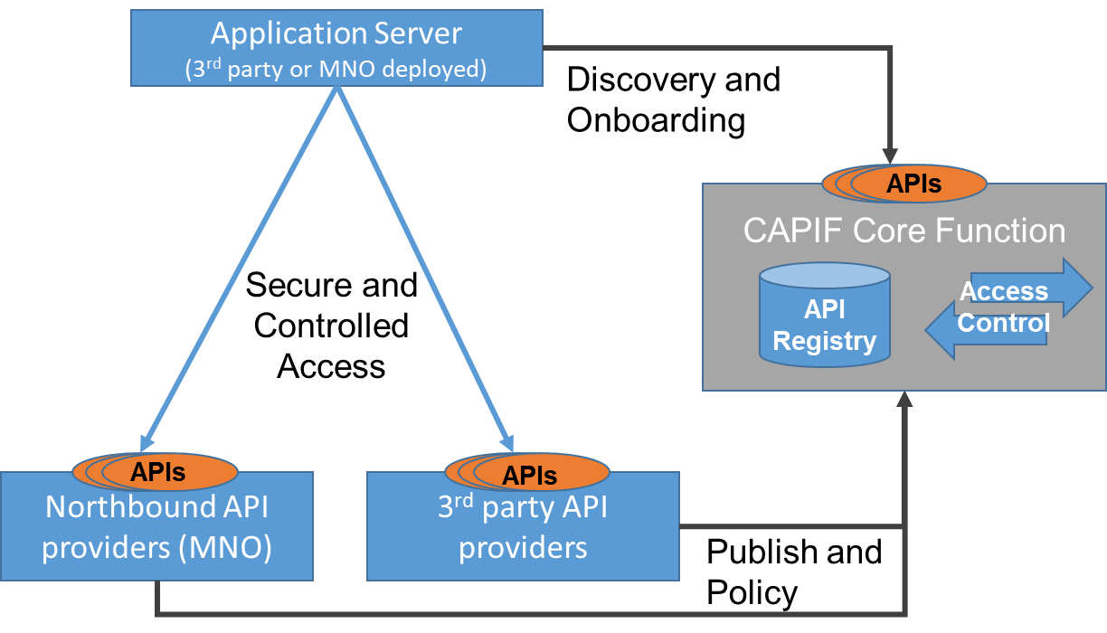
Common API Framework (CAPIF)
Purpose and Scope
  Enables a unified Northbound API framework across 3GPP network functions & ensures that there is a single and harmonized approach for API development.
  CAPIF provides a framework to host network and service APIs of PLMN and from 3rd party domain.
  Work has been successfully delivered and integrated with Northbound APIs developed by 3GPP SA2 Working Group (SCEF/NEF) and 3GPP SA4 (xMB).
Key features (see annex)

Slide 11
Service Enabler Architecture Layer (SEAL)
Purpose and Scope
  3GPP networks witnessing increasing demand from various vertical industries
  It is apparent that vertical applications will require similar core capabilities in a timely manner
  3GPP specifies application-enabling services that can be reused across vertical applications (e.g. V2X applications)
  SEAL also specifies the northbound APIs (compliant with CAPIF) - to enable flexible integration with vertical applications.
Key features (see annex)

Slide 12
Edge Application Enablement
Purpose and Scope
  Edge Application Enablement in 3GPP helps achieve the performance goals of Verticals, providing low latency and massive broadband.
  The feature aims to define a supporting application layer, which enables the deployment of applications on the edge of 3GPP networks, with minimal impacts to edge-based applications on the UE.
Key Features (see annex)
EDGEAPP Architecture - Simplified

Slide 13
Enablers for Vertical Applications
Application support for Vehicle-to-Everything (V2X) services
  V2X application enabler layer that is necessary to ensure efficient use and deployment of V2X services over 3GPP systems.
Application support for Uncrewed Aerial System (UAS)
  Identify the application aspects to support UAS that are necessary to ensure efficient use and deployment of UAS services and applications over 3GPP systems.
Application architecture for MSGin5G
  MSGin5G Service provides messaging communication capability in 5GS especially for Massive Internet of Things (MIoT).
Application support for Personal IoT Networks
Application enablement for satellite access enabled 5G services *
Application enablement for Multimedia Telephony *
… See annex for more details
* Rel-19, work in progress

Slide 14
Way Forward
3GPP has established a mature set of mission critical standards & New and enhanced mission critical features are still being specified
Expanded scope of SA6 enabled standardized support for vertical industries
Support for application development frameworks are in place & specified
3GPPs superior connectivity continue to be a major asset for all applications
Industry feedback is critical to robust standards
New mechanisms & features take time to deploy
Participation is essential: Join 3GPP / SA6!

Slide 15
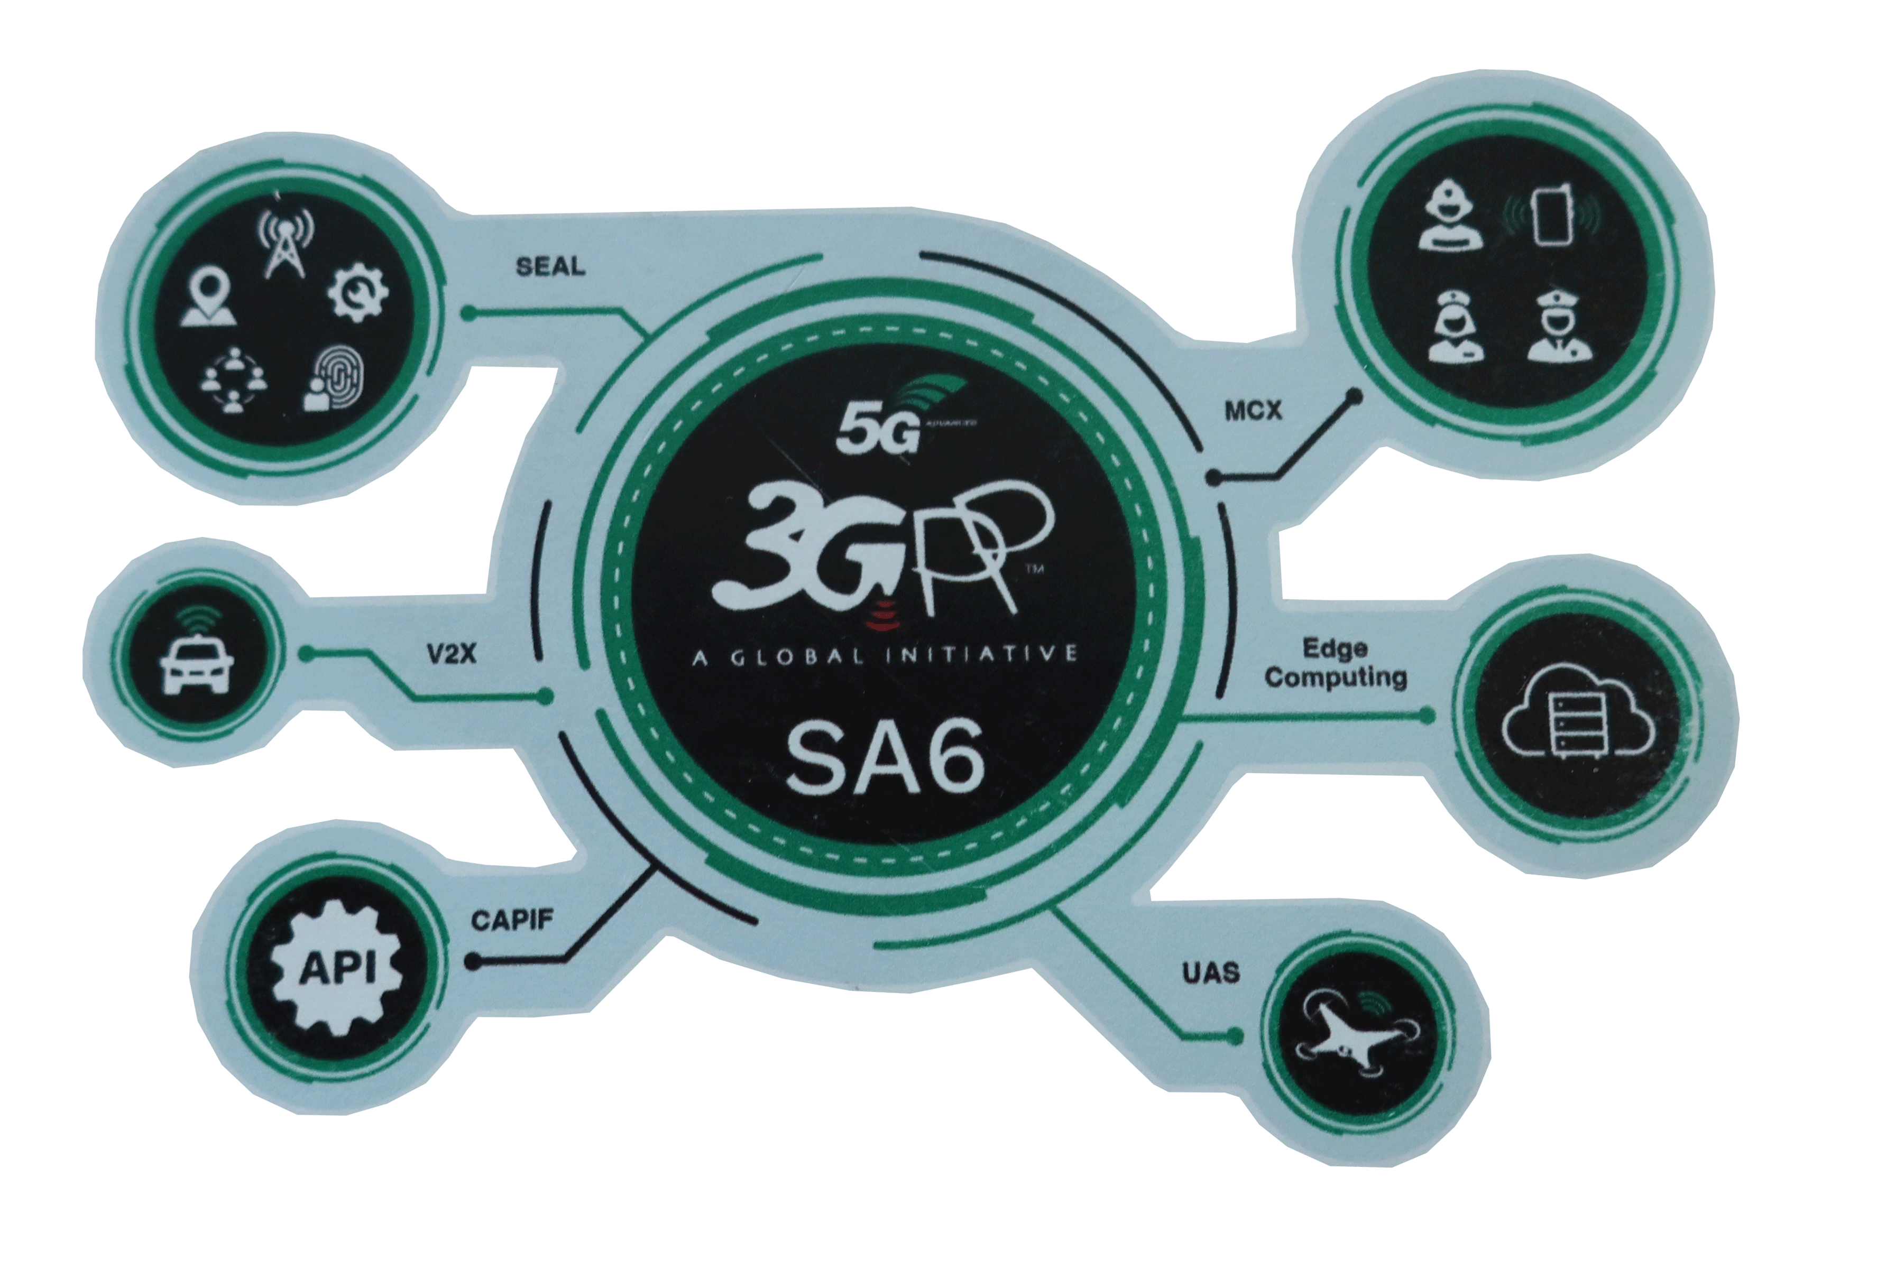
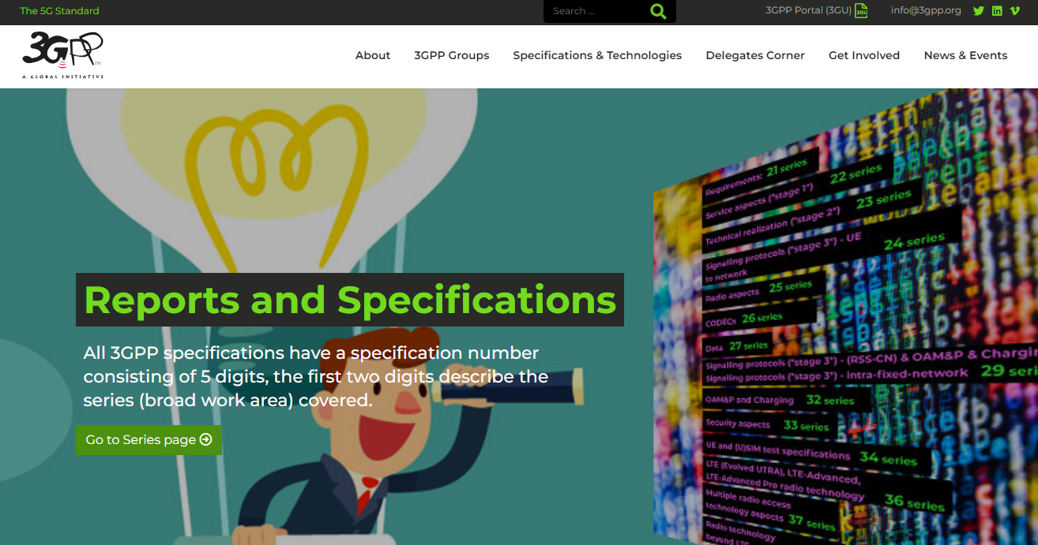
Thank you!
Atle Monrad
SA6 chair
email atle.monrad@interdigital.com
I would also like to thank the following people who have contributed to this presentation:
  Suresh Chitturi
  Jukka Vialen
  Basavaraj Pattan
  Alan Soloway
  Emmanouil Pateromichelakis
  Hyesung Kim
  Harish Negalaguli
  Michel Roy
www.3gpp.org

Slide 16
Annex
Extra slides

Slide 17
Common API Framework (CAPIF)
Purpose and Scope
  The Common API Framework (CAPIF) was developed to enable a unified Northbound API framework across 3GPP network functions, and to ensure that there is a single and harmonized approach for API development (Refer to 3GPP TS 23.222, TS 33.122 and TS 29.222).
  CAPIF provides a framework to host network and service APIs of PLMN and from 3rd party domain.
  This work has been successfully delivered and integrated with Northbound APIs developed by 3GPP SA2 Working Group (SCEF/NEF) and 3GPP SA4 (xMB).
Key features
  On-boarding/off-boarding API invoker
  Register/de-register APIs and API provider domains
  Discovery of APIs
  CAPIF events Subscription/Notification
  Entity Authentication/Authorization
  Enables secure communication
  API Access control, Auditing, Logging, Charging
  Support for 3rd party domains i.e. to allow 3rd party API providers to leverage the CAPIF framework
  Support for interconnection between two CAPIF providers
  Federation of CAPIF functions to support distributed deployments
  Dynamic routing of service API invocation
  Resource owner-aware northbound API invocation.

Slide 18
Service Enabler Architecture Layer (SEAL)
Purpose and Scope
  3GPP networks witnessing increasing demand from various vertical industries
  It is apparent that vertical applications will require similar core capabilities in a timely manner
  3GPP TS 23.434 specifies application-enabling services that can be reused across vertical applications (e.g. V2X applications)
  SEAL also specifies the northbound APIs (compliant with CAPIF) - to enable flexible integration with vertical applications.
Key features
  SEAL services are supported both in on-network and off-network
  Interconnection between SEAL servers to support distributed SEAL server deployments
  Inter-service communication between SEAL servers (e.g. location based group management)
  SEAL extension services:
    Application data analytics
    Data delivery
    Network slice capability enablement
  SEAL common core services:
    Group management
    Configuration management
    Location management
    Identity management
    Key management
    Network resource management
    Notification Management

Slide 19
Edge Application Enablement
Purpose and Scope
  Edge Application Enablement in 3GPP helps achieve the performance goals of Verticals, providing low latency and massive broadband.
  The feature aims to define a supporting application layer, which enables the deployment of applications on the edge of 3GPP networks, with minimal impacts to edge-based applications on the UE.
EDGEAPP Architecture (TS 23.558) - Simplified
Key Features
  ECS Discovery and Service Provisioning
    Enabling a UE with an Edge Enabler Client to find and connect to available Edge Data Networks (EDNs).
  Registration
    Enabling context initialization and sharing of basic information about the EEC with the EES.
  EAS Discovery
    Enabling a UE with an EEC to discover Edge AS using filters and policies, including Server capabilities, operation characteristics, service area, schedule, support for service continuity
  Service Continuity
    To discover EAS in the target area based on the expected new location
    To trigger application context transfer from source EAS (from where the AC is currently taking service) to target EAS (from where the AC will take service in new location).
  Roaming and Federation
    To enable roaming UE(s) to access local EASs
    To enables operators to make their assets and capabilities available across multiple networks.
  Capability exposure
    Expose capabilities of Edge Enabler Layer and/or 3GPP core network, such as location service, QoS, and AF traffic influence.
    And more… Edge Node Sharing (ENS), Common EAS, Dynamic Instantiation, etc.

Slide 20
Application Data Analytics Enablement
Purpose and Scope
  To provide simplified end to end performance analytics to 3rd party / verticals based on consuming / combining data from the 5G core, OAM, and UE.
  Such analytics helps identifying or predict edge/cloud server load and performance issues as well as per application session possible performance downgrades, and allows the vertical applications to pro-actively adapt its behaviour or request additional resources from the network to ensure meeting the service KPIs when using the 5GS for the communication.
Key features
  Vertical user leveraging the Application layer Analytics capabilities for predicting end to end performance and selecting the optimal VAL server
    ADAES is a SEAL functionality for providing end to end performance analytics (e.g. VAL server performance)
    ADAES may consume SEALDD (or A-DCCF) services to retrieve TCP connections statistics for a certain service area and time
    ADAES locally stores the statistics in A-ADRF
    ADAES provides the VAL server predictions to the UEs

Slide 21
Application support for Metaverse Services
Purpose and Scope
  A metaverse is an interactive and immersive system to enhance user experience using XR media, including haptic media.
  To provide localized metaverse service experience to the user – a user interaction and information provided by a service to a user that is relevant to the physical location in which the user accesses the service.
Key Features
  All new services are defined as new SEAL servers.
  Spatial anchors service
    It is an association between a location in space (three dimensions) and service information that can be used to identify and access services, e.g., information to access AR media content
  Spatial mapping and localization service
    Spatial mapping is constructing or updating a map of an unknown location, localization is tracking an object to identify its location and orientation over time
    A service offered by a mobile network operator that gathers sensor data in order to create and maintain a Spatial Map that can be used to offer customers Spatial Localization Service.
  Digital Asset management
    Digitally stored information that is uniquely identifiable and associated with user
  Existing PINAPP architecture is enhanced
    To discovering nearby PIN elements (for the purpose related to application specific task, e.g. to offload the work)

Slide 22
Application support for Vehicle-to-Everything (V2X) services
Purpose and Scope
  V2X application enabler layer that is necessary to ensure efficient use and deployment of V2X services over 3GPP systems.
Key features
  V2X service discovery
  Application level location tracking
  V2X message delivery
  File distribution
  Provisioning 3GPP system info
  Network monitoring
  V2X application resource management
  Dynamic group management (platooning support)
  V2X service continuity

Slide 23
Appliction support for Uncrewed Aerial System (UAS)
Purpose and Scope
  Identify the application aspects to support UAS that are necessary to ensure efficient use and deployment of UAS services and applications over 3GPP systems.
Key features
  UAE layer registration
  Communications between UAVs within a geographical area
  Real-Time UAV Connection Status Monitoring and Location reporting
  C2 Communication mode selection and switching
  Change of USS during flight
  UAE layer support for DAA services and applications
  Support of real time UAV flight path monitoring assistance

Slide 24






Application Enablement – APIs
Vertical Applications
API consumer
R15
1
Discover API
API Framework
Faster integration of APIs
Publish API
Scalable architecture
Plug and Play
2
API provider
R16
First wave of Service APIs
V2X
Service(s) API
Common APIs
R17
Second wave of Service APIs
Drones
IoT Messaging
Vertical APIs
Edge APIs
R18
3
Edge Delivery
Expanding service APIs
R19
4
Addressing new Verticals
AIML, Metaverse

Slide 25


Service Frameworks - Application Enablement Architecture
Application Layer
Application Clients
(V2X, UAS, IoT, …)
Application Server
(V2X)
Application Server
(UAS)
Application Server
(IoT)
APIs discovery
UE APIs
Northbound Interface (NBI)
(Service APIs)
APIs
APIs
APIs
Application Enablement services over 5G/EPS
Application Enablement Clients
(e.g VAECs, SEAL Clients, EEC)
Vertical App Enabler Services
(e.g V2XAPP, UASAPP)
SEAL services
(e.g. NRM/SEAL DD for connection over 5G/4G, NSCE for 5G Slice, Group, location)
Edge services
(e.g. ACR, AF session with QoS)
CAPIF Services
Southbound Interface (SBI)
(Network APIs)
APIs publish
5G Network services
UE Modem
APIs
APIs
Network Services
(e.g. NEF, NWDAF)
O&M Services
(e.g. FCAPS, slicing)
UE/Device
VAEC – Vertical Application Enabler Client; EEC – Edge Enabler Client; SEAL – Service Enabler Architecture Layer; CAPIF – Common API Framework;
NRM – Network Resource Management; DD – Data Delivery; ACR – Application Context Relocation; NSCE – Network Slice Capability Enablement
Providing reusable application layer components for 5G vertical applications and Application Platform centric API(s), ensuring good QoE performance by utilizing the underlying 5G network exposed APIs

Slide 26
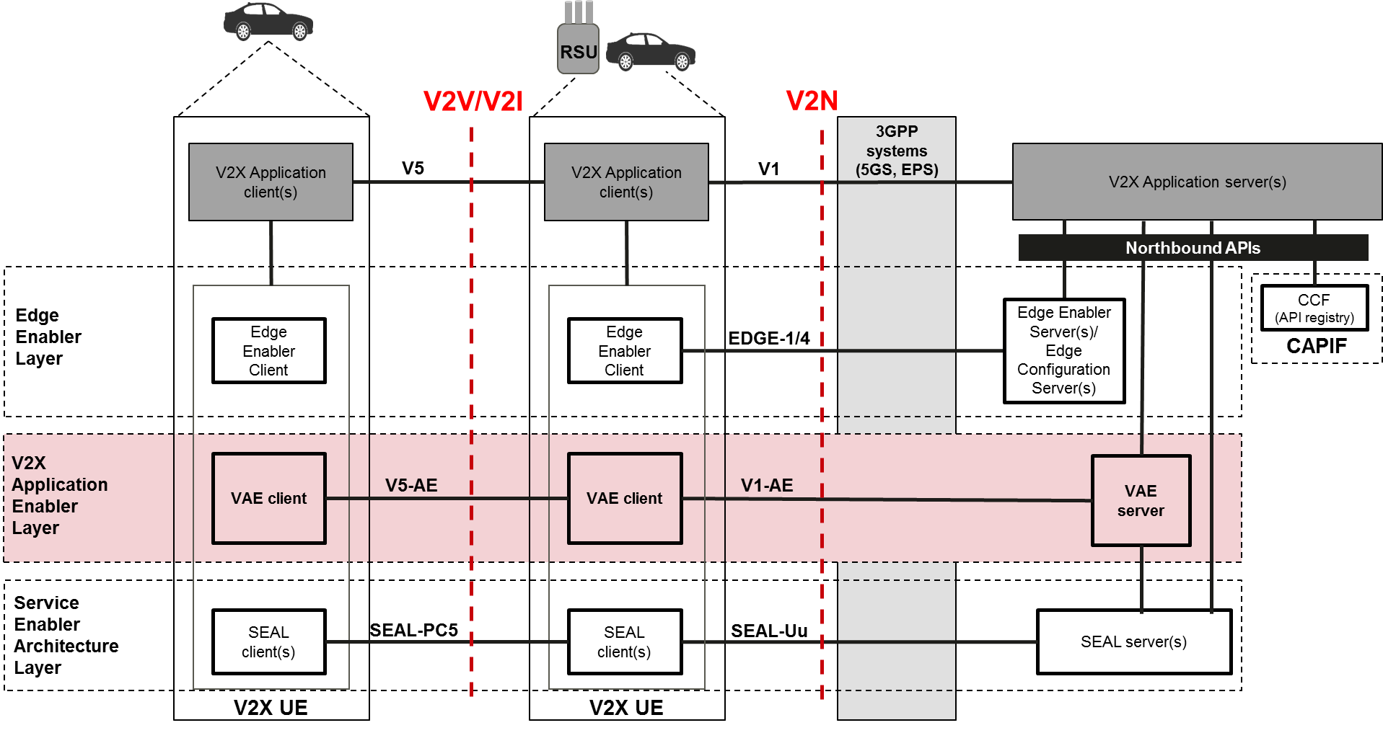
SA6 capabilites and features - example
Generic Capabilities (Pre-established sessions, Dynamic groups) to support V2X applications e.g. Tele-operated service, Platooning
V2X messages delivery capabilities (uplink, geo area, group)
Value added capabilities - Network monitoring, Service requirement (QoS) negotiation, Application resource adaptation, File distribution (MBMS)
Service Continuity support
VAE Server APIs
Multi PLMN and Multi-V2X service provider support
Benefits
Abstract and Simplify usage of 3GPP network systems (EPS and 5GS)
Support simplification of V2X application development with value-added capabilities
API based integration with V2X Application layer

