Slide 1
SA5 presentation for
SA Rel-18 workshop
SA5#138e, 23 – 31 August, 2021
Zou Lan, SA5 Vice-Chair, HUAWEI
Thomas Tovinger, 3GPP SA5 Chair, ERICSSON
Maryse Gardella, 3GPP SA5 Vice-Chair, NOKIA

Slide 2
Content
3GPP SA5 Rel-18 time plan
3GPP SA5 working relation with other groups
List of Rel-18 topics

Slide 3
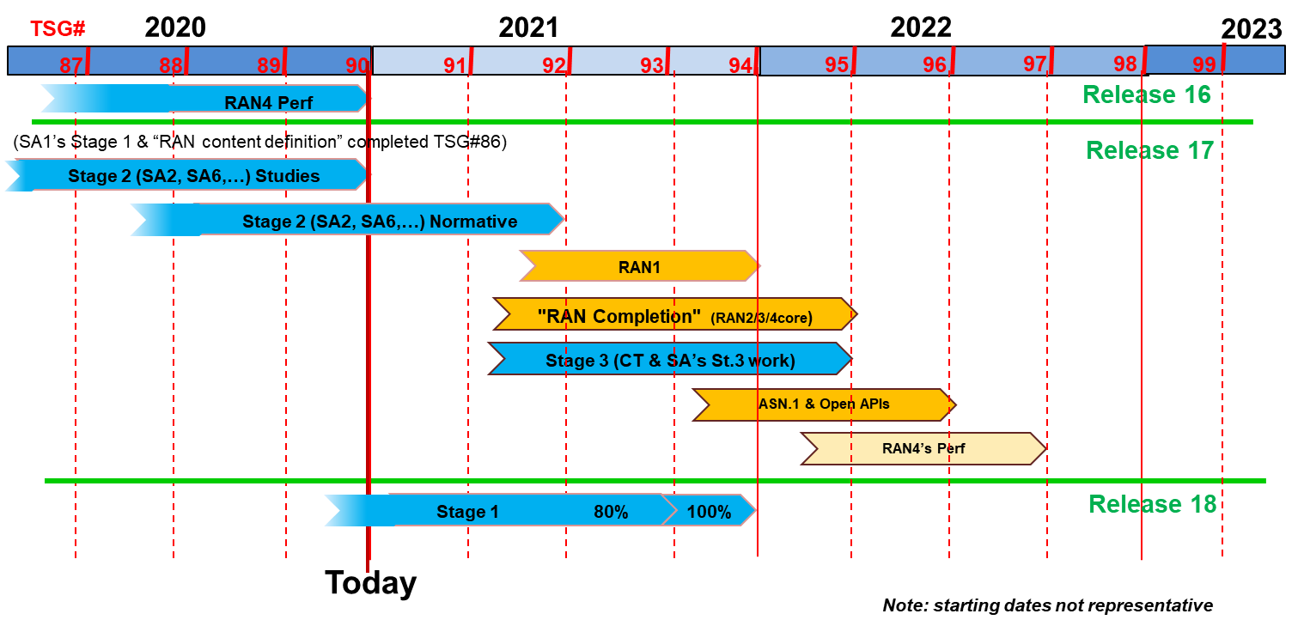

SA5 Release planning in accordance with 3GPP releases timelines
SA5 Release 17 Freezes and other milestones :
Closure of WI/SI proposal for OAM: No new Rel-17 WID/SID proposals to be submitted after SA5 #136e, except for new WIDs which have a corresponding (existing) Rel-17 study item.
Sep.2021 (SA5# 138e/TSG#93): OAM Stage 1 freeze except requirements which supporting other groups
Dec.2021 (SA5# 140e/TSG#94): Stage 2 freeze
Mar.2022 (SA5# 141/TSG#95): Stage 3 freeze
SA5 Release 18 planning：
Aug.2021 (SA5# 138e): first meeting to discuss new Rel-18 WID/SID proposals and ideas for OAM.
Jun.2022 (SA5# 143/TSG#96): OAM Rel-18 Stage 1 freeze (may adjust according to SA overall time plan)
Rel-18 stage 2/stage 3: TBD, will follow SA overall time plan.
#91e
#92e
#93e
#94
#95
#96
SA5 time plan
#135e
#136e
#137e
#138e
#139e
#140e
#141
#142
#143
No new R17 WI/SI
Rel-17
Schedule
R17 OAM stage 1
R17 OAM stage 2
R17 OAM stage 3
Rel-17 SA5 Charging
Rel-18
Schedule
(preliminary)
Start new
R18 WI/SI
R18 OAM stage 1
Rel-18 SA5 Charging

Slide 4
Detailed view of SA5 relation with other groups
1. SA1 Management requirements refer to SA5 management specifications. SA1 charging requirements as input to SA5 CH
2. Take GSMA requirements as SA5 OAM and CH input.
3. Align the MnS with ZSM if needed
4. ONAP reuses SA5 management MnS
5. Collaboration with SA2 on architecture and CN management
6. Collaboration with SA4 on QoE management
7. Provide OAM inputs to CT, collaborate stage 3 with CT.
8. Collaboration with RAN on RAN management
9. SA2 input to SA5 CH
10. SA6 input to SA5 CH
11. OAM input to SA5 CH
12. Part of SA5 CH stage 3 aligned with CT stage 3 framework
SA1
Requirements
GSMA
time
2
Stage 1
1
SA5 OAM
Stage 1
ETSI ZSM
RAN
Radio Access
3
5
11
10
Stage 2
SA2
Architecture
SA3
Security
SA4
Media
SA5 OAM
Stage 2
SA5 CH
Stage 1&2
SA6
Apps/MC
6
9
8
7
Stage 3
CT – Protocols & Coding
SA5 OAM
Stage 3
SA5 CH
Stage 3
12
4
Update of S5-212330
ONAP

Slide 5
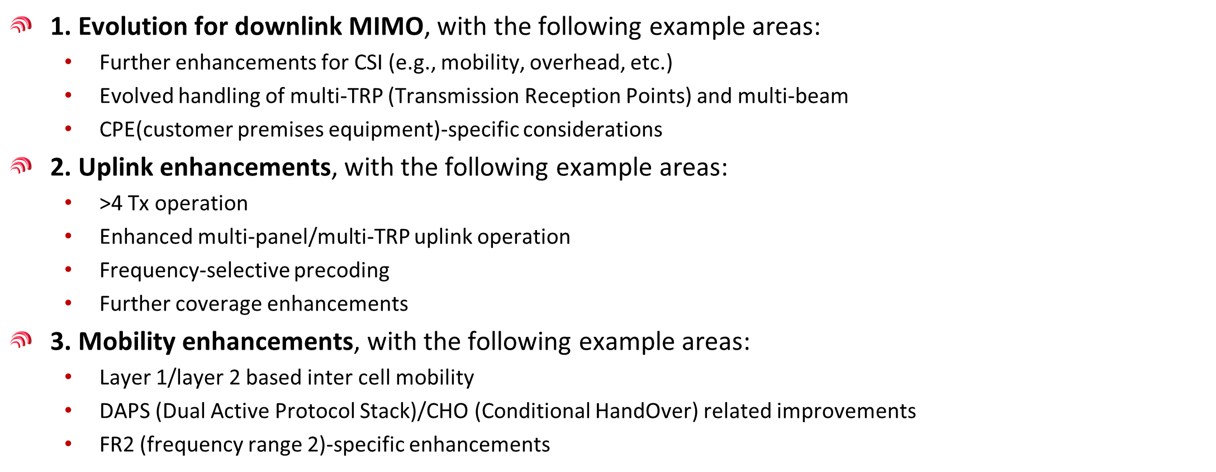
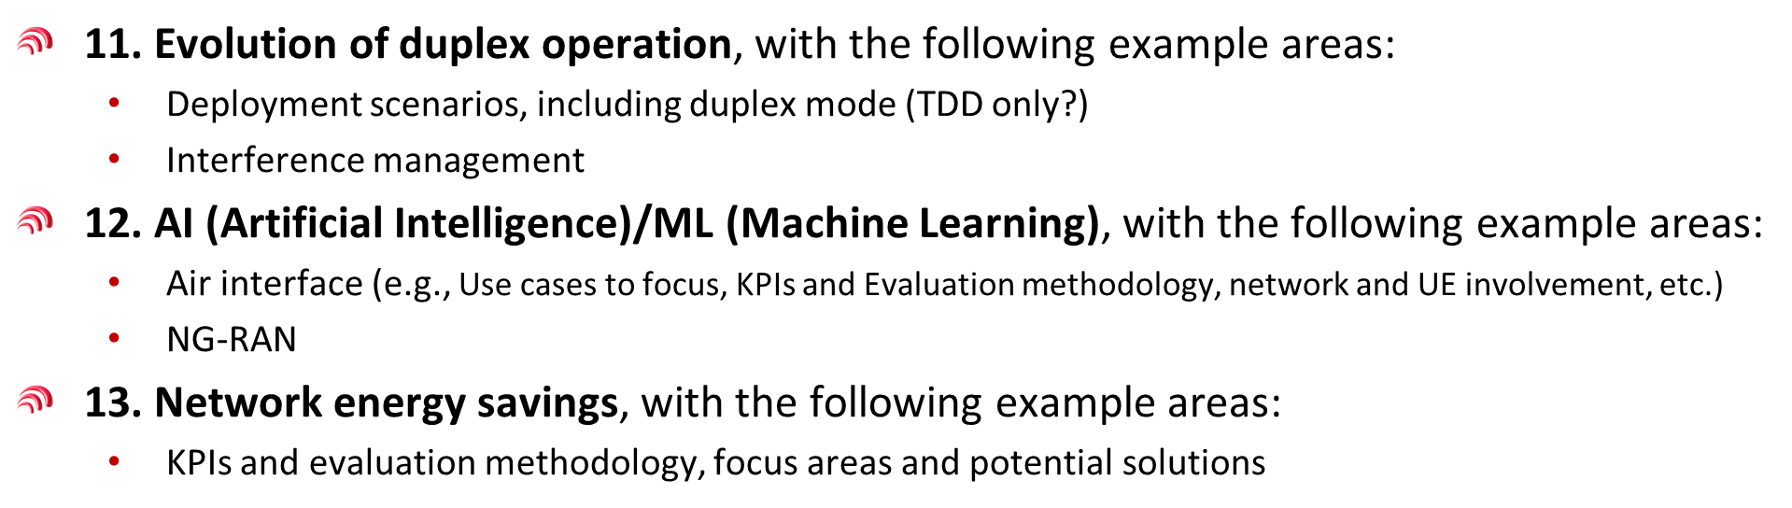
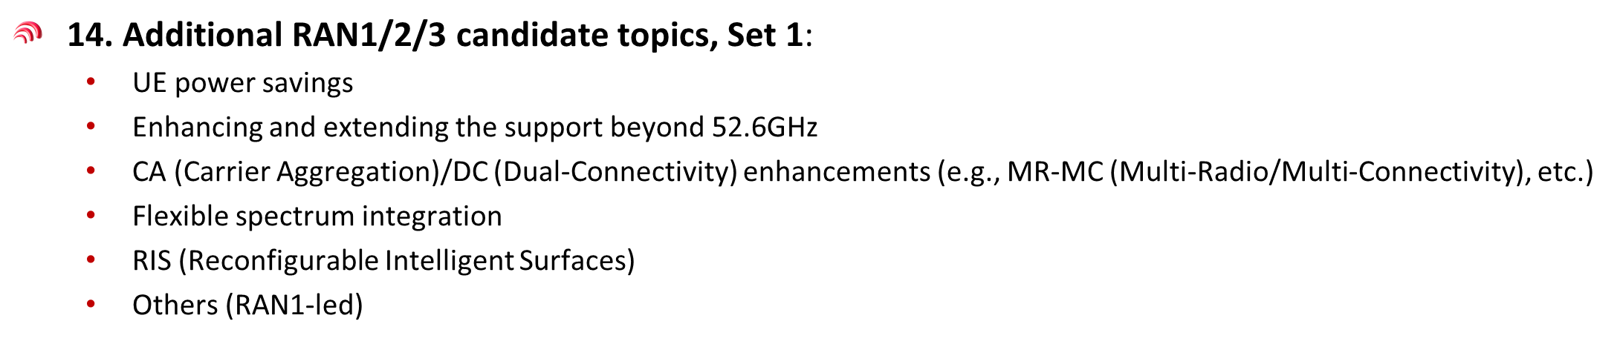
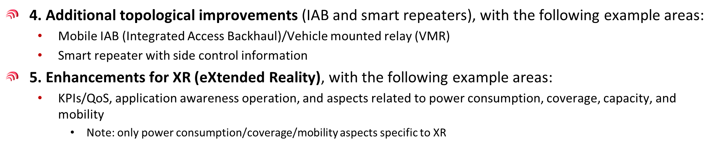
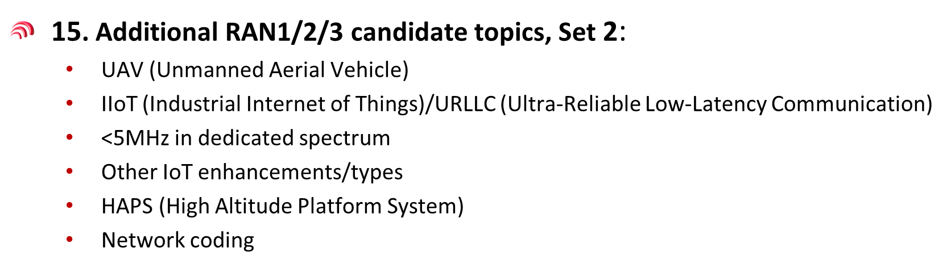
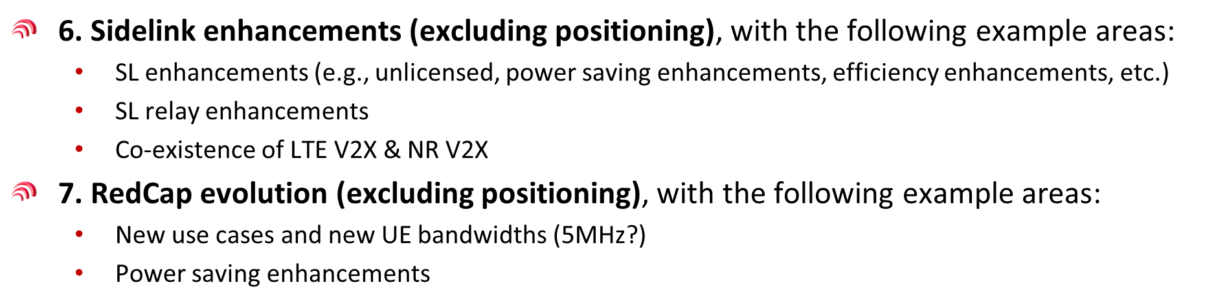
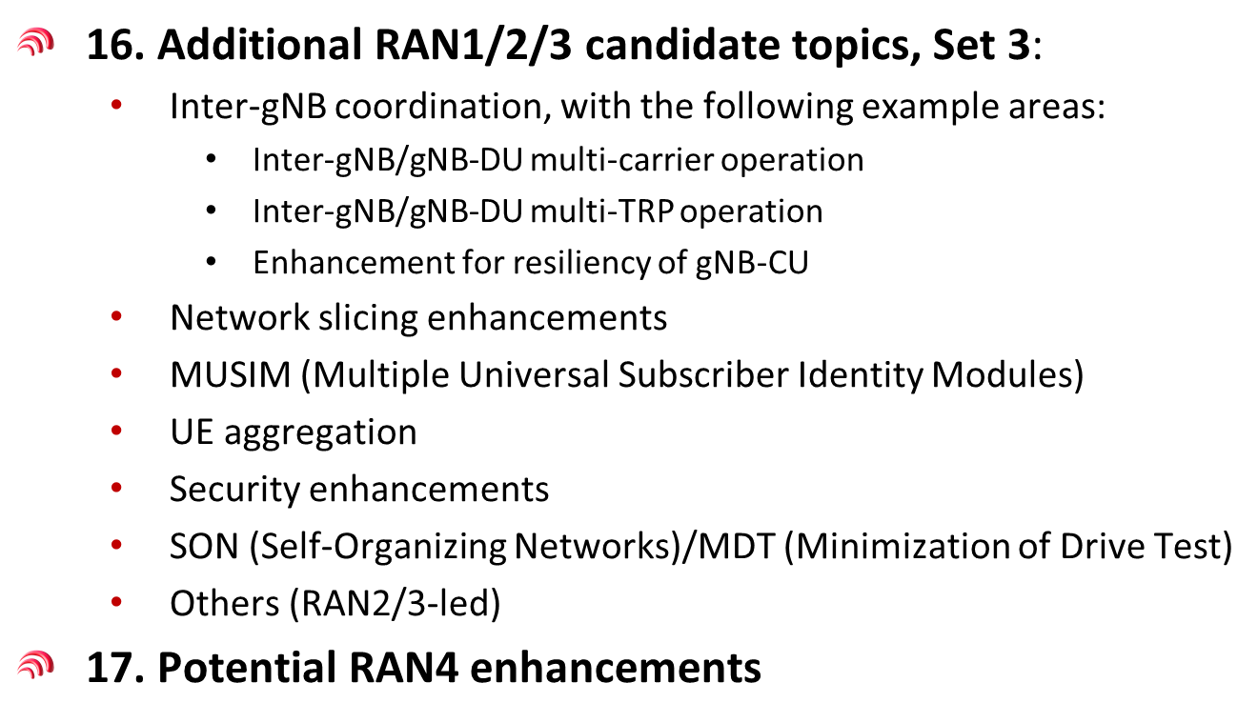
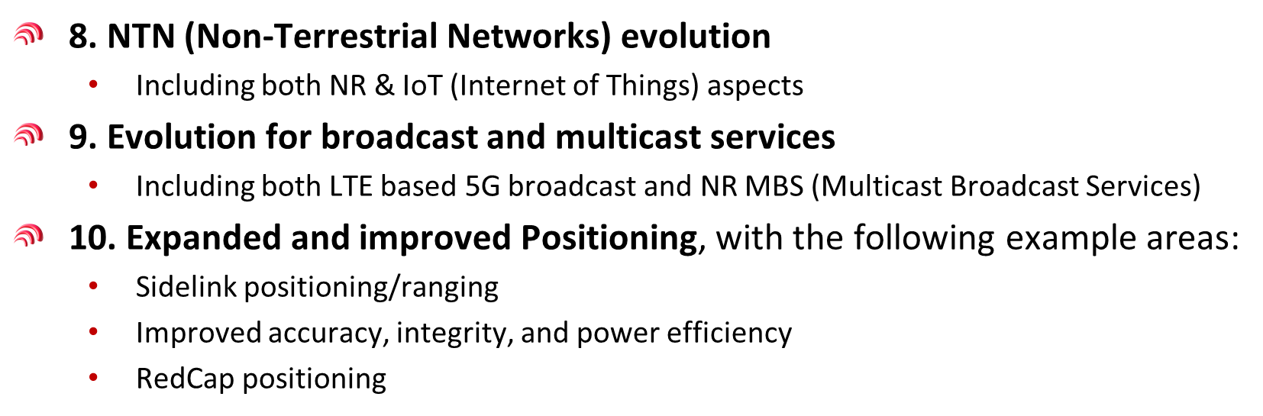
Potential SA5 relevance of RAN Rel-18 Workshop topics (ref:RWS-210659)
Summary of potential relevant topics:
1. The following topics are closely related to SA5 which need to synchronize SA5 time plan with RAN groups:
AI/ML
Network energy savings
Network slicing enhancements
SON/MDT
2. Other topics may potentially need management support after RAN has finalized their work, e.g.
Management support of new NR features, IAB, NTN etc.
Inputs rationale for discussion

Slide 6
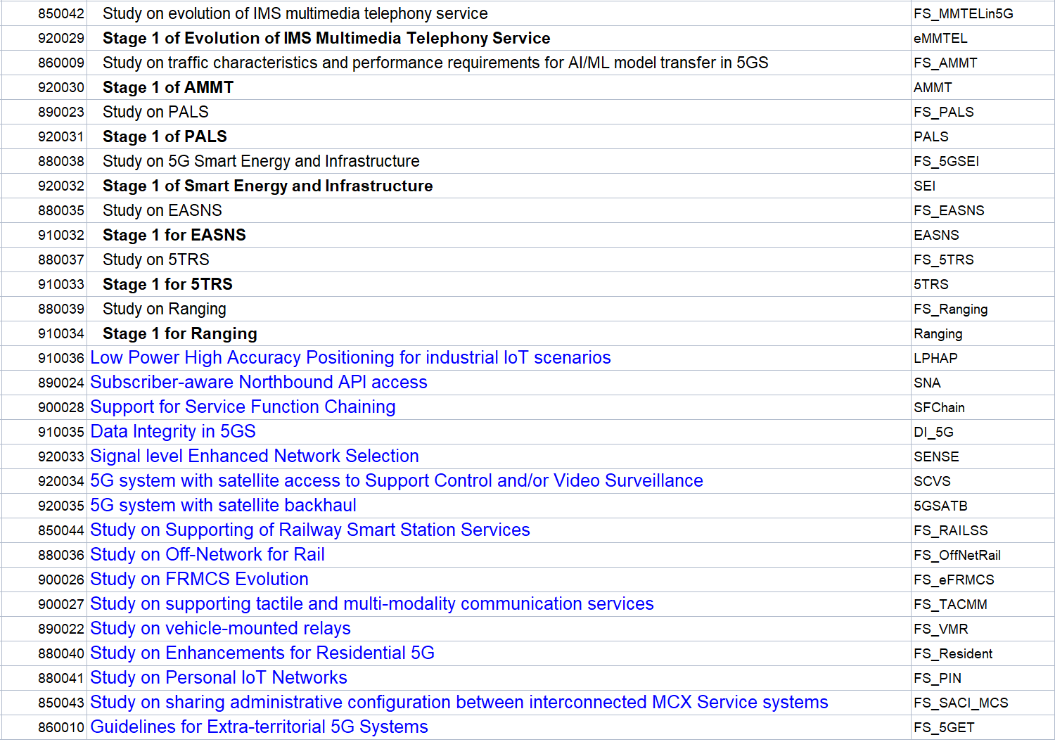
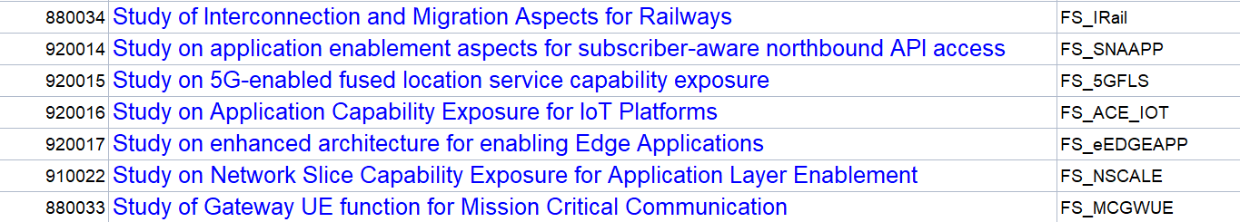
Potential SA5 relevance with SA1/SA2/SA6 agreed Rel-18 WI/SI
Inputs rationale for discussion
Summary of potential relevant topics:
SA5 work related to service management needs to consider the services defined in SA1.
The following topics are closely related to SA5 which need to synchronize SA5 time plan with SA2/CT4:
NWDAF related analytics topics
NRF/NEF related network configuration related topics
3. The following topics are closely related to SA5 which need to synchronize SA5 time plan with SA6:
Enhanced architecture for enabling Edge Applications
Network slice capability Exposure for Application Layer Enablement

Slide 7


List of categories for rel-18 SA5 work
Management and Orchestration
  Autonomous networks related topics
  Management exposure to Vertical industry
  Management of new services/new network functions/new network elements
  …..
Charging
  Rel-18 normative work based on ongoing studies expected conclusions:
    Enhancement of Nchf charging services
    5G roaming charging architecture for wholesale and retail scenarios
  Based on preliminary SA2 & SA6 Rel-18 architectures and functionalities availability: selection of charging items on top of these.

Slide 8
List of OAM topics under discussion (1/3)
1. enhancement of autonomous network levels, with the following example areas:
  …
  Collaboration with TMF, ETSI ZSM
2. Enhanced intent driven management services for mobile network, with the following example areas:
  New management scenarios for intent driven management and corresponding intent model enhancement (incl. radio network capacity intent expectation).
  New capabilities for intent driven management (incl. Intent confliction detection and resolution)
  Collaboration with TMF, ETSI ZSM
  3. Study on AI/ML management, with the following example areas:
  Collaboration with RAN on Rel-18 AI/ML work, collaboration with ETSI ZSM
  4. Self-Configuration of RAN Nes, with the following example areas:
  …
  Collaboration with RAN on Rel-18 SON work
  5. Enhancement of service-based management architecture, with the following example areas:
  Architectural support to autonomous networks
  Collaboration with TMF, ETSI ZSM
  6. Digital Twin for Network Management, with the following example areas:
  Use cases and requirements of digital twin for management
  Solutions for network management based on digital twin
  Interaction between digital twin network and network management system
  7. Federated Learning for Mobile Network Management, with the following example areas :
  Scenarios, requirements and solutions for FL
  Management aspects of federated nodes, e.g. authentication, registration, resource management

Slide 9
List of OAM topics under discussion(2/3)
  8. Study on enhancement management of non-public networks, with the following example areas:
  how the mobile network operator and vertical customer cooperate to realize management and orchestration of network in management mode 1b and 2b in TS 28.557.
  management of vertical tenant as an authorized NPN service consumer and the privilege of vertical tenant.
  management capability exposure to NPN based on the privilege of vertical tenant.
  NPN in RAN sharing scenarios.
  energy efficiency in NPN scenarios.
  convergence between NPN for an enterprise and the legacy operational technology (OT) network of the enterprise.
  9. Study on Deterministic Service Assurance Management, with the following example areas:
  Scenarios, general process, and related managed services for deterministic service assurance;
  Cross-domain and domain management collaborations to support E2E deterministic assurance;
  Potential requirements, conditions, constraints and solutions for deterministic service assurance for specific services (e.g. video monitoring, remote control etc.):
    In Network provisioning phase, network planning, verification and prediction based on deterministic service modelling and SLS requirements;
    In Operation phase, network optimization, verification and prediction solutions;
    Potential PM and FM enhancements to support deterministic services;
  10. Key Quality Indicators(KQIs)for 5G service experience, with the following example areas:
  The definition, scope and scenarios of the KQIs for 5G service experience. The KQIs of the typical services, e.g. services of Video Uploading, Remote Controlling and Cloud VR will be specified;
  The influencing factors for 5G service experience according to the example services;
  The mapping from KQI to network KPI if possible;
  The evaluation method and formula definition of related KQIs for the example services;
  The evaluation criterion of the KQIs for the example services;
  The relation with the SLS requirements.
  Collaboration with RAN on Rel-18 KPI/Performance measurements work

Slide 10
List of OAM topics under discussion(3/3)
11. Energy Efficiency of 5G, with the following example areas:
  Refine the estimates of 5G NF energy consumption in virtualized environment
  Extend existing VM-based EE KPI definitions to Containers
  New use cases and solutions for Energy Saving (incl. AI/ML assisted ES)
  Management aspects of TSG RAN energy saving functionalities
  Collaboration with RAN on Rel-18 Network Energy Saving work
12. Management aspects of traffic scheduling in terrestrial and satellite converged network, with the following example areas:
  Optimal connectivity topology and management between heterogeneous satellite constellation (including GEO, MEO and/or LEO).
  Traffic scheduling from terrestrial network to satellite network/from satellite network to terrestrial network
  Management functions/ deployments considerations on traffic scheduling in terrestrial and satellite converged network.
  Collaboration with RAN on Rel-18 NTN work??
13. Edge computing network management, with the following example areas:
  interworking with ETSI MEC??
  Interworking with GSMA??
  …
  14. Incident Management (Fault Management Evolution), with the following example areas:
  Concepts and characteristics of incident and incident management, relation with existing fault and performance management concepts;
  Scenarios and use cases of incidents, e.g. 5G SLA deterioration incidents, 5GC service risk incidents, and large-scale radio access network decommissioning incidents etc;
  Awareness, RCA, demarcation and close loop solutions for different types of incidents;
  Relation with eMDAS and eCOSLA;
  15. WID on network slice provisioning enhancement, with the following example areas:
  …
  Collaboration with SA2/SA6 on Rel-18 network slicing work??

Slide 11
List of Agreed OAM topics (1/)
  XXX

Slide 12
General principles for Rel-18 work in SA5
Align the SA5 Rel-18 time plan according to 3GPP SA overall time plan.
Work on concrete WI/SI proposals before SA#94e and try to finalize majority of Rel-18 work area before SA#94e (especially for the areas which has close relation with other SWGs).
Joint efforts and close coordination are needed on the following topics related to management and orchestration (to be updated with work progress) in Rel-18:
  RAN groups:
    AI/ML
    Network energy savings
    Network slicing enhancements
    SON/MDT
  SA2/CT4:
    NWDAF related analytics topics
    NRF/NEF related network configuration related topics
    Network slicing
  SA6:
    MEC configuration related topics
    Network slicing exposure
Joint efforts and close coordination are needed on the following topics related to Charging (to be updated with work progress):

Slide 13
Thank you!

