Slide 1
SA5 presentation for
SA Rel-18 workshop
SA5#138e, 23 – 31 August, 2021
Zou Lan, SA5 Vice-Chair, HUAWEI
Thomas Tovinger, 3GPP SA5 Chair, ERICSSON
Maryse Gardella, 3GPP SA5 Vice-Chair, NOKIA

Slide 2
Content
3GPP SA5 Rel-18 time plan
3GPP SA5 working relation with other groups
List of Rel-18 topics (under discussion)

Slide 3
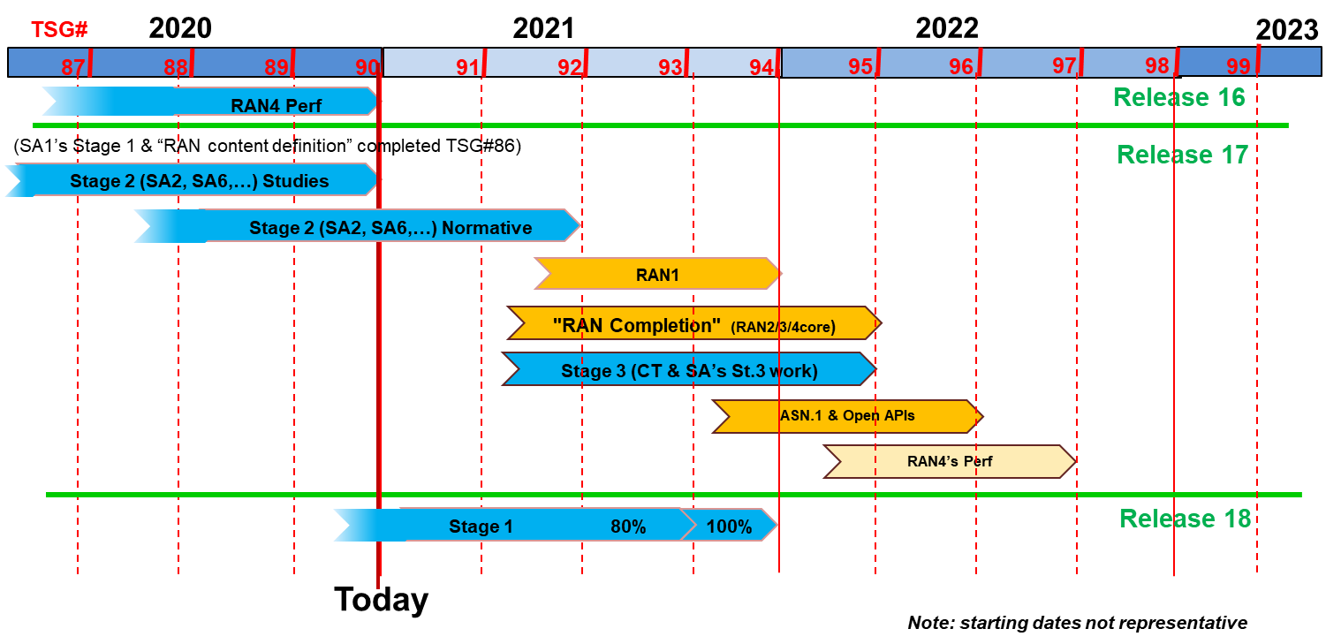
SA5 Release planning in accordance with 3GPP releases timelines
SA5 time plan
#135e
#136e
#137e
#138e
#139e
#140e
#141
#142
#143
No new R17 WI/SI
Rel-17
Schedule
R17 OAM stage 1
R17 OAM stage 2
R17 OAM stage 3
Rel-17 SA5 Charging
Rel-18
Schedule
(preliminary)
Start new
R18 WI/SI
R18 OAM stage 1
Rel-18 SA5 Charging

Slide 4

SA5 time planning
SA5 Release 17 Freezes and other milestones :
Closure of WI/SI proposal for OAM: No new Rel-17 WID/SID proposals to be submitted after SA5 #136e, except for new WIDs which have a corresponding (existing) Rel-17 study item.
Sep.2021 (SA5# 138e/TSG#93): OAM Stage 1 freeze except requirements which supporting other groups
Dec.2021 (SA5# 140e/TSG#94): Stage 2 freeze
Mar.2022 (SA5# 141/TSG#95): Stage 3 freeze
SA5 Release 18 planning：
Aug.2021 (SA5# 138e): first meeting to discuss new Rel-18 WID/SID proposals and ideas for OAM.
Jan. 2022 (SA5#141): first meeting to start new Rel-18 WID/SID for CH.
Jun.2022 (SA5# 143/TSG#96): OAM Rel-18 Stage 1 freeze (may adjust according to SA overall time plan)
Rel-18 stage 2/stage 3: TBD, will follow SA overall time plan.

Slide 5
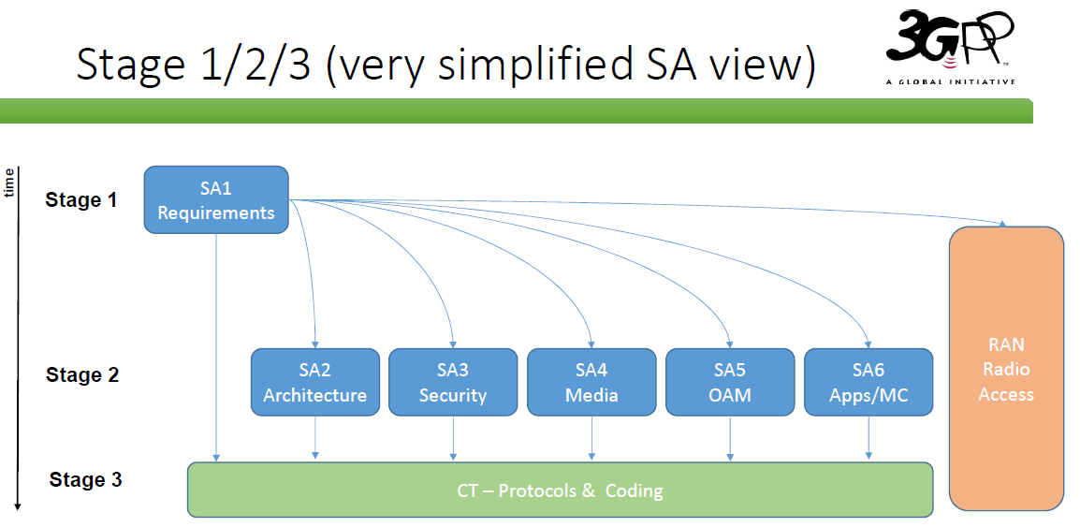
Ref: SA#86 3GPP Newcomer Orientation.pdf

Slide 6
Detailed view of SA5 relation with other groups
1. SA1 Management requirements refer to SA5 management specifications. SA1 charging requirements as input to SA5 CH
2. Take GSMA requirements as SA5 OAM and CH input.
3. Align the MnS with ZSM if needed
4. ONAP reuses SA5 management MnS
5. Collaboration with SA2 on architecture and CN management
6. Collaboration with SA4 on QoE management
7. Provide inputs to CT
8. Collaboration with RAN on RAN management
9. SA2 input to SA5 CH
10. SA6 input to SA5 CH
11. OAM input to SA5 CH
12. Part of SA5 CH stage 3 aligned with CT stage 3 framework
SA1
Requirements
GSMA
time
Stage 1
1
2
ETSI ZSM
SA5 OAM
Stage 1
3
11
RAN
Radio Access
5
SA5 OAM
Stage 2
SA5 CH
Stage 1&2
10
Stage 2
9
6
ONAP
8
7
4
SA2
Architecture
SA3
Security
SA4
Media
SA5 OAM
Stage 3
SA5 CH
Stage 3
SA6
Apps/MC
12
Stage 3
CT – Protocols & Coding
Update of S5-212330

Slide 7


List of categories for rel-18 work
Management and Orchestration
  Autonomous networks related topics
  Management support to Vertical industry
  Management of new network functions/new network elements
  …..
Charging
  Rel-18 normative work based on ongoing studies expected conclusions:
    Enhancement of Nchf charging services
    5G roaming charging architecture for wholesale and retail scenarios
  Based on preliminary SA2 & SA6 Rel-18 architectures and functionalities availability: selection of charging items on top of these.

Slide 8
General principles for Rel-18 work
1.

Slide 9
List of topics under discussion
1. XXX, with the following example areas:
  ...
  …
2. YYY, with the following example areas:
  …
  …
3. ZZZ, with the following example areas:
  …
  …

Slide 10
Thank you!

