Slide 1
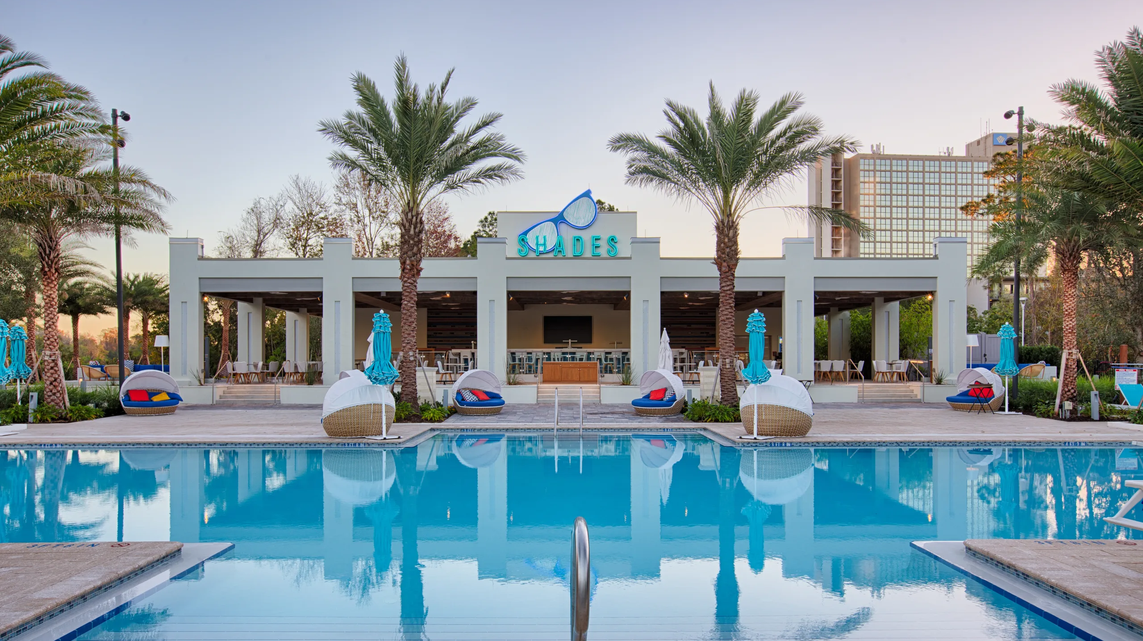
SA4 Social Gathering at Hilton Wyndham Pool Bar
Thursday, November 21 2024 at 1900

Slide 2
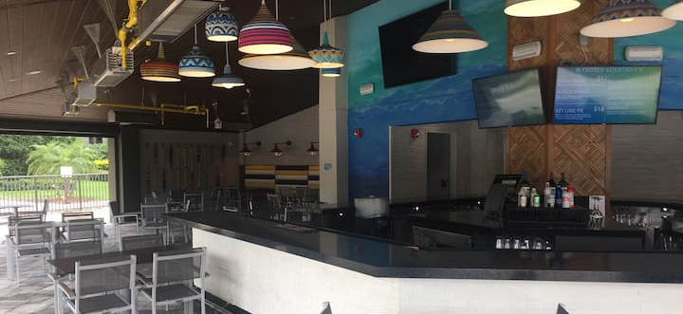
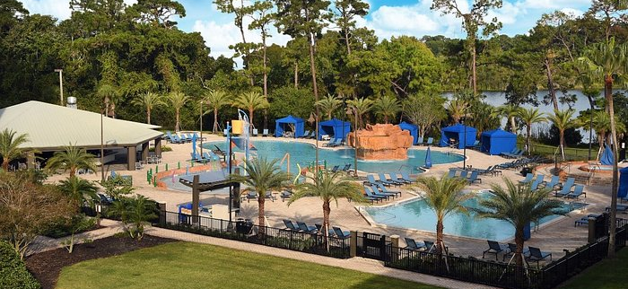
Details
After checking different options, decided to make it simple. A good advice in general
Plan:
  can just go there and have drinks for 1 hour, then people can head off for dinner.
  Everyone is invited
  Everything will be self-paid at the pool bar – serve beer and drinks - food is available
  You may also bring your swimming clothes and jump into the water

Slide 3

