Slide 1
ITU-R Study Group 6
Broadcasting Service
Yukihiro Nishida
Chair Study Group 6
Amir Nafez
Chair Working Party 6A
Paul Gardiner
Chair Working Party 6B
Andy Quested
Chair Working Party 6C

Slide 2
ITU-R Study Group 6
Broadcasting Service
Study Group 6
Working Party 6A
Terrestrial broadcasting delivery
Working Party 6B
Broadcast service assembly and access
Working Party 6C
Programme production and quality assessment
Task Group 6/1
WRC-23 agenda item 1.5

Slide 3
Working Party 6A Activities
Systems
Second generation DTTB systems - Rec. BT.1877
Advanced transmission technologies - New Report
5G broadcast system
Methods for introduction of new services
Protection of broadcasting
Monte Carlo simulation for assessing interference - Rec BT.2136
Spectrum requirements for DTTB in UHF band - Rep BT.2302

Slide 4
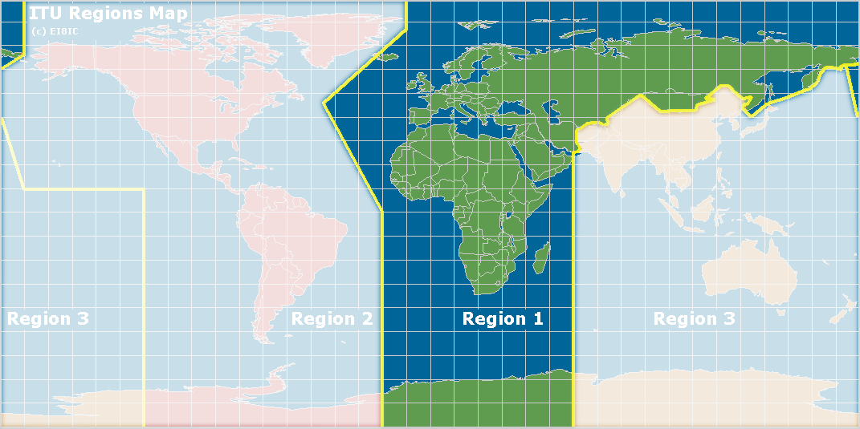
Task group 6/1
Develop draft CPM text under WRC-23 Agenda Item1.5
Review the spectrum use and spectrum needs of existing services in the frequency band 470-960 MHz in Region 1
Consider possible regulatory actions in the frequency band 470-694 MHz in Region 1 on the basis of the review in accordance with Resolution 235 (WRC-15)

Slide 5
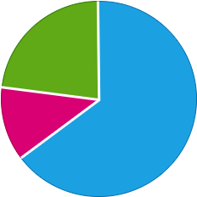
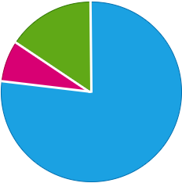
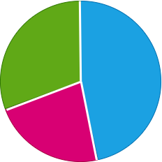
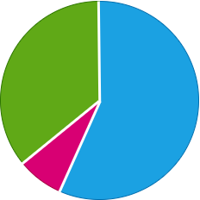
Report ITU-R BT.2302 - Intention for More Services
Protection of Spectrum
Q16. Do you anticipate the introduction of more programme on DTTB in your country in the future
Q17. Do you anticipate the introduction of enhanced services (e.g. HDTV, UHDTV HDR, other) on DTTB in your country in the future
16 (21%)
12 (15%)
4 (5%)
52 (69%)
62 (80%)
7 (10%)
Q18. Do you foresee the need to allow for additional reception modes (e.g. portable, mobile) on DTTB in your country in the future?
Q19. Do you use or plan to use interactive broadcast broadband (IBB) on your DTTB platform
Yes
27 (35%)
22 (29%)
35 (45%)
No
43 (55%)
20 (26%)
Don’t Know
8 (10%)

Slide 6
Working Party 6B Activities
Audio metadata for broadcasting
Interactive and object-based sound broadcasting
Audio definition model (ADM) - Rec. BS.2076
Transport of non-PCM audio and data including Rec. BS.2125 Serial ADM
Broadband
Integrated Broadcast (IBB) systems - Rec. BT.2075 and Rep. BT.2267
Interfaces and Delivery
IP-based interfaces - Rec. BS.2137
Serial digital interfaces – Rec. BT.2077
Global platform for broadcasting – Rep. BT.2400

Slide 7
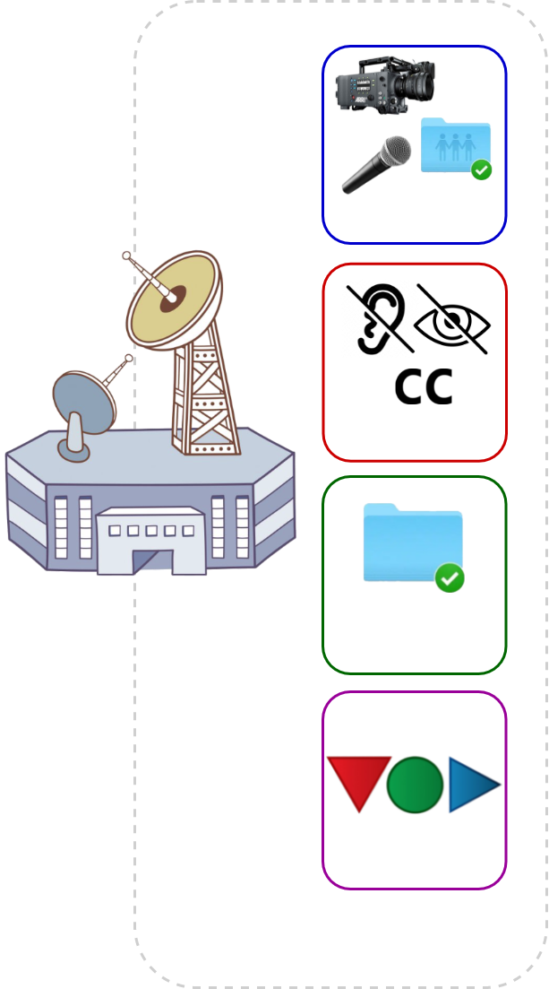
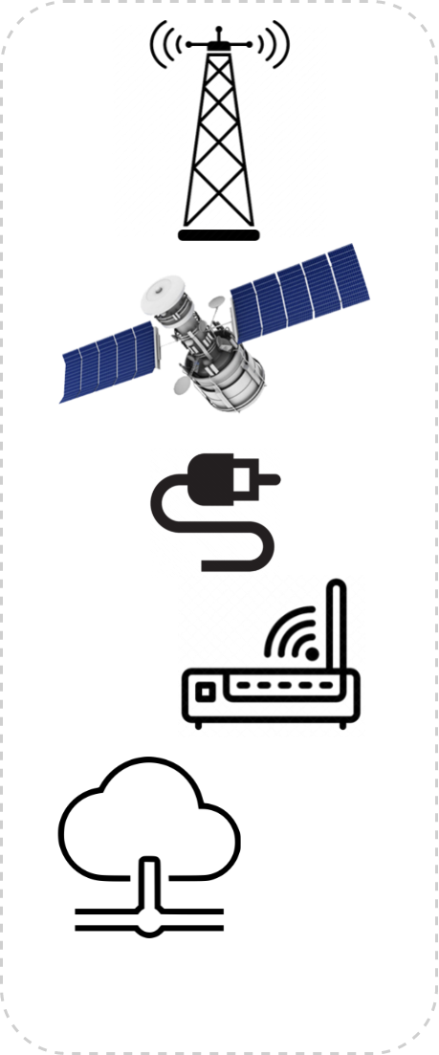
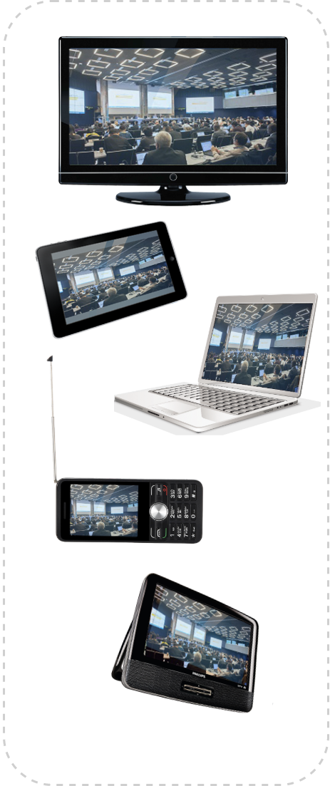
Working Party 6B Activities
A Global Platform for Broadcasting
Rep. ITU-R BT.2400

Slide 8
Working Party 6C Activities
High Dynamic Range (HDR) Television - Rec BT.2100
Guidance HDR operational practices - Rep. BT.2390 and Rep. BT.2408
Conversion between HDR and SDR – Rep. BT.2446
Audio
Renderer for object-based sound - Rec. BS.2127
Quality evaluation
Consolidation of subjective video quality assessment in Rec. BT.500
Advanced Immersive Sensory Media & Artificial Intelligence
360-deg video - Rec. BT.2123
Use cases for programme production - Rep. BT.2447 & BT.2420
Accessibility and personalization - Rep. BT.2207

Slide 9
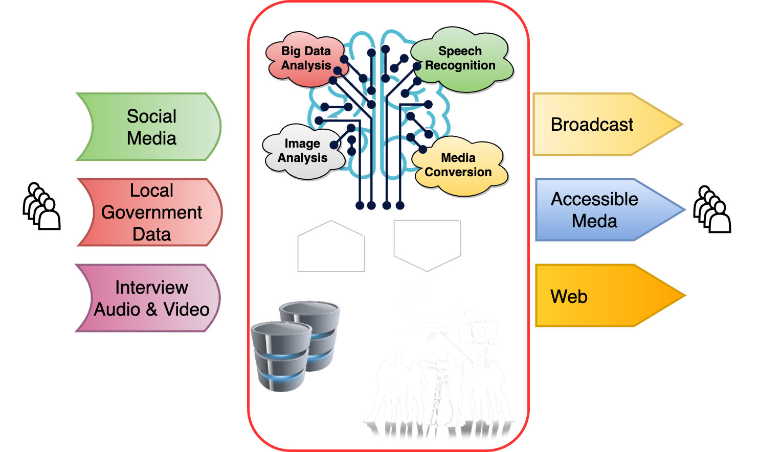
Working Party 6C Activities
Advanced Immersive Audio-visual Systems & AI
Potential new technologies for content creation
Programme production
Data mining, big data analysis
Language translation
Text-voice/voice-text translation
Visual/speech recognition
Quality evaluation
Audio & Video compression
Access service
System monitoring & diagnosis
Rep. ITU-R BT.2447

Slide 10
Future of Broadcasting
ITU-R Resolutions 70 and 71
Changing ICT environment
Viewers & listeners enjoy audiovisual content delivered through growing number of platforms and reproduced on wide variety of user terminals.
Increasing spectrum needs
Worldwide deployment of IMT and IMT-2020 or ‘5G’
Unchanging role of broadcasting
Most effective and trusted way to deliver information, education, culture, and entertainment to large audiences.

