Slide 1
FS_Ranging_SL Status Report
S2-2211390
Sherry (Yang) Shen
Xiaomi (Rapporteur)

Slide 2
FS_Ranging_SL status after SA2#154 (1/2)
WI Code | Work Item Title | WP | Target Date | WID#
FS_Ranging_SL | Study on Ranging based services and sidelink positioning | 70% > 85% | Jan, 23 | SP-211647
 | Key Issues
Solutions | 1 | 2 | 3 | 4 | 5 | 6 | 7 | 8
1 | X |  |  |  |  |  |  | X
2 | X
3 |  |  |  | X
4 |  |  | X | X
5 |  |  | X | X
6 |  |  |  |  | X
7 |  |  |  |  | X
8 |  |  |  |  | X
9 |  |  |  |  |  | X
10 |  |  |  |  |  | X
11 |  |  |  |  |  | X
12 |  |  |  |  | X |  | X
13 |  |  |  |  |  |  | X
14 | X | X | X | X | X | X | X | X
15 |  |  |  |  |  |  |  | X
16 |  | X
17 |  | X
18 |  |  | X
19 |  |  |  | X | X
20 |  |  |  |  | X
21 |  |  |  |  | X
22 |  |  |  |  |  | X | X
23 |  |  |  |  |  |  | X
24 |  |  |  |  |  |  | X
25 |  |  |  |  |  | X
26 |  | X | X | X | X | X | X
27 |  | X | X | X | X | X | X
28 |  | X | X | X | X | X | X
29 |  | X
30 |  | X
31 |  |  |  |  | X
32 |  |  |  | X | X
33 |  |  |  |  |  | X | X
34 |  | X |  |  |  | X
General
The latest TR 23.700-86 is available here: http://www.3gpp.org/ftp/Specs/archive/23_series.
Total TUs requested for Study Phase is 3.5 TUs. 3 TU is used, and 0.5 TU is remaining
Evaluation & Conclusion for the 8 KIs and 1 new solutions (Solution#34) are added
6 Solutions are updated (#6, #10, #19, #20, #31, #32)
1 LS sent to RAN WGs for RAN dependent issues
New WID created.
34 solutions and their mapping to Key Issues (see the table)
RAN impacts and dependencies:
Terminologies
RAN impacts or dependencies identified for Key Issue #1, #2, #3, #4, #5 and #8 and their corresponding solutions
SA3 dependencies：
Privacy protection and other security aspects identified in Solution #6, #9, #11, #13, #17, #18, #19, #20, #21, #24, #25, #31, #33 and #34.
Contentious Issue:
TR completion postponed to Jan. 2023, due to no TU on #154.

Slide 3
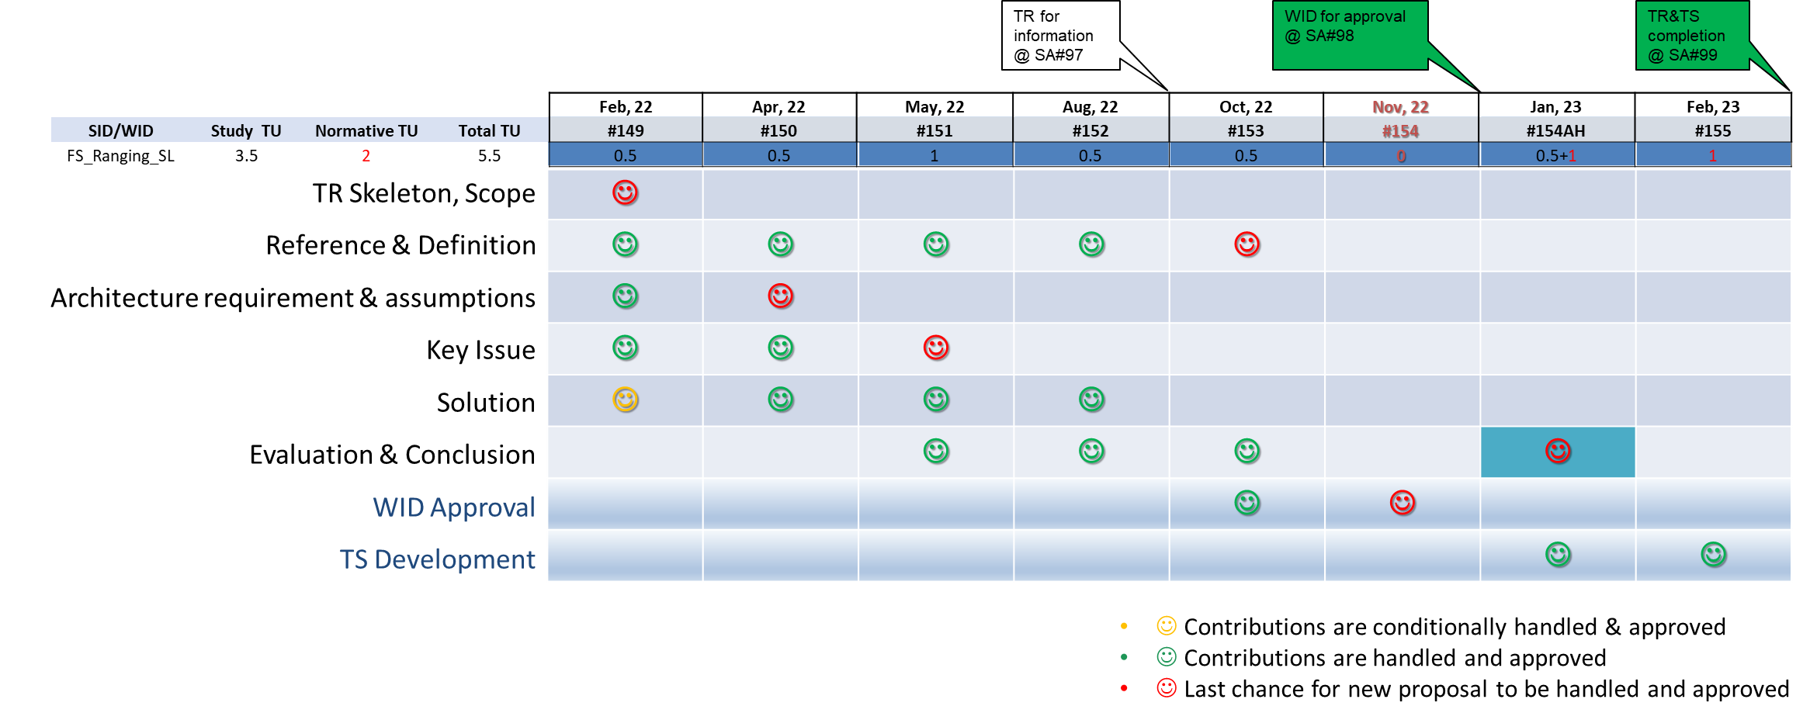
FS_Ranging_SL status after SA2#154 (2/2)
Focus for the Next Meeting:
SA2#154AH: No updates to definition, Key Issues and Architecture Requirements&Assumptions (except editorial changes and issues remarked with EN), no new solution, finalize existing solutions & the Evaluation&Conclusions and start normative work which are concluded in the TR.
Overall Plan:

Slide 4
FS_Ranging_SL status at SA#98e
WI Code | Work Item Title | WP | Target Date | WID#
FS_Ranging_SL | Study on Ranging based services and sidelink positioning | 70% > 85% | Jan, 23 | SP-211647
Progress since SA#97-e:
Evaluation & Conclusion for the 8 KIs and 1 new solutions (Solution#34) are added
6 Solutions are updated (#6, #10, #19, #20, #31, #32)
1 LS sent to RAN WGs for RAN dependent issues
New WID created on SA2#154
RAN impacts and dependencies:
Terminologies
RAN impacts or dependencies identified for Key Issue #1, #2, #3, #4, #5 and #8 and their corresponding solutions
SA3 dependencies：
Privacy protection and other security aspects identified in Solution #6, #9, #11, #13, #17, #18, #19, #20, #21, #24, #25, #31, #33 and #34
Next steps:
SA2#154AH: No updates to definition, Key Issues and Architecture Requirements&Assumptions (except editorial changes and issues remarked with EN), no new solution, finalize existing solutions & the Evaluation&Conclusions and start normative work which are concluded in the TR.

