Slide 1
SA2 FS_eLCS_Ph3 Work Plan
CATT, Huawei
S2-220xxxx

Slide 2
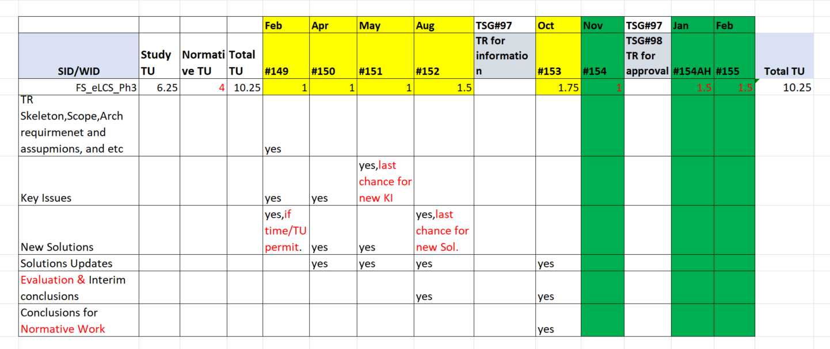
FS_eLCS_Ph3 Work Plan (was discussed in SA2#149e)
Will propose first draft of WID in #152, and try to get WID approved in #153.
Normative work happens in #154, #154AH, #155.
NOTE ADDED THIS TIME: Key issues have RAN dependency may need more time to finish.
S2-2200xxxx

Slide 3
Status till Now and Next steps : 1/2
Key Issues | RAN dependency? | Candidate Solutions | Next Step
#1: Architectural Enhancement to support User Plane positioning | No. | #1,#2,#3,#19 | Concluded this Oct. Start TS work since Nov.
#2: Enhanced positioning architecture for NPN deployment | Yes | #4,#5 | Concluded this Oct. Start TS work since Nov.
#3: Local Area Restriction for an LMF and GMLC | No. | #6,#7,#8,#9 | Concluded this Oct. Start TS work since Nov.
#4: Interaction between Location Service and NWDAF | No. | #10,#11,#12,#13,#18,#20 | Co-ordinates with FS_eNA_Ph3. Concluded In Oct. Start TS work since Nov.
#5: Assistance data provisioning for low power high accuracy GNSS positioning | No. | #21 | Concluded this Oct. Start TS work since Nov.
#6: UE Positioning without UE/User Awareness | Maybe | #14 | Try to Concluded this Oct . Start since Nov.
S2-2200xxxx

Slide 4
Status till Now and Next steps: 2/2
Key Issues # : Name | RAN dependency? | Candidate Solutions | Next Step
#7: support of Positioning Reference Units and Reference UEs | Yes. | #15,#16,#17; | RAN finalized PRU work in Rel-17, SA2 can concluded this Oct. Start TS work since Nov.
#8: support of location service continuity in case of UE mobility | Yes. | #22 | Try to Concluded this Nov. Start TS work Next Year.
#9: Support of Positioning Requirements Related to Satellite Access | Yes. | #18,#23,#24 | Co-ordinates with RAN. Try to conclude this KI this Nov ?
#10: Support of Reduced Latency | No. | #1,#19 | Concluded this Oct. Start TS work since Nov.
#11: Enhance the Triggered Location for UE power saving purpose | No. | #25 | Concluded this Oct. Start TS work since Nov.
#12: support of low power and/or high accuracy positioning | Maybe | #26 | Concluded this Oct. Start TS work since Nov.
S2-2200xxxx

Slide 5
Head Up for Location Experts:
Following Studies have Key Issues and solutions may need coordination with this FS_eLCS_PH3 Study.
Location experts are encouraged to look at those, and to contribute.
Study Name | Key Issues # : Name | Candidate Solutions
FS_Ranging_SL | #5: Network assisted Sidelink Positioning for In Network Coverage and Partial Network Coverage | #6,#7,#8,#14,#20,#21,#26,#27,#28;
FS_VMR | #5: Support of location services for UEs accessing via a mobile base station relay | #7,#8,#14,#15;
S2-2200xxxx

