Slide 1
FS_Ranging_SL Status Report
S2-2206980
Sherry (Yang) Shen
Xiaomi (Rapporteur)

Slide 2
FS_Ranging_SL status after SA2#152E (1/2)
WI Code | Work Item Title | WP | Target Date | WID#
FS_Ranging_SL | Study on Ranging based services and sidelink positioning | 60% > 70% | Jan, 23 | SP-211647
General
The latest TR 23.700-86 is available here: http://www.3gpp.org/ftp/Specs/archive/23_series.
Total TUs requested for Study Phase is 3.5 TUs. 2.5 TU is used, and 1 TU is remaining
Terminologies are updated for RAN alignments
5 new solutions added in TR 23.700-86 v0.4.0.
33 solutions and their mapping to Key Issues (see the table)
RAN impacts and dependencies:
Terminologies
RAN impacts or dependencies identified for Key Issue #4, #5 and #8 and their corresponding solutions, i.e. Solution #3, #4, #5, #6, #7, #8, #14, #19, #26, #28, #31 and #32.
SA3 dependencies：
Privacy protection and other security aspects identified in Solution #6, #9, #11, #13, #17, #18, #19, #20, #21, #24, #25, #31 and #33.
Contentious Issue:
None
 | Key Issues
Solutions | 1 | 2 | 3 | 4 | 5 | 6 | 7 | 8
1 | X |  |  |  |  |  |  | X
2 | X
3 |  |  |  | X
4 |  |  | X | X
5 |  |  | X | X
6 |  |  |  |  | X
7 |  |  |  |  | X
8 |  |  |  |  | X
9 |  |  |  |  |  | X
10 |  |  |  |  |  | X
11 |  |  |  |  |  | X
12 |  |  |  |  | X |  | X
13 |  |  |  |  |  |  | X
14 | X | X | X | X | X | X | X | X
15 |  |  |  |  |  |  |  | X
16 |  | X
17 |  | X
18 |  |  | X
19 |  |  |  | X
20 |  |  |  |  | X
21 |  |  |  |  | X
22 |  |  |  |  |  | X | X
23 |  |  |  |  |  |  | X
24 |  |  |  |  |  |  | X
25 |  |  |  |  |  | X
26 |  | X | X | X | X | X | X
27 |  | X | X | X | X | X | X
28 |  | X | X | X | X | X | X
29 |  | X
30 |  | X
31 |  |  |  |  | X
32 |  |  |  | X | X
33 |  |  |  |  |  | X | X

Slide 3
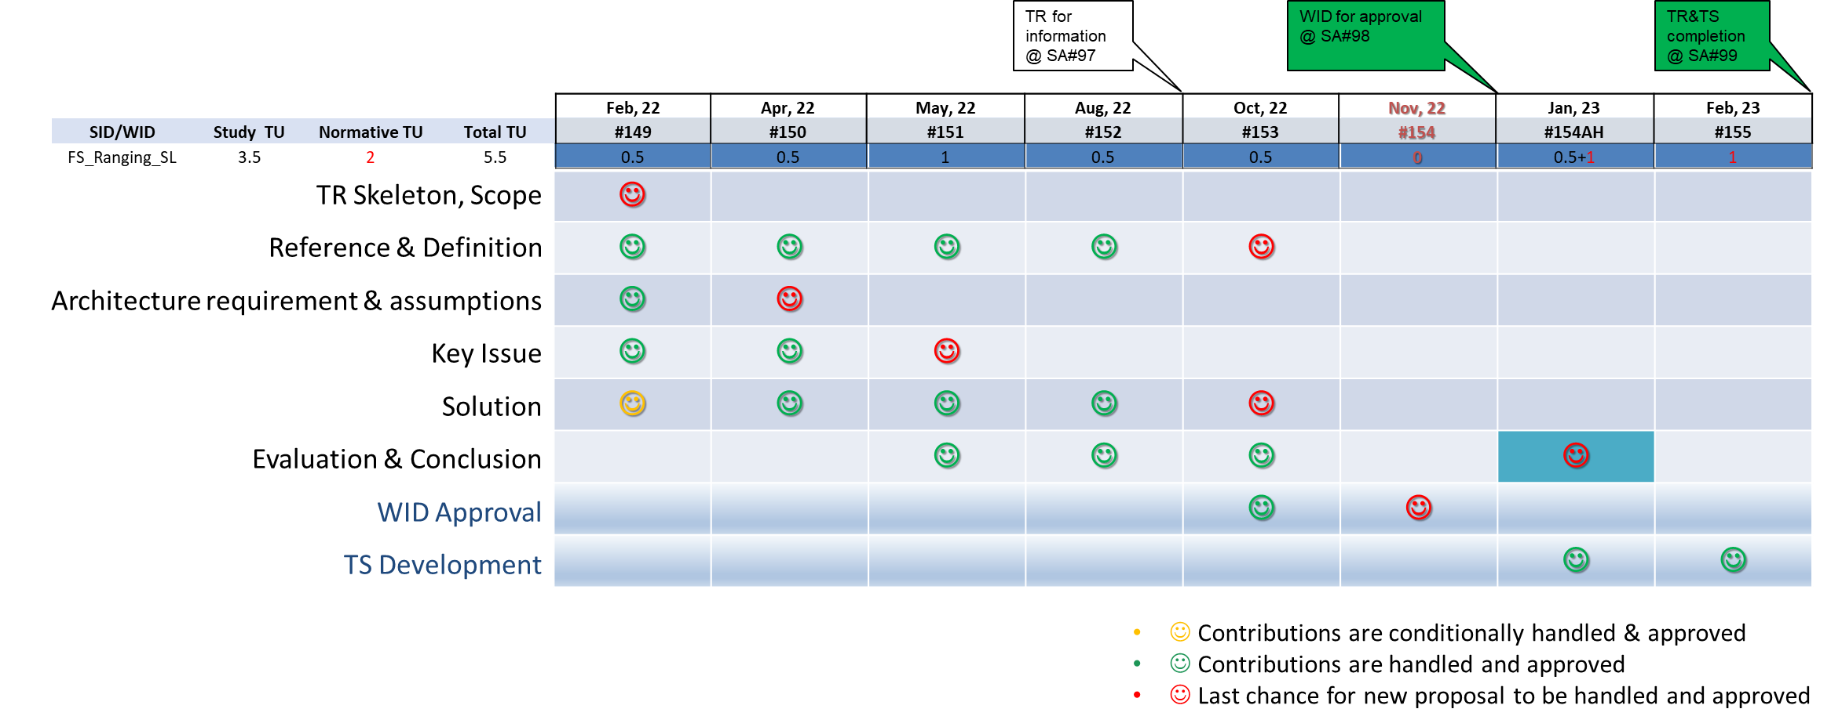
FS_Ranging_SL status after SA2#152E (2/2)
Focus for the Next Meeting (SA2#153E):
No updates to Key Issues and Architecture Requirements&Assumptions (except editorial changes and issues remarked with EN), continue with definition and solution updates, start Evaluation&Conclusions, new WID proposal
Last Chance of new solutions, but they will be handled with low priority.
Overall Plan:

Slide 4
FS_Ranging_SL status at SA#97e
WI Code | Work Item Title | WP | Target Date | WID#
FS_Ranging_SL | Study on Ranging based services and sidelink positioning | 60% > 70% | Jan, 23 | SP-211647
Progress since SA#96-e:
Terminologies are updated for RAN alignments
5 new solutions added, 6 solutions updated
1 LS related to terminology alignments sent to RAN1, RAN2, RAN3
RAN impacts and dependencies:
Terminologies
RAN impacts or dependencies identified for Key Issue #4, #5 and #8 and their corresponding solutions, i.e. Solution #3, #4, #5, #6, #7, #8, #14, #19, #26, #28, #31 and #32
SA3 dependencies：
Privacy protection and other security aspects identified in Solution #6, #9, #11, #13, #17, #18, #19, #20, #21, #24, #25, #31 and #33
Next steps:
No updates to Key Issues and Architecture Requirements&Assumptions (except editorial changes and issues remarked with EN), continue with definition and solution updates, start Evaluation&Conclusions, new WID proposal
Last Chance of new solutions, but they will be handled with low priority.

