Slide 1
SA WG2 Status report for FS_ATSSS_Ph3
Apostolis Salkintzis
Lenovo

Slide 2
FS_ATSSS_Ph3 status after SA2#152e
WI Code | Work Item Title | WP | Target Date | WID#
FS_ATSSS_Ph3 | Study on Access Traffic Steering, Switching and Splitting support in the 5G system architecture; Phase 3 | 70% > 80% | Sep. 2022 > Dec. 2022 | SP-211612
TR 23.700-53 is provided for Information
Progress since SA#96-e:
SID updated to move TSG approval to Dec. 2022 (from Sep. 2022)
6 TUs requested for the study phase; 1 TU remaining (for Oct. e-meeting)
1 P-CR agreed for KI#2 (no conclusions yet)
Evaluation and conclusions agreed for KI#3 (some EN remain)
Evaluation and conclusions agreed for KI#5 (some EN remain)
Evaluation and conclusions agreed for KI#6
RAN impacts and dependencies:
None
Next steps:
Finalize conclusions for all KIs

Slide 3
FS_ATSSS_Ph3 status after SA2#152e
RAN and SA3 impacts and dependencies:
None for RAN
1 issue identified for SA3: “Whether and how encryption in the QUIC layer can be omitted is FFS and need to be verified by SA3.”
Contentious Issue:
None
Focus for the Next Meeting (SA2#153e):
Finalize the existing solutions and resolve the ENs.
Finalize the conclusions for all KIs.
Complete the study and submit it for TSG approval in Dec. 2022
Overall Plan:
See next slide
Risks:
None identified

Slide 4
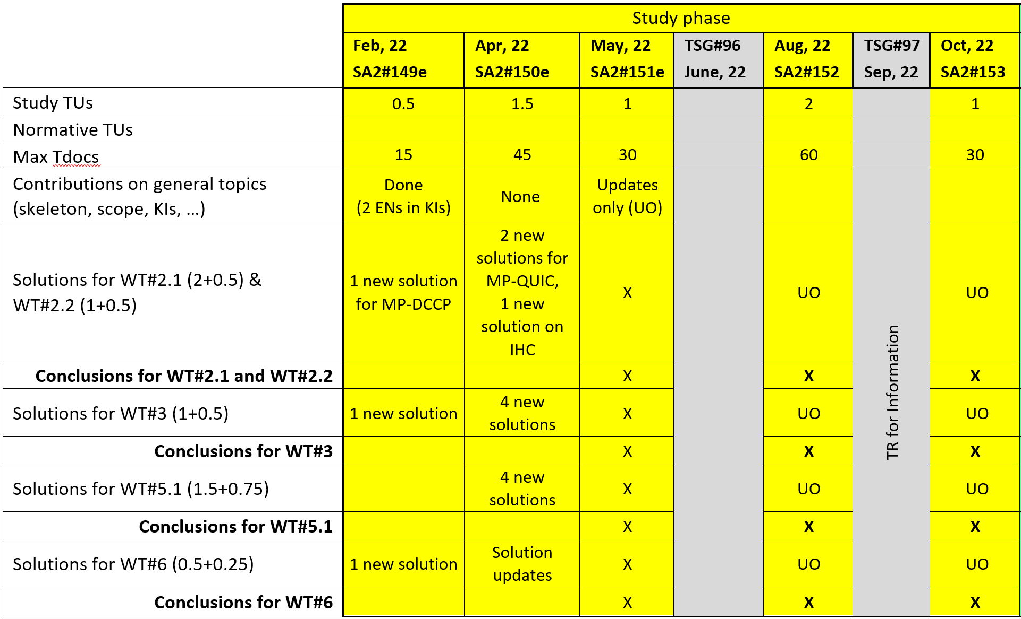
FS_ATSSS_Ph3 status – Working plan
Fully complete the study in Oct. 2022.
TR for information @TSG#97 and for approval @TSG#98 (Dec. 2022).

