Slide 1
Multipath Re-ordering findings
3GPP SA2 Rel. 18 study phase CC on KI#2
Deutsche Telekom, Alibaba, BT, Tencent
Markus Amend, Dieter Gludovacz

Slide 2
KI#2 solution
Goal: Enhanced throughput with traffic splitting beyond single-path
Challenge: Splitting introduces significant Jitter and Out-of-order
Observation: Today services struggle with high Jitter and Out-of-order
Solution: Re-ordering and path latency difference compensation
Side-effect: Duplicate packet filtering for KI#3

Slide 3
Why is re-ordering needed?
Access propagation difference can be expected in the order of several tens of milliseconds.
Therefore, disjoint path propagation introduces
huge amount of out-of-order delivery and
significant jitter
not comparable with today‘s single path transmission.
Problem: E2E QUIC based services are sensitive to out-of-order generated duplicate ACKs, like TCP, and reduce throughput.
Problem: E2E QUIC using latency sensitive Congestion Control, e.g. BRR as used in Google‘s universe, reduce performance when jitter is experienced.
Re-ordering overcomes disjoint path characteristics and provides performance beyond single path
Measurement w/o re-ordering
TCP E2E
QUIC E2E

Slide 4
Can Re-ordering be left to implementation?
Different implementations can be expected in UE and UPF
no implementation to
support of partial or
very comprehensive re-ordering
May not be activated or de-activated
Inconsistent implementations in UE and UPF might lead to
worse performance than single-path
different Up- and Downlink experience
Minimum requirement to be supported by each implementation
Measurement w/ partial re-ordering
BBR E2E

Slide 5
Why MP-QUIC stream is not a good idea?
Imposes strict reliability with re-transmission and strict in-order delivery to E2E traffic
Dominant future user traffic expected to be HTTP3/QUIC, i.a. strict reliability and in-order.
Problem 1: Nested reliability with re-transmission and in-order delivery
Problem 2: No solution for latency variance due to path latency difference
Measurements conducted by MPTCP enthusiasts have shown very bad performance tunneling QUIC over MPTCP. From the characteristic, this is effectively the same as QUIC over MP-QUIC in stream mode.
Phenonema is well known and denoted as TCP Meltdown

Slide 6
Why specifying re-ordering in 3GPP?
Ensure KI#2 performance better than single-path for any traffic which is not known to be re-ordering robust.
→Proposal 1: ATSSS Phase 3 to provide a solution for a switch to activate or de-activate re-ordering in the context of a MA-PDU session

Slide 7
How specifying re-ordering in 3GPP?
Implement one mechanism which is known to deliver best performance across any traffic types
→Proposal 2: ATSSS Phase 3 to specify one re-ordering including path latency difference compensation
Use re-ordering sequencing for duplicate packet detection and filtering
→Proposal 3: Consider re-ordering for redundant steering mode KI#3.
Measurement

Slide 8
Backup

Slide 9
Why Reordering is not provided by IETF?
IETF doesn‘t show any activity to treat re-ordering in scope of any of the MP-protocol developments.
In that it follows the pure focus on the protocol design and doesn‘t care about traffic distribution or re-assembly. For that reason 3GPP had to define steering modes on top of MP protocol.
The only known document on re-ordering is located as informational research document from an individual in IRTF.
→ Even if work would start today at IETF no meaningful output can be expected within Rel. 18 time frame.

Slide 10
General observations shared in S2-2203965
Observation 1: Latency/Jitter and Out of order packet delivery are even bigger challenges in multi-path than in single path scenarios.
Observation 2: TCP's and QUIC's reliable and in-order delivery transport characteristic is ensured by flow and congestion control with specific demand on latency/jitter and order of delivery.
Observation 3: There exists UDP traffic which does not need flow and/or congestion control at all or with lower quality demand on latency/jitter and order of delivery.
Observation 4: Non-TCP traffic mix ranges between UDP and TCP-like requirements with different demands on in-order delivery and stable latency.
Observation 5: All solutions discussed for non-TCP traffic splitting must cope with this broad range of transport requirements.
Observation 6: At the last SA2#150e meeting it was widely acknowledged, that re-ordering is a necessity.
Observation 7: Re-ordering for MP-DCCP or MP-QUIC is not on the roadmap of IETF.
Observation 8: MPTCP or MP-QUIC (without DATAGRAM) as such are not suitable for in-order delivery for non-TCP traffic.
Observation 9: Test results show re-ordering can greatly improve the performance/throughput of reliable flows (e.g. QUIC traffic) with strict in order requirement.
Observation 10: For services without sensitivity to reliability and order of delivery work well without re-ordering, otherwise re-ordering is needed.

Slide 11
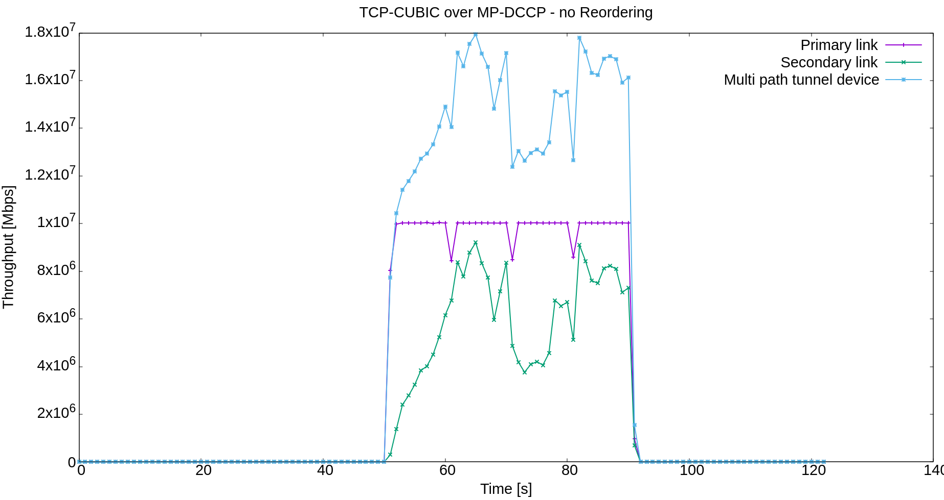
Measurement w/o re-ordering carrying TCP
Back
Packets entering the ATSSS receiver are forwarded in the order they arrive.
Setup: Priority based steering mode with preference on low-latency path, Path delay difference 15ms, 10Mbps both links
Note: Average goodput measured by iPerf = 12.0 Mbits/sec and indicates, as per the measurement diagram, that throughput is wasted for unnecessary re-transmissions.
Out-of-order data reception causes Duplicate Acknowledgements (DupACKs) in TCP, which TCP’s congestion control (CC) interprets as error prone transmission. Consequently, the CC reduces the send window to avoid overflowing into the secondary path, impacting the total achievable throughput adversely.

Slide 12
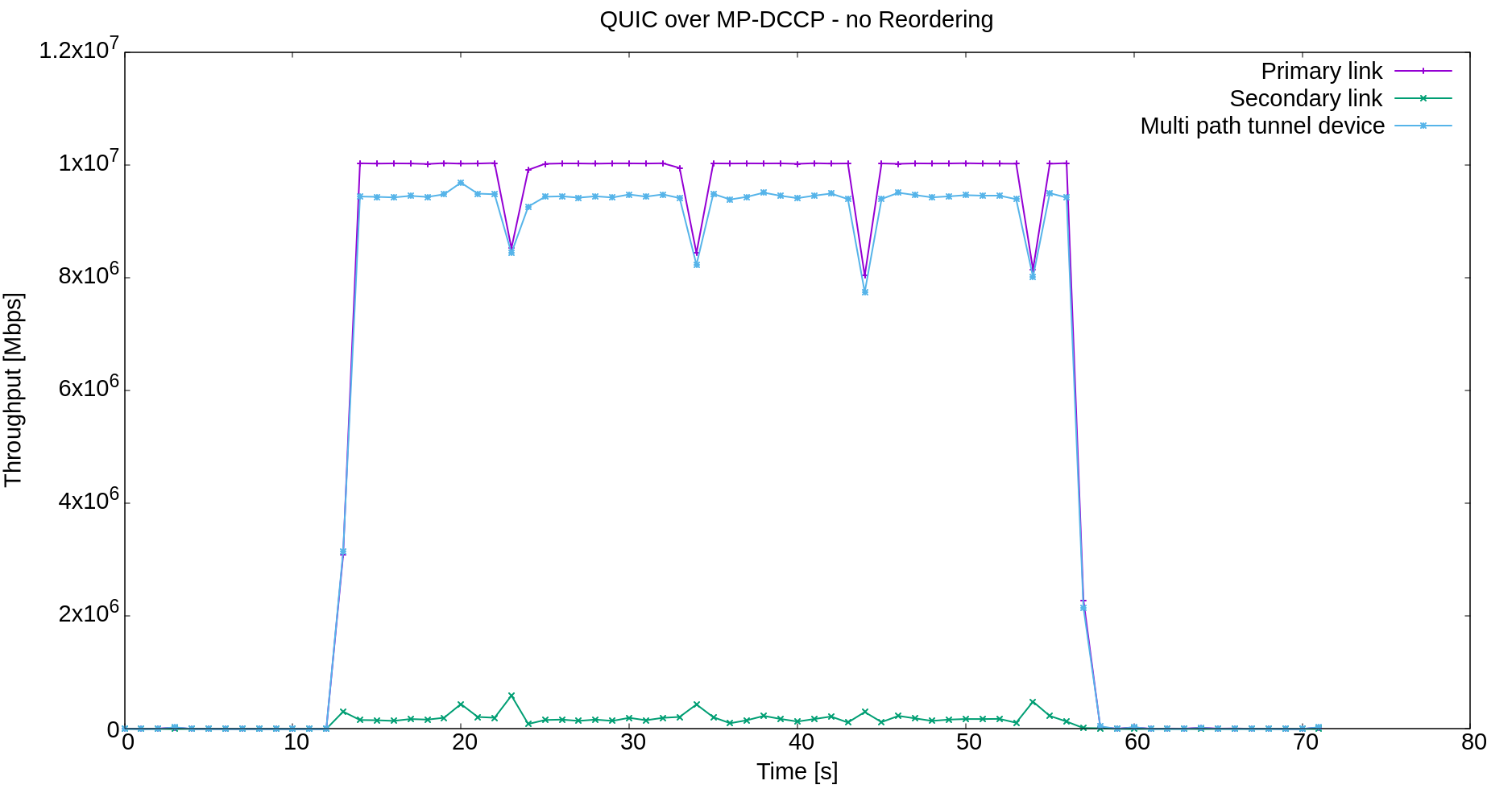
Measurement w/o re-ordering carrying QUIC
Back
Packets entering the ATSSS receiver are forwarded in the order they arrive.
Setup: Priority based steering mode with preference on low-latency path, Path delay difference 15ms, 10Mbps both links
Similar to TCP’s DupACK strategy, RFC9000 (QUIC) specifies a similar mechanism which causes the quic-go implemented congestion control to assume packet loss. This prevents the bundling of the secondary path (green) with the higher latency and the primary path (purple) is used almost exclusively. The end-to-end stream (blue) is limited therefore by the primary path capabilities. (Note: the primary link throughput is greater than the end-to-end stream due to the tunnel overhead)

Slide 13
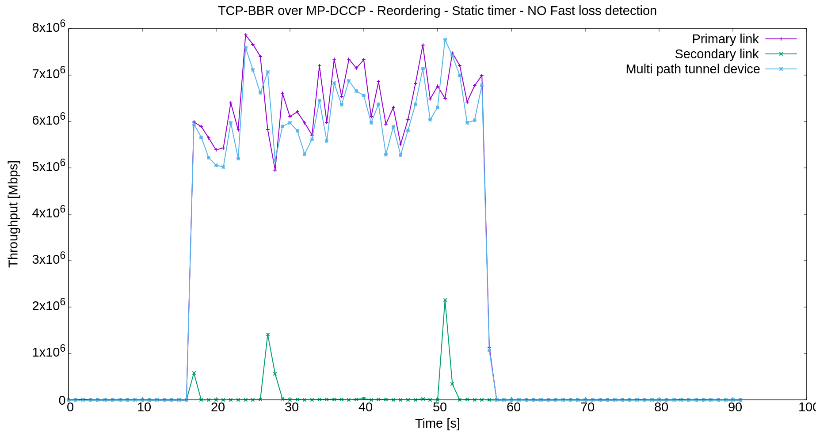
Measurement w/ partial re-ordering carrying latency sensitive BBR
Back
Setup: Priority based steering mode with preference on low-latency path, Path delay difference variable, 10Mbps both links, Expiration timer value 50ms
Packet loss introduced in the primary path: 1%
Fast packet loss detection exploits path and connection sequencing to detect packet loss much earlier than when the packet loss detection timer expires. Most latency spikes caused by the expiration of the timer are avoided and provides therefore a more stable end-to-end latency. This further helps the carried service to detect earlier the packet loss in its receiver and request re-transmission from its sender.
In case no fast packet loss detection is available, a latency sensitive TCP BBR stream is not able to achieve aggregation and even worse, falls below the single path capabilities (<10 Mbps). With fast packet loss enabled, the end-to-end latency is more stabilized when the expiration of the static timer can be avoided and leads therefore to an aggregation benefit.

Slide 14
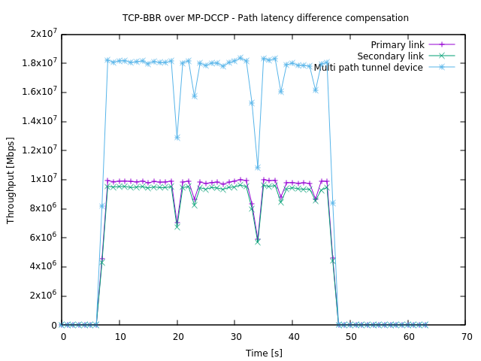
Measurement w/ re-ordering and path latency compensation
Back
Setup: Priority based steering mode with preference on low-latency path, Path delay difference 15ms, 10Mbps both links, Dynamic expiration timer, Path latency difference compensation
Multi-path characteristic close to singlepath characteristic is the right mean to provide aggregated througput performance.
This is achieved due to re-ordering and path latency difference compensation.

