Slide 1
PCF authorizing MBS Session policy - For discussion

Slide 2
Related TDOCs
Tdoc number | Title | Source | Affected clauses |  |  |  |  |  | Note | WF proposal
 |  |  | Annex A | 9.X (General description) | 9.Y (PCF service with SMF) | 9.Z (PCF service with NEF) | 7.1.1 | 6.6
S2-2102726 | 23.247: MBS Application and Service Configuration Options | Tencent | ✓ |  |  |  |  |  | AF-->PCF-->MB-SMF
S2-2102439 | 23.247: Policy control for Multicast and Broadcast services | CATT |  | ✓ |  |  |  |  | General description
S2-2102946 | 23.247: PCF service for Interactions between MB-SMF and PCF. | Nokia |  |  | ✓ |  |  |  | Interaction between MB-SMF and PCF | Separate one
S2-2102724 | 23.247: Requested MBS QoS and Dynamic PCC | Tencent |  |  |  |  |  | ✓ | AF-->PCF-->MB-SMF
S2-2102725 | 23.247: MBS Session-AMBR | Tencent |  |  |  |  |  | ✓ | Session AMBR for MBS should be considered for individual delivery | Separate one
S2-2102947 | 23.247: NEF PCF interactions. | Nokia |  |  |  | ✓ | ✓ |  | Interaction between NEF and PCF
Tdoc number | Title | Source | Affected clauses |  |  |  |  | Note | WF proposal
 |  |  | 7.1.1 | 7.1.2 | 7.1.1.x de-configuration | 7.1.1.y configuration update | 7.2.1.3
S2-2102354 | 23.247: Update on common procedures for multicast and broadcast services | Samsung | ✓ | ✓ | ✓ | ✓ |  | Adding de-configuration and configuration update procedure | Should be merged into one
S2-2102392 | 23.247: Updates for MBS session configuration | Huawei | ✓ |  |  |  | ✓ | Timing of establishing N6 connection
S2-2102437 | 23.247: Procedures of configuration for MBS | CATT | ✓ |  |  | ✓
S2-2102673 | 23.247: [7.1.1]-Update to configuration procedures | vivo | ✓ |  |  |  |  | Separate the “big” configuration procedure.
S2-2102727 | 23.247: Update the MBS Session Configuration Procedure | Tencent | ✓ |  |  |  |  | AF-->PCF-->MB-SMF
S2-2102338 | 23.247: Clause 7.1.1: Clarification on MBS service area | LG Electronics | ✓
Tdoc number | Title | Source | Affected clauses |  |  |  | Note | WF proposal
 |  |  | 7.3.1 | 7.3.2 | 7.3.3 | 7.3.x
S2-2102728 | 23.247: Update MBS Session Establishment for Broadcast procedure | Tencent | ✓ |  |  |  | AF-->PCF-->MB-SMF
S2-2102729 | 23.247: Update MBS Session Update for Broadcast procedure | Tencent |  |  | ✓ |  | AF-->PCF-->MB-SMF
S2-2102730 | 23.247: Update MBS Session Release for Broadcast procedure | Tencent |  | ✓ |  |  | AF-->PCF-->MB-SMF

Slide 3
Different proposed options
Option 1 (Ericsson proposal, no CR)
Service requirements are included in message from NEF to MB-SMF and then forwarded to PCF
PCF
MB-SMF
NEF/MBSF
AF
MB Session Start (service requirement)
MBS Policy Association Req/Resp

Slide 4
Different proposed options
Option 2 (Tencent)
If PCF is used, it triggers establishment of MBS context at MBS

Slide 5
Different proposed options
Option 3 (2947 (Nokia), 2673(Vivo)?, 2439 (Intel, Lenovo, Tencent, Motorola Mobility)?)
Similar to existing PCC
Session binding based on MBS session context at PCF
For initial configuration, NEF can store session information in database and/or establish PCC authorization session
For updates, direct interaction between NEF and PCF
PCF retrieves stored configured session information from database (Nokia: UDM, Vivo: UDR)
BSF used to discover PCF with MBS session context

Slide 6
Comparison of Options
Option 1
Unclear how policy authorization requests can be rejected
Large containers might be required for service decription
MB-SMF would be affected for service informnation updates even if PCF does not updated authorized QoS
Unclear how PCF can use preconfigurede input for policy decisions (without database access)
Option 2
Substantial change of MB-SMF PCF interactions compared to existing PCFSmPolicyControl (might become an MB-SMF service)
Unclear how PCF can use preconfigurede input for policy decisions (without database access)
Option 3
Aims for alignment with existing PCC procedures

Slide 7
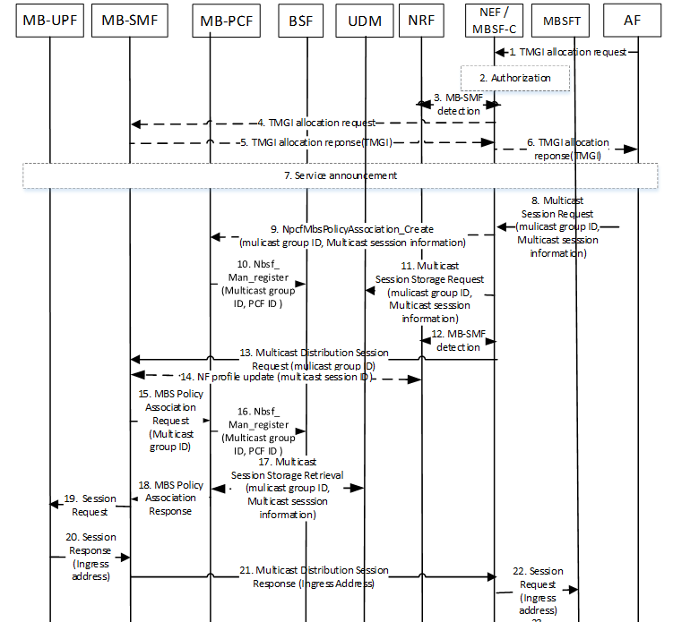
Answers to Questions by Ericsson
S2-2102947 NEF PCF interactions
Q1: For trusted AF, NEF may not be needed. If so, public safety AS would be impacted to do authorization first and then do MBS Session start ?
Nokia Reply: Public safety would use MB2 interface and MBSF. Thus, no impact
MB-PCF
MB-SMF
AF
Authorizing MBS Session
MB Session Start (service requirement)
MB Session Start Response
Q2: why is BSF is needed?
Nokia reply: BSF enables AF and or MB-SMF to detect PCF. (Depending on what entity contacts PCF first, the other needs to contact same PCF for session binding)

Slide 8
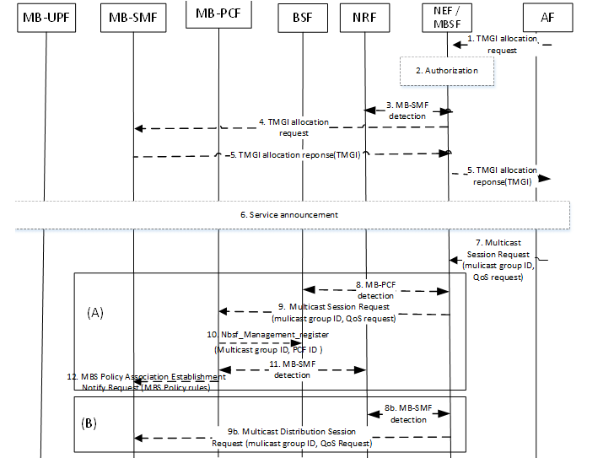
Answers to Questions by Ericsson
S2-2102727 Update the MBS Session Configuration Procedure
Q: Establishment or Notify?
Notify does not work as there is no MBS policy association established yet.
Nokia: Agree, would need to be establishment

Slide 9
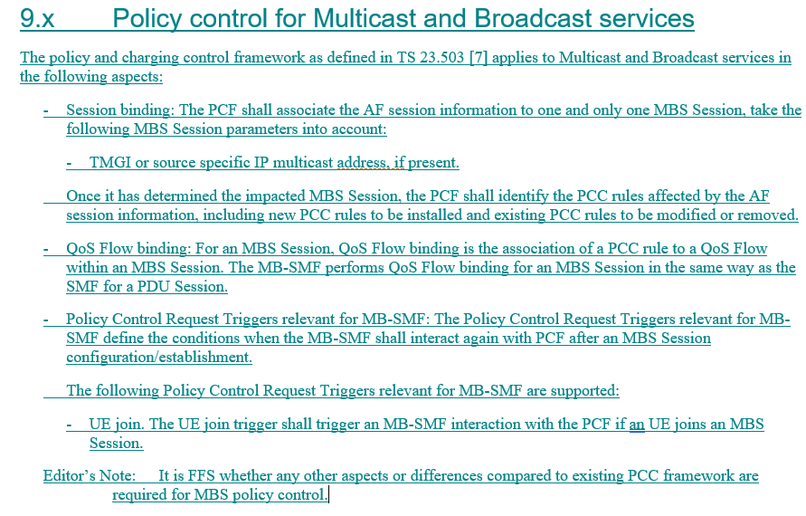
Answers to Questions by Ericsson
S2-2102439 Policy control for Multicast and Broadcast services
Q1: Why is Session binding needed?
Nokia: AF and MB-SMF both establish connections towards the PCF
Q2: Do we have some examples what PCRT may be needed?
Nokia: I left that FFS in my service proposal. Might be that we have nothing in the first release. Also depends on information provided by AMFs and SMFs
Q3: MB-SMF interacts with PCF when AF started the MBS Session, but not at UE join.
Nokia: I agree. MB-SMF is unaware of UUs joining

Slide 10
Thank You!

