Slide 1
Stage 1 Rel-19 Content
SWS-230075

Slide 2
Introduction
Stage-1 Release -19 comprises:
  13 studies + respective normative work (where applicable)
  8 normative work without previous studies (see annex, work plan)
3 big topics with broad 3GPP interest (Sensing & Communication , Ambient IoT and Metaverse).
SA1 progress on Rel-19 is on time:
SA1#103 21-25 Aug 2023 80% normative ready
SA1#104 13-17 Nov 2023 100% normative ready
* 7 WIDs metioned in this presentation are coming for approval at SA#100.

Slide 3
3GPP Release 19 timeline
2022
2023
2024
TSG#93-e
TSG#94-e
TSG#95-e
TSG#96
TSG#97-e
TSG#98
TSG#99
TSG#100
TSG#101
TSG#102
TSG#103
TSG#104
TSG#105
Sep.
Dec.
Mar.
Jun.
Sep.
Dec.
Mar.
Jun.
Sep.
Dec.
Mar.
Jun.
Sep.
SA1 Stage 1 80%
100%
RAN Rel-19 workshop
RAN Content def.
RAN4
content def.
SA Rel-19
Workshop (TBC)
SA St.2 Content approval
SA1 expected completion dates:
SA1#103 21-25 Aug 2023 80% normative ready
SA1#104 13-17 Nov 2023 100% normative ready
Now

Slide 4
Stage 1 Rel-19 Topics
New Features
Verticals + NTN focused
Integrated Sensing and Communication (Sensing)
Ambient power-enabled Internet of Things (Ambient IoT)
Localized Mobile Metaverse Services (Metaverse)
Network of Service Robots with Ambient Intelligence (SOBOT)
Satellite access - Phase 3 (5GSAT_Ph3)
UAV Phase 3 (UAV_Ph3)
FRMCS - Phase 5 (FRMCS_Ph5)
Interconnect of SNPN (FS_ISN)
Enhancements
Roaming value added services (RVAS)
Energy Efficiency as service criteria (EnergyServ)
Upper layer traffic steering, switching and split over dual 3GPP access (DualSteer)
AI/ML Model Transfer_Phase2 (AIML_MT_Ph2)
Network Sharing Aspects (NetShare)

Slide 5
New Features

Slide 6
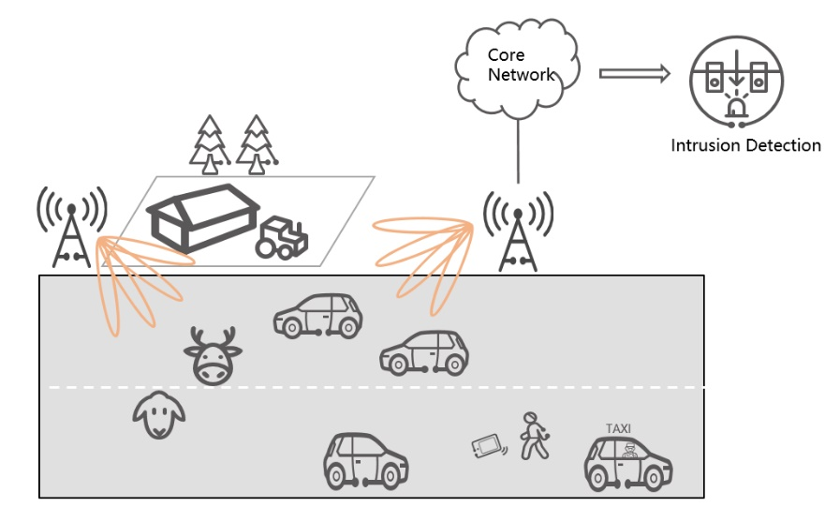
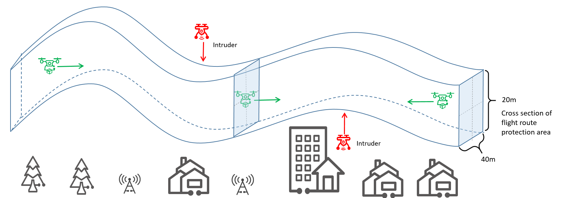
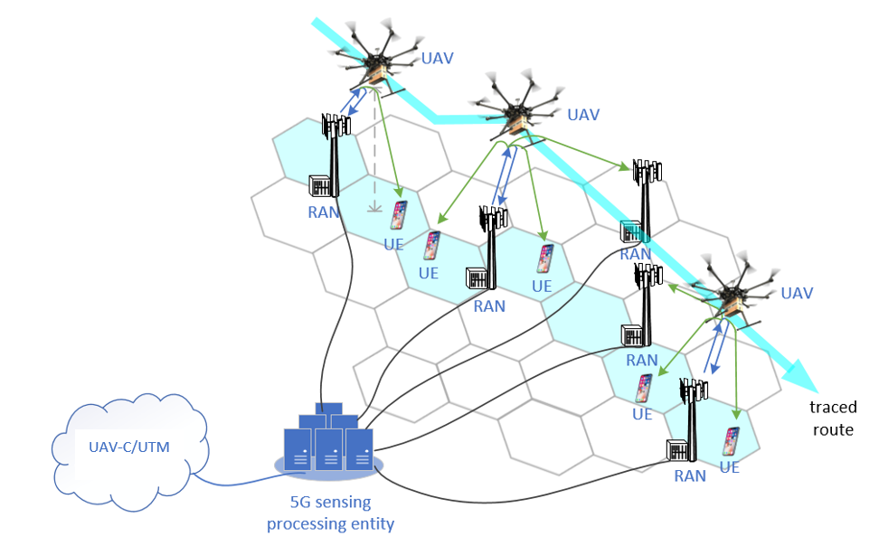
Integrated Sensing & Communication
Rapporteur: | Vasil Aleksiev (Deutsche Telekom) | Output : | TR 22.387 WID - SP-230507
Description
This work focuses on the potential of integrated sensing and communication technology for enabling new services and use cases for various industries. 5G wireless sensing service, as part of a cellular network provides new possibilities for enhanced usage of the telecommunication infrastructure in areas of object detection and tracking, environment monitoring and human motion monitoring. It provides input to various verticals - UAVs, smart home, V2X, factories. Use cases cover a wide range of applications, including: Intruder detection for smart home, on a highway, for railways, for factory, for predefined secure areas around critical infrastructure Collision avoidance and trajectory tracking of UAVs, vehicles, AGVs Automotive maneuvering and navigation Public safety search and rescue Rainfall monitoring and flooding Health and sports monitoring

Slide 7




Ambient power-enabled IoT (1/2)
Rapporteur: | Weijie Xu (OPPO) | Output : | TR 22.840
Description
Ambient power-enabled Internet of Things device is an IoT device powered by energy harvesting, being either battery-less or with limited energy storage capability (e.g. using a capacitor) and the energy is provided through the harvesting of radio waves, light, motion, heat, or any other power source that could be seen suitable. The promising characteristics of ambient IoT device: With low complexity, small size, lower power consumption (than existing IoT devices) thus enable ultra-low cost It can be maintenance free thus it save the labour cost and it is friendly to the environment It can have long life span (e.g. more than 10 years). It is able to adapt to some extreme environmental conditions (e.g. high pressure, extremely high/low temperature, humid environment
Battery-less
Small size
Ultra-low cost

Slide 8
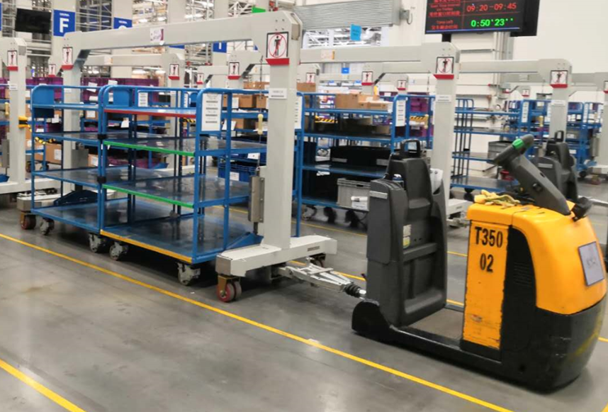

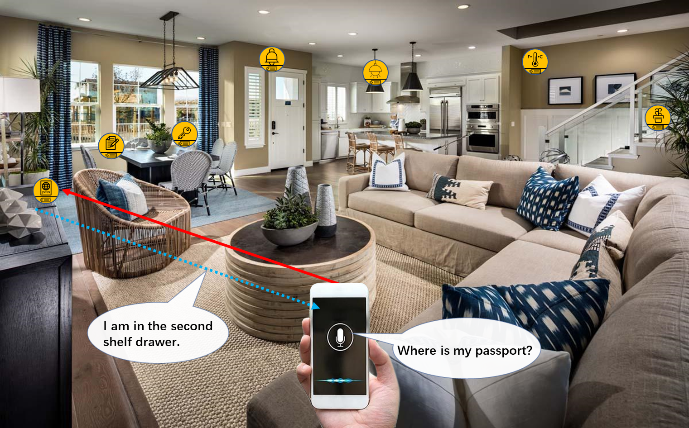
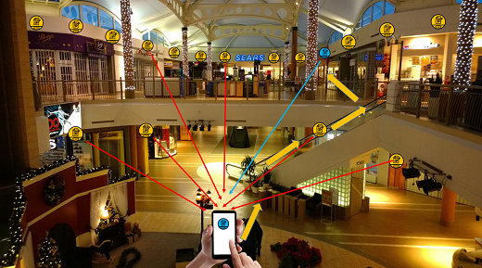
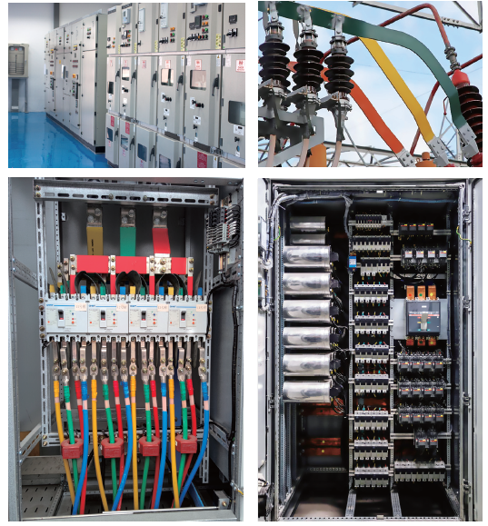

Ambient power-enabled IoT (2/2)
During the SA1 study, the following functions of ambient have been identified:
  Identification for inventory
  Sensor data collection
  Positioning
  Actuator
It can be used in To-C area and To-B area, and for indoor or outdoor deployment.

Slide 9
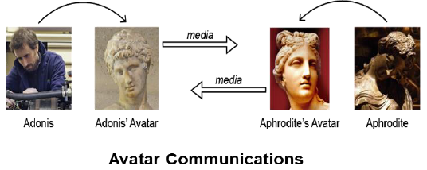
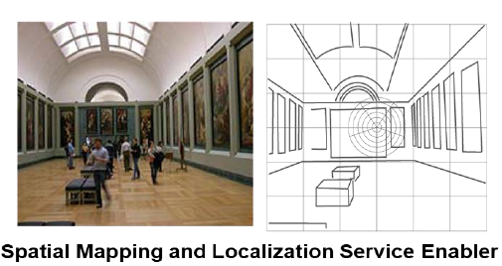
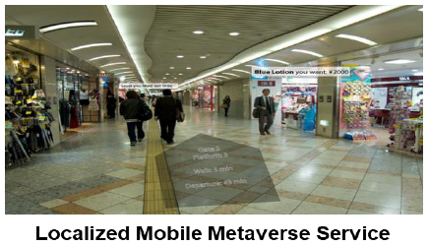
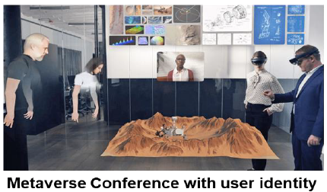
Localized Mobile Metaverse Services
Rapporteur: | Erik Guttman (Samsung) | Output : | TR 22.856 WID - SP-220353
Description
Investigate enhancement of the 5G system to enhanced XR-based services as well as other functionality to offer shared and interactive user experience of local content and services, accessed by users in the proximity or remotely. The following areas have yielded potential requirements in the study include: Localized mobile metaverse service functionality to define, discover, interact with and perceive services associated with a point in space, surface, etc. 3D avatar call a new service for conversational communication XR service enablers for location agnostic service experience to overcome latency as a constraint for long-range interactive services. Coordination and operation of mobile metaverse services to support diverse media scenarios involving multiple applications, users and devices. Support user identity verification and management. Support for virtual entities in mobile metaverse services such as software entities that can be ‘users’ of 3GPP services. Digital asset management to support diverse services that can benefit from a 5G system enablers, analogous to functions offered by the EU digital wallet initiative.

Slide 10
Enhancements

Slide 11
Roaming value added services
Rapporteur: | Peter Bleckert (Ericsson) | Output : | TR 22.877 SP-230232 CR668 to TS 22.261
Description
Roaming Value Added Services (RVAS) enabled by the PLMN for 5GS roaming form part of the roaming services ecosystem. Some RVAS can be provided using non-standardized methods in 2G/3G/4G networks, but issues have been identified in 5GS roaming deployments preventing to offer the same RVAS over 5G. SA1 have studied and derive potential service requirements for three RVAS enabled by the PLMN in 5GS in a new TR 22.877: Welcome SMS Steering of Roaming (SoR) during the registration procedure IMSI based routing to a particular core network (e.g., in a different country) These service requirements have been added as normative requirements in a new subchapter in TS 22.261 to enable these RVAS by the PLMN for 5GS roaming.

Slide 12
Network Sharing Aspects
Rapporteur: | Qun Wei (China Unicom) | Output : | WID - SP-220087 TR 22.851
Description | Extend a Shared NG-RAN managed by a Hosting Operator to support a new scenario: Indirect Network Sharing. Participating Operator 5GC is “indirectly connected” to Shared NG-RAN via the Hosting Operator 5GC. Indirect 5GC connectivity is transparent, and Service experience and KPIs are maintained to UE.
Why | Operators driver to improve their operator network better. Shared RAN can be used by more participating operators, saving resources. Easy cooperation by reducing maintenance of direct interface between large number of RAN Shared nodes and Participating Operator’s 5GC. Enables new ways for Operators to share RAN network, and avoid impact to UE.
OP 1 shared
NG-RANs
OP 2
NG-RANs
①
②
5G core network
of Hosting OP1
5G core network
of Participating OP2
SEPPs/IPUPs: vSEPP/hSEPP
4G network of OP2
SA1 Use cases and requirements
include Service and Service Continuity, charging and QoS , Access Control and mobility between sharing parties, International Roaming Users in a Shared Network , Hosted Services , Emergency call, Long-distance mobility in and across shared networks, PWS in Shared NG-RAN and considerations on security.
NOTE: UE moves as ① and ②

Slide 13
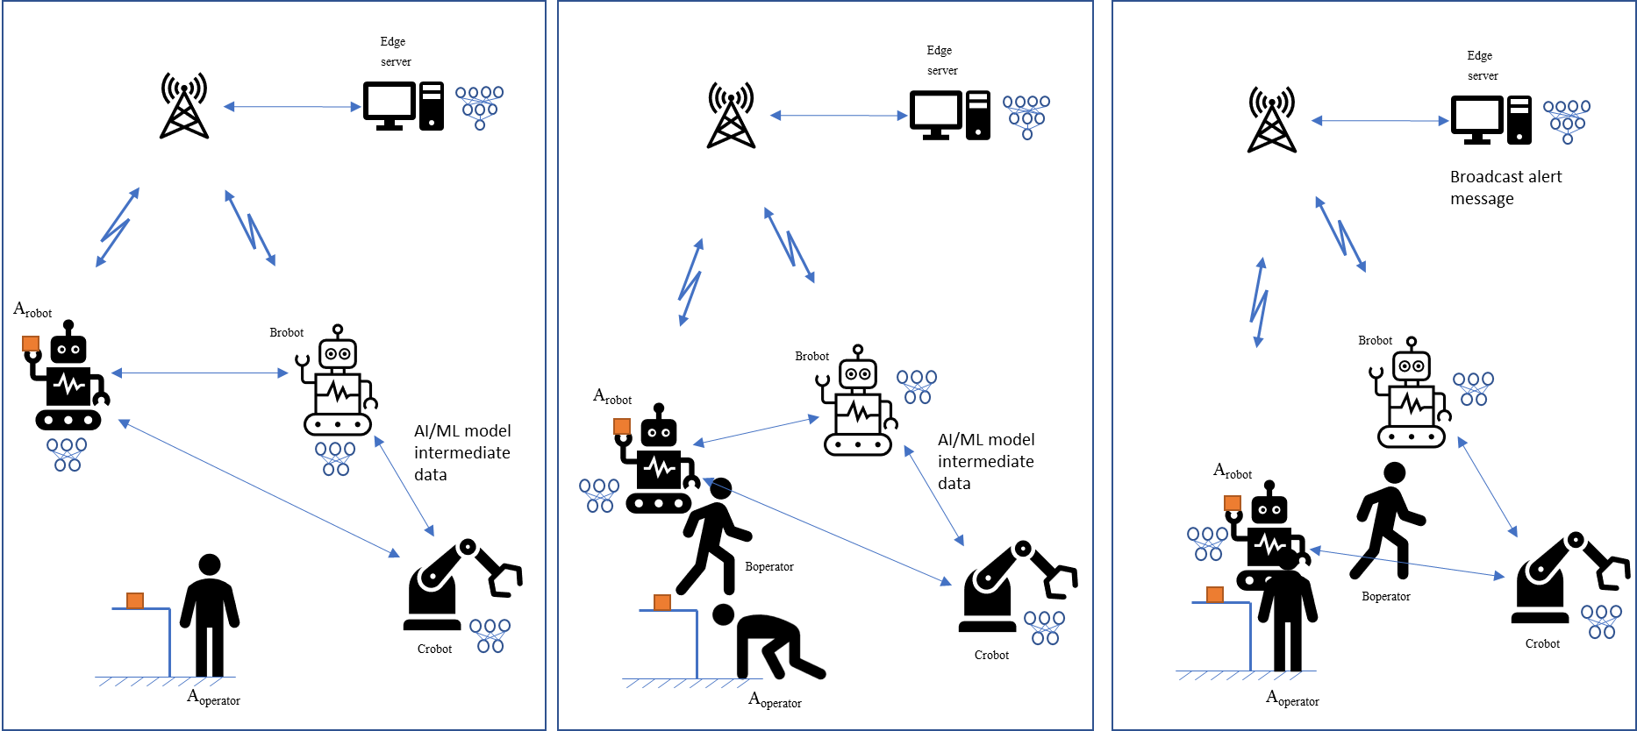
AI/ML Model Transfer – Phase 2
Rapporteur: | Yang Xu (OPPO) | Output : | TR 22.876 WID - SP-230514
Description
As AI/ML is becoming popular, more and more AIML model related data will be transmitted in 5GS. In order to support an efficient AI/ML operations using for various applications e.g. auto-driving, robot remote control, the 5GS needs to be enhanced in both functionality and performance wise by leveraging Uu and side link interface.In R19, it continues to study how the 5GS can have more gains for different type of AIML operations when leveraging side link. The promising characteristics of AI/ML operations: AI/ML operation splitting between AI/ML endpoints via side link; AI/ML model/data distribution and sharing via side link; Distributed/Federated Learning via side link. SA1 Use cases and requirements: Proximity based work task offloading for factory robots, image recognition, AI Model Transfer Management through side link, Transfer learning for trajectory prediction, Side link assisted synchronous and asynchronous Federated Learning, and distributed joint inference for 3D object detection

Slide 14
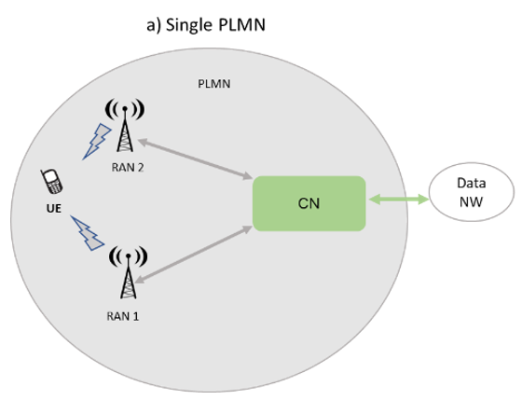
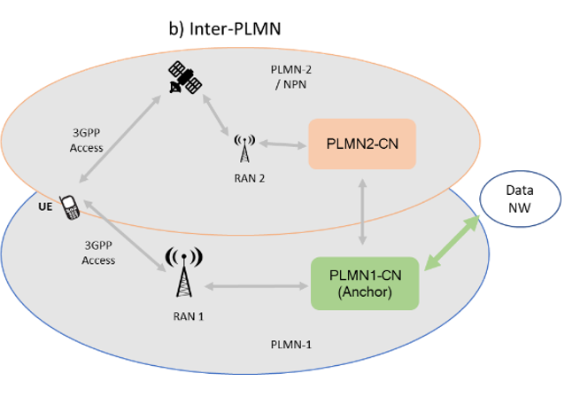
Upper layer traffic steering, switching and split over dual 3GPP access
Rapporteur: | Francesco Pica (Qualcomm) | Output : | TR 22.841
Description
The study TR captures a set of use cases and potential service requirements related to 5G system support of traffic steering, splitting and switching of UE’s user data (pertaining to the same data session), across two 3GPP access networks. Different scenarios are covered: same PLMN, two PLMNs, or between a PLMN and an NPN, solely considering one single PLMN subscription.
Various combinations of 3GPP access networks are covered, using same or different RAT, including terrestrial NR plus NR or NR plus E-UTRA, a mix of terrestrial plus satellite NR, as well as dual NR satellite access (e.g. using same or different NTN orbits).
Traffic configuration policies, assumed to be under HPLMN control, can consider different criteria, rules or conditions/restrictions, e.g., based on subscription, application/traffic type, service QoS, location and/or time, network conditions.
Requirements do not foresee RAN impacts.
Example of Intra-PLMN DualSteer – TN + TN RATs
Inter-PLMN/NPN Example – TN + NTN RATs

Slide 15

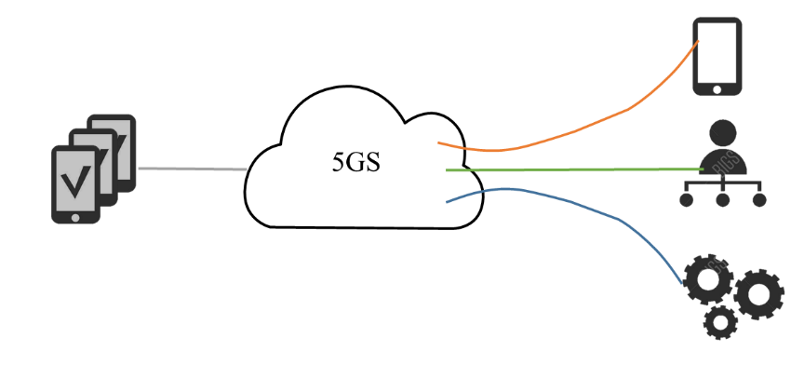
Energy Efficiency as service criteria
Rapporteur: | Xiaonan Shi (China Mobile) | Output : | WID - SP-230235 TR 22.882
Description
There are number of existing studies related to Energy Efficiency in 3GPP as well as other standard groups. Apart from enhancing network capability on satisfying user experience while achieving energy efficiency from network aspect, it is worth considering how to deliver services with energy efficiency as service criteria, associated with applications’ preferences, and how to support the policy of handling energy as part of a subscription. This work item aims at specifying 5G service requirements to support energy efficiency as service criteria. SA1 Use cases and requirements: • Define and support Energy Utilization as Service Criteria to user and application services. • Support different energy states of network elements and network functions for energy efficiency. • Enhancement on monitoring and measurement related to energy efficiency. • Information exposure related to energy usage. • Other aspects include security, charging and privacy.
Monitoring of Energy Events by the 5G network for an AS
Supporting service-level energy efficiency analysis for verticals

Slide 16
Enhancements
Verticals + NTN

Slide 17
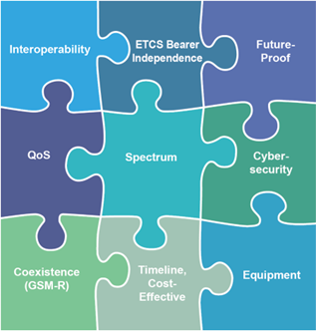

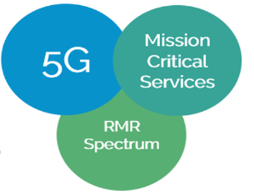
FRMCS Phase 5
Rapporteur: | Vassiliki Nikolopoulou (UIC) | Output : | TR 22.989 WID - SP-230512
Description:
Future Railway Mobile Communication System (FRMCS) will be the 5G worldwide standard for railway operational communications, conforming to European regulation, as well as responding to the needs and obligations of rail organisations outside of Europe. UIC (International Union of Railways) is leading the design of this telecommunication system, in close cooperation with the railways stakeholders. FRMCS shall rely on 3GPP building blocks to support mission-critical rail applications. The UIC FRMCS 3GPP Task Force regularly analyses impact of FRMCS specifications on existing stage 1 use cases and requirements collected in TR 22.989, from Rel-18 onwards. This is the purpose of the on-going SID: FS_FRMCS_Ph5, whose expected outcome is the enhancement of existing operationally critical use cases and the description of some new ones, in the Rel-19 timeline. The findings of on-going Rel-19 study led us to the need of a new WID FRMCS_Ph5, whose purpose is to provide the normative changes by fulfilling the missing requirements to allow downstream groups (e.g., stage 2&3) implement functional FRMCS specifications endorsed by 3GPP specifications, in the Rel-19 timeline.
FRMCS in a nutshell

Slide 18



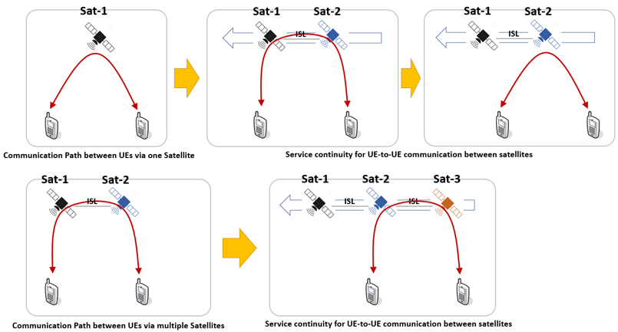
Satellite access - Phase 3
Regenerative payload satellite with full eNB onboard and part of CN functions (e.g. MME)
Rapporteur: | Thierry Bérisot / Xu Xia (Novamint) / (China Telecom) | Output : | WID - SP-220679 TR 22.865
Description
Support of new capabilities related to satellite access with strong market relevance: Store and Forward Satellite operation with intermittent/temporary satellite connectivity for delay-tolerant communication service UE-Satellite-UE communication without going through the ground network GNSS independent operation Positioning enhancements for satellite access
Feeder link
Service link
NTN gateway
Core Network
IoT NTN device
Store and forward connectivity service for delay-tolerant IoT NTN applications
Topics addressed by 5GSAT phase 3 | Market Relevance
Store & Forward Satellite operation | VERY HIGH ⁽¹⁾ ⁽²⁾
UE-Satellite-UE communication (Local switching) | VERY HIGH ⁽¹⁾ ⁽²⁾
GNSS independent operation | VERY HIGH ⁽¹⁾ ⁽²⁾
Positioning enhancements | HIGH⁽³⁾
(1): key capability needed to support commercial deployments
planned in the (very) short term
(2): already supported by non 3GPP solutions
(3): enhancements needed to improve existing services

Slide 19
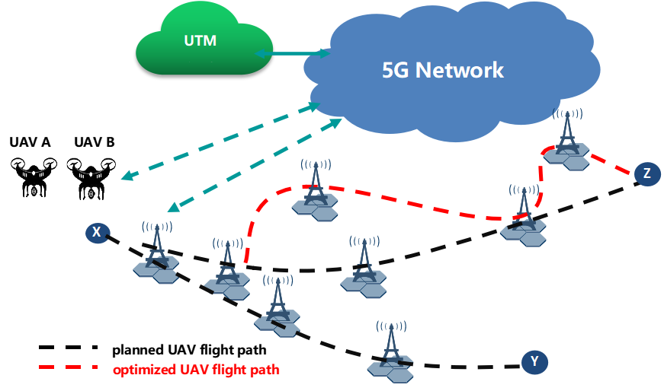
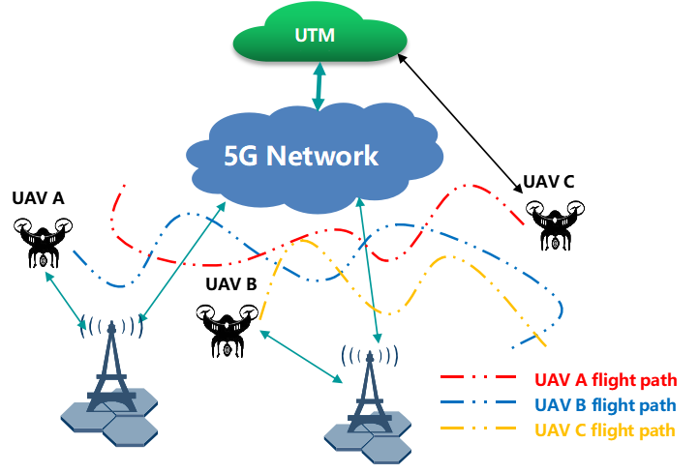
UAV Phase 3
Rapporteur: | Pengtai Qin (China Mobile) | Output : | WID - SP-220954 TR 22.843
Description
This study focuses on additional use cases and potential service requirements to improve 5GS support of UAV operations and management including pre-flight/inflight path monitor &optimization, the safety and security of UAV operations. The uese cases and potential requirements in the study includes: Supporting UAV pre-flight preparation and inflight operations by providing a method to monitor and predict network condition (e.g. bitrate, latency, reliability) for the UAV continuous geographic path. UAV detection: enable 5G system to detect that a UE is on board a UAV. Geofencing for Visual Line-of-Sight UAV missions to enable the 5G system to be aware if VLoS constraints should be applied to UAV operations. UAV flight route tracking at Rendezvous points to enable 5G system to track a UAV which doesn’t have subscription with network operator. Support for network-assisted UAV DAA: further enhancement for UAV flight safety with the development of network capabilities, such as sensing.
UAV pre-flight preparation
UAV inflight monitoring
UAV flight route tracking at Rendezvous points
Network-assisted UAV DAA

Slide 20
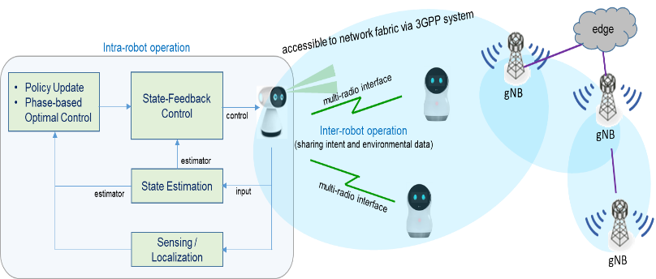
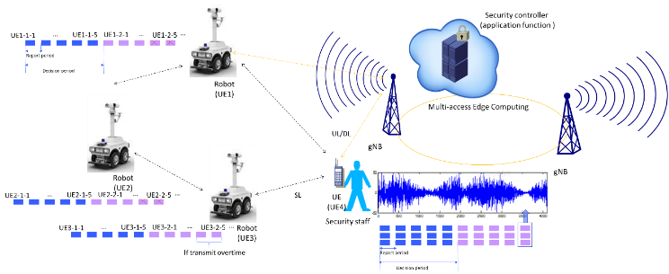
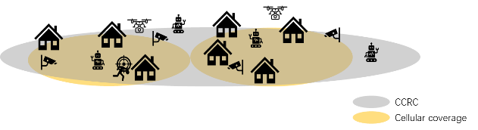
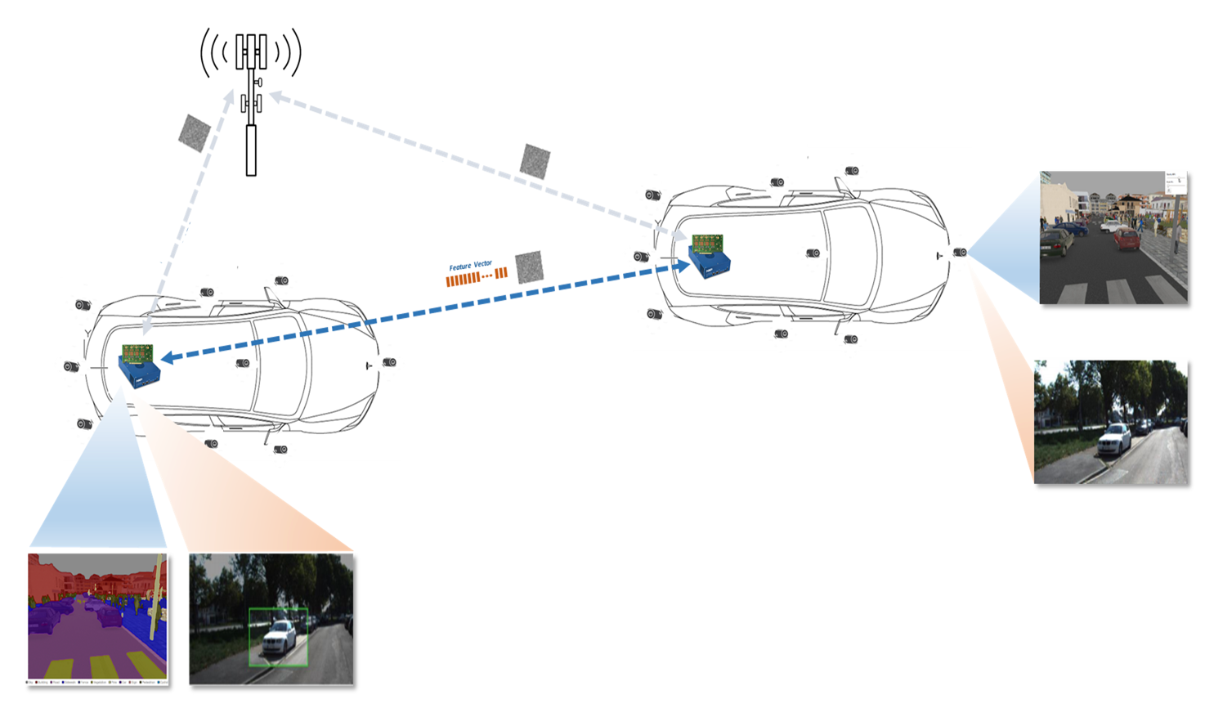
Network of Service Robots with Ambient Intelligence
Rapporteur: | Ki-Dong Lee (LG Electronics) | Output : | TR 22.916
Description
The present document describes use cases and aspects related to efficient communications service and cooperative operation for a group of service robots including: exposure of information between application layer and communications layer, support of on-demand high priority communications, KPIs for large-scale group operation scenarios, support of scalable and efficient use of communication resources, requirements related to media applications specific for service robots, and aspects related to security, privacy and charging that are relevant to support stable operation of service robots. This document also describes the existing service requirements and potential correlation with other studies

Slide 21
Interconnect of SNPN
Rapporteur: | Thierry Bérisot (Novamint) | Output : | TR 22.848 (new)
Description
SNPN deployments are expected to rise tremendously in the coming years, especially in locations where there is no suitable public network, to support digitalization of verticals areas of work. In several sectors (ports, airports, mainports, utilities, railway…), this will imply multiple deployments of SNPNs with very distinct owners sharing and using the same services (for example, a container port with several container terminals and one generic container exchange route all owned and managed by different players or SNPNs deployed on ships). The study is addressing these emerging use cases and the associated requirements to interconnect SNPNs with the necessary security, scalability, continuity of service… and resilience.
Topics addressed by ISN | Market Relevance
Interconnect between SNPNs | VERY HIGH ⁽¹⁾
interconnect of SNPN with identity providers | VERY HIGH ⁽¹⁾

Slide 22
Annex
Work plan Rel-19

Slide 23
SA1 Work Plan Rel-19 (1/3)
UID | Name | Acronym | Target | Old % | WID | New % | Change or comment
950003 | Study on Integrated Sensing and Communication | FS_Sensing | 06/06/2023 | 80% | SP-220717 | 90% | TR sent for approval, target date changed to 09/2023
1000026 | Integrated Sensing and Communication | Sensing | 12/12/2023 | - | SP-230507 | 0% | NEW
950004 | Study on Ambient power-enabled Internet of Things | FS_AmbientIoT | 03/03/2023 | 80% | SP-220085 | 90% | TR NOT sent for approval, normative WID not approved yet
950005 | Study on Localized Mobile Metaverse Services | FS_Metaverse | 03/03/2023 | 75% | SP-220353 | 90% | TR 22.856 for approval
1000028 | Localized Mobile Metaverse Services | Metaverse | 12/12/2023 | - | SP-230509 | 0% | NEW
950006 | Study on Network Sharing Aspects | FS_NetShare | 03/03/2023 | 80% | SP-220087 | 95% | TR 22.851 for approval
1000029 | Network Sharing Aspects | NetShare | 12/12/2023 | - | SP-230511 | 35% | NEW
950007 | Study on FRMCS Phase 5 | FS_FRMCS_Ph5 | 09/09/2023 | 50% | SP-220437 | 80% | New target:: Dec. 2023
1000031 | FRMCS Phase 5 | FRMCS_Ph5 | 12/12/2023 | - | SP-230512 | 0% | NEW
950008 | Study on AI/ML Model Transfer Phase2 | FS_AIML_MT_Ph2 | 06/06/2023 | 75% | SP-220439 | 95% | TR 22.876 for approval
1000030 | AI/ML Model Transfer Phase2 | AIML_MT_Ph2 | 12/12/2023 | - | SP-230514 | 0% | NEW
960016 | Study on satellite access - Phase 3 | FS_5GSAT_Ph3 | 06/06/2023 | 80% | SP-220679 | 90% | TR 22.865 for approval
1000024 | Satellite access - Phase 3 | 5GSAT_Ph3 | 12/12/2023 | - | SP-230516 | 0% | NEW
960017 | Study on UAV Phase 3 | FS_UAV_Ph3 | 06/06/2023 | 65% | SP-220954 | 95% | TR 22.843 for approval
1000032 | UAV Phase 3 | UAV_Ph3 | 12/12/2023 | - | SP-230518 | 0% | NEW
960018 | Study on Upper layer traffic steering, switching and split over dual 3GPP access | FS_DualSteer | 06/06/2023 | 75% | SP-220445 | 90% | Normative WID not approved yet

Slide 24
SA1 Work Plan Rel-19 (2/3)
UID | Name | Acronym | Target | Old % | WID | New % | Change or comment
960019 | Study on Energy Efficiency as service criteria | FS_EnergyServ | 06/06/2023 | 70% | SP-230235 | 90% | TR 22.882 for approval
1000033 | Energy Efficiency as service criteria | EnergyServ | 12/12/2023 | - | SP-230520 | 0% | NEW
960020 | Study on Network of Service Robots with Ambient Intelligence | FS_SOBOT | 09/09/2023 | 70% | SP-220447 | 80%
990053 | Study on Interconnect of SNPN | FS_ISN | 12/12/2023 | 0% | SP-230236 | 30% | Study ongoing
990052 | Supporting UE Mobility for XR Services | XRMobility | 06/06/2023 | 50% | SP-230233 | 50%
990049 | PS Data Off for IMS Data Channel Service | IMSDCDataOff | 03/03/2023 | 0% | SP-230227 |  | ??
1000025 | UE-to-UE Multi Hop Relay | UEMHopRelay | 06/06/2023 | - | SP-230521 | 100% | New “Mini WID”
1000027 | Preventing Excessive Data Exposure within an NPN | SecNPN | 06/06/2023 | - | SP-230523 | 100% | New “Mini WID”
960015 | Study on roaming value added services | FS_RVAS | 12/12/2022 | 100% | SP-220442 | -
990051 | Roaming Value-Added Services | RVAS | 03/03/2023 | 100% | SP-230231 | -
850044 | Study on Supporting of Railway Smart Station Services | FS_RAILSS | 08/09/2022 | 100% | SP-190838 | -
990050 | Edge Computing for Industrial Scenarios | EDGINDUS | 03/03/2023 | 100% | SP-230229 | -
970044 | Multi-path relay | MultiRelay | 19/09/2022 | 100% | SP-220943 | -

Slide 25
SA1 Work Plan Rel-19 (3/3)
UID | Name | Acronym | Target | Old % | WID | New % | Change or comment
970044 | Multi-path relay | MultiRelay | 19/09/2022 | 100% | SP-220943 | -
970043 | Interworking of Non-3GPP Digital Terrestrial Broadcast Networks with 5GS Multicast Broadcast Services | DTT4MBS | 19/09/2022 | 100% | SP-220941 | -
For more information, see the full Work Plan at: https://ftp.3gpp.org/information/Work_Plan

Slide 26
Thank you for your attention!

