Slide 1
Discussion on handling of PRD21 v130
3GPP TSG-RAN5 Meeting #97 R5-22XXXX
Toulouse, France, Nov 14 – 18, 2022
CMCC, Ericsson, Huawei, Hisilicon, Nokia, DISH

Slide 2
Some Bands/Configurations may have NO “Interested Operators”
Observation 1: Some Bands/Configurations (e.g. railway bands n100 and n101) have been introduced into 3GPP without “Interested Operators” but with “Interested Deployer”. These “Interested Deployer” may be organizations (e.g. railway union) OR a V2X company OR an industry company (e.g. agriculture company, power company) interested in deploying these Bands/Configurations.
Proposal 1: In PRD21 v130, to introduce a new term of “Interested Deployer” in Section “3.1 Terms”, and to update the whole PRD21 with “Interested Deployer” accordingly.
Interested Deployer: An organization (e.g. railway union) interested in deploying a 5G NR band or 5G NR CADC configuration (e.g. 5G NR railway band or 5G NR railway CADC configuration), or a V2X company interested in deploying a 5G NR V2X band or 5G NR V2X CADC configuration, or an industry company (e.g. agriculture company, power company) interested in deploying a 5G NR band or 5G NR CADC configuration.
Notes:
any configuration specific change requests to Chapter 5 ONLY shall NOT be accepted by RAN5

Slide 3
Some Terms are missing in Section 3.1
Observation 2: Some terms are missing in Section “3.1 Terms”, including “Assigned band”, “Completed band”, “Interested Operator”, “ Ongoing band”, “Pending band” and “Responsible Company”.
Proposal 2: In PRD21 v130, to introduce the missing terms into Section “3.1 Terms”.
Assigned band: A 5G NR band is assigned to a company volunteering to take responsibility to make sure that the necessary contributions to include the band into RAN5 conformance test specifications are prepared, submitted and agreed in RAN5.
Completed band: All CRs required to make the 5G NR band completed have been agreed by RAN5 for inclusion in next version of impacted RAN5 conformance test specifications.
Interested Operator: An mobile network operator interested in deploying a 5G NR band or 5G NR CADC configuration.
Ongoing band: A 5G NR band that has been interested by at least one "Interested Operator" or "Interested Deployer" and is open for assignment or contributions in RAN5. As long as a 5G NR band has been interested by at least one "Interested Operator" or "Interested Deployer", it can be regarded as an Ongoing band no matter it has been assigned to a volunteering company or not.
Pending band: A 5G NR band that has not been interested by any operator or deployer yet in RAN5.
Responsible Company: A company that volunteers to take responsibility to make sure that the necessary contributions to include a 5G NR band or configuration into RAN5 conformance test specifications are prepared, submitted and agreed in RAN5.
Notes:
any configuration specific change requests to Chapter 5 ONLY shall NOT be accepted by RAN5

Slide 4
A new 5G NR Rel-17 WI has been introduced at RAN5#96e
Observation 3: A new 5G NR Rel-17 WI “Further enhancements of NR RF requirements for frequency range 2 (FR2) (UID-970070)” has been introduced at RAN5#96e.
Proposal 3: In PRD21 v130, to introduce the new 5G NR Rel-17 WI “Further enhancements of NR RF requirements for frequency range 2 (FR2) (UID-970070)” into the tables of the following Sections,
Section “1 Scope”
Section “4.3 Guidelines to handle the 5G NR feature specific WIs impacting 5G NR CADC configurations”.
Notes:
any configuration specific change requests to Chapter 5 ONLY shall NOT be accepted by RAN5

Slide 5
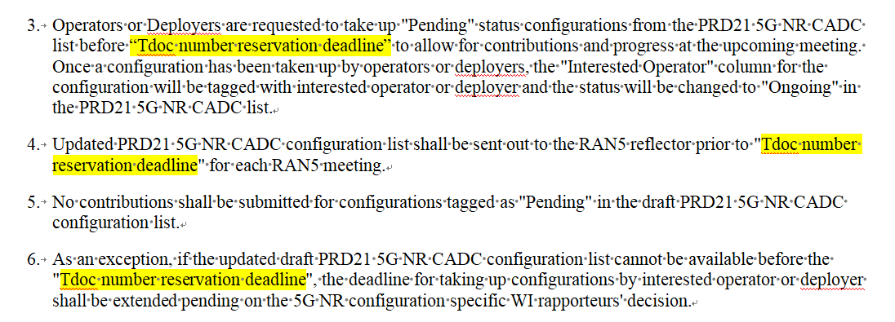
The deadline for operators/deployers to show “interest” to bands/configurations needs FFS
Observation 4: In PRD21 v120, the deadline for operators/deployers to show “interest” to the bands/configurations is no later than “3GU Opening” which is floating and not easy to anticipate. Meanwhile, “Grace Period” is needed for companies to prepare Tdocs for the newly picked “Ongoing” bands/configurations for the upcoming RAN5 meeting.
Proposal 4: In PRD21 v130, to revise the configuration taking deadline from “3GU Opening” into “Tdoc number reservation deadline”, and to update the related guidance in Section 4.1 of PRD21 v130 as follows.
Notes:
any configuration specific change requests to Chapter 5 ONLY shall NOT be accepted by RAN5

Slide 6
Thank you!

