Slide 1
3GPP RAN5 #100-e
16 to 27 August 2021
Where do standards engineers come from?

Slide 2
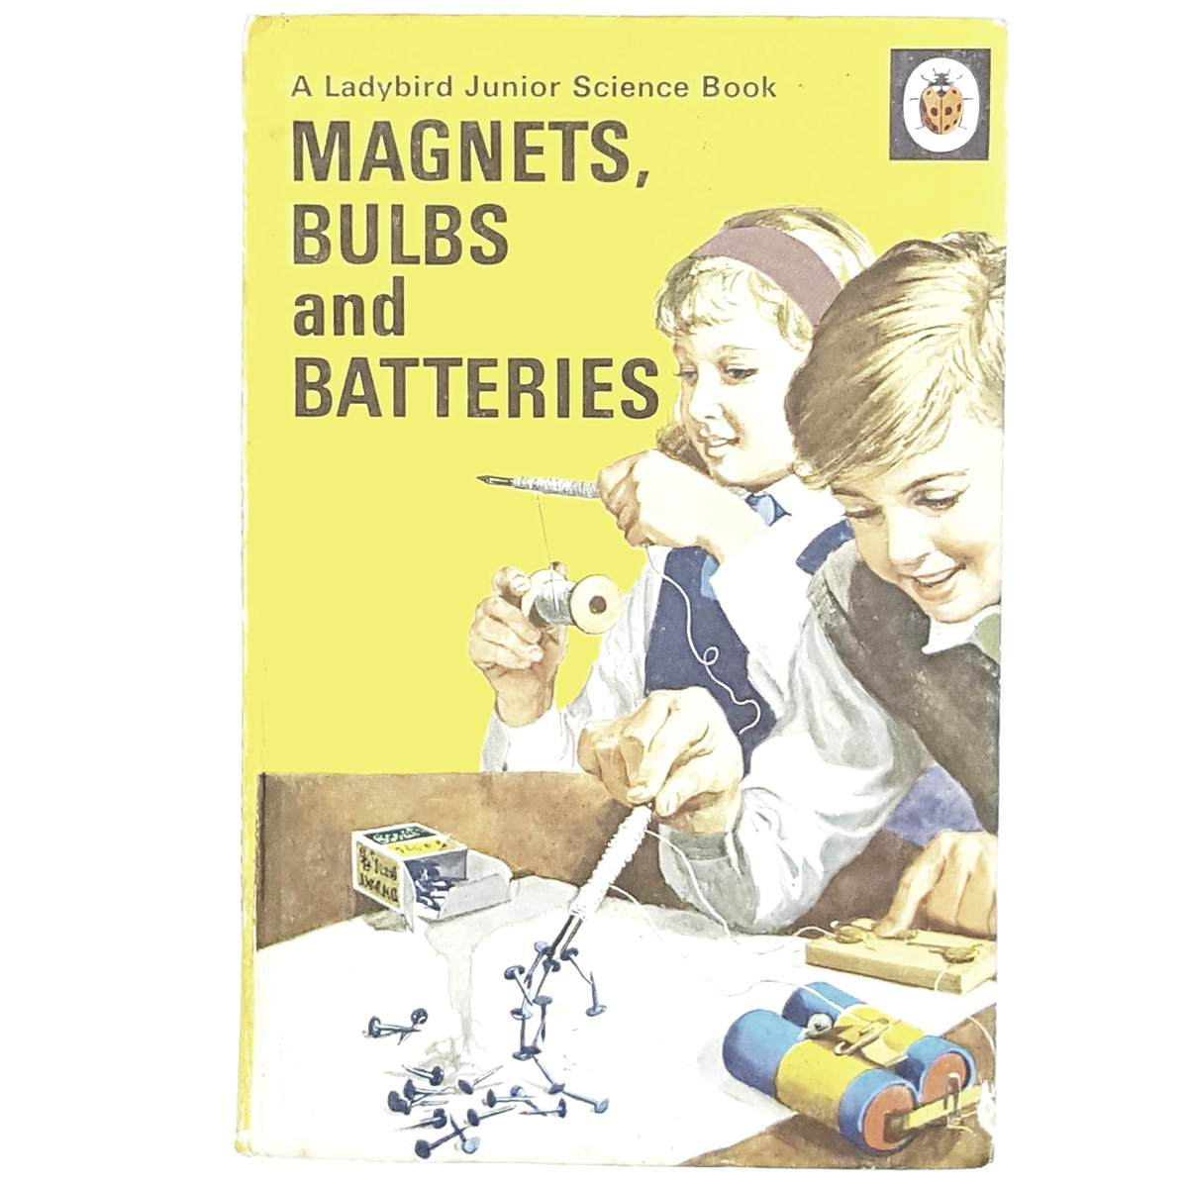
In 1959..
There was no internet
Telephones were landlines
I was born in Sheffield, a UK industrial city
Many UK industries were in decline (and most of my city too)
The transistor was quite a new thing
My parents could tell I was a bit nerdy..

Slide 3
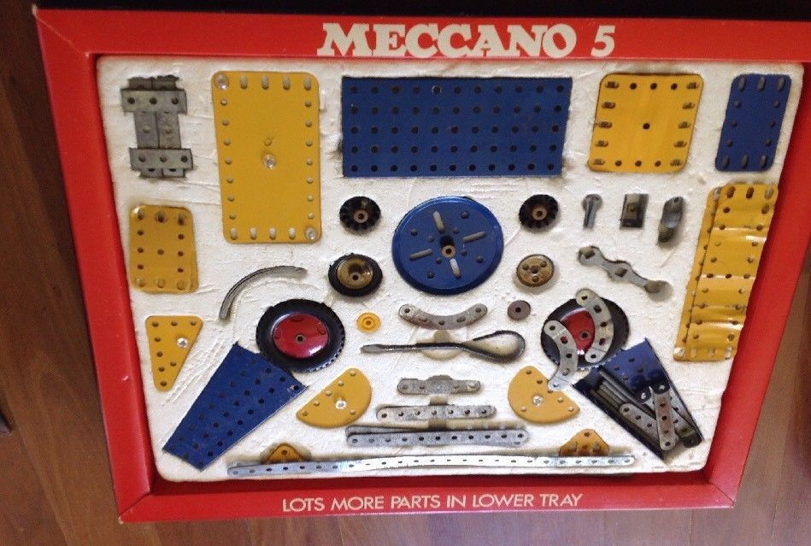
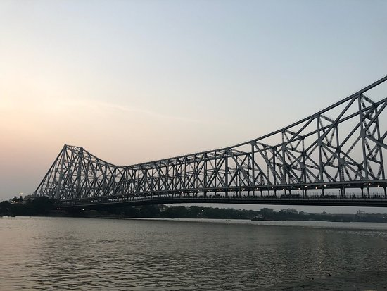
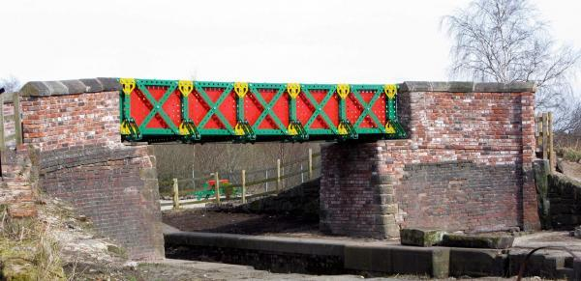
Toys?
They bought me a Meccano set..
But I really wanted one with an electric motor (too expensive)

Slide 4
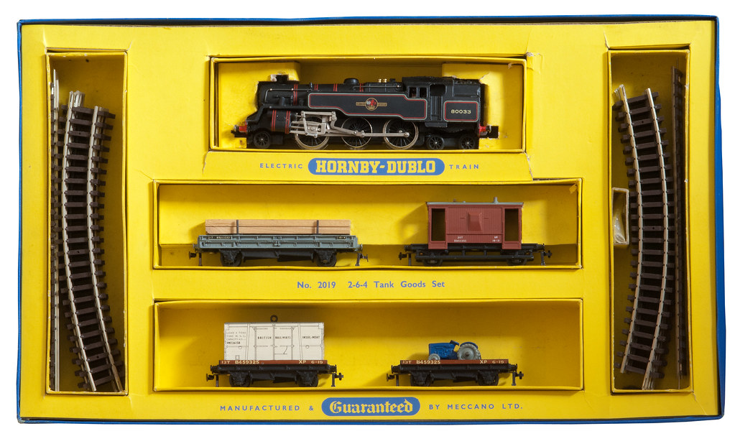
More toys
My grandfather was a railway engineer, so..

Slide 5
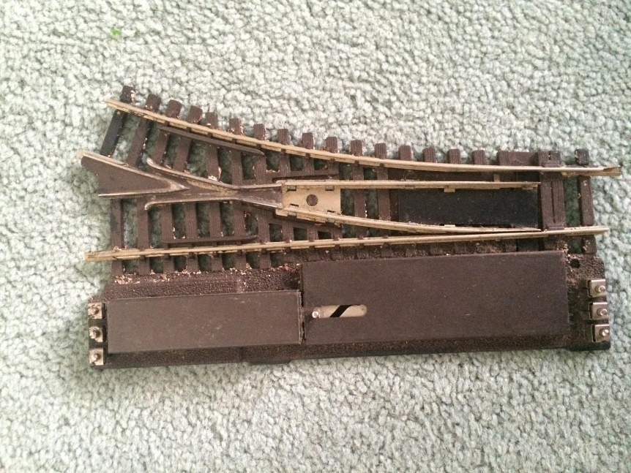
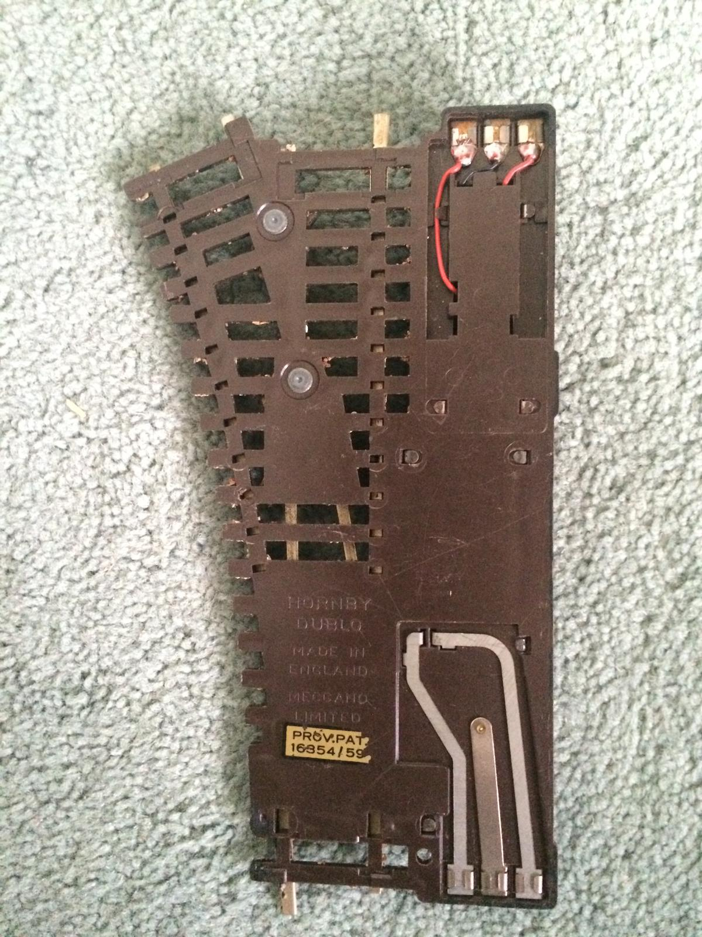
When I could buy my own toys..
I wanted electric gadgets for my train set, like electric points
  My brother’s train set did not have electric points ☺

Slide 6
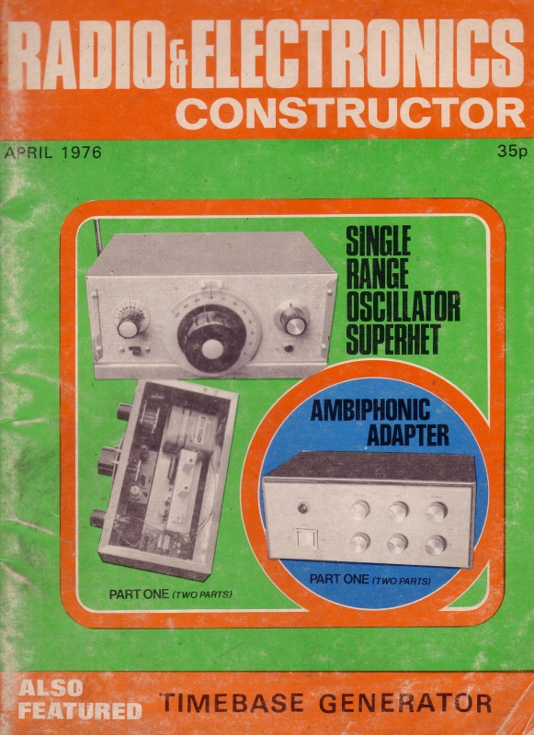

The big breakthough
Dispense with the trains (leave that to my brother)
  Just play with electricity!
And my Dad bought me a magazine..

Slide 7
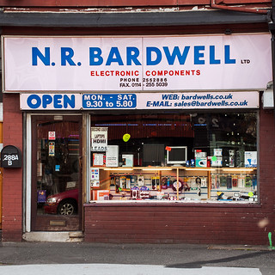
The local electronics shop was good
I was always buying things for build-it-yourself projects..

Slide 8
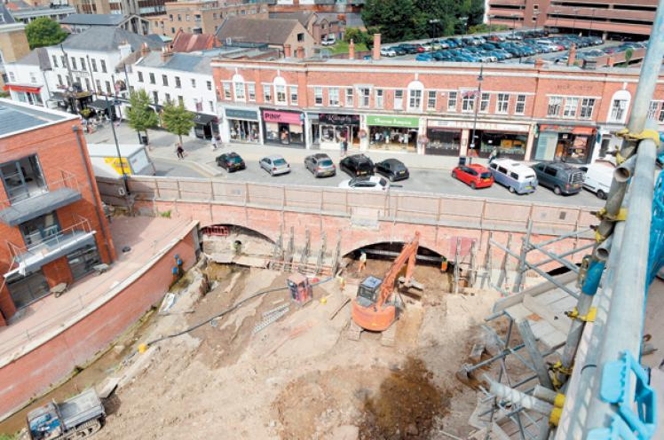
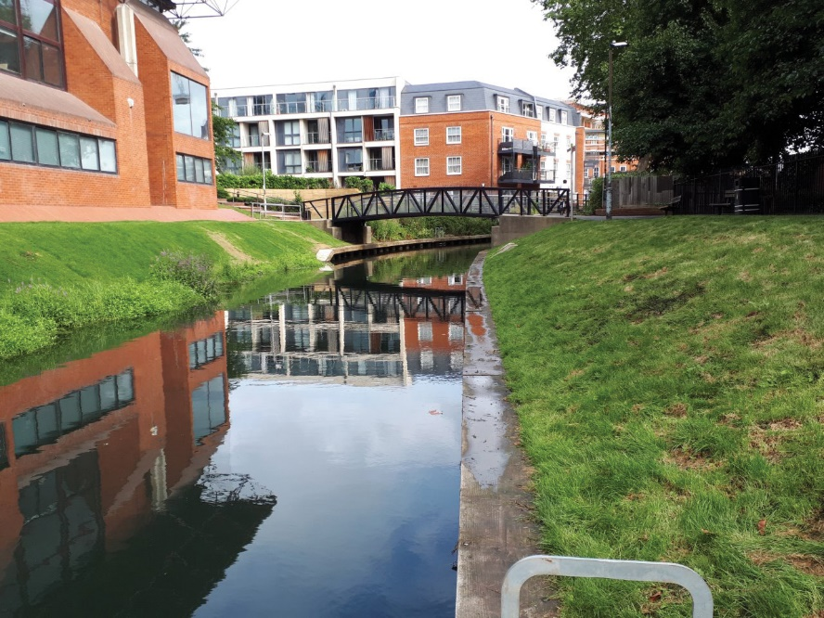
What next?
I’m involved in a project to build a canal through our town
  My schoolteacher said the idea was 200 years too late

