Slide 1
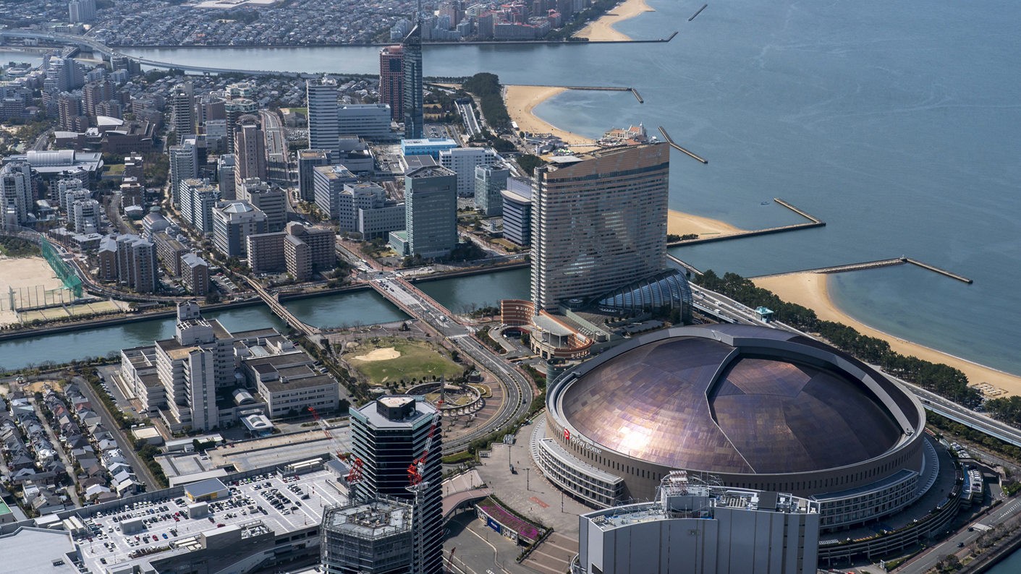

Welcome to Fukuoka
3GPP RAN1#117, RAN2#126, RAN3#124, RAN4#111, RAN5#103
The Japanese Friends of 3GPP warmly welcome all of you to Fukuoka, Japan.
Photograph(s) provided by Fukuoka City.

Slide 2
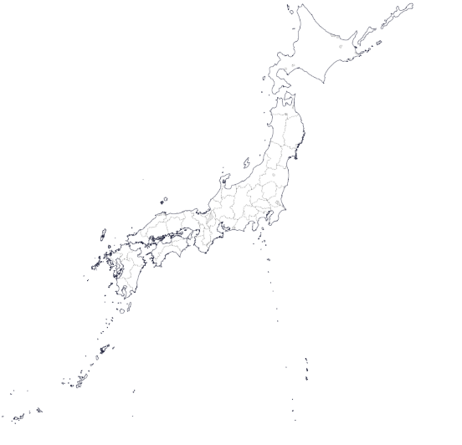







About Fukuoka
Fukuoka city
- Fukuoka city is located in the south-west of Japan and has the 6th largest population (approx.1.6 million)
-As Japan's closest gateway to Asia, Fukuoka city combines traditional and global influences, attracting visitors from around the world with its diverse community.
- RAN WGs were held in 2013 and 2015.
3rd Osaka city
5th Sapporo city
1st Tokyo, 23 wards
2nd Yokohama city
4th Nagoya city
Sister Cities
Oakland
Guangzhou
Bordeaux
Auckland
Ipoh
Busan
Atlanta
Yangon
Source: Portal Site of Official Statistics of Japan website (https://www.e-stat.go.jp/),GSI Maps Vector

Slide 3
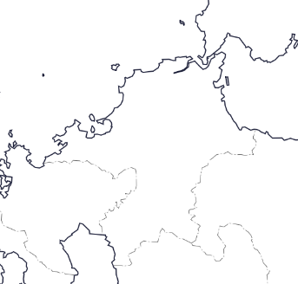
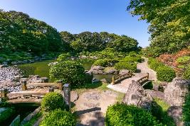
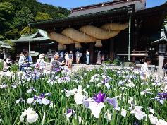
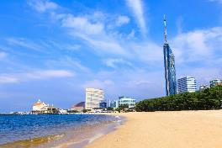
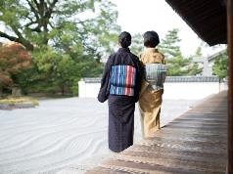
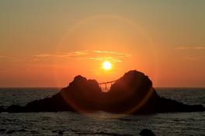
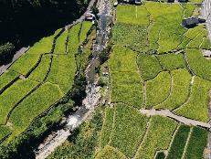
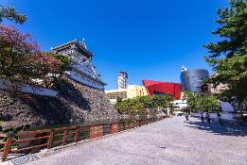
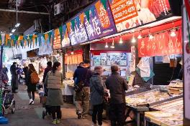
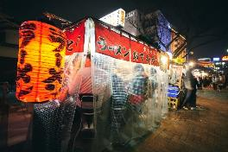
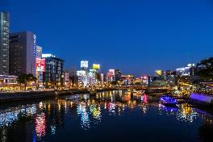
Landscape
Hakata Station
[3],[4]
[5]
[2]
[7]
Experience the captivating beauty of Fukuoka's landscape
- A perfect blend of scenic nature and vibrant city life.
[1]
[6]
[8],[9],[10]
[1] Ohori Park
[2] Miyajidake Shrine
[3] Momochihama Beach
[4] Hakata Textiles
[Hakata Traditional Craft And Design Museum]
[5] Sakurai Futamigaura
[6] Toho Village
[7] kokura castle
[8] Yanagibashi Rengo Market
[9] Nakasu Yatai
[10] Nakasu
© Fukuoka Prefecture Tourism Association, Source: GSI Maps Vector

Slide 4
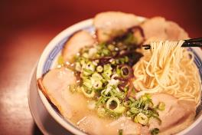
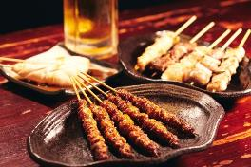
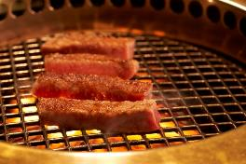
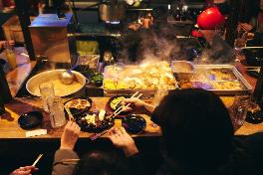
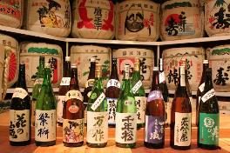
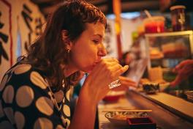
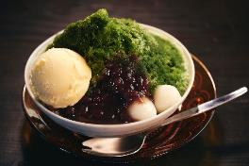

Food
Enjoy a lot of delicious food in Fukuoka.
Ramen, Yakitori, Wagyu, Oden, Sake, Matcha, Amao-Strawberries, etc.
Hakata Ramen
Yakitori
Wagyu
Oden
Sake
Yatai
Matcha
Amao-Strawberries
© Fukuoka Prefecture Tourism Association

Slide 5
Meeting Room
Hakata International Exhibition Hall & Conference Center
Opening/Closing Time
07:45 – 21:00 JST local time
(Access to the meeting room will not be permitted on Sunday, May 19)
The venue closes at 9 PM, so we kindly ask you to leave the meeting room around 8:30PM.

Slide 6
Meeting Time Schedule
 | RAN1 | RAN2 | RAN3 | RAN4 | RAN5
Door opens | 7:45 | 7:45 | 7:45 | 7:45 | 7:45
Meeting starts (The first day is from 9:00) | 8:30 | 8:30 | 8:30 | 8:30 | 8:30
Coffee break AM | 10:30~11:00 | 10:30~11:00 | 10:30~11:00 | 10:30~11:00 | 10:30~11:00
Lunch break | 13:00~14:30 | 13:00~14:30 | 13:00~14:30 | 12:30~14:00 | 12:30~14:00
Coffee break PM (Except on Friday) | 16:30~17:00 | 16:30~17:00 | 16:30~17:00 | 16:30~17:00 | 16:30~17:00
Door close (Friday's meeting ends at 17:00) | 21:00 | 21:00 | 21:00 | 21:00 | 21:00

Slide 7
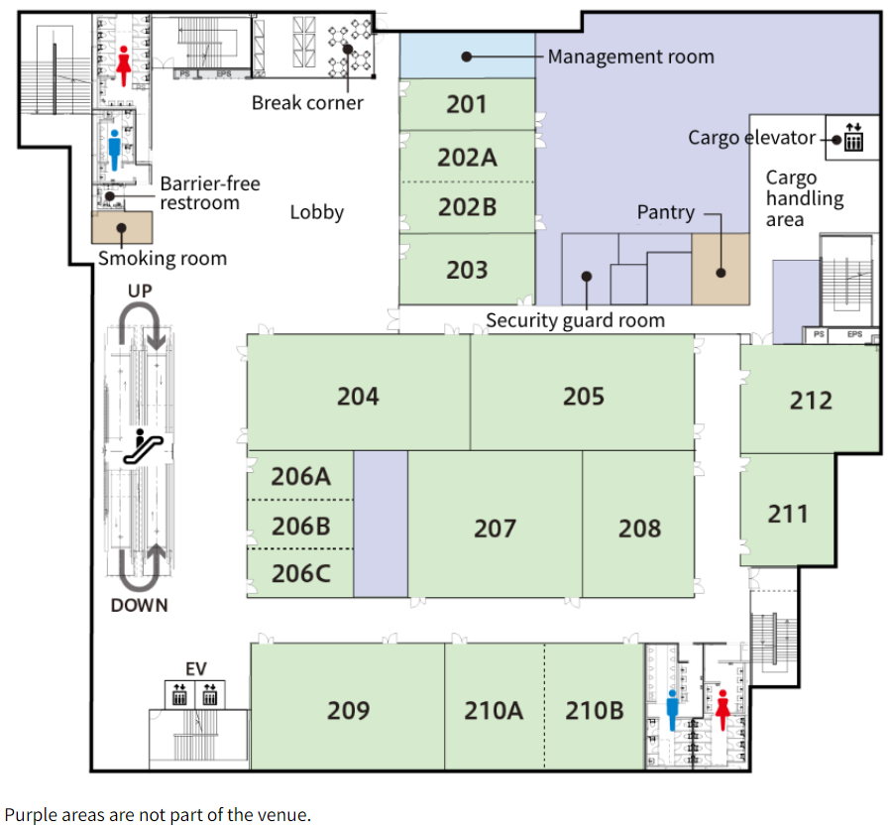
Meeting rooms (2F)
RAN1 Offline 1
Coffee break corner
Please contact the meeting coordinators at the “Info. desk”, if you have any questions!
Info. desk
RAN2 breakout 1
RAN2 breakout 2
RAN1 Offline 2
On the 1st floor of the venue, bento boxes will be sold during the lunch break, and donuts and drinks will be sold between 10:30 and 17:00.
RAN4
Breakout
RAN4
RRM
RAN3 Breakout
RAN2 breakout 3
RAN5 Breakout

Slide 8
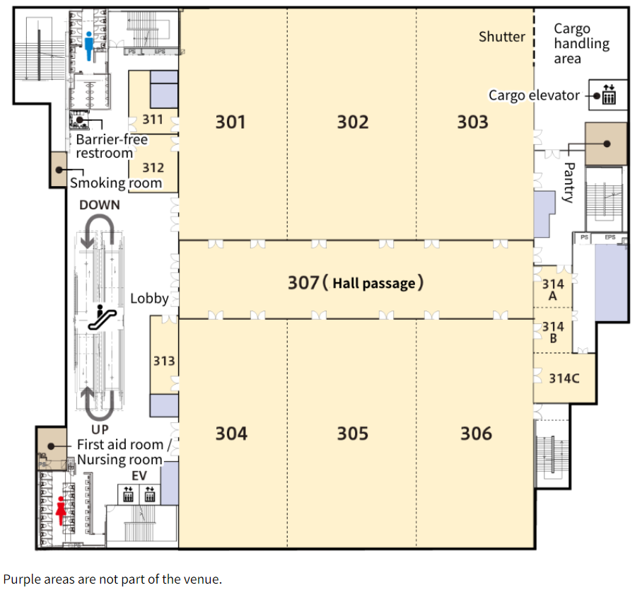
Meeting rooms (3F)
RAN4
Main Plenary
RAN4
BSRF
RAN4
Main All week
RAN3
Main
Please contact the meeting coordinators at the “Info. desk”, if you have any questions!
Coffee break corner
Info. desk
RAN1
Online2
RAN1
Online3
RAN5
Main

Slide 9
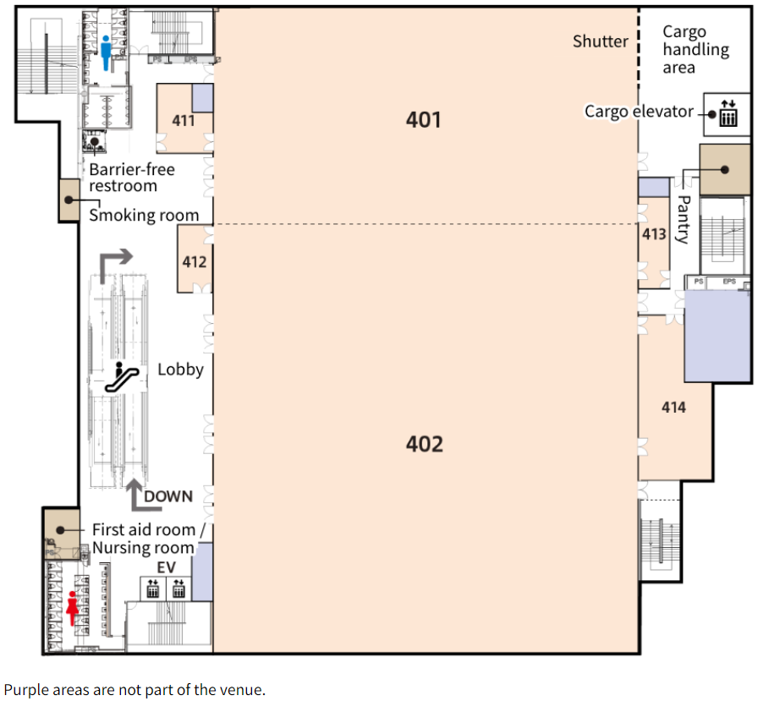
Meeting rooms (4F)
RAN2 Main Plenary, Main All week
(RAN2 main)
Please contact the meeting coordinators at the “Info. desk”, if you have any questions!
Coffee break corner
Info. desk
RAN1 Joint Session, Online1

Slide 10
Wi-Fi info
Wireless LAN：
SSID: 3GPPWIFI
Password: 3GPP3GPPM(CAPITAL LETTERS!)
IP address: 10.10.10.10
--> USUAL SETTING
To avoid traffic concentration on the main Wi-Fi, we provide Wi-Fi for the Internet connection only.
(You cannot connect to a 3GPP local file server with this Wi-Fi.)
SSID：3GPP-INTERNET-ONLY
Password: 3GPP3GPPM (CAPITAL LETTERS)

Slide 11
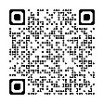
Attention, please!
Please wear your badge at all times in the venue.
Please smoke your cigarette in the smoking room.
Please do not leave your personal belongings and PCs unattended when you leave the meeting room.
If you have symptoms such as fever or nausea, please refrain from coming to the venue and rest at your accommodation.
It is possible to eat and drink inside the venue, but please throw away cans and bottles in separate designated trash bags on each floor.
No Food Delivery Services are permitted at the venue (e.g. Uber Eats), due to the instruction from the Public Health Center.
On the 1st floor of the venue, bento boxes will be sold during the lunch break, and donuts and drinks will be sold between 10:30 and 17:00.
FYI, a list of nearby restaurants, convenience stores and supermarkets is available. Please refer to the list of nearby restaurants below:
https://www.3gpp.org/ftp/Joint_Meetings/RAN%20WGs%20May%202024%20Fukuoka
Please contact meeting coordinators at the “Info. desk” on each floor if you have any questions!

Slide 12
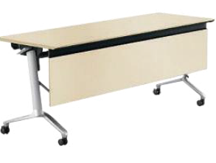







Trash Collection Point
Please separate burnable waste and bottles/cans into different trash bags on each floor.
Trash
collection point
Bottle & Can
Burnable waste

Slide 13
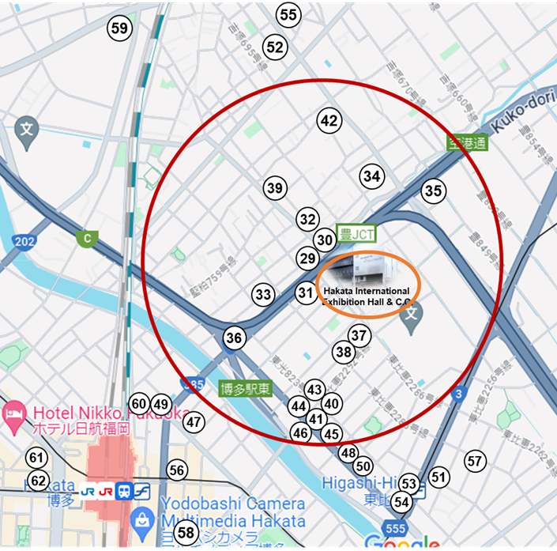
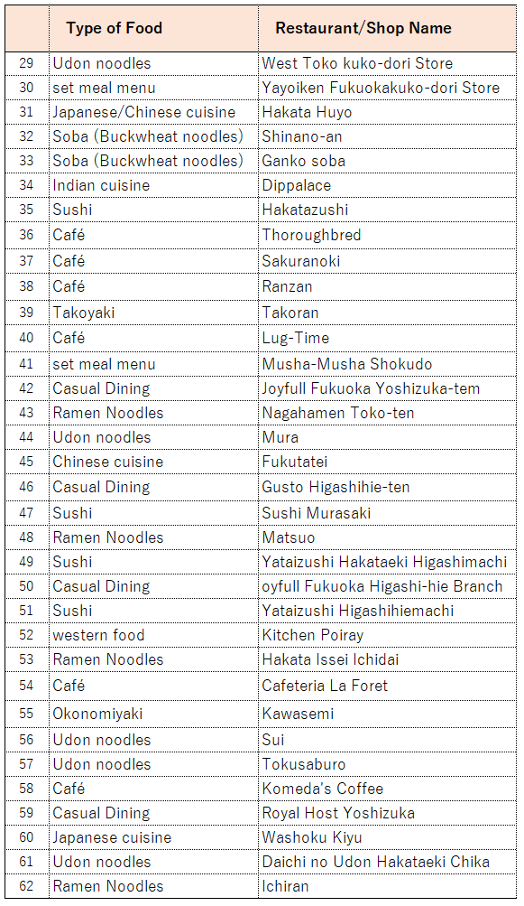
Roadside Restaurants Map & List
This red circle represents a 10-minute walking radius.

Slide 14
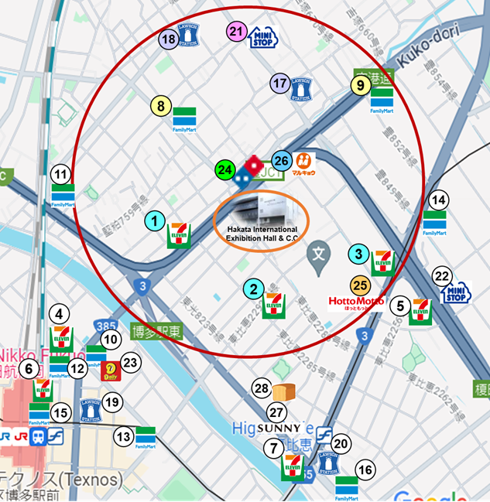
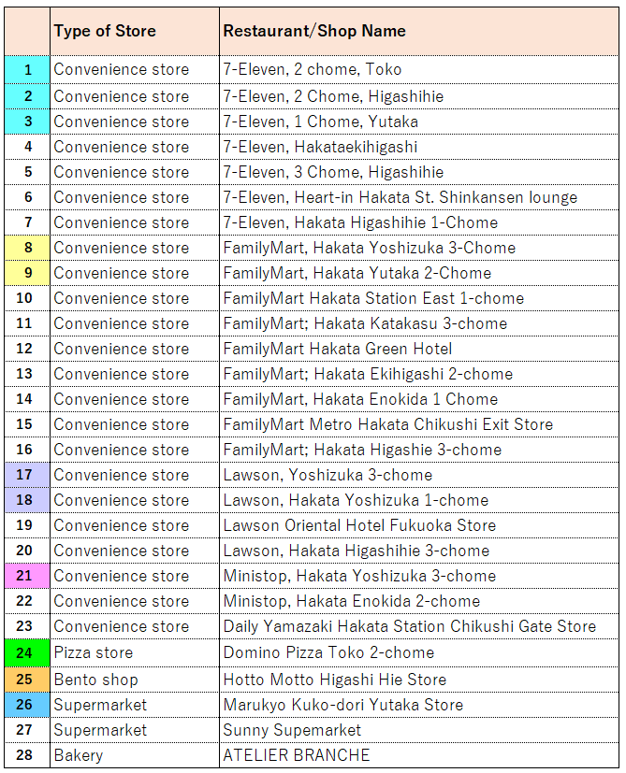
This red circle represents a 10-minute walking radius.
Take-out Stores Map & List

Slide 15
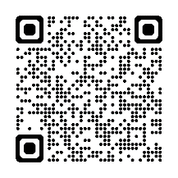
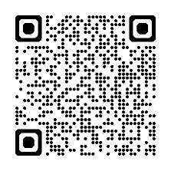
Please don’t miss to check
[Fukuoka City]
Fukuoka City Official Tourist Guide
(Fukuoka City)
https://gofukuoka.jp/
[Fukuoka Prefecture]
VISIT FUKUOKA
(Fukuoka Prefecture Tourism Association)
https://www.crossroadfukuoka.jp/en

Slide 16
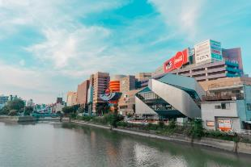


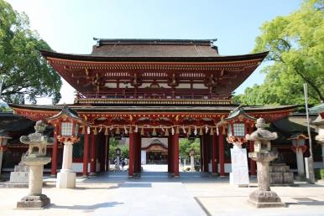
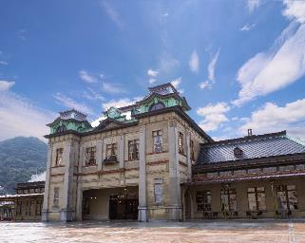
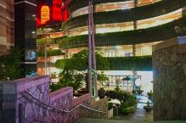


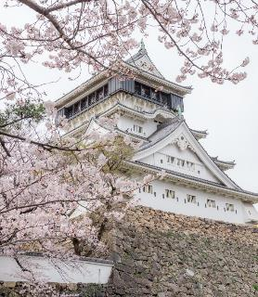
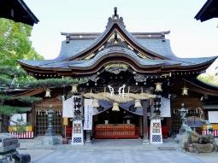

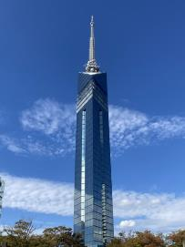

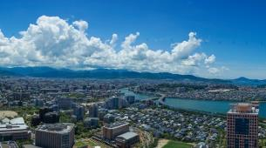
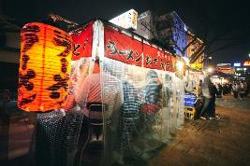



Recommended tourist spots
Shopping
Japanese Culture
Mojiko Retro area
Canal city Hakata
Dazaifu Tenmangu Shrine
©福岡県観光連盟
Nice View
Kushida Shrine
Fukuoka Tower
Kokura Castle
“Yatai” food stalls
©福岡県観光連盟
©福岡県観光連盟

Slide 17
Enjoy your stay
and
have a successful meeting!

