Slide 1
Objectives and work plan for 5G Broadcast Phase 2
RP-24xxxx
EBU

Slide 2

Objectives – Time interleaving
The time interleaving part of TFI is performed by following the principles of NR TBoMS and mapping the resulting TB to non-consecutive subframes. The formal objective is as follows:
For the time-interleaving part of 5G Broadcast TFI, one transport block is mapped to multiple non-consecutive subframes, following the principles of NR TBoMS. The following steps are followed:
  Scale the TBS by a factor of N, where N is the number of subframes over which the TB is mapped.
    RAN1 to discuss the details of the scaling, the value(s) for N and the set of subframes over which the TB is mapped, including how to schedule the TBs.
  Within one subframe, the transmitted rate matched bits are read consecutively from the circular buffer.
    In a given subframe, the procedure in TS 36.212 Section 5.1.4.1.2 applies (except for the parameter $k_{0}$ which needs to be modified according to point 3 below)
    Before frequency interleaving, the mapping from coded bits to RE follows the current specification.
  Across subframes belonging to the same TB, the starting point for reading from the circular buffer $(k_{0}$ in TS 36.212 Section 5.1.4.1.2) is to be decided by RAN1
  NOTE 1: The maximum TBS after scaling and soft buffer size should follow limitations imposed by current LTE categories. RAN1 to discuss how to capture this limitation.
  NOTE 2: Time interleaving is not applied for PMCH carrying MSI and/or MCCH.

Slide 3
Objectives – Frequency interleaving
The frequency interleaving operates in the unit of OFDM symbol, using a row-column interleaving with potential permutation of rows / columns.
For the frequency-interleaving part of 5G Broadcast TFI, interleaving is performed via a row-column interleaving with the following steps
  1) Data symbols in an OFDM symbol are written column-wise.
    RAN1 to decide what is the unit over which data symbols are written (e.g. a single RE, four REs, etc.)
  2) The rows and elements in each row may be permuted (taking as baseline the design in R1-1913290), with details to be decided by RAN1.
  2) Data symbols in an OFDM symbol are read row-wise.
  RAN1 to decide the number of {rows, columns} of the interleaver.

Slide 4
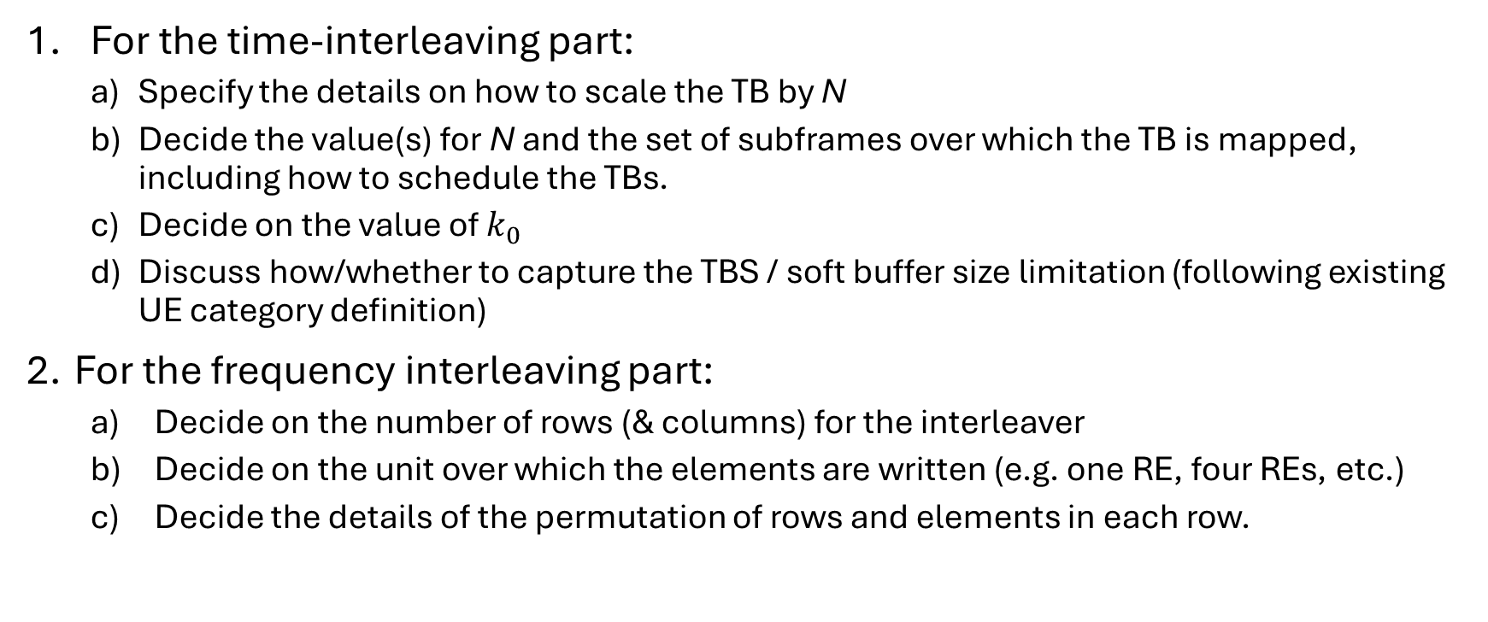
Detailed tasks for RAN1
For the time-interleaving part:
  Specify the details on how to scale the TB by N
  Decide the value(s) for N and the set of subframes over which the TB is mapped, including how to schedule the TBs.
  Decide on the value of $k_{0}$
  Discuss how/whether to capture the TBS / soft buffer size limitation (following existing UE category definition)
For the frequency interleaving part:
  Decide on the number of rows (& columns) for the interleaver
  Decide on the unit over which the elements are written (e.g. one RE, four REs, etc.)
  Decide the details of the permutation of rows and elements in each row.

Slide 5
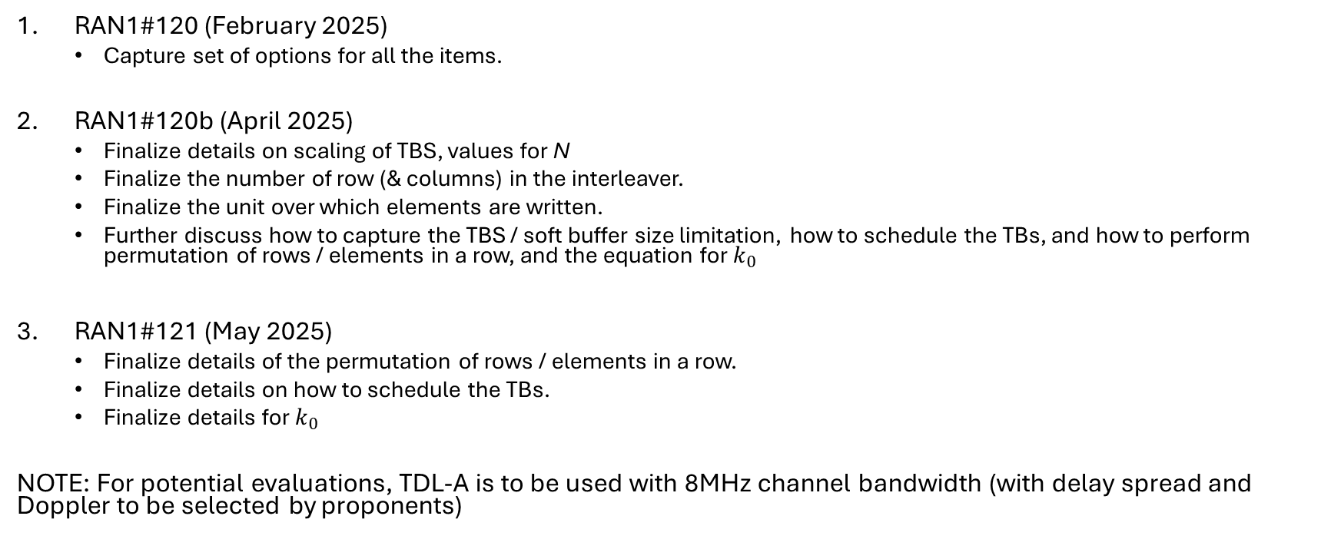
Work plan – RAN1
RAN1#120 (February 2025)
  Capture set of options for all the items.
RAN1#120b (April 2025)
  Finalize details on scaling of TBS, values for N
  Finalize the number of row (& columns) in the interleaver.
  Finalize the unit over which elements are written.
  Further discuss how to capture the TBS / soft buffer size limitation, how to schedule the TBs, and how to perform permutation of rows / elements in a row, and the equation for $k_{0}$
RAN1#121 (May 2025)
  Finalize details of the permutation of rows / elements in a row.
  Finalize details on how to schedule the TBs.
  Finalize details for $k_{0}$
NOTE: For potential evaluations, TDL-A is to be used with 8MHz channel bandwidth (with delay spread and Doppler to be selected by proponents)

Slide 6
Work plan – RAN2 / RAN3
RAN2#130 (May 2025)
  Initial discussion and draft CRs to capture the new features in TS 36.321 (MSI) and 36.331
  NOTE: Changes to MSI may be needed based on RAN1 decision on how to schedule the TBs.
RAN3#128 (May 2025)
  Identifying the impact to TS 36.443
RAN2#131 (August 2025)
  Finalize impact on for TS 36.321 and 36.331.
RAN3#129 (August 2025)
  Finalize the impact to TS 36.443

Slide 7
Work plan – RAN4 (performance)
RAN4#116
  Agree on evaluation assumptions & reference channel.
RAN4#116b
  Initial discussion on evaluation results
RAN4#117
  Finalize requirements

