Slide 1

3GPP SA Rel-18 Status
Georg Mayer, 3GPP SA Chair

Slide 2






3GPP
Global standards organization for mobile communication
750+ Companies from all over the world actively participating
A new Release every 15 to 24 months
A new Generation every 10 years – 3G/UMTS, 4G/LTE, 5G
Standards for all sectors of mobile communication – VoLTE, NB-IoT
~20 Working Groups & TSGs, each meeting 4 to 8 times a year
Contribution driven
Consensus based
PCG
Project Coordination Group
TSG RAN
Radio Access Networks
TSG SA
Services &
Architecture
TSG CT
Core Network &
Terminal
RAN1
radio layer 1
SA1
services & requirements
CT1
end-2-end
aspects
RAN2
radio layer 2 & 3
SA2
architecture
CT3
interworking with external networks
RAN3
RAN-CN interface
SA3
security
CT4
network internal protocols
RAN4
radio performance
SA4
Codec
CT6
smart card applications
RAN5
terminal testing
SA5
management
RAN6
legacy radio
SA6
(mission critical) applications

Slide 3
5G Advanced
Rel-18 is the Start of 5G Advanced
During Rel-15 to Rel-17, 3GPP has developed 5G from a collection of visions and buzzwords into a powerful new mobile communication environment which is rolled-out all over the world.
5G, besides many other things, enables mobile communication for industrial applications and enable so-called vertical services.
5G Advanced will develop 5G into the future, taking new technological and societal developments into account, e.g. environmental requiremtens, artificial intelligence, virtual/extended reality – to name a few.

Slide 4
Timeline & Releases (SA View)
TSG#
2021
2022
2023
2024
91
92
93
94
95
96
97
98
99
100
101
102
103
104
Stage 2
Exceptions
Release 17
Stage 3 (CT & SA)
ASN.1 & Open APIs
Stage 1
Release 18
Timeline
approval
Content
approval
Stage 2
today
Stage 3 (CT & SA)
ASN.1 & Open APIs
Release 19
Stage 1 (no timeline defined yet)

Slide 5
Rel-18 Status in 3GPP SA (October 2021)
SA1 / Requirements
over 80% of Rel-18 work completed
Requirements are complete and serve as a base for further work in SA, RAN, CT
Examples:
  personal IoT NWs
  smart energy services
  satellite backhaul
SA2 / Architecture
More than 40 proposals for Rel-18 items – prioritization process started on SA level
Examples:
  next generation real time communication
  vehicle mounted relays
  tactile & media services
  enhancements to e.g. slicing, edge computing, non-public networks, ntn, proximity based services, multicast/broadcast, …
SA3 / Security
Rel-18 work will start in 2022, as security issues are related to initial decisions in RAN and SA (SA2, SA6)
SA4 / Media & Codecs
Work on Rel-18 is starting
Examples:
  XR Services (artificial/virtual reality)
  immersive media
  broadcast media delivery
SA5 / OAM & Charging
Initial discussions on R18 started
Examples:
  AI/ML management
  digital twins
  self organizing networks
SA6 / MCC & Applications
Initial work on some Rel-18 items started
Examples:
  integration/migration of railway networks
  data delivery enabler for vertical applications
  smart grid

Slide 6
Prioritization and Content Approval
Rel-18 content will be approved by 3GPP SA, RAN and CT during the December 2021 plenary meetings
Due to the large amount of SA2 Study / Work Item proposals,
3GPP SA will conduct a prioritization process, which will be finalized during the December 2021 plenary meetings. A special prioritization workshop will be held before the plenary.
It is likely, that not all SA2 Study / Work Items will be part of the final Rel-18 content.
People who are interested in these discussions have to participate in the upcoming SA2 and SA meetings.

Slide 7
3GPP Release 19
As Rel-18 content is close to finalization, new requirements cannot be taken on board for Rel-18.
Whilst the detailed technical work on Rel-18 is progressing in the different 3GPP WGs, SA1 is already starting to collect and discuss requirements for 3GPP Release 19.
These activities are in their very initial phase and currently it is not possible to predict any items which will be part of Rel-19.
Companies with new ideas for e.g. vertical services, which make use of 5G Advanced, are invited to bring their proposals to 3GPP SA1.

Slide 8
3GPP SA Rel-17
Satoshi Nagata
Vice Chair, 3GPP TSG-SA
(NTT DOCOMO, INC.)

Slide 9
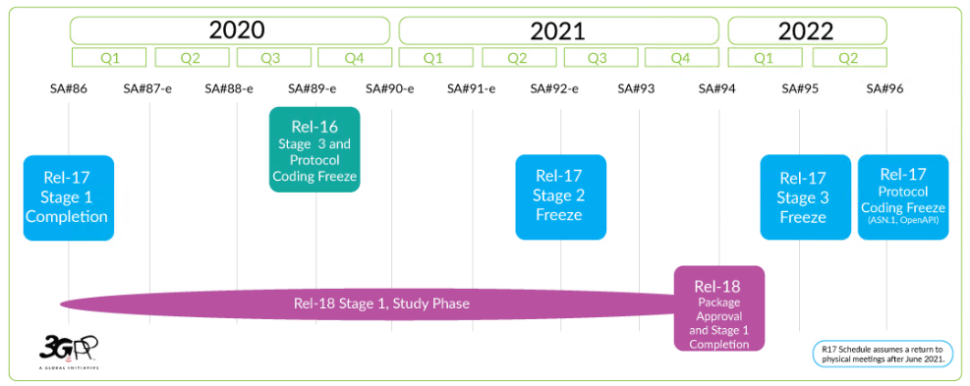
3GPP schedule
Notes:
5G multicast-broadcast services
System enhancement for proximity based services in 5GS
Support for Multi-USIM devices

Slide 10
Enhanced Support of Non-Public Networks
To enable support for Standalone Non-Public Network (SNPN) along with subscription/credentials owned by an entity separate from the SNPN, support for Video, Imaging and Audio for Professional Applications, Support of IMS voice and emergency services for SNPN, and support for UE Onboarding and remote provisioning.
P-CSCF
I/S-CSCF
IMS-HSS
IMS Subscription Holder
NU1
SNPN

Slide 11



Enhanced support of Industrial Internet of Things
To enhance support of Time Sensitive Communication (TSC), including enhancements for support of deterministic applications and enhancements to IEEE Time-Sensitive Networking (TSN). Key issues addressed in the study include Uplink Time Synchronization, UE-UE TSC communication, Exposure of QoS and related enhancements, Exposure of Time Synchronization services for activation/deactivation, support for PTP time sync and use of Survival Time for Deterministic Applications in 5GS.
Time synchronization
5G system
Core NW

Slide 12





Enhancement of support for Edge Computing in 5GC
To define solutions to enhance the forwarding of some UE application traffic to the applications/contents deployed in Edge Computing Environment, including the dynamic insertion of traffic offloading capabilities, seamless change of application server serving the UE, provide local applications with information on e.g. the expected QoS of the data path, supporting PSA change when the application does not support notifications of UE IP address change.
Gaming application
(example)
Core Network

Slide 13



Supporting Unmanned Aerial Systems (UAS) Connectivity, Identification, and Tracking
Vehicles (UAV) identification, UAV authorization by UAS Traffic Management, UAV authorization revocation and (re)authorization failures, UAV - UAV Controller association and tracking, and User Plane Connectivity for UAVs. It addresses both 5G Core and 4G EPC.
Uncrewed Aerial System (UAS)
Uncrewed Aerial Vehicle (UAV)
UAS Service Supplier (USS)
UAS Traffic Management (UTM)
UAV controller(UAVC)
Third Party Authorized Entity(TPAE)

Slide 14
Access traffic steering, switch and splitting support; Phase 2
Aims to support additional traffic steering capabilities as well as supporting Multi access PDU Session using 3GPP LTE/EPC resources as a 3GPP access.

Slide 15
Enablers for Network Automation for 5G; Phase 2
To address some leftover work from Rel-16, such as data collection from UE for analytics generation; how to ensure that slice SLA is guaranteed. Also new functionality will be supported which includes - Multiple NWDAF Instances in one PLMN including hierarchies, enabling real-time or near real-time NWDAF communication, NWDAF-Assisted UP Optimization, Interaction between NWDAF and AI Model & Training Service owned by the operator.

Slide 16
Enhancement of Network Slicing; Phase 2
Identifying the gaps that need to be filled in providing support in the specifications owned by SA WG2 for the Generic Network Slice Template (GST) attributes defined by GSMA 5GJA and captured in document NG.116.

Slide 17
Architecture Enhancements for 3GPP Support of Advanced V2X Service; Phase 2
This study aims to provide support of QoS aware NR PC5 power efficiency for pedestrian UEs.

Slide 18
Architecture Aspects for using Satellite Access in 5G
Addresses following aspects related to integration of satellite access in the 5G system - Mobility Management with large coverage areas, Mobility Management with moving coverage areas, Delay in satellite, QoS with satellite access, QoS with satellite backhaul, RAN mobility with NGSO (Non-Geostationary Satellite Orbit) regenerative-based satellite access, Regulatory services with super-national satellite ground station.

Slide 19
5G System Enhancement for Advanced Interactive Services
This Work Item is to define potential QoS parameters e.g. new standardized 5QI(s) corresponding to QoS requirements for interactive services like cloud gaming service.

Slide 20
Enhancement to the 5GC Location Services; Phase 2
Aims to provide support for very low latency and very high accuracy positioning, including horizontal and vertical positioning service levels, 5G positioning service area. This work item will also enable MCX UE to use the 5G positioning services to determine its position.

Slide 21
Multimedia Priority Service (MPS); Phase 2
Addresses the impacts to EPS and 5GS core network specifications for supporting MPS for MMTel voice teleconferencing, MPS Data Transport Service (DTS) communications and MPS for MMTel video, MMTel video teleconferencing and streaming video.

