Slide 1
Evolution of the Core Network in 5G
Lionel Morand, 3GPP TSG CT Chair
Hiroshi Ishikawa, 3GPP TSG CT WG4 Vicechair

Slide 2
Agenda
About 3GPP TSG CT
Rel-17: From where we were…
Rel-17: …To where we are
CT activities for successful 5G rollout

Slide 3

About 3GPP TSG CT
From circuit-switched network to IP-based system
From mobile terminal to any device…
From a telco-centric network to a flexible service enabler platform…

Slide 4
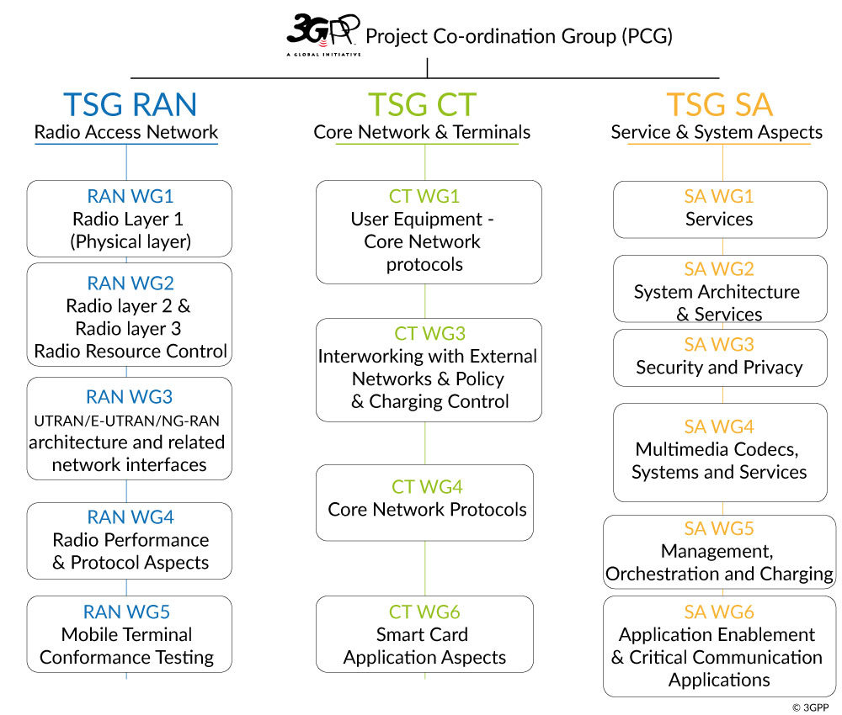

TSG Core Network and Terminals (TSG CT)
Network Enabler factory
  Transforming service functional requirements into network enablers
Responsible of detailed protocol specifications for:
  Control and user signaling planes
  User and terminal mobility management
  Call/session control
  Policy, charging QoS enforcement
  Interworking with external networks
  Network capabilities exposure
  3GPP smart card applications, and the interface with the Mobile Terminal
you are here

Slide 5

Rel-17: From where we were…

Slide 6
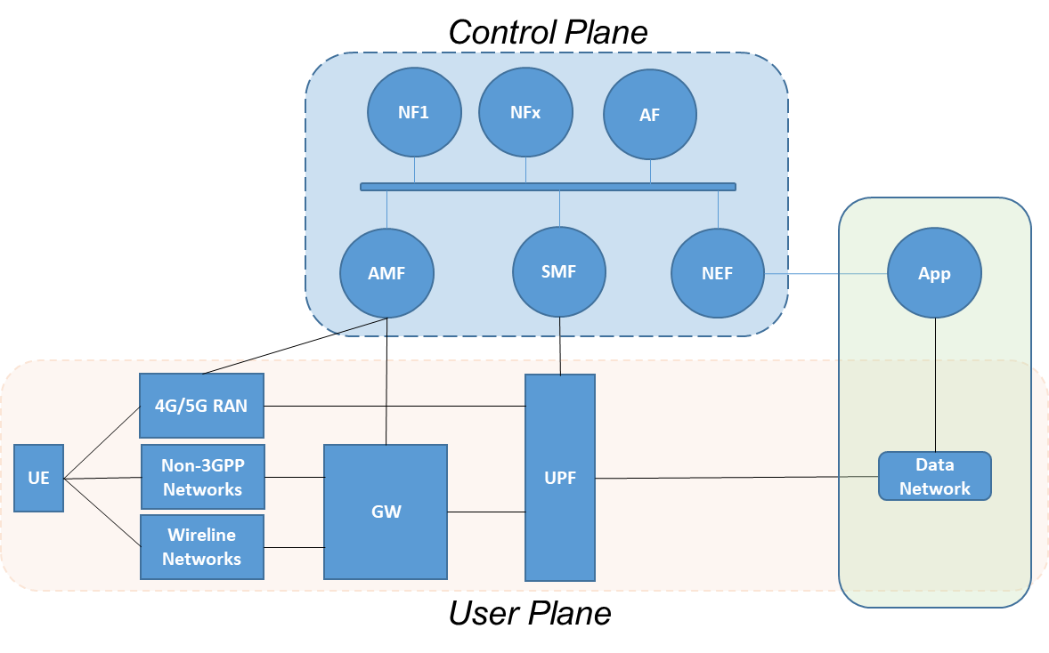
Release 15: New Paradigm with 5G
Frozen in June 2019
Not Everywhere…
  User Plane, UE/CN interfaces, CUPS inherited from 4G
But in the Control Plane:
  New Service-based Architecture
    Virtualization, Cloud-friendly
    Programmable, stateless, scalable
    Ease the introduction of any new feature/service
  Main Decision: Define RESTful APIs to expose services offered by NF
    Use of HTTP/2 as transport protocol
    API Design based on the REpresentational State Transfer (REST) principles
    JavaScript Object Notation (JSON) as a data format
    Standardized versioning mechanism
5G System architecture

Slide 7

Release 16: Building on core capabilities
Frozen in July 2020
Adding new features
  Introduction of additional services
    New APIs for IMS integration, Steering of roaming, Location services, etc.
  Storage mechanism of stateless/dataless NF
    New API to store dynamic state data in dedicated database (UDSF).
  User data interworking mechanisms between 4G and 5G
    New API to interconnect HSS in EPC and UDR in 5GC
  Load and Overload Control mechanisms for 5GC
  Interworking between NR and UTRAN Voice Call Continuity
More support to Verticals
  5G Enablers for Network Automation
  Support of time sensitive communication
  Common capabilities for a Service Enabler Architecture Layer
  Cellular IoT functionality for 5G System
  Support of advanced V2X services over 5G
  Further protocol enhancements for
    Mission Critical Services
    Public Warning System
    Future Railway Mobile Communication System

Slide 8
Rel-17: … To Where We Are

Slide 9
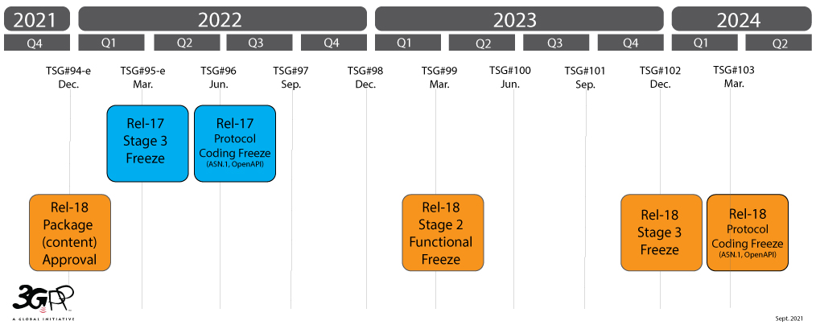

3GPP Release Timelines (current)
Rel-17 for CT:
  49 work items, 7 small technical enhancements, 5 study items

Slide 10
Rel-17: New Features (non-exhaustive)
Support of new services:
  Mission Critical services over 5G
  Proximity based services (ProSe) in 5GS
  5G multicast-broadcast services
  Multimedia Priority Service (MPS) Phase 2
Architecture enhancement
  5GC architecture for satellite networks
  Enhanced support of Edge computing and deployment of edge applications
  Enabling Multi-USIM Devices
  Message service for MIoT over 5G System
  Support of time-sensitive communication (TSC) for Industrial IoT
  Protocols for support of Application layer for Uncrewed Aerial System (drones)

Slide 11
Rel-17: New Features (non-exhaustive)
Security:
  Authentication and key management for applications based on 3GPP credential in 5G
  Integration of GBA into SBA
  PAP/CHAP protocols usage in 5GS
Protocol enhancements/improvement
  BEst Practice of PFCP (CUPS)
  Mission Critical Services
  Restoration of PDN Connections in PGW-C/SMF Set
  Support for Minimization of service Interruption
  Start of Pause of Charging via User Plane
  enhanced IMS to 5GC Integration Phase 2

Slide 12

CT activities for successful 5G rollout

Slide 13
Tasks in CT for successful 5G rollout
Standard solutions for multi-vendor interoperability
Network high-reliability and resilience
Ensure migration, interworking and roaming between networks
Secure APIs for controlled access to network capabilities by service providers and application developers

Slide 14
5GC Protocol Enhancements
Generic, continuous protocol enhancements framework in CT
Various proposals addressing update to every 3GPP Release
5GProtoc Stage-3 5GS NAS protocol development
SBIProtoc Service Based Interface Protocol Improvements Release
NBI Enhancements of 3GPP Northbound Interfaces and Application Layer APIs
“NBI”
in CT3
“SBIProtoc”
in CT4 and CT3
“5GProtoc”
in CT1

Slide 15
Some CT activities driven by operators
Not only vendors, but operators need to follow CT activities
  Ensure service requirements from operators to be reflected in CT specifications
  Dialogue between vendors and operators are essential to realise the solution in CT specifications
Illustration of the importance of the presence of operators in CT
  Steering of Roaming
    Operators have various business requirements
    Vendor assumptions tend to be unique for all operators
    Details were left to CT to specify and debate on how to reflect operator requirements with the vendor support on the feature
  IMS voice service support and network usability guarantee for UE’s E-UTRA capability disabled scenario in SA 5GS
    Issue raised from operators providing service for a voice capable 5GS device under specific condition, while 5GS and EPS coverage are not fully spread out.
    Requires additional handling at UE defined within CT specification, and agreed to start the work with support from several vendors and operators

Slide 16
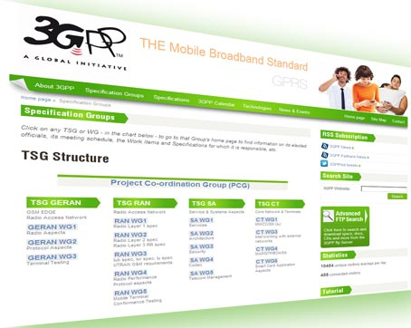


Thank You!
Lionel Morand
TSG CT Chair
ETSI
lionel.morand@orange.com
Hiroshi Ishikawa
TSG CT WG4 Vicechair
TTC
hiroshi.ishikawa.ev@nttdocomo.com

