Slide 1
Introducing 3GPP
<Person, Title>

Slide 2
Content
The role of 3GPP
GSM roots
The 3GPP Eco-system
Organizing the work
…
Conclusions

Slide 3
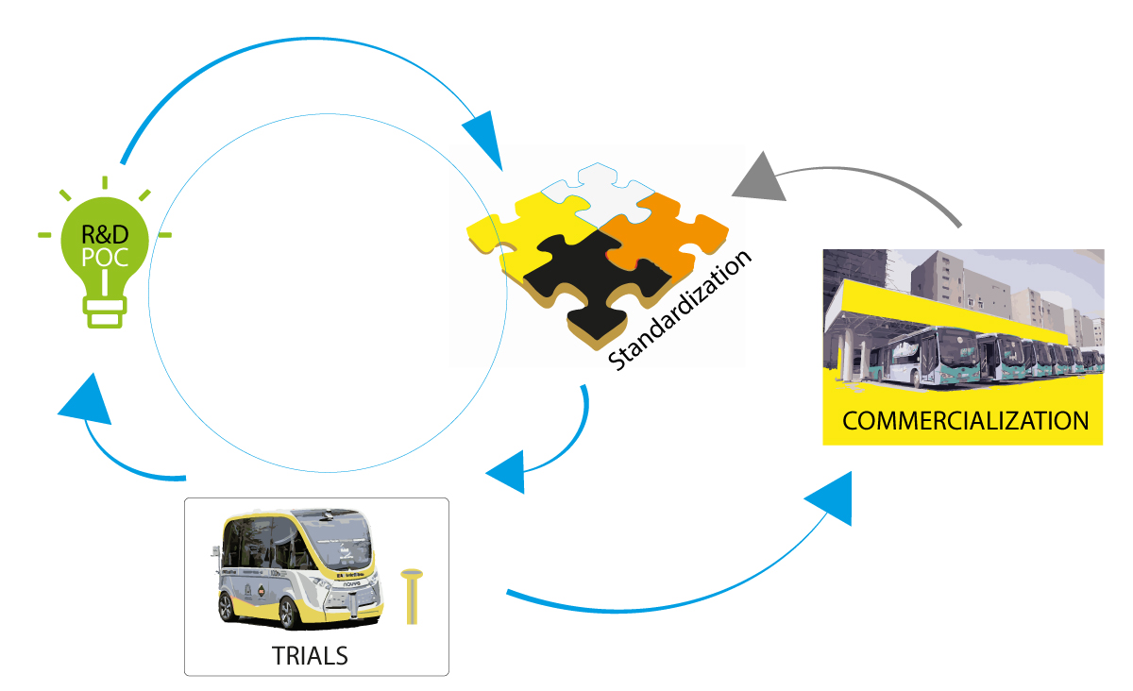
The role of 3GPP
Part of the invention, proof of concept, standardization, trials, commercialization …cycle
Specifications and Studies providing a complete system description for mobile telecommunications
The system description is characterized by a number of standardized interfaces. It is not a description of a standardized deployment
This standardization effort enables an interoperable, multi-vendor approach to deployment and generates mass market economies of scale, without stifling innovation

Slide 4
Evolution …thanks to GSM
Generation | Systems
1G | Analogue technology, from the 1980s onwards (NMT, AMPS, TACS, A-Netz to E-Netz, Radiocom 2000, RTMI, JTACS and TZ-80n)
2G | First digital systems, deployed in the 1990s introducing voice, SMS and data services (GSM/GPRS & EDGE, CDMAOne, PDC, iDEN, IS-136 or D-AMPS).
3G | 3GPP evolved Global System for Mobile communication (GSM) with the evolution of General Packet Radio Service (GPRS) and Enhanced Data rates for GSM Evolution (EDGE), as well as further developments with the Universal Mobile Telecommunications System (UMTS) and High Speed Packet data Access (HSPA). 3G brought a global scale to the evolution of mobile networks, with the creation of the ITU's family of IMT-2000 systems which included EDGE, CDMA2000 1X/EVDO and UMTS-HSPA+ radio access technologies.
3G/4G | LTE and LTE-Advanced have crossed another “generational boundary” with high speed data, significant spectral efficiencies and adoption of advanced radio techniques, they have been the direction of travel for [ all ] new mobile systems from Release 8 onwards.
5G | 5G brings another major technology step, with the creation of a 'New Radio' (NR). While initial specifications enabled non-standalone 5G radio systems integrated in previous-generation LTE networks, later Release 15 work expanded to cover ‘standalone’ 5G, with the new radio system complemented by a next-generation core network.

Slide 5
3GPP standards eco-system
3GPP Organizational Partners (OPs)
The 3GPP Organizational Partners (OP) - 7 Standards Organizations - from China, Europe, India, Japan, Korea and the United States.
Participation in 3GPP by companies and organizations becoming Members of one of these 7 OPs.
Inputs on market requirements may come in to the Project via 3GPP Market Representation Partners (MRP).
There is a lot of additional external liaison activity…SDOs, Industry bodies, projects…
Official Liaisons on specification work:
~700 companies
450 MHz Alliance, AISG, Bluetooth, Broadband Forum (BBF), CableLabs, International Special Committee on Radio Interference (CISPR), CTIA, Digital Video Broadcasting (DVB) Project, Ecma, International, Expert Group for Emergency Access (EGEA), Eurescom, COST 273, European Radiocommunications Committee (ERC), Fixed Mobile Convergence Alliance (FMCA), GCF, Global TD-LTE Initiative (GTD), GPS Industry Council, GSM Association, HomeRF Forum, IDB Forum, IEEE, Internet Engineering Task Force (IETF), IrDA, International Multimedia Telecomunications Consortium (IMTC), Internet Streaming Media Alliance, ISO-ITU expert group, ISO MPEG / JPEG, ITU-T SG2, JAIN tm (Javatm APIs for Integrated Networks), The Java Community Process (JCP), Liberty Alliance Project, Metro Ethernet Forum (MEF), NENA, NGMN (Next Generation Mobile Networks), oneM2M, OMA (Open Mobile Alliance ), Open Networking Foundation (ONF), Open IPTV Forum, Object Management Group (OMG), PCS Type Certification Review Board (PTCRB), Portable Computer and Communications Association (PCCA), Presence and Availability Management (PAM) Forum, RSA Laboratories, SDR Forum, Sun Micro Systems Inc., Steerco, SyncML Initiative, Trusted Computing Group (TCG), TeleManagement Forum (TMF), TCCA, TIA /TR45, TIA/TR47, ITU, TV-anytime Forum, Voice eXtensible Mark-up Language (VXML) Forum, Wi-Fi Alliance, Wireless Broadband Alliance (WBA), WLAN Smart Card Consortium, Wireless World Research Forum (WWRF), World Wide Web Consortium (W3C)
(Source: extract from https://www.3gpp.org/about-3gpp/15-bodies-with-which-3gpp-has)
3GPP Market Representation Partners (MRPs)
5G Projects
Certification Bodies

Slide 6
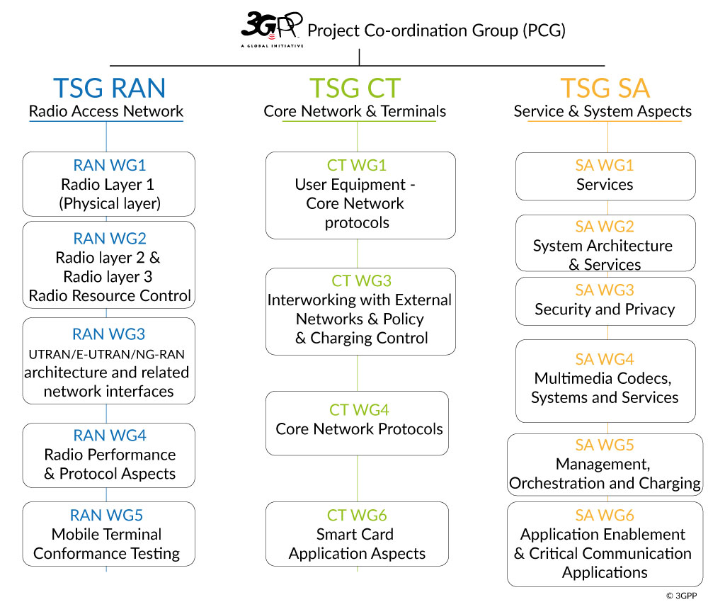
Technical Specification Groups
The TSGs prepare, approve and maintain the 3GPP Technical Specifications and Technical Reports.
They are responsible for the detailed time frame and management of the work’s progress;
Management of work items;
Technical Co-ordination;
Proposal and approval of work items within the agreed scope and terms of reference of the TSG
The TSG Chairman is responsible for the overall management of the technical work within the TSG and its Working Groups.
The WG Chairman is responsible for the overall management of the technical work within the WG and its sub-groups.

Slide 7
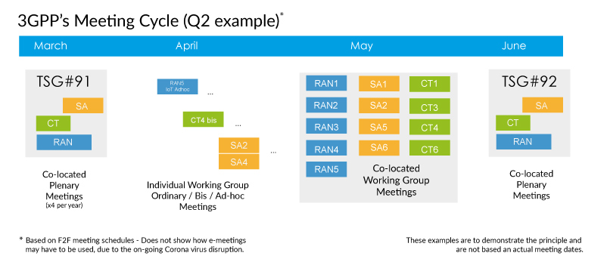
Work Schedule driven by technical meetings
New work are initiated by member companies as Work Items, via Tdocs at meetings
Work Items are prioritised and allocated time for discussion during meetings
3GPP member companies may contribute to any work item, on equal terms
3GPP seeks consensus on all technical matters (but has mechanisms if consensus cannot be reached)
The Release deadline is respected. Unfinished work is deferred to a later release

Slide 8
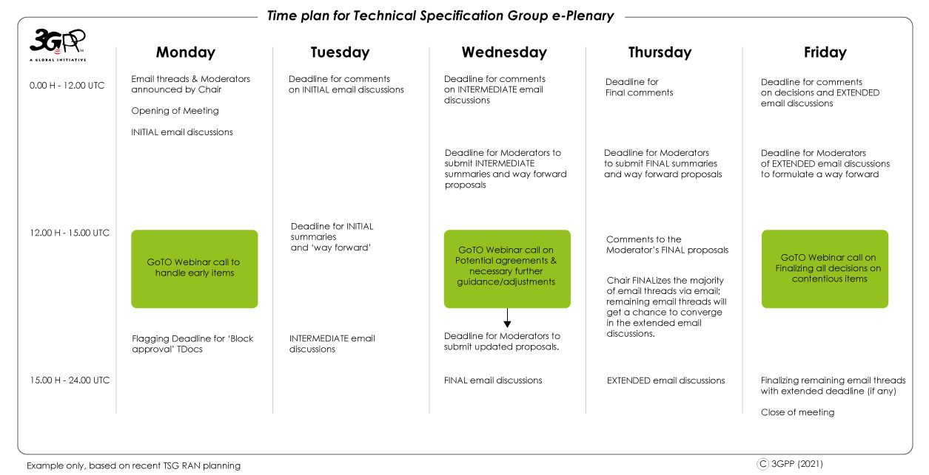
E-Meeting schedule (example)
eMeetings are working Across all time zones
The number of meeting days have been extended to allow for email discussion
GoTO Webinar used for real-time discussions
Discussions are split into Initial, Intermediate, Final and Extended periods

Slide 9
3GPP Releases
Release-based work
Releases are major packages of Features (The is a new 3GPP Release ~ every 15 – 24 months)
A strong commitment to time-lines guarantees reliable planning and time-to-market
The Work plan is built-up of Work Items that deliver the Features
Work Items:
WI may cover more than one specification
WI may cover more than one TSG or WG
WI Description document exists for each WI
Multiple releases are maintained in parallel
See the 3GPP Work Plan for details:
http://www.3gpp.org/Work-Plan
Number of specifications (frozen Releases)
June 2021

Slide 10
Three stage approach to Features, through Releases
time
Stage 1 Requirements: Overall service description from the user’s standpoint.
SA1
Requirements
RAN
Radio Access
Stage 2
Architecture: Overall description of the organization of the network functions to map service requirements into network capabilities.
SA2
Architecture
SA3
Security
SA4
Media
SA5
OAM
SA6
Apps/MC
Stage 3
Protocols: The definition of switching and signalling capabilities needed to support services defined in Stage 1.
CT – Protocols & Coding

Slide 11
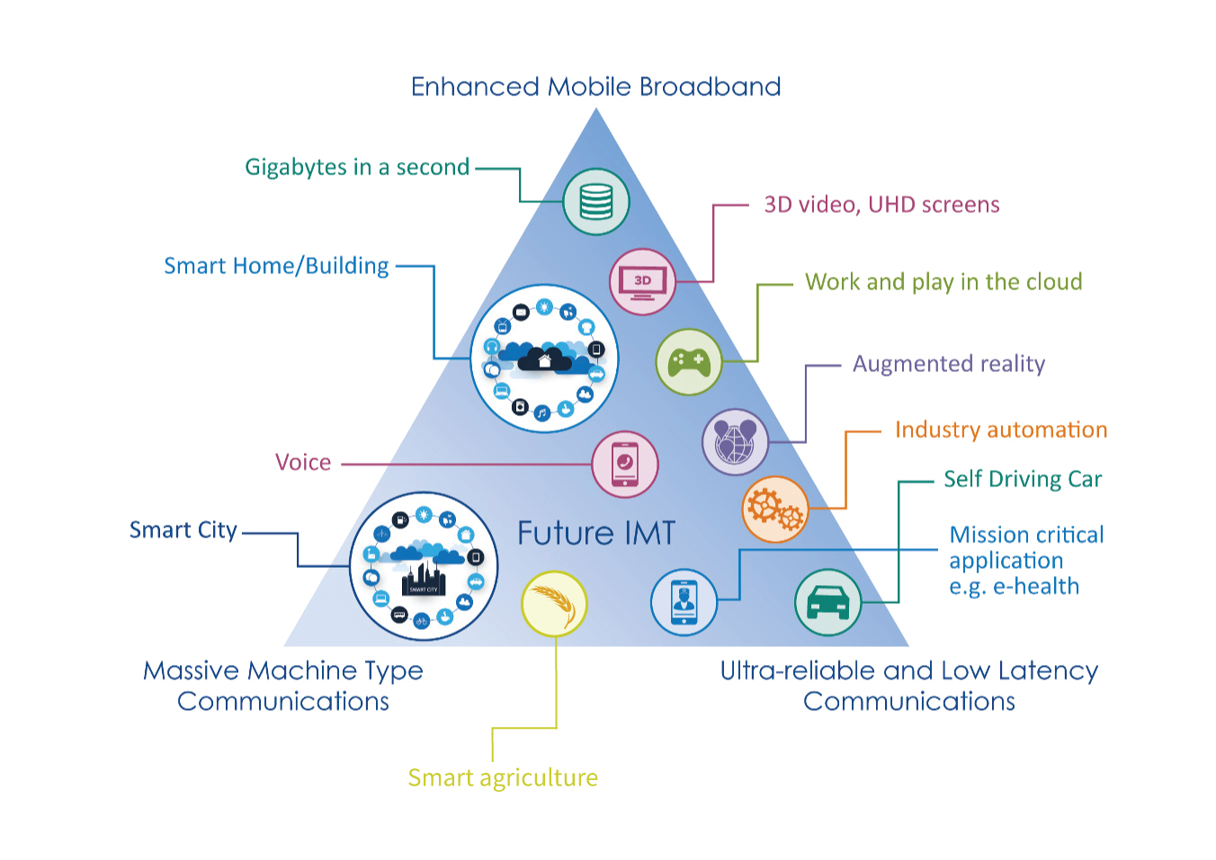
Bringing the work in to the groups
3GPP Specifications and Reports:
Requirements | 21 series
Service aspects ("stage 1") | 22 series
Technical realization ("stage 2") | 23 series
Signalling protocols ("stage 3") - user equipment to network | 24 series
Radio aspects | 25 series
CODECs | 26 series
Data | 27 series
Signalling protocols ("stage 3") -(RSS-CN) and OAM&P and Charging (overflow from 32.- range) | 28 series
Signalling protocols ("stage 3") - intra-fixed-network | 29 series
Programme management | 30 series
Subscriber Identity Module (SIM / USIM), IC Cards. Test specs. | 31 series
OAM&P and Charging | 32 series
Security aspects | 33 series
UE and (U)SIM test specifications | 34 series
Security algorithms | 35 series
LTE (Evolved UTRA), LTE-Advanced, LTE-Advanced Pro radio technology | 36 series
Multiple radio access technology aspects | 37 series
Radio technology beyond LTE | 38 series
Use Case diversity
High or Low data rates
Higher user mobility
Improved coverage
Overall Goals
Enable new business
Greater efficiency
More flexibility – not one-size-fits-all systems

Slide 12
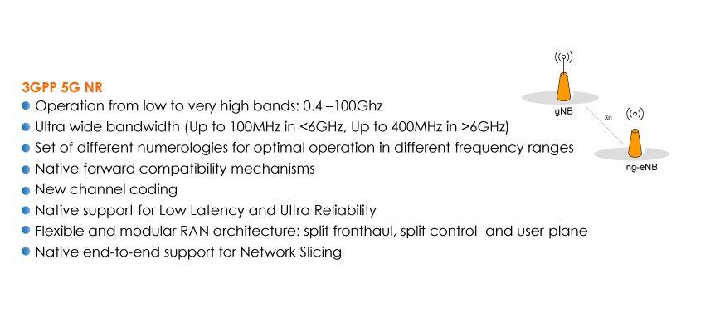
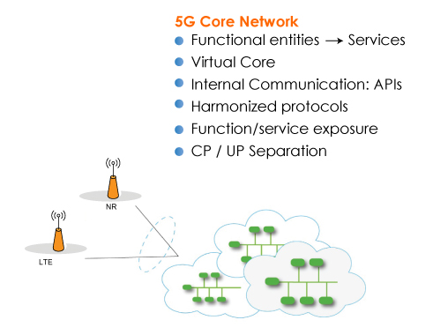
5G – brings new growth
5G delivers the perfect storm of technology trends:
Availability of a reliable low latency radio and a fully flexible network
New focus on Artificial Intelligence and Automation
Augmented Reality and Virtual reality are inspiring a device revolution
All industries are going cellular

Slide 13
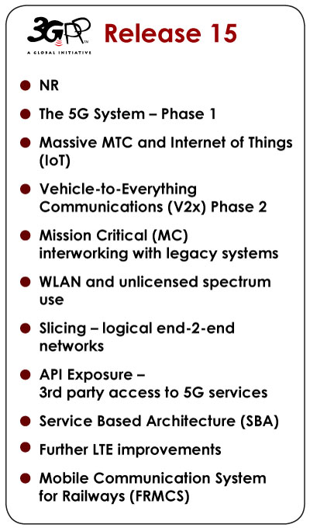
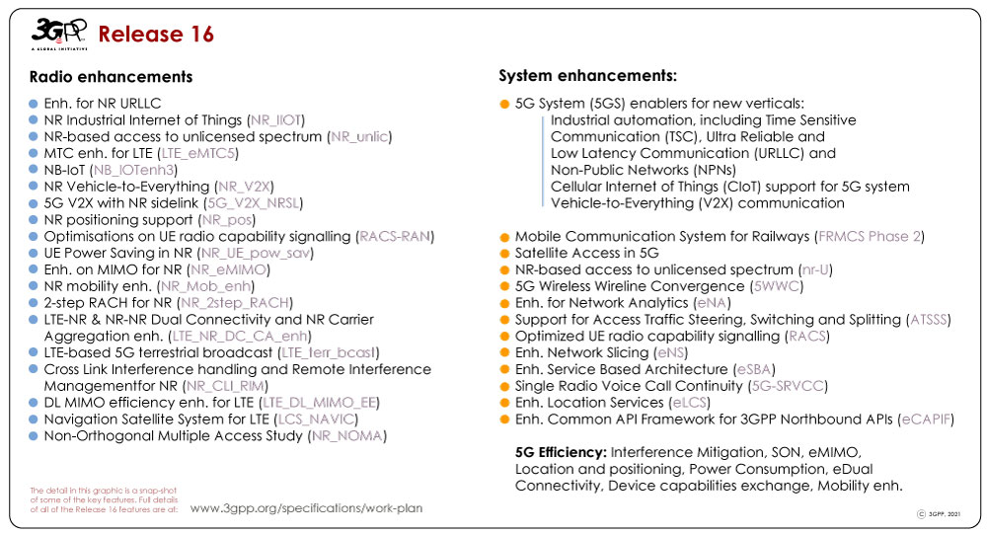
5G Releases
Release15: The work on new radio (nr) and the 5G system (5GS) jointly addressed the urgent subset of needs for early commercial deployments.
Release16: Met all identified 5G use cases, to allow a full 3GPP IMT 2020 submission to ITU-R.
Notes:
10/31/16

Slide 14
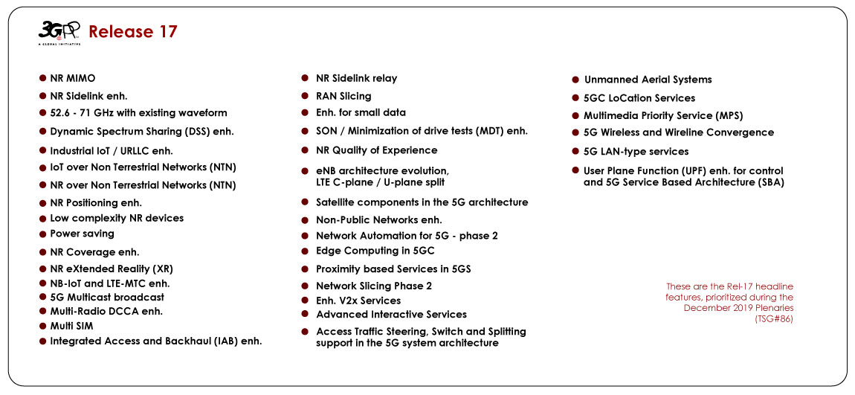
5G Releases
Release 17: Will enhance the earlier 5G work, including more 'vertical' industry needs, NR operation in unlicensed bands, NR MIMO, V2-everything… Completion Mid-2022.
Notes:
10/31/16

Slide 15
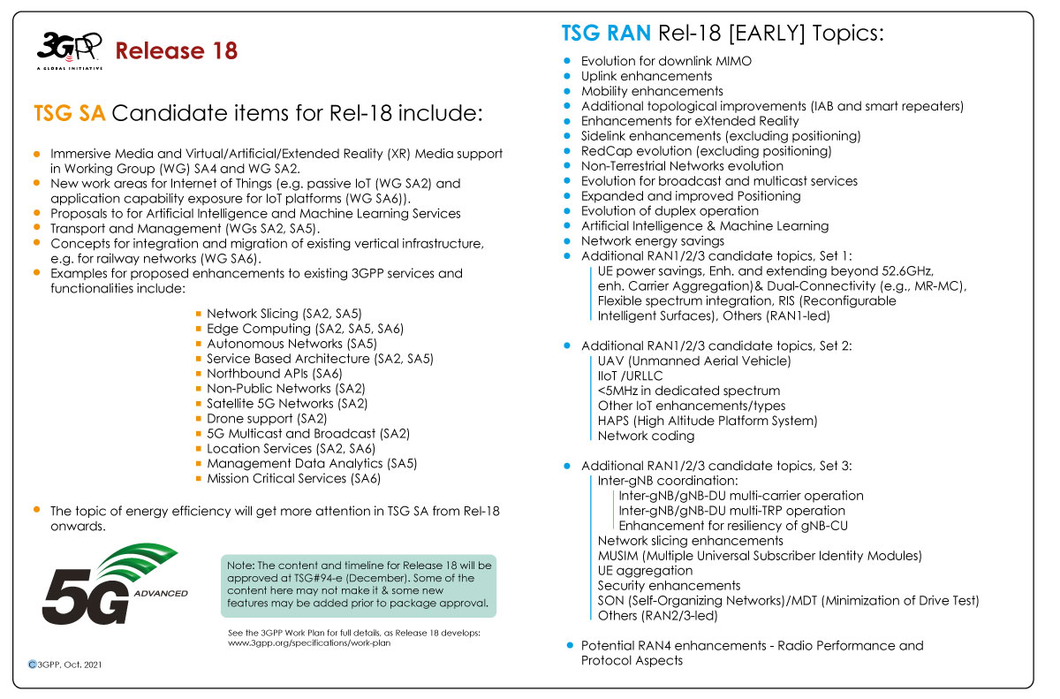
5G Releases
Release 18: Advanced use cases are being discussed during 3GPP workshops & on email threads in 2H 2021. The final decision on content of the release to be made at the December 2021 Plenaries.
The new marker ‘5G-Advanced’ is to be used on spec. cover sheets from Release 18 onwards.
Notes:
10/31/16

Slide 16
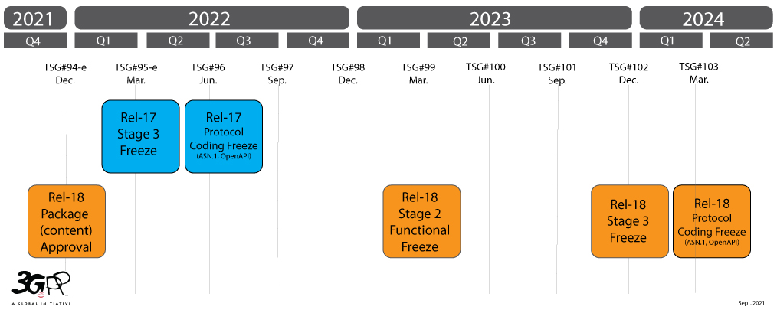
Release 17 & 18 Schedules
December 2019, TSG SA#90-e agreed a firm Rel-17 schedule (see image right):
E-meetings and COVID-19 have challenged the ability of the groups to complete all Rel-17 work in the time allowed. Groups considering down-scaling some feature work in Rel-17, but the agreed freeze dates are to be met.
3GPP Rel-18 studies & workshops underway. The firm package content (features) and timeline will be available by December 2021.
TSG RAN Workshop was held June 28 – July 2. See website article “Advanced plans for 5G”
TSG SA (overall architecture and service capabilities) Workshop was held as an e-meeting Sept 9 – 10.
TSG#93-e (September)Agreed Rel-18 timeline (right).
Prioritization and content to be confirmed at TSG#94-e (December)

Slide 17
Concluding thoughts
3GPP is industry driven - Standardization of interfaces enables an interoperable, multi-vendor approach to deployment.
The 3GPP processes are necessarily complex, but we will adapt to bring new sectors in to the work.
Release 17 focus has continued to expand towards the new use cases.
Release 17 has a firm timeline – independent from the decision to return to physical meetings.
Release 18 will see the appearance of the mid-generational marker 5G-Advanced.
Early indications given by TSG RAN that Release 18 will see a balanced evolution in terms of:
Mobile broadband evolution versus further vertical domain expansion;
Immediate versus longer-term market needs;
Device evolution versus network evolution.
Release 18 will have an important role in helping to lay early foundations for future work on 6G technologies.

Slide 18
For more info…
All documents available online; www.3gpp.org
Join 3GPP & attend special newcomers sessions and mentoring programme.
Subscribe to our regular newsletter ‘Highlights’
Keep in touch;
Info, membership, marcom, liaisons;
www.3gpp.org/contact
www.3gpp.org/highlights

