Slide 1

Next Generation Core Networks Summit 2011
Standardisation and Developments within SAE
Frédéric Firmin (frederic.firmin@3gpp.org)
3GPP Technical Officer

Slide 2
Terminology
SAE
EPC
The 3GPP work item defining…
The Evolved
Packet Core network
EPS
The Complete
System
And...
LTE
Evolved radio access technology…but LTE is often used to describe the Complete system – Including Radio
TAKEAWAY: this presentation covers EPC aspects

Slide 3
Topics of this presentation
Overview of the standardisation work on SAE
How is EPC different to current core networks?
Standards and releases – Where are we now & where are we heading?

Slide 4
Overview of the standardisation work on SAE

Slide 5

The 3rd Generation Partnership Project
Development of a
3G mobile system
based on evolved GSM and UTRA (both FDD and TDD)
Development of an evolved 3G and beyond system: EPS
Maintenance and development of
GSM, GPRS and EDGE
TAKEAWAY: This is an international effort

Slide 6
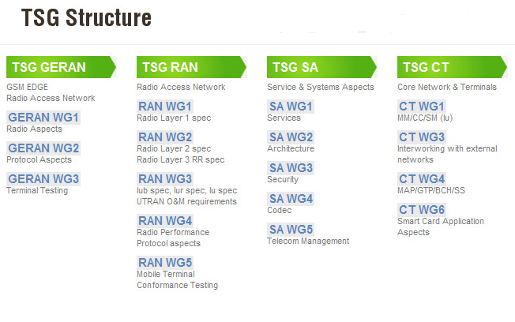
Technical Specification Groups
SAE work
TAKEAWAY: Work split across TSGs & their Working Groups

Slide 7
3GPP Evolution
Higher data thoughput
Lower latency
RADIO
INTERFACES
More spectrum flexibility
Improved CAPEX and OPEX
SERVICES
IP
CORE
NETWORK
All-IP network
Support of non-3GPP
accesses
More IMS applications
Improved security
Greater session continuity
Greater device diversity
TAKEAWAY: Whole system approach

Slide 8
How is EPC different to current core networks?

Slide 9
2G/3G architecture domains
Voice, SMS…
Access network
Core network
External networks
3GPP accesses
Circuit
core domain
2G / 3G RATs:
GSM/GPRS, UMTS,
EDGE, HSPA
CS
networks
IMS domain
Packet
core domain
PS
networks
Data
Multimedia services
TAKEAWAY: Today both CS and PS in the mix

Slide 10
EPS architecture domains
Access network
Core network
External networks
3GPP accesses
Circuit
core domain
2G / 3G RATs
CS
networks
LTE / LTE Advanced
IMS domain
Packet
core domain
PS
networks
non-3GPP accesses
cdma2000©
WiMAX
WLAN
EPC = all-IP network
…
TAKEAWAY: EPC, an all-IP network with support of multiple access technologies

Slide 11
An all-IP core network
in 2G/3G, the CS domain handles the voice calls and SMS
… but in EPC, there is no CS domain anymore!
How to provide those services in this all-IP network?
Solutions for voice
Solutions for SMS
CS fallback
IMS: 3GPP MMTel / GSMA VoLTE
CS over PS
Over the top VoIP
SMS over SGs interface
IMS
CS over PS
TAKEAWAY: EPC optimized for IMS, but CSFB is covered in the specifications

Slide 12
Multiple access networks
3GPP
accesses
GSM/GPRS, EDGE, UMTS, HSPA, LTE…
EPC
Access
networks
Trusted
WiMAX, cdma2000©…
Non-3GPP
accesses
Non-trusted
Public WiFi…
Inter-system mobility
TAKEAWAY: convergence facilitated by the EPC ; additional security for untrusted accesses

Slide 13



QoS in the EPS
UEs
Voice calls
RADIO RESOURCES
Web browsing
CN RESOURCES
E-mail
IP connectivity
Video streaming
QoS
Other services
TAKEAWAY: Diverse range of UE s and Services stretching Resources to the limit

Slide 14
QoS in the EPS
Different services, different requirements in terms of:
  Service level: best effort or guaranteed service level
  Acceptable packet delays and loss rate
Different QoS deployment models:
  User-based differentiation
  Service-based differentiation
  Or a combination of user / service-based
TAKEAWAY: Differentiation is a key requirement

Slide 15
Differences between pre-EPS and EPS QoS
Pre-EPS QoS | EPS Qos
4 traffic classes: conversational, streaming, interactive and background 13 individual QoS parameters: Maximum bitrate, Delivery order, Maximum SDU size, SDU format information, SDU error ratio… | 9 QoS Classes Indexes (QCI) map to combinations of: GBR/non-GBR, and predefined values for priority, packet delay budget and acceptable packet loss rate
Allocation and Retention Priority 3 priority values | Allocation and Retention Priority 15 priority values
No always-on bearer after attach Bearer establishment initiated by the network or the UE | Always-on IP connectivity Default bearer / dedicated bearer Bearer establishment initiated by the network
For more details: see 3GPP TS 23.107 | For more details: see 3GPP TS 23.203
TAKEAWAY: EPS Qos: simplified, more flexible and efficient

Slide 16
Standards – Where are we now & where are we heading?

Slide 17
3GPP releases
STABLE BASE
FOR IMPLEMENTORS
Release freeze
3GPP
RELEASE
BACKWARD
COMPATIBLE
PARALLEL
TAKEAWAY: A release is a consistent set of specifications and features provided within

Slide 18
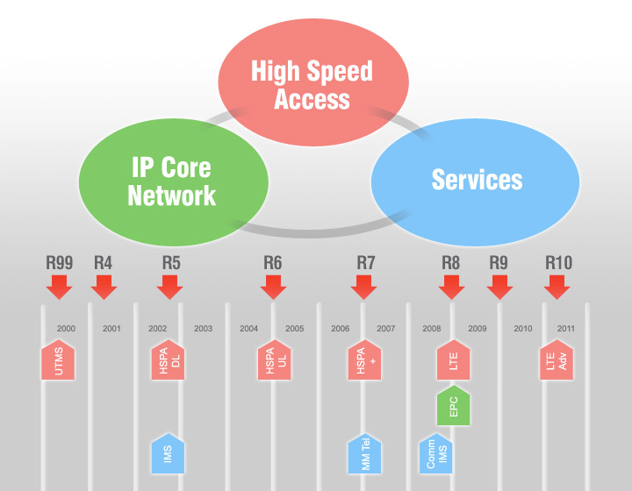
Building on releases
EPS Releases
TAKEAWAY: A new 3GPP Release slated every 1-2 years

Slide 19
Release 8
First release of EPS (LTE and EPC)
Frozen since December 2008
SAE core work:
    High level functions and procedures common for all accesses
    Evolution of the GPRS core to support LTE access (TS 23.401)
    Support of non-3GPP accesses (TS 23.402)
    Inter-system mobility
Some features:
    CS fallback
    Home NodeB / eNodeB
    Earthquake and Tsunami Warning System (ETWS)
TAKEAWAY: All LTE networks and trials are based on Rel-8 & Rel-9 so far

Slide 20
Rel-9
Frozen since December 2009
Some features:
    IMS Emergency Calls over GPRS and EPS
    Public Warning System (PWS)
    Enhancements to Home NodeB / eNodeB
TAKEAWAY: All LTE networks and trials are based on Rel-8 & Rel-9 so far

Slide 21
Rel-10
Frozen since March 2011
Some features:
  Network improvements for M2M (NIMTC)
  Local IP Access (LIPA) and Selected IP Traffic Offload (SIPTO)
  IP Flow Mobility and WLAN offload (IFOM)
  Multi Access PDN Connectivity (MAPCON)
On the radio side:
  First release of LTE-Advanced, which was submitted to ITU-R as a candidate for IMT-Advanced 4G mobile technology
TAKEAWAY: This is where we are now

Slide 22
Rel-11 (future)
Service requirements ("stage 1") are still being discussed. They will be frozen in September 2011.
Architecture (“stage 2”) and protocol design (“stage 3”) will be frozen in March and September 2012 respectively.
Some features and studies:
  Further improvements for M2M
  Study on Alternatives to E.164 for M2M
  Simulation of USSD in IMS
  QoS Control Based on Subscriber Spending Limits
Note: Summaries of all releases can be found at:
http://www.3gpp.org/ftp/Information/WORK_PLAN/Description_Releases/
TAKEAWAY: Rel-11 is now the priority

Slide 23
Conclusions
3GPP LTE & EPC are the major enabler for mobile broadband
IMS, a companion to the EPC
3GPP is open and transparent as Members define the content of Rel-11 and further releases

Slide 24

Thank You!
www.3gpp.org
Frédéric Firmin (frederic.firmin@3gpp.org)
3GPP Technical Officer

