Slide 1
3GPP Standards Update
Adrian Scrase
Head of 3GPP Mobile
Competence Centre

Slide 2
The role of 3GPP
GSM, GPRS, EDGE, W-CDMA, HSPA and LTE are all [RAN] Technologies specified by 3GPP
Core network and Systems architecture evolution have kept pace
The 3GPP Organizational Partners are Regional and National Standards Bodies;
Companies participate through their membership of one of these 6 Partners

Slide 3
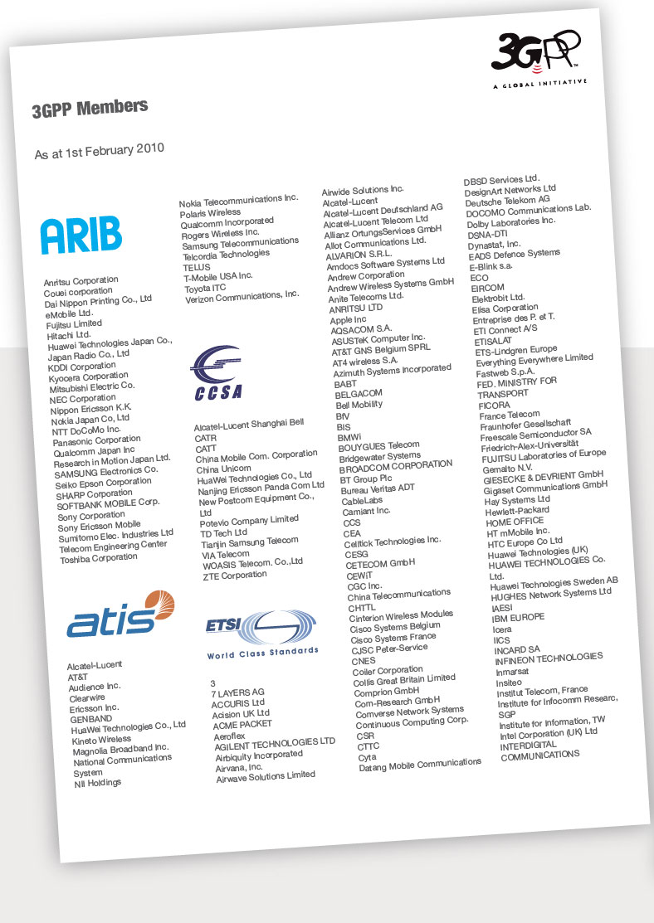
3GPP Membership
378 Organisations (November 2010)

Slide 4
Where the work is done
Meeting Delegates* by region (June 2010):
* Participants in TSG and WG meetings over the last year
Plenary meetings every 3 months, approve specifications and the Freezing of 3GPP Releases
The 50th TSG Plenary will be in Istanbul in December 2010

Slide 5
Spanning the Generations...
3GPP Specified Radio Interfaces
2G radio: GSM, GPRS, EDGE
3G radio: WCDMA, HSPA, LTE
4G radio: LTE Advanced
3GPP Core Network
2G/3G: GSM core network
3G/4G: Evolved Packet Core (EPC)
3GPP Service Layer
GSM services
IP Multimedia Subsystem (IMS)
Multimedia Telephony (MMTEL)
Support of Messaging and other OMA functionality
Emergency services and public warning
Etc.
“
...UMTS became the dominant 3G technology, setting the foundations for a single worldwide 4G standard in future years
”
Radio-Electronics.com

Slide 6
3GPP Evolution
Radio Interfaces
Higher Data Throughput
Lower Latency
More Spectrum Flexibility
Improved CAPEX and OPEX
IP Core Network
Support of non-3GPP Accesses
Packet Only Support
Improved Security
Greater Device Diversity
Service Layer
More IMS Applications (MBMS, PSS, mobile TV now IMS enabled)
Greater session continuity
“
Through successive standards releases, 3GPP offers the wireless industry a coherent framework to serve the evolving needs of its customers while optimising the value of operators’ current network investments.
”
J-P Bienaime, UMTS Forum

Slide 7
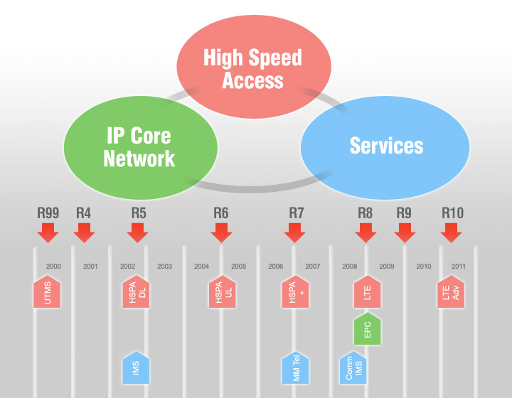
Building on Releases
Release 99: Enhancements to GSM data (EDGE). Majority of deployments today are based on Release 99. Provides support for GSM/EDGE/GPRS/WCDMA radio-access networks.
Release 10 LTE-Advanced meeting the requirements set by ITU’s IMT-Advanced project.
Also includes quad-carrier operation for HSPA+.
Release 4: Multimedia messaging support. First steps toward using IP transport in the core network.
Release 9: HSPA and LTE enhancements including HSPA dual-carrier operation in combination with MIMO, EPC enhancements, femtocell support, support for regulatory features such as emergency user-equipment positioning and Commercial Mobile Alert System (CMAS), and evolution of IMS architecture.
Release 5: HSDPA. First phase of Internet Protocol Multimedia Subsystem (IMS). Full ability to use IP-based transport instead of just Asynchronous Transfer Mode (ATM) in the core network.
Release 6: HSUPA. Enhanced multimedia support through Multimedia Broadcast/Multicast Services (MBMS). Performance specifications for advanced receivers. Wireless Local Area Network (WLAN) integration option. IMS enhancements. Initial VoIP capability.
Release 8: HSPA Evolution, simultaneous use of MIMO and 64 QAM. Includes dual-carrier HSPA (DC-HSPA) wherein two WCDMA radio channels can be combined for a doubling of throughput performance. Specifies OFDMA-based 3GPP LTE.
Defines EPC.
Release 7: Evolved EDGE. Specifies HSPA+, higher order modulation and MIMO. Performance enhancements, improved spectral efficiency, increased capacity, and better resistance to interference. Continuous Packet Connectivity (CPC) enables efficient “always-on” service and enhanced uplink UL VoIP capacity, as well as reductions in call set-up delay for Push-to-Talk Over Cellular (PoC). Radio enhancements to HSPA include 64 Quadrature Amplitude Modulation (QAM) in the downlink DL and 16 QAM in the uplink. Also includes optimization of MBMS capabilities through the multicast/broadcast, single-frequency network (MBSFN) function.
Text adapted from 3G Americas White Paper, September 2010

Slide 8
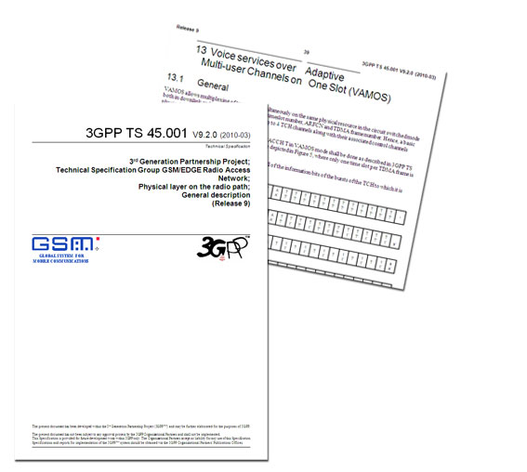
Evolving EDGE
GERAN H(e)NB Enhancements (Release 9)
Voice services over Adaptive Multi-user channels on One Slot (VAMOS) (Release 9)
GERAN Improvements for Machine Type Communications
GERAN/E-UTRAN Inter-working
Multicarrier and Multi-RAT BTS
Local call local switch (Release 10 onwards)
Conformance Test development

Slide 9
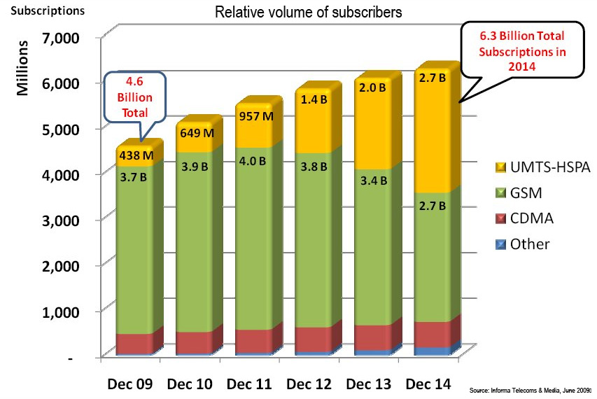
Evolving HSPA
3GPP R5 & R7 added MIMO antenna and 16QAM (Uplink)/ 64QAM (Downlink) modulation
Improved spectrum efficiency (modulation 16QAM, Reduced radio frame lengths
New functionalities within radio networks (incl.re-transmissions between NodeB and the Radio Network Controller)
Latency reduced (100ms for HSDPA and 50ms for HSUPA)

Slide 10
3GPP LTE Release 8
Broadband data throughput
Downlink target 3-4 times greater than HSDPA Release 6
Uplink target 2-3 times greater than HSUPA Release 6
Increased cell edge bit rates
Downlink: 70% of the values at 5% of the Cumulative Distribution Function (CDF)
Uplink: same values at 5% of the Cumulative Distribution Function (CDF)
Significantly reduced latency
High mobility
Significantly reduced CAPEX and OPEX
www.3gpp.org/releases
10

Slide 11
3GPP LTE Release 9
Continuing femtocell integration
Added functionality, broadens LTE deployment scenarios
Feeding back results from first LTE deployments
Emergency user-equipment positioning and Commercial Mobile Alert System (CMAS)
Further evolution of IMS architecture.
Work on integrating non-LTE technologies
www.3gpp.org/releases

Slide 12
LTE network commitments

Slide 13
LTE-Advanced
LTE Release 8 can meet most requirements of IMT-Advanced.
Two additional improvements to LTE performance needed:
Wider bandwidth
To improve peak data rate and spectrum flexibility
Spectrum/carrier aggregation based on component carrier(CC) concept to keep backward compatibility and allow smooth network migration
Support of maximum 5 component carriers
Each component carrier has a bandwidth defined in Release 8/9
Intra-band contiguous(, intra-band non-contiguous) and inter-band non-contiguous aggregation
RRC management of primary and secondary component carriers per UE
Dynamic cross-carrier scheduling by MAC
Specified under the work item, “Carrier aggregation for LTE”
Advanced MIMO techniques
To improve peak data rate and cell/cell-edge spectrum efficiency
Up to 8-layers for DL and 4-layers for UL
Dynamic SU/MU-MIMO switching
Support 4 spatial layers for MU-MIMO with maximum 2 layers per user
Improved CSI feedback using double codebook structure
Dedicated reference signal structure to support advanced precoding
New codebook for 2Tx and 4Tx uplink MIMO
Specified under the work items, “Enhanced Downlink Multiple Antenna Transmission for LTE” and “UL multiple antenna transmission for LTE”

Slide 14
LTE-Advanced
Other improvements in LTE Release 10 are set to improve LTE performance even further:
Heterogeneous network
To improve cell-edge user throughput, coverage and deployment flexibility
Interference coordination for overlaid deployment of cells with different Tx power
Sspecified under the work item, “Enhanced ICIC for non-CA based deployments of heterogeneous networks for LTE”
Relaying
To improve coverage and cost effective deployment
Type 1 relay node terminating up to layer 3, which can be seen Release 8 eNodeB from Release 8 LTE terminal
To be specified under the work item, “ Relays for LTE”
Coordinated multipoint transmission and reception (CoMP)
To improve cell-edge user throughput, coverage
To be studied under the study item, “Coordinated Multi-Point Operation for LTE”
LTE Self Optimising Networks (SON) Enhancements
HNB and HeNB mobility enhancements

Slide 15
LTE-Advanced Timeline LTE-Advanced is the 3GPP submission for the ITU’s IMT-Advanced system
Study Item, “LTE-Advanced” approved in 3GPP - Mar 2008 ✓
LTE-Advanced Requirements (TR 36.913) - Jun 2008 ✓
LTE-Advanced “Early Submission” made to ITU-R - Sep 2008 ✓
“Complete Technology Submission” to ITU-R - Jun 2009 ✓
“Final submission” to ITU-R - Oct 2009 ✓
Evaluation Process “Final Decision” by ITU-R - Oct 2010 ✓
Completion of LTE-Advanced specifications by 3GPP - Mar 2011

Slide 16
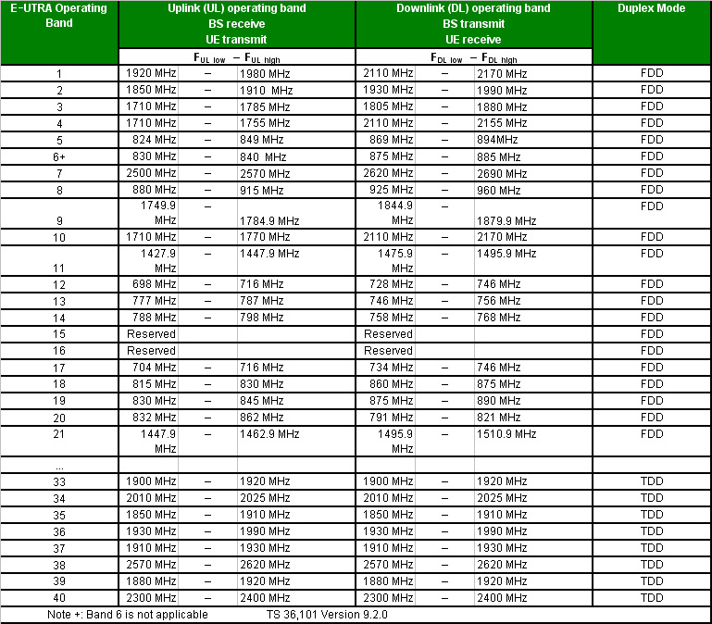
Spectrum
Additional spectrum can be added to the specifications as required
(eg. 3500MHz currently being added)
Re-farming
900/1800MHz GSM bands are attracting a lot of attention, as “spectrum re-farming” in those bands is seen as one way to allow the roll out of mobile broadband services.
(See 3GPP TS 36.101)
16

Slide 17
Machine Type Communications
Work started on this in Rel 10
14 MTC Features identified
Low Mobility
Time Controlled
Time Tolerant
Packet Switched (PS) Only
Small Data Transmissions
Mobile Originated Only
Infrequent Mobile Terminated
MTC Monitoring
Priority Alarm Message (PAM)
Secure Connection
Location Specific Trigger
Network Provided Destination for Uplink Data
Infrequent Transmission
Group Based MTC Features
In Rel 10, 3GPP will focus on the general functionality required to support these features
Overload control (Radio Network Congestion use case, Signalling Network Congestion use case and Core Network Congestion use case)
Addressing
Identifiers
Subscription control
Security

Slide 18
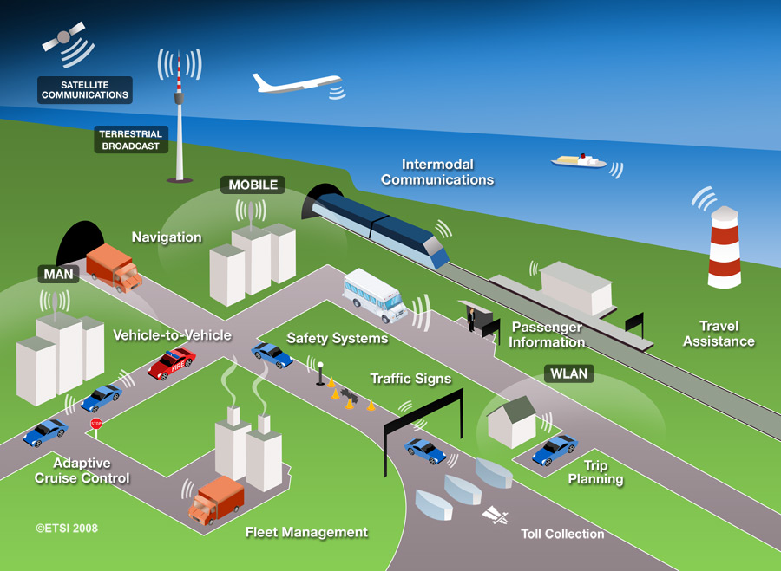
Convergence (Scale)
Machine-to-machine
Intelligent Transport Systems
Smart Grids
Smart Cards, eCommerce, USB, High Speed Interface
mHealth
RFID
Multi-Standard Radio (MSR-BS)
18

Slide 19
Convergence (Technology)
3GPP LTE is a point of convergence, to unite the world’s operators on a common technology platform
2009 - CDMA Development Group (CDG) join 3GPP as a Market Representation Partner (MRP)
2009 - TD-SCDMA Forum pave the way for TD-LTE in China
2009 - Public Safety Agencies announce that LTE meets their requirements (See APCO, NENA, NPSTC Announcements)
2010 – 3GPP is working with Broadband Forum to support FMC using 3GPP EPC
19

Slide 20
Conclusions
3GPP LTE is set to be the major enabler for mobile broadband
EDGE and HSPA remain hugely successful
Industrial input to the standards process is of an unprecedented level
The first commercial LTE Networks have been launched based on 3GPP Release 8 and R9
LTE-Advanced will enable new services & innovation beyond 3GPP Release 10
3GPP LTE is an evolution path which unites the GSM/UMTS, TD-LTE and CDMA families as well as the fixed/mobile communities
20

Slide 21
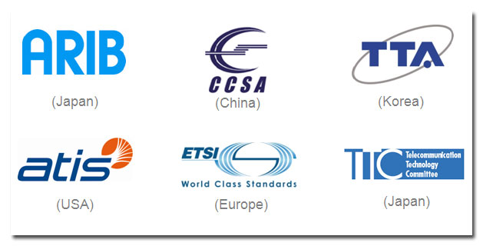
Thank You
www.3gpp.org

