Slide 1
Introducing 3GPP
<Name>
<Role>

Slide 2
Content
The role of 3GPP
3GPP – How the project works
The 3GPP eco-system
Technical Specification Groups
Quarterly meeting cycle
3GPP releases & Stages of a release
Bringing the work in
5G Releases
Rel-19 planning
Conclusions
Beyond Release 19…

Slide 3
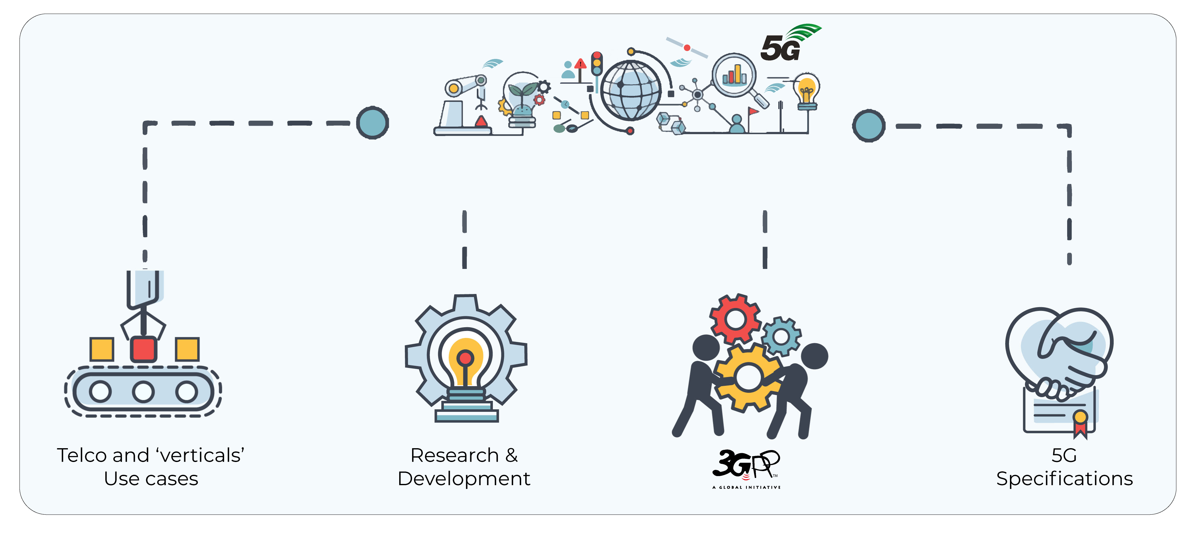
The role of 3GPP
Standardization of three generations of cellular. Soon to be four!
Providing the system description for mobile telecommunications
This system description is characterized by a number of standardized interfaces. It is not a description of a standardized deployment
Enabling an interoperable, multi-vendor approach to deployment for mass market economies of scale, without stifling innovation

Slide 4
3GPP – How the project Works
3GPP works based on
Participation in face-to-face meetings
Pro-activity & Contributions – you need written proposals to get attention
Consenus – nobody says “no” in order to progress
Work organization
Study Items, Work Items
Releases with fixed time-lines, which are partially overlapping
Work Plan (good overview)
3 stages, often overlapping
Stage 1: Requirements
Stage 2: Architecture
Stage 3: Protocols
Companies not individuels participate
From all over the world
All major telecommunication companies – operators, vendors, service providers
Ministries, Regulators and government agencies actively engaged
More and more vertical industry representatives bring their work directly to 3GPP
Amazing Track Record
3GPP started 1998, since then all 3GPP Releases have been deployed
Seamless migration from “old” to “new” mobile generations
A new Release every 15 to 24 months
Allows for resonably fast standardization & deployment of new technologies
Strong commitment to time-lines guarantees reliable planning

Slide 5
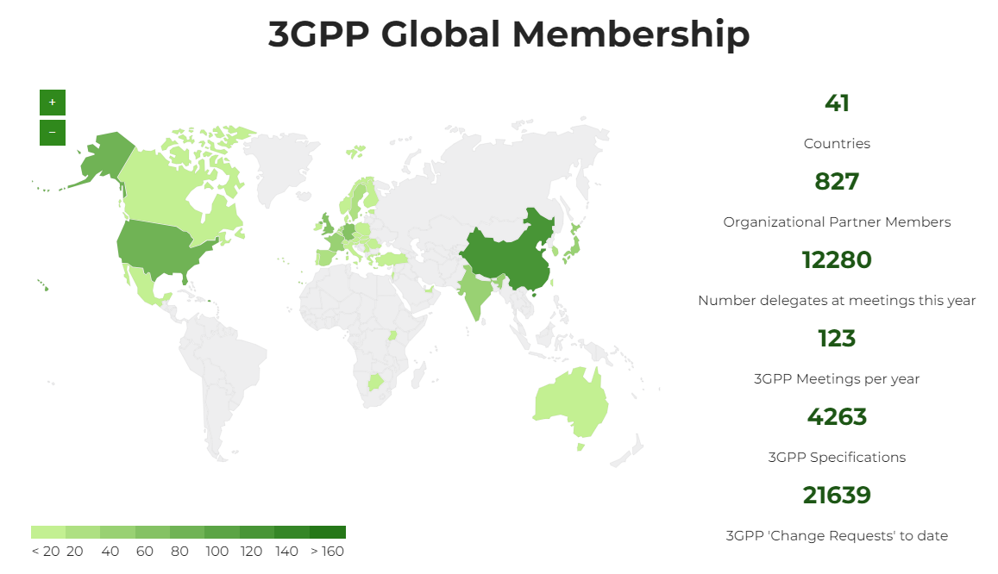
3GPP Membership
7 Organizational Partners – from Asia, Europe and North America – determine the general policy and strategy of 3GPP.
Companies and Organizations have joined 3GPP as Members via one of these OPs.
July 2024
https://www.3gpp.org/about-us/partners

Slide 6
3GPP standards eco-system
3GPP Organizational Partners (OPs)
The 3GPP Organizational Partners (OP) - 7 Standards Organizations - from China, Europe, India, Japan, Korea and the United States.
Participation in 3GPP by companies and organizations becoming Members of one of these 7 OPs.
Inputs on market requirements may come in to the Project via 3GPP Market Representation Partners (MRP).
There is a lot of additional external liaison activity…SDOs, Industry bodies, projects…
Liaisons in/out:
800+ companies
450 MHz Alliance, AISG, Bluetooth, Broadband Forum (BBF), CableLabs, International Special Committee on Radio Interference (CISPR), CTIA, Digital Video Broadcasting (DVB) Project, Ecma, International, Expert Group for Emergency Access (EGEA), Eurescom, COST 273, European Radiocommunications Committee (ERC), Fixed Mobile Convergence Alliance (FMCA), GCF, Global TD-LTE Initiative (GTD), GPS Industry Council, GSM Association, HomeRF Forum, IDB Forum, IEEE, Internet Engineering Task Force (IETF), IrDA, International Multimedia Telecomunications Consortium (IMTC), Internet Streaming Media Alliance, ISO-ITU expert group, ISO MPEG / JPEG, ITU-T SG2, JAIN tm (Javatm APIs for Integrated Networks), The Java Community Process (JCP), Liberty Alliance Project, Metro Ethernet Forum (MEF), NENA, NGMN (Next Generation Mobile Networks), oneM2M, OMA (Open Mobile Alliance ), Open Networking Foundation (ONF), Open IPTV Forum, Object Management Group (OMG), PCS Type Certification Review Board (PTCRB), Portable Computer and Communications Association (PCCA), Presence and Availability Management (PAM) Forum, RSA Laboratories, SDR Forum, Sun Micro Systems Inc., Steerco, SyncML Initiative, Trusted Computing Group (TCG), TeleManagement Forum (TMF), TCCA, TIA /TR45, TIA/TR47, ITU, TV-anytime Forum, Voice eXtensible Mark-up Language (VXML) Forum, Wi-Fi Alliance, Wireless Broadband Alliance (WBA), WLAN Smart Card Consortium, Wireless World Research Forum (WWRF), World Wide Web Consortium (W3C)
(Source: extract from https://www.3gpp.org/about-3gpp/15-bodies-with-which-3gpp-has)
3GPP Market Representation Partners (MRPs)
5G / 6G Projects
Certification Bodies

Slide 7
Technical Specification Groups
TSG RAN – Radio Access Network
TSG SA – Service and System Aspects
TSG CT – Core Network and Terminals
TSGs prepare, approve and maintain the 3GPP Technical Specifications and Technical Reports.
Responsible for the detailed time frame and management of the work’s progress;
Management of work items;
Technical Co-ordination;
Proposal and approval of work items within the agreed scope and terms of reference of the TSG
TSG Chair is responsible for the overall management of the technical work within the TSG and its Working Groups.
WG Chair is responsible for the overall management of the technical work within the WG and its sub-groups.
3GPP Project Coordination Group (PCG) and OP group are management groups (See ‘About/PCG’ section of the website)
RAN1 – Radio Layer 1 (Physical Layer)
SA WG1 - Services
CT WG1 - User Equipment - Core Network Protocols
RAN2 – Radio Layer 2 and Radio Layer 3 RRC
SA WG2 - System Architecture and Services
CT WG3 - Interworking with External Networks & Policy and Charging Control
RAN3 – UTRAN/E-UTRAN/NG-RAN Architecture and Related Network Interfaces
SA WG3 - Security and Privacy
CT WG4 - Core Network Protocols
RAN4 – Radio Performance and Protocol Aspects
SA WG4 - Multimedia Codecs, Systems and Services
CT WG6 - Smart Card Application Aspects
RAN5 – Mobile Terminal Conformance Testing
SA WG5 - Management, Orchestration and Charging
RAN AH1 – TSG RAN ITU-R Ad Hoc
SA WG6 - Application Enablement and Critical Communication Applications

Slide 8
Work Schedule driven by technical meetings
New work is initiated by member companies as Work Items, via Tdocs at meetings
Work Items are prioritised and allocated time for discussion during meetings
3GPP member companies may contribute to any work item, on equal terms
3GPP seeks consensus on all technical matters (but has mechanisms if consensus cannot be reached)
The Release deadline is respected. Unfinished work is deferred to a later release

Slide 9
3GPP productivity
Release-based work
Releases are major packages of Features (There is a new 3GPP Release ~ every 15 – 24 months)
A strong commitment to time-lines guarantees reliable planning and time-to-market
The Work plan is built-up of Work Items that deliver the Features
Work Items:
WI may cover more than one specification
WI may cover more than one TSG or WG
WI Description document exists for each WI
Multiple releases are maintained in parallel
See the 3GPP Work Plan for details of features:
http://www.3gpp.org/Work-Plan
Number of specifications (frozen Releases)

Slide 10
Three stage approach to Features, through Releases
time
Stage 1 Requirements: Overall service description from the user’s standpoint.
SA1
Requirements
RAN
Release content
definition
RAN
WGs
Stage 2
Architecture: Overall description of the organization of the network functions to map service requirements into network capabilities.
SA2
Architecture
SA3
Security
SA4
Media
SA5
OAM
SA6
Apps/MC
Stage 3
Protocols: The definition of switching and signalling capabilities needed to support services defined in Stage 1.
CT – Protocols & Coding

Slide 11
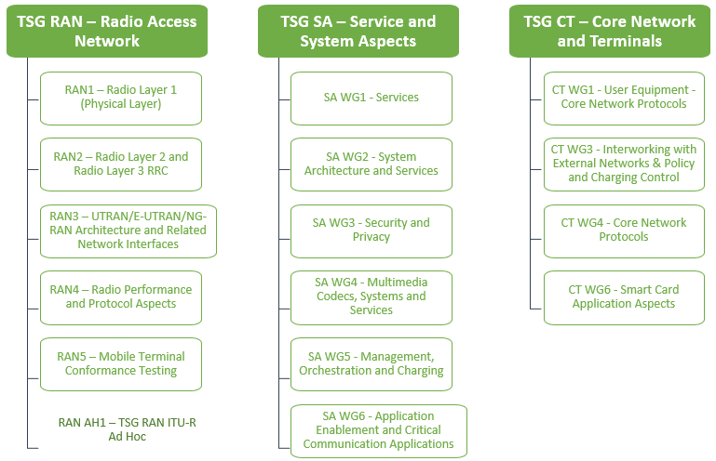
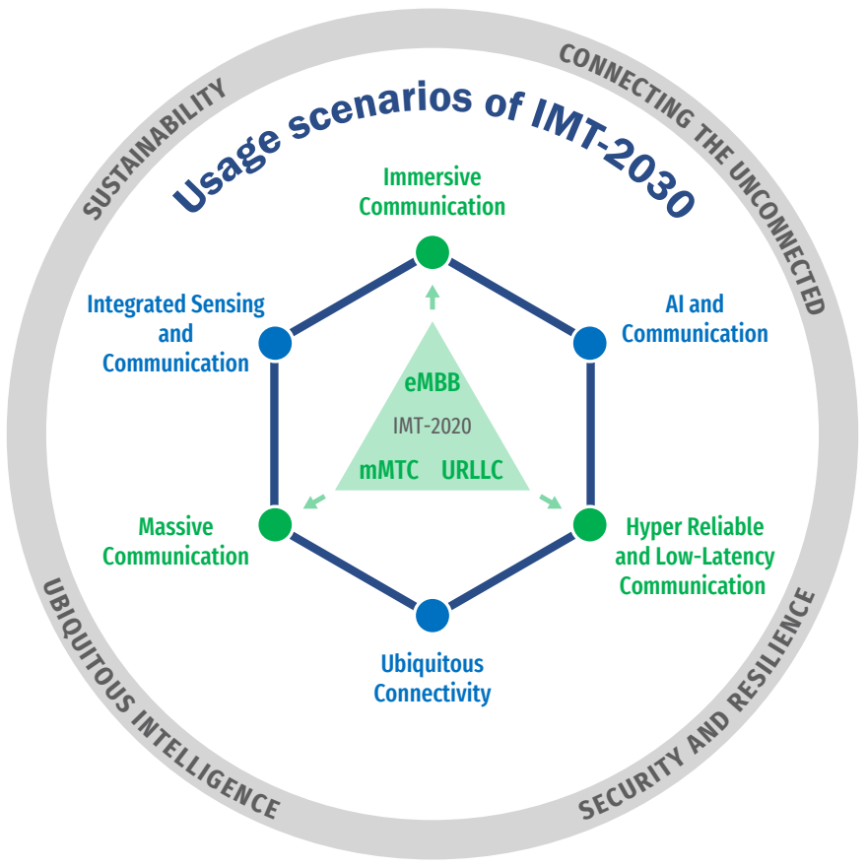
Bringing the work into the groups
Use Case diversity
High or Low data rates
Higher user mobility
Improved coverage
3GPP Specifications and Reports:
Requirements | 21 series
Service aspects ("stage 1") | 22 series
Technical realization ("stage 2") | 23 series
Signalling protocols ("stage 3") - user equipment to network | 24 series
Radio aspects | 25 series
CODECs | 26 series
Data | 27 series
Signalling protocols ("stage 3") -(RSS-CN) and OAM&P and Charging (overflow from 32.- range) | 28 series
Signalling protocols ("stage 3") - intra-fixed-network | 29 series
Programme management | 30 series
Subscriber Identity Module (SIM / USIM), IC Cards. Test specs. | 31 series
OAM&P and Charging | 32 series
Security aspects | 33 series
UE and (U)SIM test specifications | 34 series
Security algorithms | 35 series
LTE (Evolved UTRA), LTE-Advanced, LTE-Advanced Pro radio technology | 36 series
Multiple radio access technology aspects | 37 series
Radio technology beyond LTE | 38 series
3GPP Working Groups
Overall SystemGoals
Enable new business
Greater efficiency
More flexibility – not one-size-fits-all
Pre-Standards R&D
Test beds
3GPP MRP Papers and Vision
Regional initiatives
IMT process (ITU)

Slide 12
5G Releases
Release15: The work on new radio (nr) and the 5G system (5GS) jointly addressed the urgent subset of needs for early commercial deployments.
Release16: Met all identified 5G use cases, to allow a full 3GPP IMT-2020 submission to ITU-R.
Release 17: Enhances the earlier 5G work, meeting more 'vertical' industry needs, specifying NR operation in unlicensed bands, NR MIMO, V2-everything.
Release 18: Brought a balanced evolution in terms of:
Mobile broadband evolution versus further vertical domain expansion;
Immediate versus longer-term market needs;
Device evolution versus network evolution.
Introduced 5G-Advanced as a mid-generational marker (covers Rel-18, 19, 20)
Release 19: The current focus of the groups. Due for completion in 2025…
Release 20: Further 5G Advanced content. Stage-3 freeze envisaged Mar. 2027
Notes:
10/31/16

Slide 13
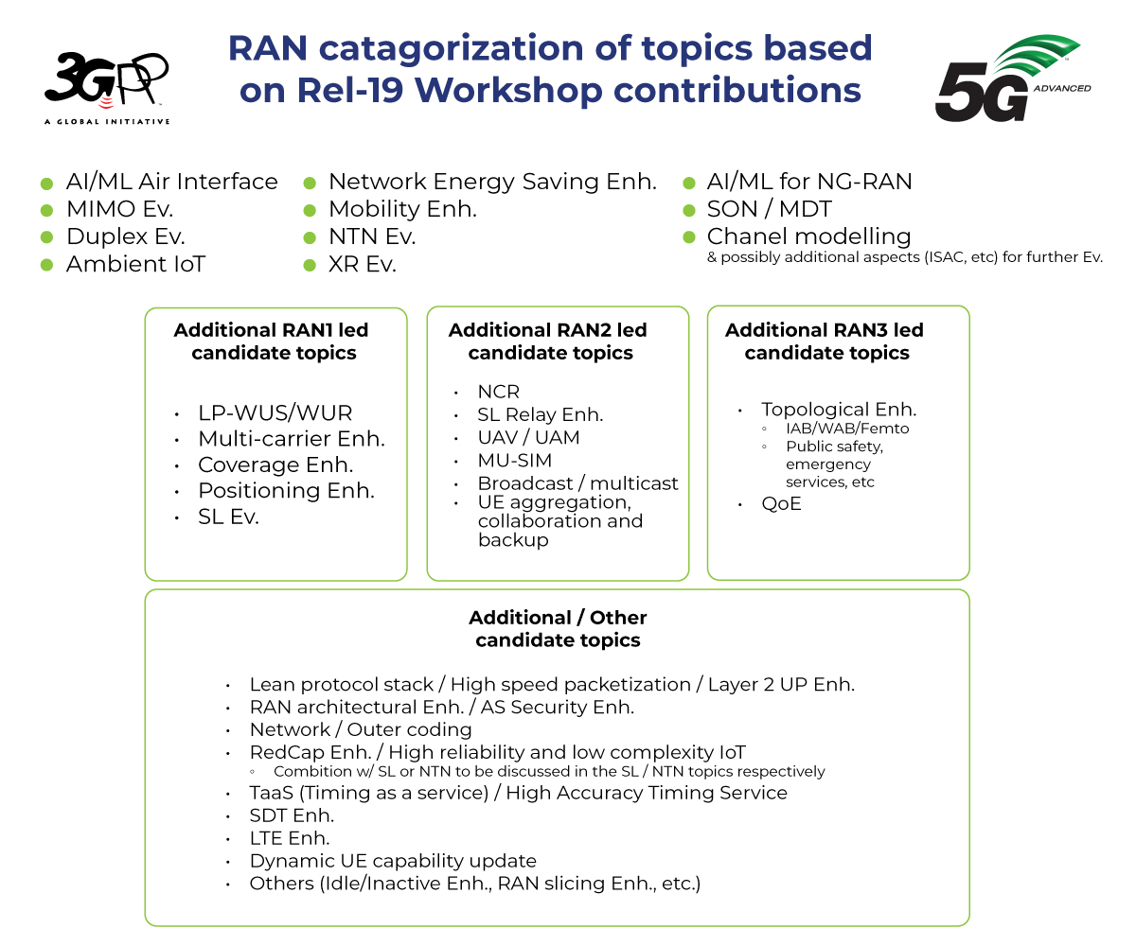
Rel-19 takes shape (RAN)
TSG RAN (RWS-230488)
Major topics: AI/ML Air Interface, MIMO Evo., Duplex Evo., Ambient IoT, Network Energy Saving Enh., Mobility Enh., NTN Evo., XR Evo., AI/ML for NG-RAN, SON/MDT, Channel Modeling (& possibly additional aspects e.g. for ISAC) for further evol.
Plus, other RAN1, RAN2 & RAN3 led topics.
Plus, others listed in RWS-230488 slide 7.

Slide 14
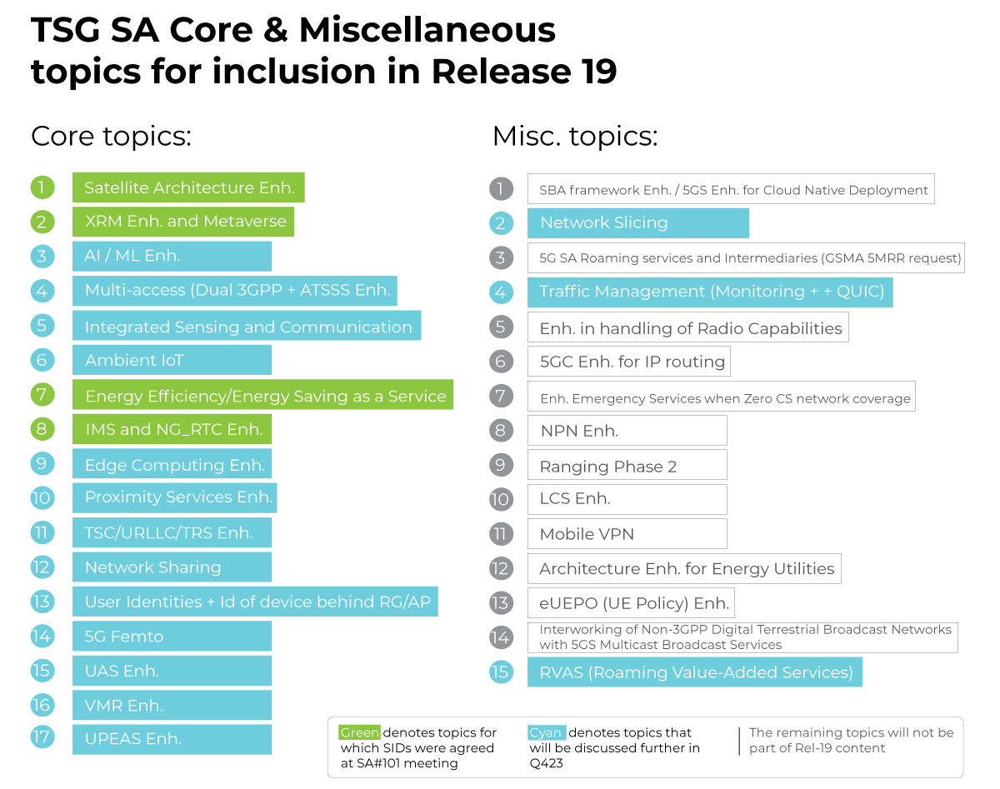
Rel-19 takes shape (SA)
TSG SA (SP-230765, SP-230759)
Guidance to SA2 on Rel-19 work planning:
Headline “core” topics: Satellite Access, Energy Efficiency / Energy Saving as a Service, XRM and Metaverse, IMS and NG_RTC enh. …

Slide 15
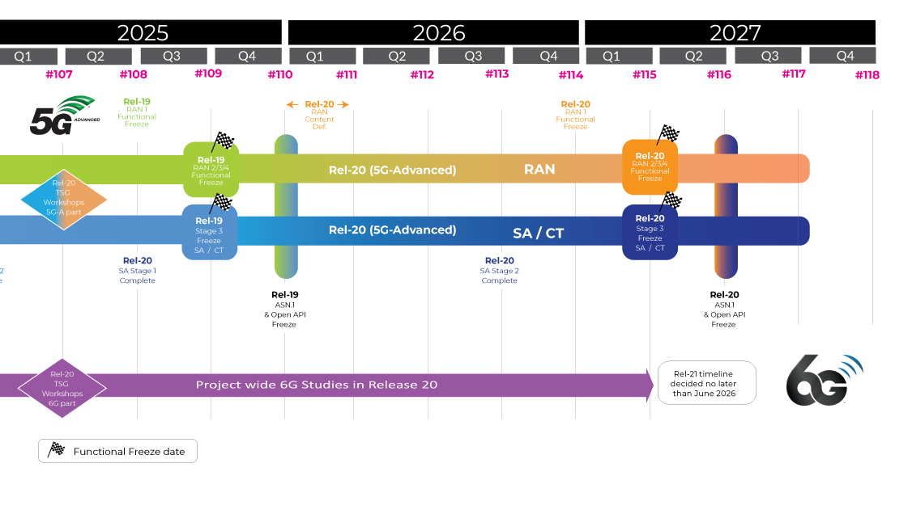
Beyond Release 19
Release 19: Complete e/o 2025
Release 20:
TSG-Wide Rel-20 Workshops during TSG#107 week
Rel-20 focusing on Technical Specifications for 5G Advanced
6G Studies expected to start in Release 20, including TSG RAN IMT-2030 study
Release 21:
TSG RAN IMT-2030 submission and normative work for 6G
1st set of 3GPP 6G technical specifications
Release 21 is expected to be delivered with a single drop (i.e., a single code freeze)
Timeline decided by June 2026

Slide 16
For more info on 3GPP…
Specifications, working documents, news, portal, technology articles:
Online; www.3gpp.org
Consider attending a WG or TSG meeting (listing):
https://portal.3gpp.org/
Subscribe to our regular newsletter:
www.3gpp.org/highlights
Keep in touch:
www.3gpp.org/contact
www.3gpp.org/highlights
www.3gpp.org
www.3gpp.org

Slide 17
Concluding thoughts
3GPP is industry driven - Standardization of interfaces enables an interoperable, multi-vendor approach to deployment.
The 3GPP processes are necessarily complex, but we will adapt to bring new sectors into the work.
Release 19 is the current focus of the groups. Due for completion in 2025.
Release 20 content and priorities discussion underway.
5G Advanced (Rel-18 onwards) will lay the foundations that 6G will be built on.
6G timeline under consideration. Studies will come in Rel-20 and Specifications no sooner than Rel-21.
3GPP uses a system of parallel "Releases" which provide developers with a stable platform for the implementation of features at a given point and then allow for the addition of new functionality in subsequent Releases. You can learn more about 3GPP Releases by looking into the following resources:
A full Release Description is produced by the Work Plan manager at the completion of the Release:
TR 21.914 | Release 14 Description; Summary of Rel-14 Work Items
TR 21.915 | Release 15 Description; Summary of Rel-15 Work Items
TR 21.916 | Release 16 Description; Summary of Rel-16 Work Items
TR 21.917 | Release 17 Description; Summary of Rel-17 Work Items
TR 21.918 | Release 18 Description; Summary of Rel-18 Work Items

