Slide 1
DP on 5G Advanced Charging (SA5 #146)
Chen Shan Huawei

Slide 2
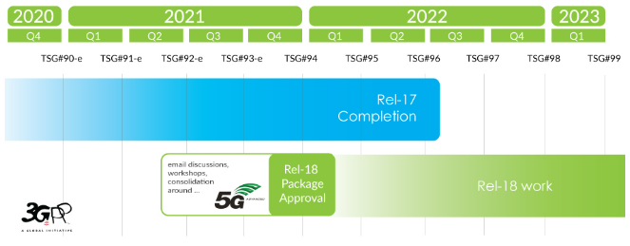
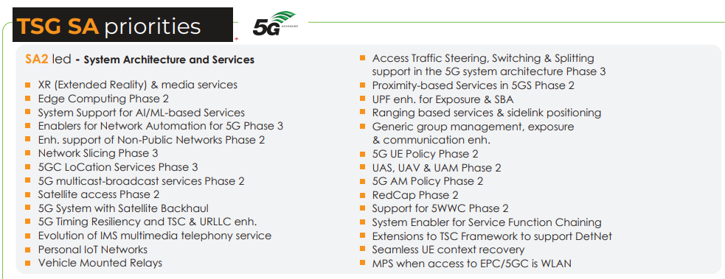
3GPP 5G Advanced Start from R18
3GPP 5G-Advanced
On April 27 2021, 3GPP PCG conference officially named 5G evolution as 5G-Advanced, starting from the Rel-18
In June 2021, 3GPP has been launched workshop and preliminarily confirmed 17 topics and topic sets, including downlink MIMO evolution, large uplink, XR, low-power positioning, etc.;
Plan for 5G-Advanced
The time duration for the release in RAN is tentatively set at 18 months, with the final decision on that to be confirmed in September 2021, following TSG RAN#93-e.
Source: Advanced plans for 5G https://www.3gpp.org/news-events/2210-advanced_5g)
TSG Rel-18 timeline & content --- SA2
Stage 2 functional freeze: March 2023
Stage 3 freeze: December 2023
Rel-18 content largely decided at the December 2021 TSGs (#94-e):

Slide 3
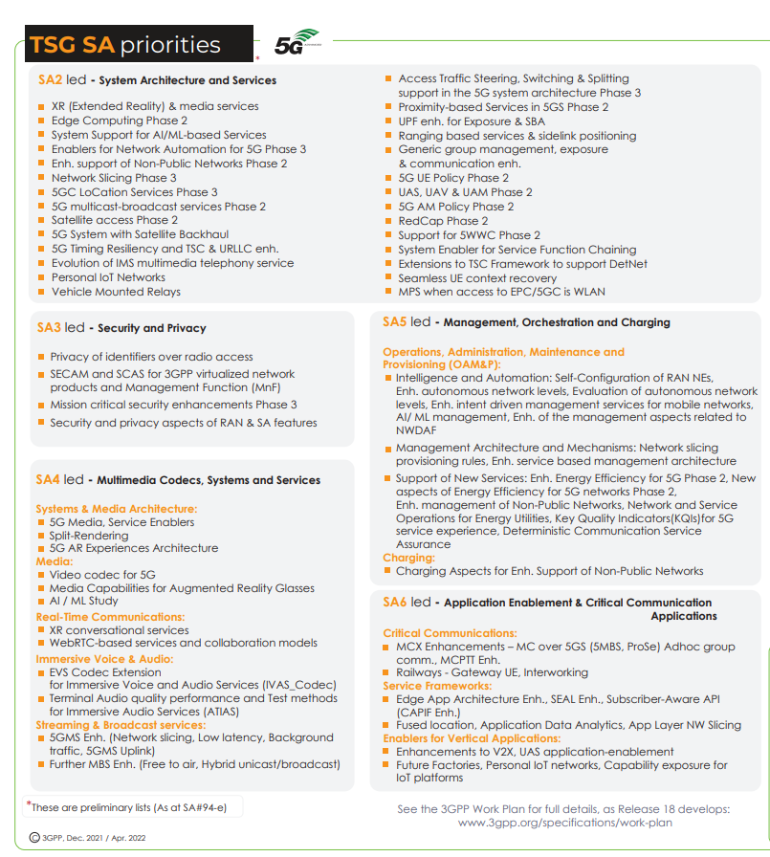
SA5 5G Charging
Charging Standard and Releases:
Rel 15: Basic 5G Charging (e.g. 5G Converged charging and SBI)
Rel 16: Enhanced support for 5G Charging (e.g. Network Slice NSPA and NSM Charging )
Rel 17: Enhancement and evolution of 5G Charging (e.g. Edge Computing Charging, 5G Roaming Charging)
Rel 18: 5G-Advanced Charging (e.g. NPN Charging)
Updated Rel-18 Charging SID/WID
Until SA 97e meeting, the following Rel18 ongoing charging SID/WID are present:
WI code | WI Title | Rapporteur | TS
FS_NETSLICE_CH_Ph2 | SID on charging aspects for enhancements of Network Slicing Phase 2 | Matrixx | TR 32.847
FS_NCHF_Ph2 | SID on Nchf charging services phase 2 | Ericsson | TR 28.826
FS_CHROAM | SID on 5G roaming charging architecture for wholesale and retail scenarios | Ericsson | TR 28.827
FS-eNPN_CH | SID on Charging Aspects for Enhanced support of Non-Public Networks | CMCC | TR 28.828
FS_TSNCH | SID on Time Sensitive Networking charging | Huawei | TR 28.839
MMS_CH_SBI | MMS Charging in 5G System Architecture | Ericsson | TS 32.270

Slide 4
SA5 5G Advanced Charging
Evolution from 5G Charging to 5G Advanced Charging
charging in Rel 18 focus on the enhanced 5G basic charging which features are already specified and mentioned in the R16/R17.
5 charging in Rel18 focus on the 5G Advanced feature charging.
Suggested basic 5G charging enhanced in the Rel18
Suggested 5G Advanced Charging in the Rel18
Title | S/WID
5G (Multimedia Messaging Service) MMS Converged Charging | Ongoing
Nchf charging services phase 2 | Ongoing
charging aspects for enhancements of Network Slicing Phase 2 | Ongoing
5G roaming charging architecture for wholesale and retail scenarios | Ongoing
Features type | Title | S/WID
Industrial capability advanced | NPN Charging | Ongoing
 | TSN Charging | Ongoing
 | Network Slice Charging Phase 3 | Suggested
 | Edge Computing Charging Phase 2 | Suggested
Interaction capability advanced | 5GMARCH Charging | Suggested
 | AR/XR Charging | Suggested
Network capability advanced | Satellite Charging | Suggested
 | UAS Charging | Suggested

Slide 5
Conclusion
Suggestion:
In the general operation level: Distinguish the basic 5G charging and 5G advanced charging
In the specification operation level: Reserve the charging specification numbers for 5G Advanced Charging.
For example: in the TR/TS template, using the 5G advanced logo replacing the 5G Logo (MCC can help to change the template from R18? TBC);
Currently, the new charging specifications allocated for 5G charging, such as the TS 32.255, TS 32.290 and TS 32.291 …. The charging specifications enhanced for 5G Charging, such as the TS 32.240, TS 32.298 (maintain for the EPC charging and 5G charging is very complex) …
For 5G Advanced charging, suggest to allocate the new charging specification numbers：
New TS(s) for 5G Advanced service/feature.
Separate maintenance of the 5G ASN.1, For example 32.298-01 or 32.298 Annex for 5G advanced?

Slide 6
Thank you!

