Slide 1
Rel-18 SA3 Planning
Suresh Nair, SA3 Chair, Nokia

Slide 2
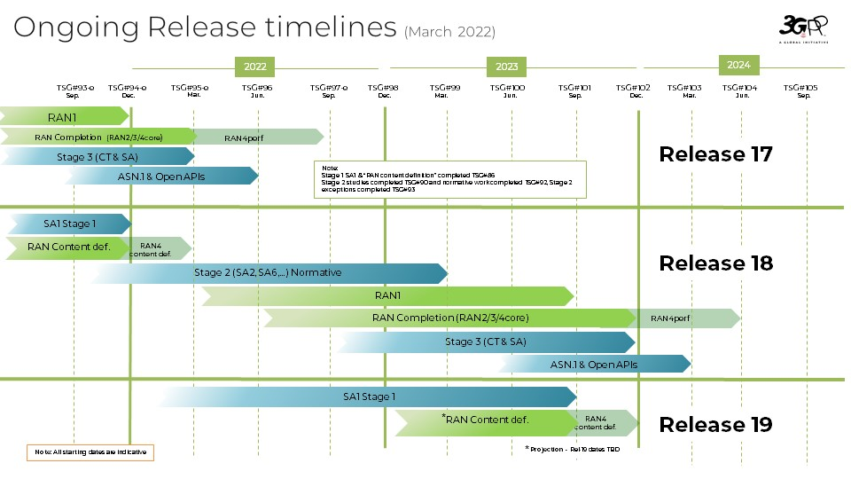
3GPP Ongoing release timelines

Slide 3
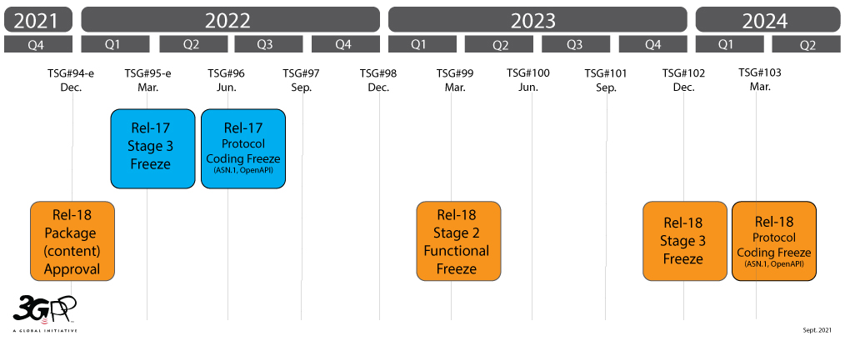
Rel-18 Timeline for SA3
Rel-18 Freeze for SA3

Slide 4
Stage 2.5 work in SA3
3GPP assumes 18 month development schedules (SI+WI) for releases.
Stage 2 work in SA2, SA3, SA6 etc takes 12 months.
Stage 3 WGs need 2Q to finalize the stage 3 work.
SA3 is dependent on other WGs like SA2/SA6 etc to finalize feature architecture , usually this take 2/3 meetings cycles. Which means SA3 is starting the work 1Q late, so we have been taking another 1Q to complete.
This is being raised as a concern now by CT. SA3 generates stage3 work late in the timeline, with just 1Q to complete the Release.

Slide 5
SA3: SI/WI planning
Need to plan for SI and WI phases
In SI phase, stages for KI and solutions need to be planned.

Slide 6

Thank You!
Suresh Nair
3GPP SA3 Chairman
mail: suresh.p.nair@nokia.com
phone: +1 973 978 9038

